Slide 1
Ryder Belgarde Mechanical Engineering
Hometown: Fargo, ND Advisor: Mark Anderson Office: ERB 809 Email: rbelgarde@wisc.edu Hometown: Fargo, ND
Research Project: Thermal Stresses in Sodium Fast Reactors due to Thermal Oscillations (Thermal Striping)

Slide 2
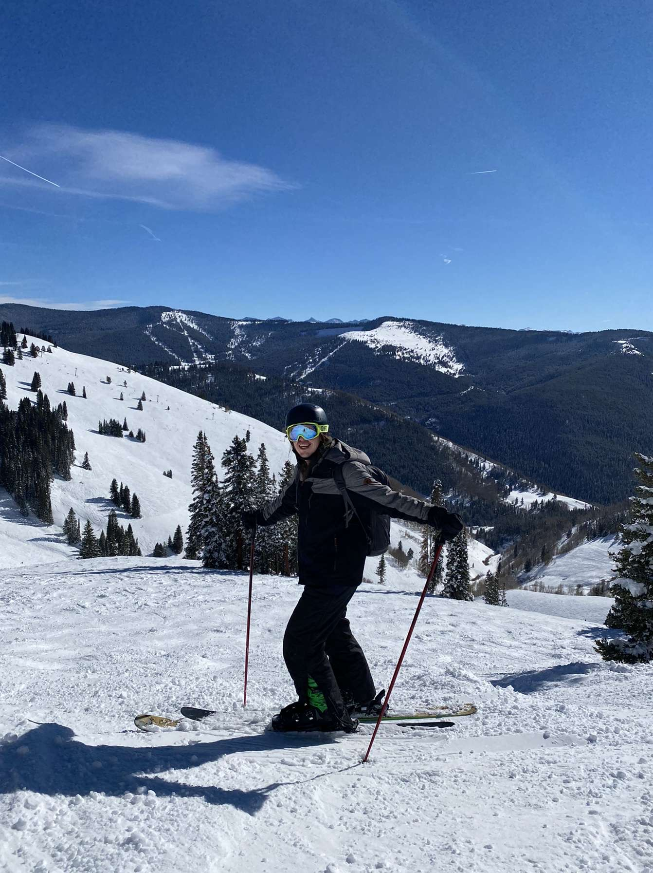
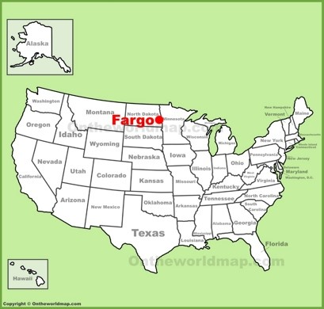
Things about me

Slide 3
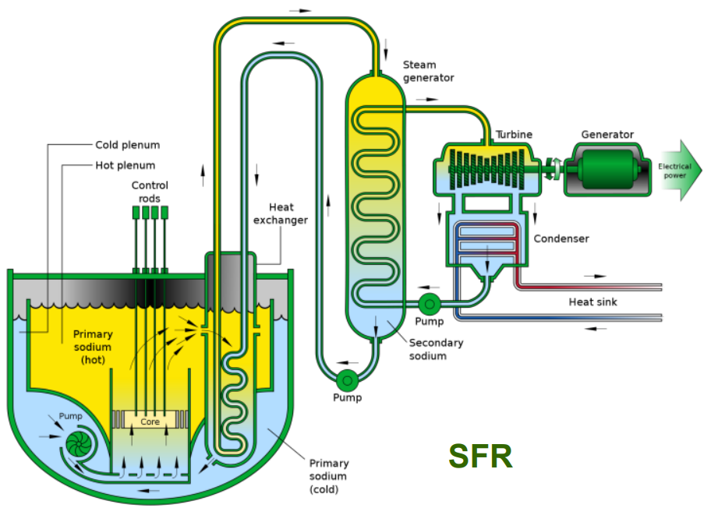
Overview of Sodium Fast Reactors (SFR)
One of the six designs considered for Gen IV reactors
Two types: Pool and loop designs
Pool type preferred by most countries
Usually have three heat transfer systems:
Primary heat transfer system – cools the core
Intermediate heat transfer system (IHX)
Takes heat from primary loop to the steam generator system or other applications
Keeps radiation in primary loop from interacting with other components
Energy conversion system
Generates electricity for consumer use
Usually steam turbine generator
Natrium thermal storage
Pool Type Sodium Fast Reactor

Slide 4
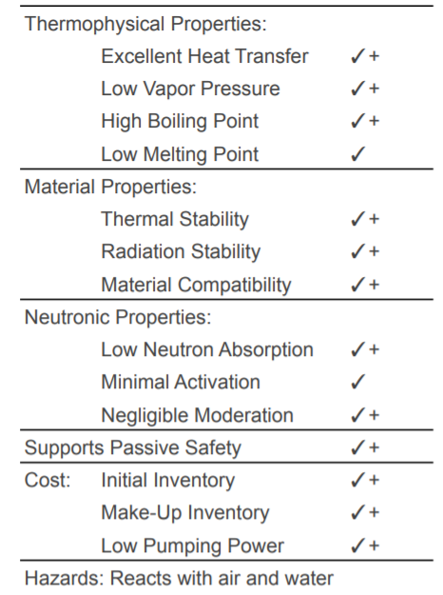
Why Sodium?
Low neutron absorption cross section
Ideal candidate for Fast Reactor – no intentional moderation
High thermal conductivity: 76 (W/m*k) at 300°C
Water: 0.6 (W/m*k)
Gives passive decay heat removal for nuclear core
Sodium remains liquid between 98°C-882°C
Allows for low refueling temperatures
Low risk of boiling
Typical reactor outlet temperatures 510°C-550°C
~ 400°C margin to boiling
Higher core outlet temperature leads to higher power density
Able to operate near atmospheric pressures
Due to operating temperatures being well below boiling point
Sodium compared to other fast reactor coolants: (✓) is comparable (✓+) is superior
Notes:
~15°C for LWR safety margin
More neutrons are produced when a fission occurs, resulting from the absorption of a fast neutron, than the comparable process with slow (thermal, or moderated) neutrons. Thus, criticality is easier to attain than with slower neutrons.

Slide 5
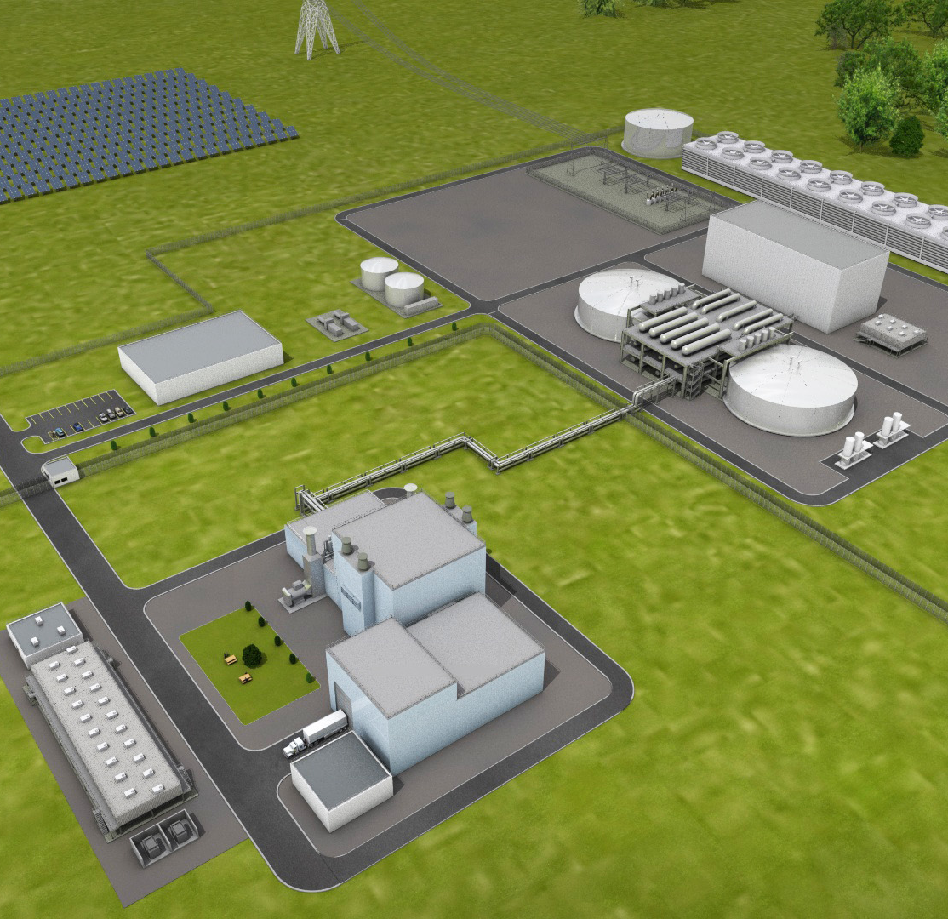
TerraPower’s Natrium Reactor Plant
Minimize interaction between sodium and water
Energy production and storage systems decoupled from reactor
IHX fluid replaced with Nitrate Salt
Steam generation
Energy storage tank
Will be built in Kemmerer, Wyoming
Replacing the Naughton coal plant
Set to open 2028
Turbine Building
Steam Generation
Reactor Building
Control Building
Salt Piping
Energy Storage Tank
Single unit Natrium site: left building cluster known as nuclear island; right building cluster known as energy island
Fuel Building

Slide 6
The Natrium Reactor
840MWt , 345 MWe SFR
~41% net thermal efficiency, LWR ~33%
Natrium Nuclear Island
Notes:
Runs 24/hr a day 7 days a week
Reactor building contains pretty much only the reactor (not the same for LWR)
Allows operation to have a once-through fuel cycle
Passive cooling Demonstrated in Experimental Breeder Reactor II (EBR-II) [7]
Sodium’s thermal conductivity heavily contributes to thermal efficiency

Slide 7
Overview of the Four Tasks Given by TerraPower

Slide 8
The Four Project Tasks
Task 1: Sodium Thermal Striping on Reactor’s Upper Internal Structures
Task 2: Sodium Thermal Striping “T” or “Y” Junctions
Task 3: Sodium Plugging Temperature Indication Testing
Task 4: Sodium Velocity Limits Testing
Notes:
Sodium plugging temperature indication (PTI) work needed to qualify a PTI design with smaller orifices than Reactor Development and Technology (RDT) standard design (0.0350” compared with 0.520”)
New tests will be following more stringent QA requirements to validate 2016 data
Also validating UW-minimum method
Discuss why I’m going over task 4: TerraPower issues with scaling

Slide 9
Task 4: Sodium Velocity Limits Testing
At the bottom of Natrium’s primary heat system, a plate separates the core from the cold sodium loop
Hundreds of thousands of orifices in the plate
Acts hydraulic resistance by restricting flow area
Reducing pressure up to 60 kPa
High velocity sodium flow has been shown to induce damage through erosion, corrosion, and pitting due to cavitation
Previous SFR designs have put a velocity limit of 10 m/s
Zoomed in look at SFR primary loop

Slide 10
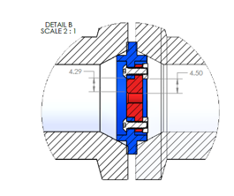
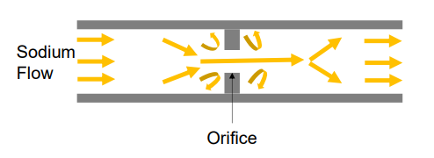
Task 4: Sodium Velocity Limits Testing
Explore impact of sodium flowing through orifice holes at various velocities
8-20 meters/second
Using an isothermal sodium loop the six tests will be ran in parallel for ~5000 hours
Orifices must be characterized to be able to measure potential changes
Beginning of testing
Throughout test at intervals of 500 hours
End of test
Orifice testing side view
Simple schematic showing orifice testing

Slide 11
Orifice Characterization
Notes:
Include reintroduction to Devan's project and picture of loop
Explain why I'm going over this and not thermal striping

Slide 12
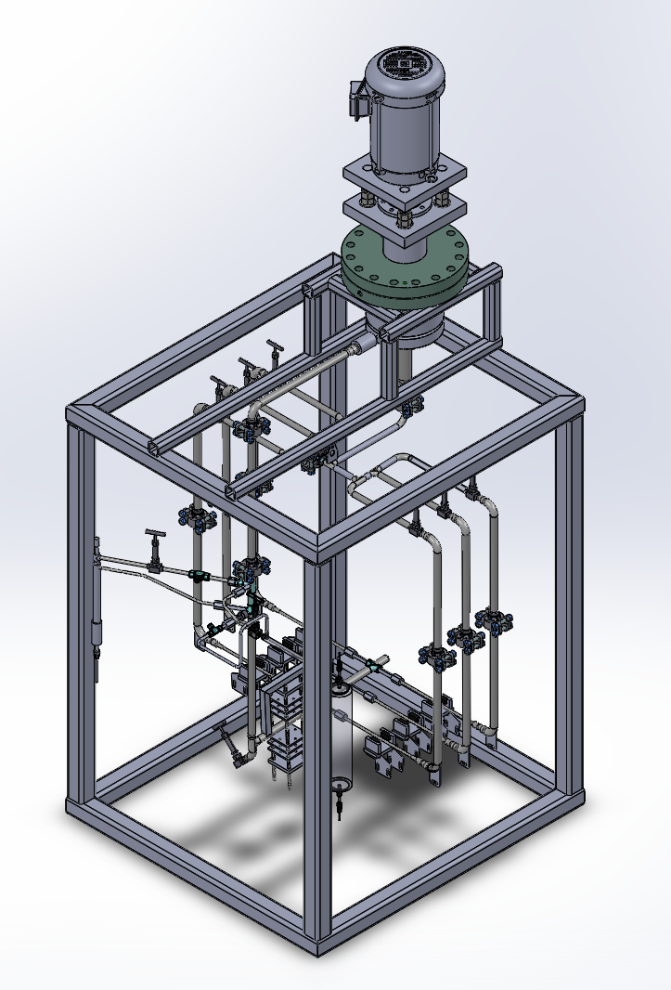
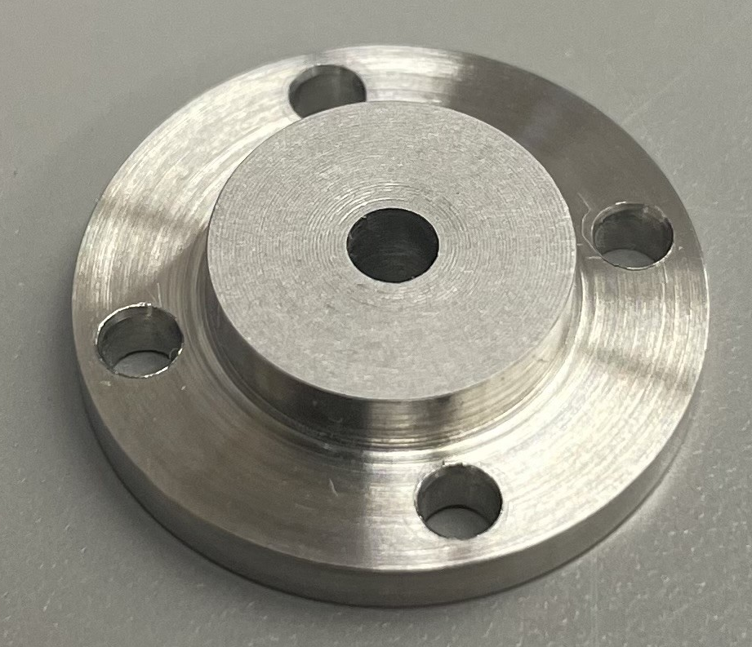
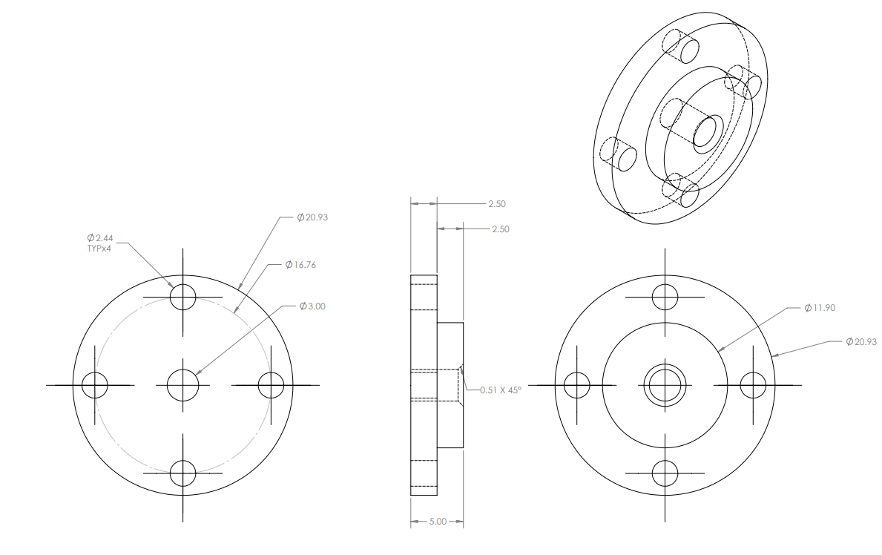
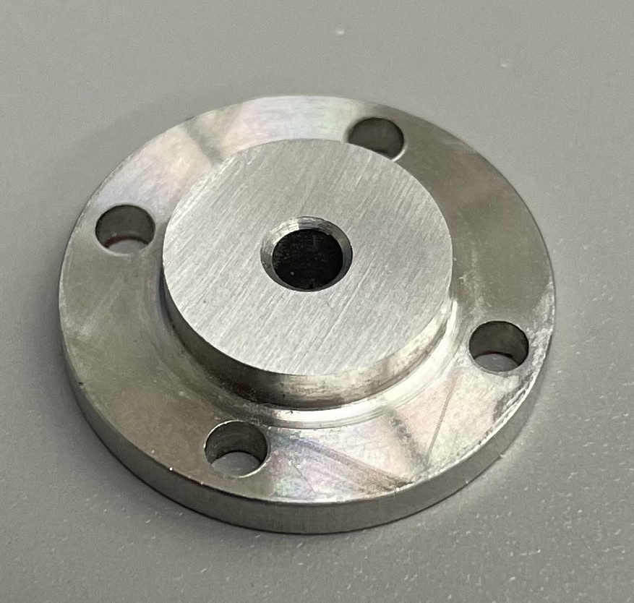
Task 4: Sodium Velocity Limits Testing
GraylocTM fitting for Holding Orifice
Sample Square Orifice
Proposed Sodium Loop for Sodium Velocity Testing
Drawings of Proposed Design for Orifice Plates
Sample Chamfered Orifice

Slide 13
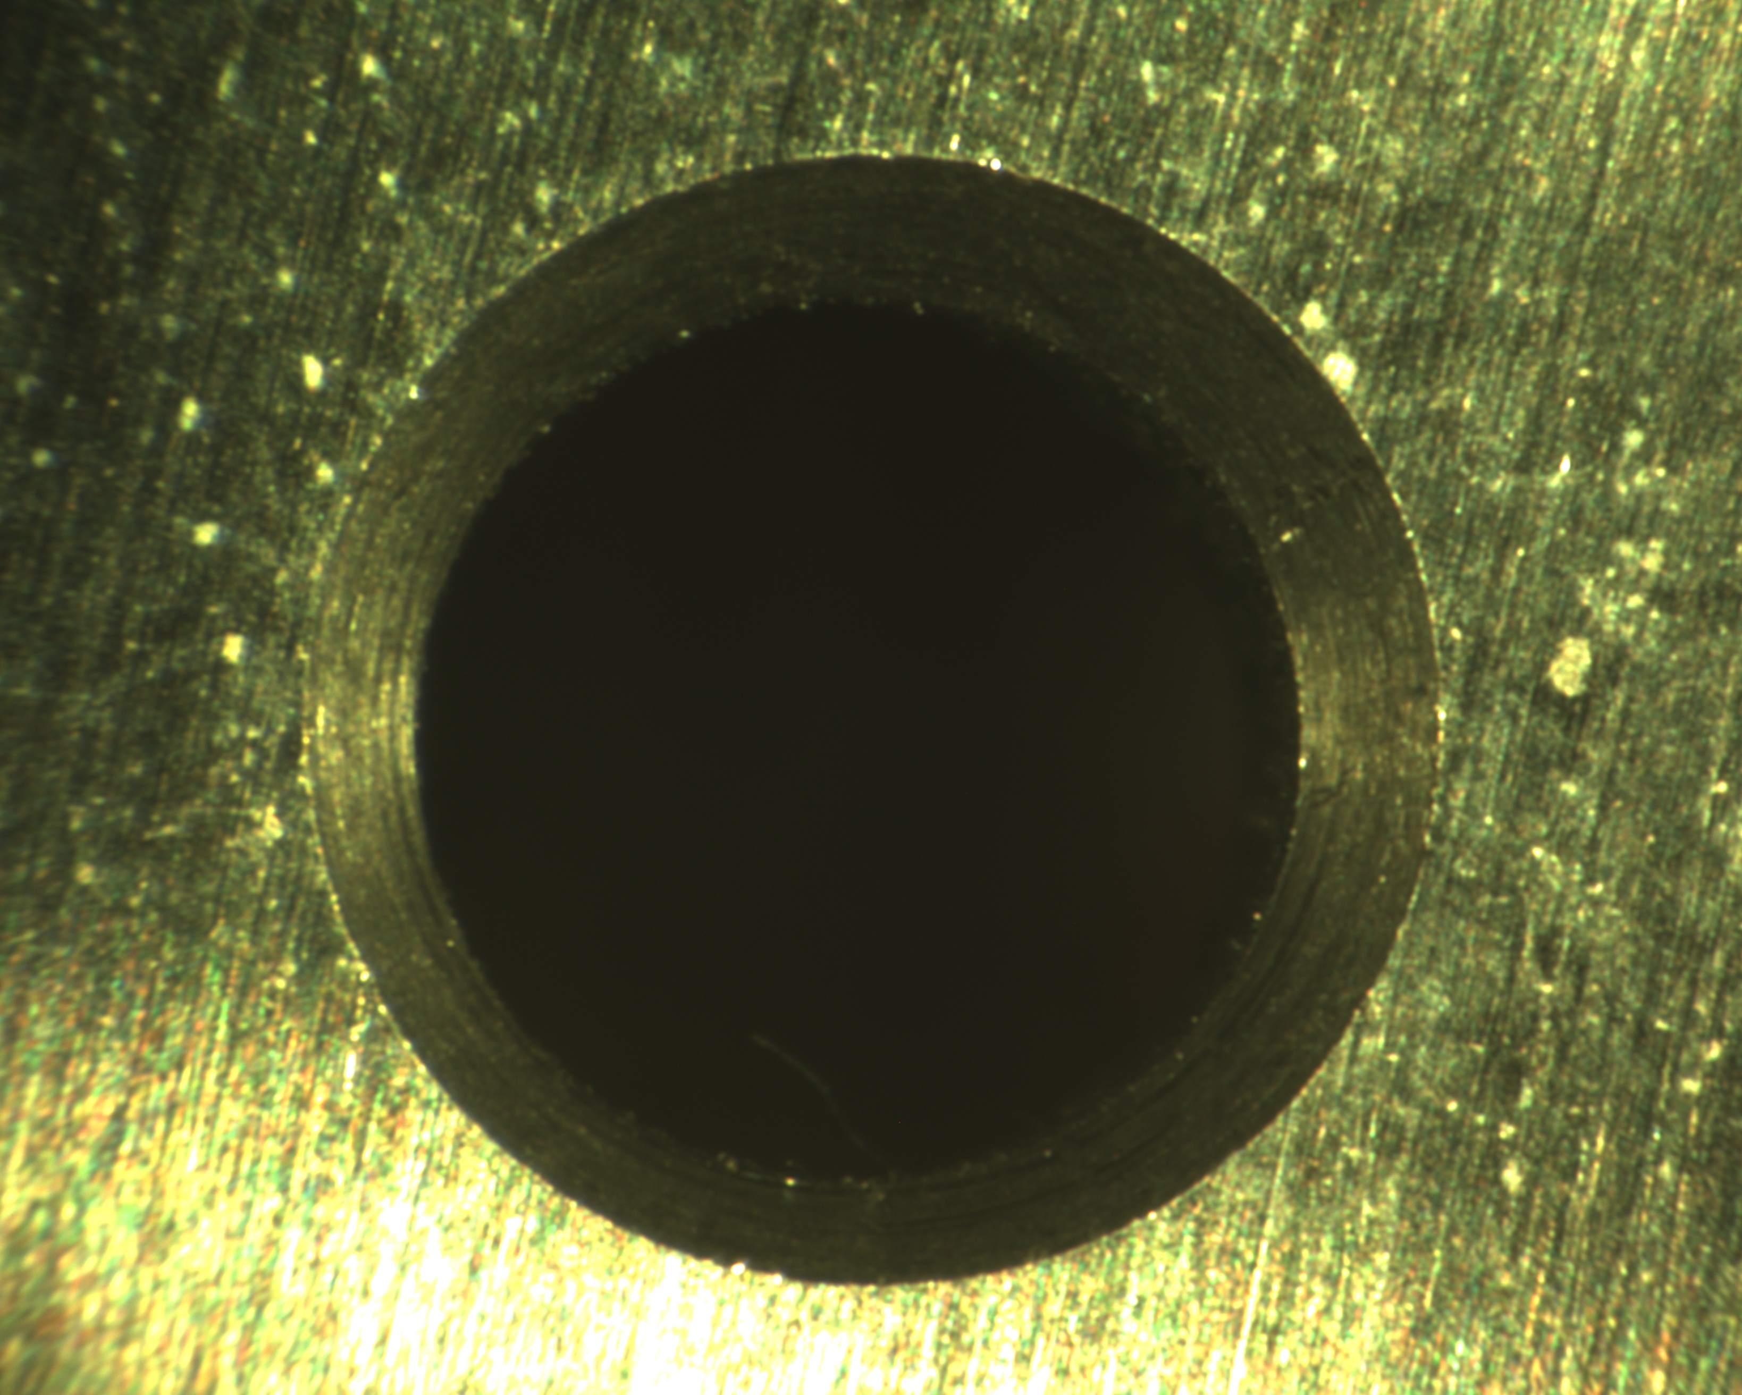
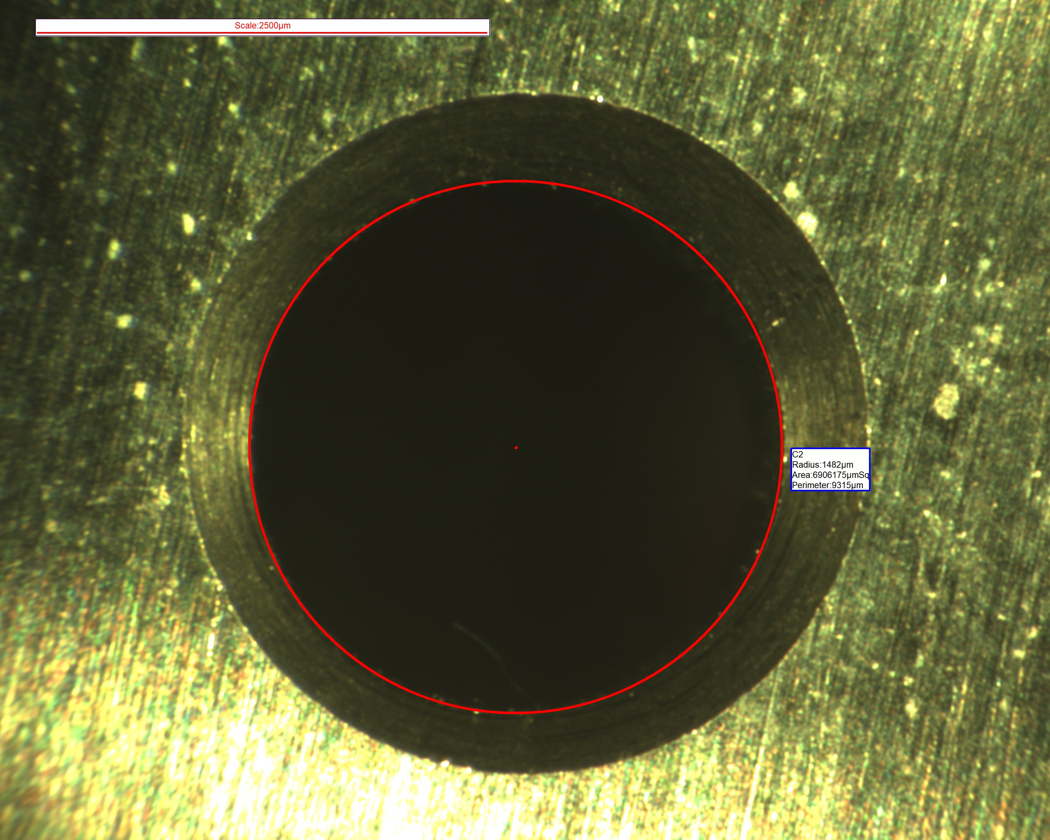
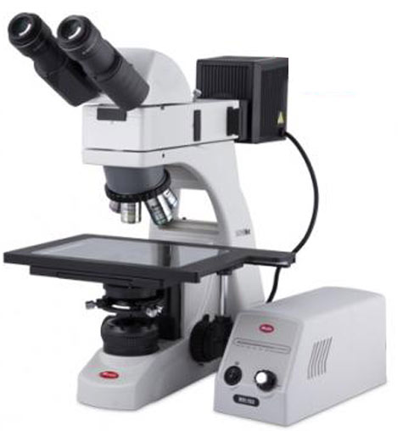
BA310MET – Optical Microscope
Standard Microscope Image
Macroscopic images (Big picture)
Multiple different magnifications
Good imaging at low magnification
Able to post process images to give estimation on diameter
ID Picture with Dimensions and Scale
Scale: 2500 microns
ID: 1482 microns
Machined expected radius: 1500 microns
https://cdn.shopify.com/s/files/1/0452/4209/files/20130422085731172.pdf?6148

Slide 14
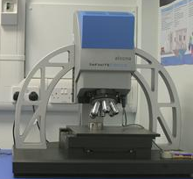
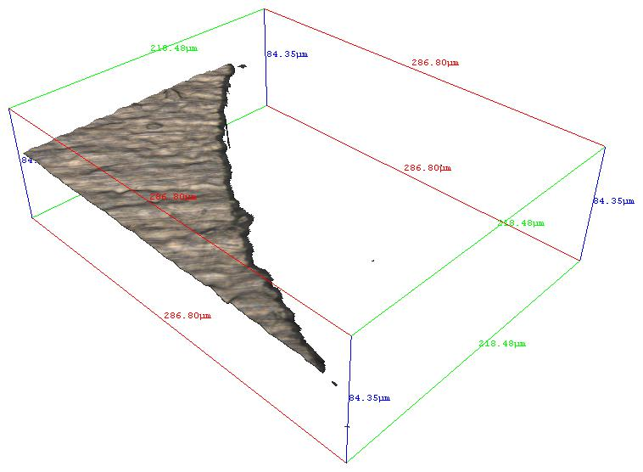
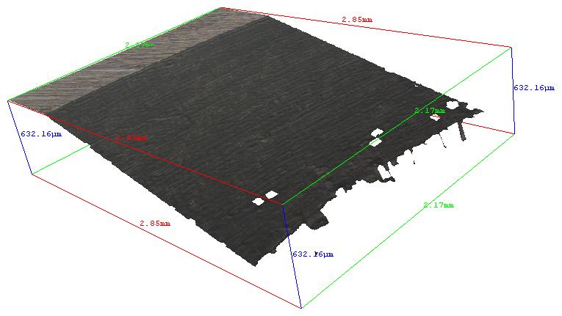
Alicona InfiniteFocus G4
Lateral Resolution (X & Y): 10 um
Verticle Resolution (Z) 10-100 nm range
Can tell the microscope what resolutions to use
Able to use the microscope for surface roughness measurements (microscale) and bulk part measurements (macro)
Objective magnification |  | 2.5× | 5× | 10× | 20× | 50× | 100×
Vertical resolution | nm | 2300 | 410 | 100 | 50 | 20 | 10
Min. measurable roughness (Ra) | µm | 7 | 1.2 | 0.3 | 0.15 | 0.06 | 0.03
2D picture – section of square edge
Section of the square orifice
Section of the chamfered orifice

Slide 15
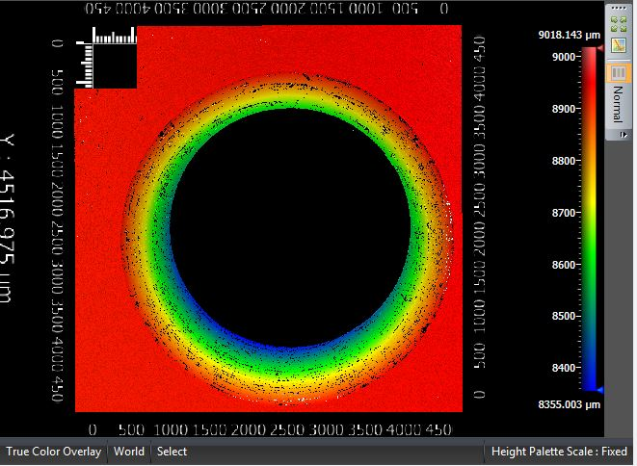
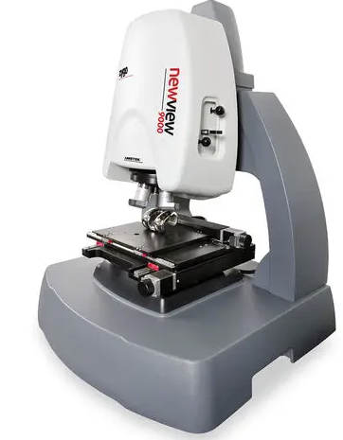
Zygo NewView 9000
Instrumentation Name | Zygo New view 9000 - Zygo Interferometer
Optical Lateral Resolution | 0.52 µm (50X objective)
RMS Repeatability (Vertical Resolution) | 0.008 nm
Fast and easy measurement
Can stitch images of roughness together to get macroscopic images
Not able to directly image the inner diameter of orifice
Entire chamfered orifice Zygo image
Bottom chamfer image
Notes:
Tell software you want X number of images near each other, and software will provide one comprehensive image

Slide 16
Optical Diverter – For Zygo Newview 9000

Slide 17
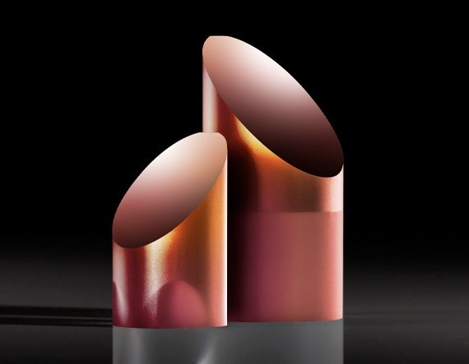
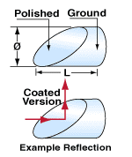
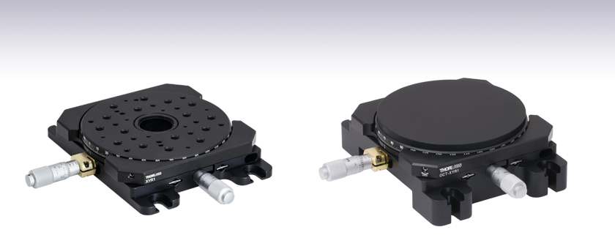
Optical Diverter and Rotating Platform- For Zygo Newview 9000
Image of 1mm Diameter 45° Rod Mirror Aluminum Coated
Image of XY Translation stage with Rotating Platform
Length (mm): 2.00
Diameter (mm): 1.00 +0.00/-0.05
https://www.edmundoptics.com/f/45deg-rod-lenses-and-mirrors/11554/#
Manual rotating platform would give individual spot measurements while leaving optical diverter in place
https://www.thorlabs.com/NewGroupPage9_PF.cfm?Guide=10&Category_ID=220&ObjectGroup_ID=3693

Slide 18
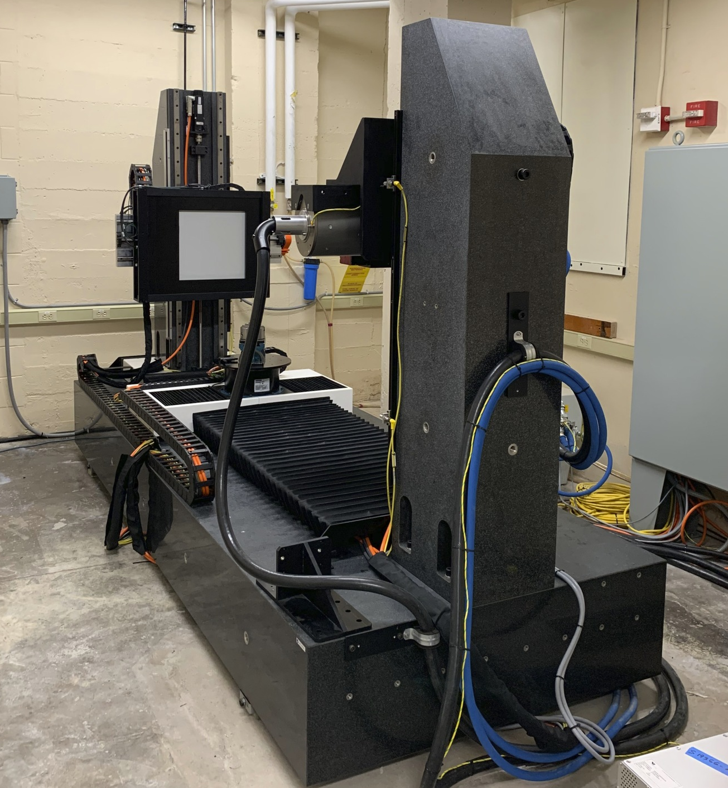
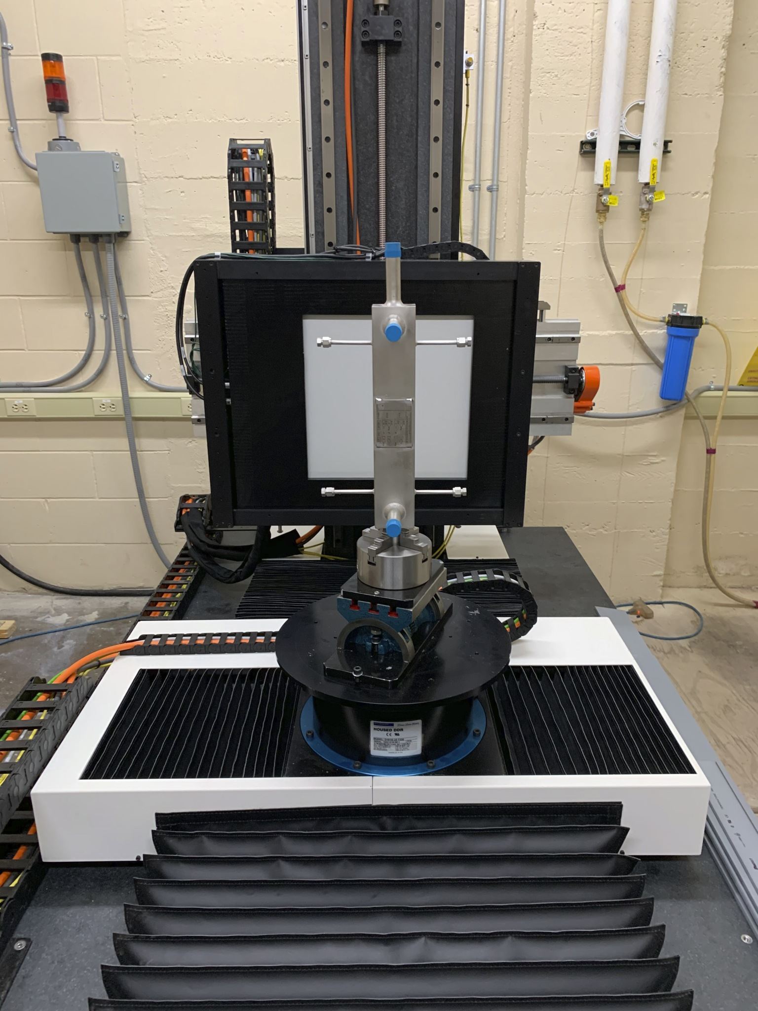
UW-Madison CT Scanner
Resolution: ~90 µm (.09mm)
Energy Level: 450 kV
Rotating Chuck

Slide 19
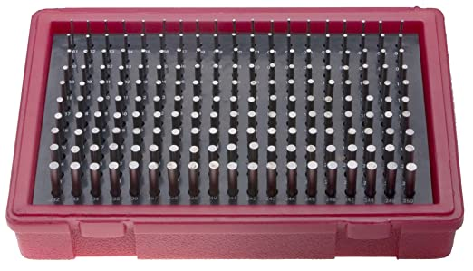
Mechanical Options
Pin gauge set could be used to physically measure orifice inner diameter
Does not consider geometry of orifice

Slide 20
Zeiss Contura G2 Coordinated-Measuring Machine (CMM)
Mechanical touch probe
Can give diameter, and orientation
Able to provide point cloud data
No roughness information
Resolution: 1.8µm
https://www.zeiss.com/metrology/products/systems/coordinate-measuring-machines/bridge-type-cmms/contura-2019.html

Slide 21
Tentative Characterization Plan
Take macroscopic images using optical microscope
Post process images to get values for diameter using microscopes software
Image with Zygo NewView 9000
This will give more accurate measurement along with chamfer gradient
Lateral resolution - 0.52 µm (50X objective)
Use optical diverter to give inner diameter surface roughness
Surface Topography Repeatability - 0.08 nm
Repeatability of RMS surface roughness - 0.008 nm
Vertical resolution
Use Zeiss Contura G2 to characterize orifice diameter
Position accuracy within the full measurement volume is better than 2 µm

Slide 22
Tasks 1 & 2: Thermal Striping

Slide 23
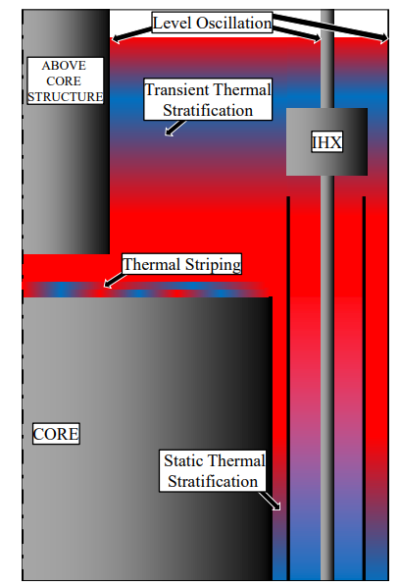
Task 1: Sodium Thermal Striping on Reactor’s Upper Internal Structures
Turbulent flow is paired with non-isothermal streams can cause thermal striping
Thermal striping temperature oscillation frequency range from 0.1 – 10 Hz
High thermal conductivity comes with disadvantages
Temperature oscillations can transmit to structural components
Causing thermal fatigue and mechanical failure
Typically found at the core exit or piping junctions where two dissimilar temperature flows mix
Industry examples
Cracks in piping of cold trap in BN 600
Cracking in SUPERPHENIX “T” Junctions welds
Different thermal hydraulic effects found in SFR
Notes:
Low Prandtl number hard to simulate computationally

Slide 24
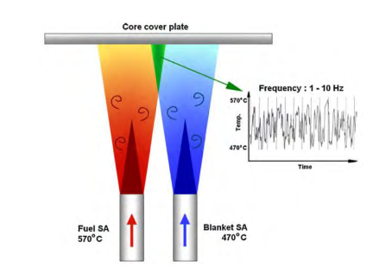
Task 1: Sodium Thermal Striping on Reactor’s Upper Internal Structures
When sodium exits the nuclear core and mixes with colder sodium in the control rods thermal striping can occur
Simulate different core channel temperature distributions
Conduct a test which measures internal stresses induced by thermal oscillations as a jet impinges a plate
Measure stresses with optical fiber
Validate a CFD model of both wall stress and oscillations in flow loop temperatures
Low Prandtl number makes modeling difficult
$$\operatorname{Pr}{=\frac{momentum diffusivity}{thermal diffusivity}=\frac{υ}{α}=}\frac{c_{p}μ}{k}$$

Slide 25
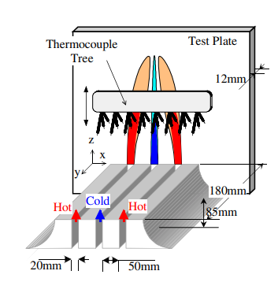
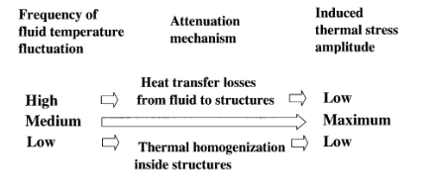
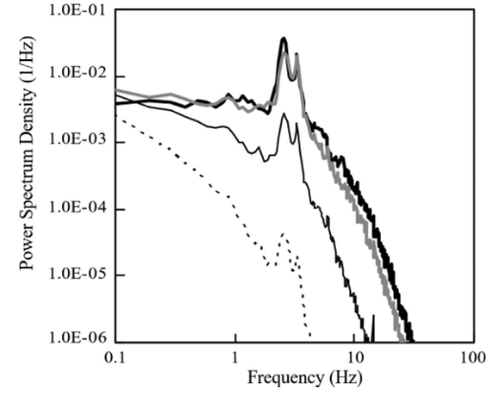
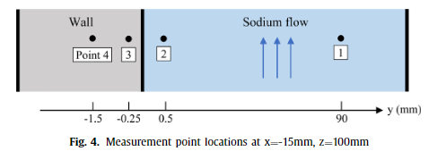
Task 1: Sodium Thermal Striping on Reactor’s Upper Internal Structures
Thermal oscillations don’t inherently transmit to structure
Frequencies that are too fast prevent heat transfer from fluid to structure
Slower frequencies allow the structural components to homogenize with the fluid
Reducing thermal fatigue
Medium frequencies are a “sweet” spot for thermal fatigue
2 Hz appears to be the dominate frequency
“Experimental investigation on transfer characteristics of temperature fluctuation from liquid sodium to wall in parallel triple-jet”
Nobuyuki Kimura *, Hiroyuki Miyakoshi, Hideki Kamide Japan Atomic Energy Agency, 4002 Narita, O-arai, Ibaraki 311-1393, Japan
Received 26 July 2006; received in revised form 29 September 2006 Available online 5 December 2006

Slide 26
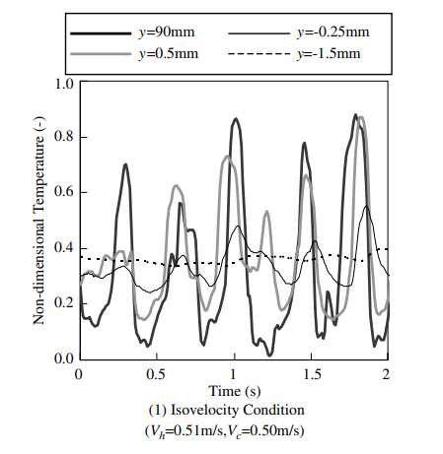
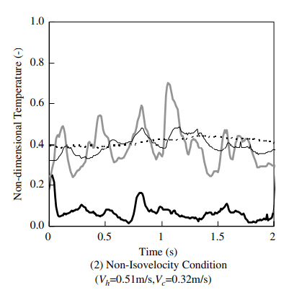
Task 1: Sodium Thermal Striping on Reactor’s Upper Internal Structures
The temperature fluctuations in the solid are much smaller than the fluctuations in the fluid
May be a bigger concern in piping due to smaller walls
The experimental conditions with iso-velocity jet conditions produced periodic temperature fluctuations

Slide 27
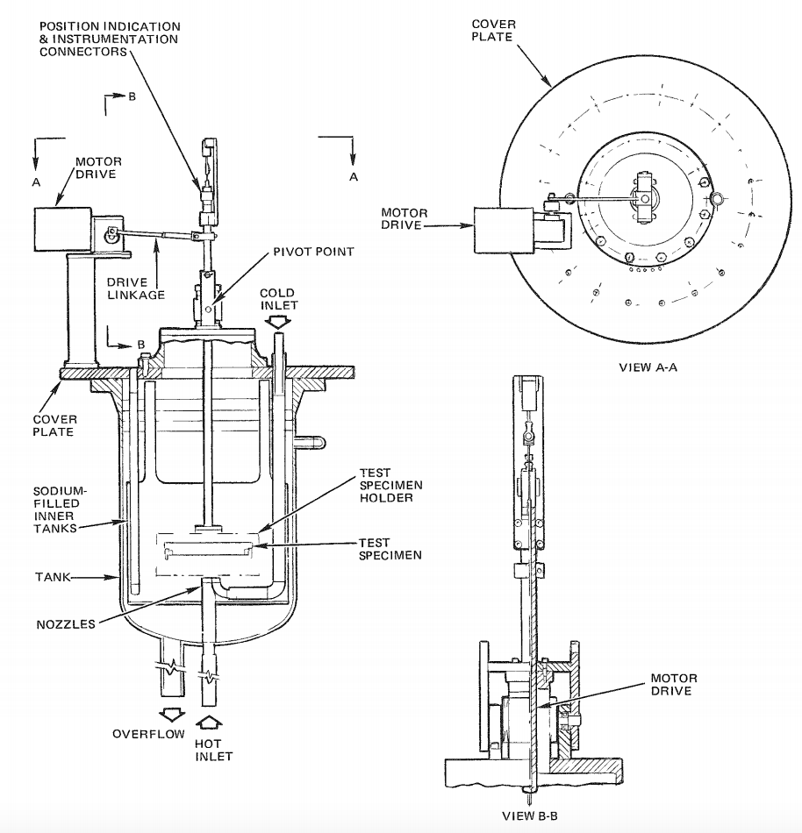
Task 1: Sodium Thermal Striping on Reactor’s Upper Internal Structures
Having an equal velocity for the two jets creates larger temperature fluctuation amplitudes
There is high attenuation of thermal striping at a 50% cold flow stream velocity and a 100% hot flow stream velocity (flow rate up to 10 gpm)
LMFBR Thermal-Striping Evaluation -EPRI NP-2673 Project 17-4-11 Interim Report October 1982
Prepared by Rockwell international -Energy systems group
PI - J.E. Brunings
Notes:
Correlating study showed

Slide 28
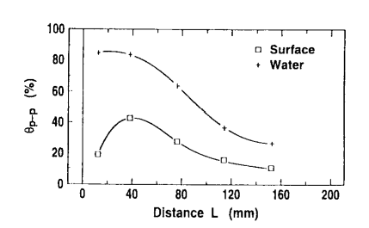
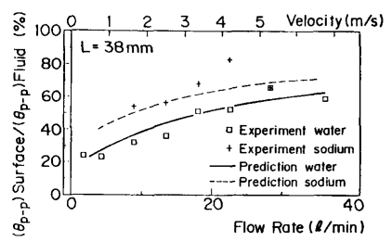
Attenuation of Temperature Fluctuations in Thermal Striping
Relationship between temperature fluctuations and distance between plate that is struck by an impinging jet
L = 38 mm produced the largest fluctuations on the surface
Temperature fluctuations were reduced by half when transmitted to surface
A consequence of thermal boundary layer attenuating temperature response to surface
Peak-to-peak surface temperature fluctuations increased with an increase in jet flow rate
Due to the thermal boundary layers contribution decreasing with an increasing flow rate
Relation between peak-to-peak amplitude and distance L
Attenuation of Temperature Fluctuations in Thermal Striping, Mitsuo Wakamatsu, Hiromichi Nei and Koh Hashiguchi, Toshiba Nuclear Engineering Laboratory, Toshiba Corporation, Received May 12, 1994
Attenuation ratios of peak-to-peak amplitude vs flow rate

Slide 29
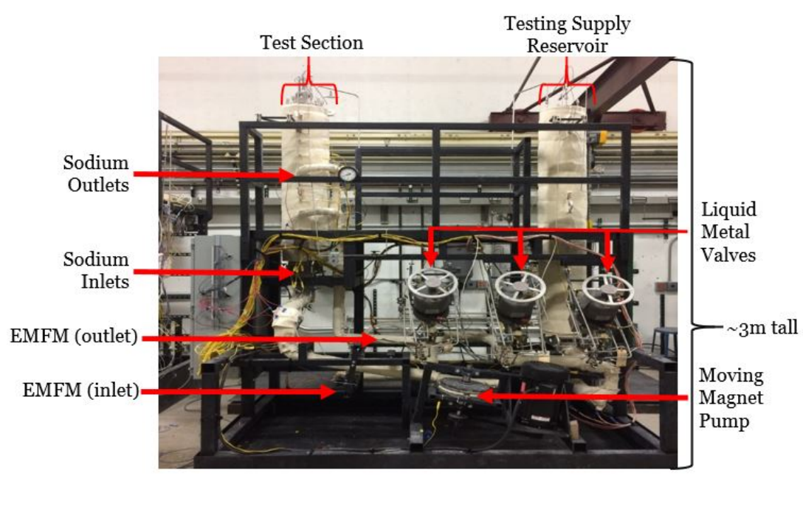
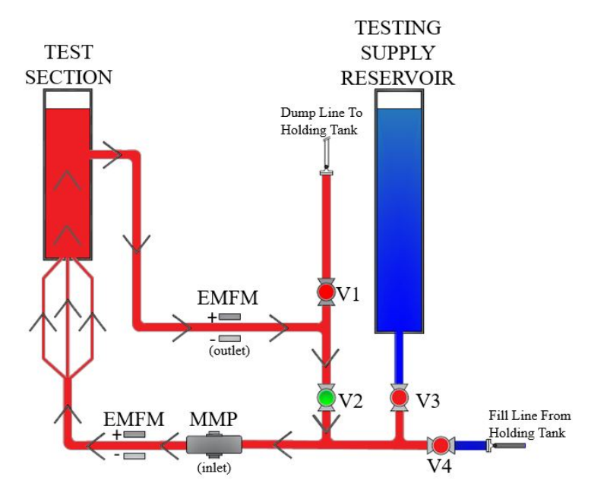
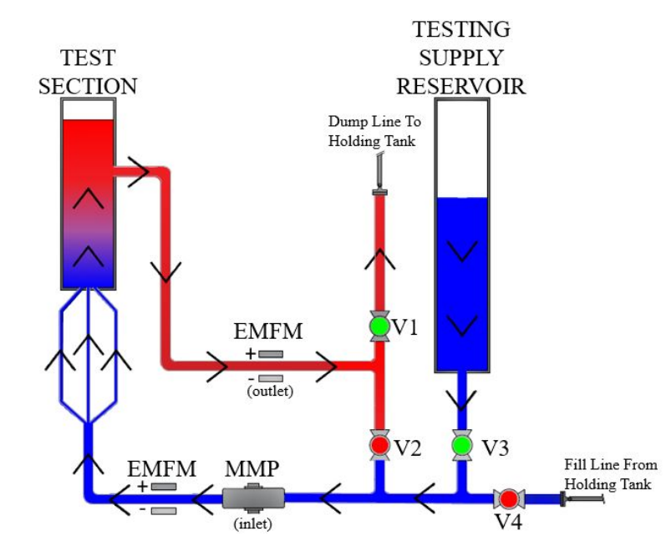
Thermal Stratification Testing
(Left)Schematic of the operation of the TSTF during the heating (Right) Schematic of the operation of the TSTF during an experimental run
Facility is 225 liters in total
Testing supply 75 [l] and a testing supply reservoir (150 [l])
Facility has access to a 1000 [l] sodium holding tank
Full layout of the thermal stratification testing facility

Slide 30
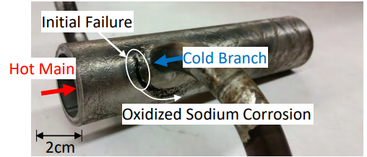
Task 2: Sodium Thermal Striping “T” or “Y” Junction Tests
Temperature differences in sodium pool can cause cold or hot slugs of sodium to be pushed into secondary piping
Prompt thermal striping
Thermal stresses on the reactor piping
Goal is to conduct testing to assist in the validation of a 1D model in piping subjected to thermal oscillations
Testing will investigate pipe temperatures in
vulnerable pipe sections of varying geometries
Measure thermal stresses in various pipe geometries
Fig XX. UW T-junction thermal striping induced fatigue

Slide 31
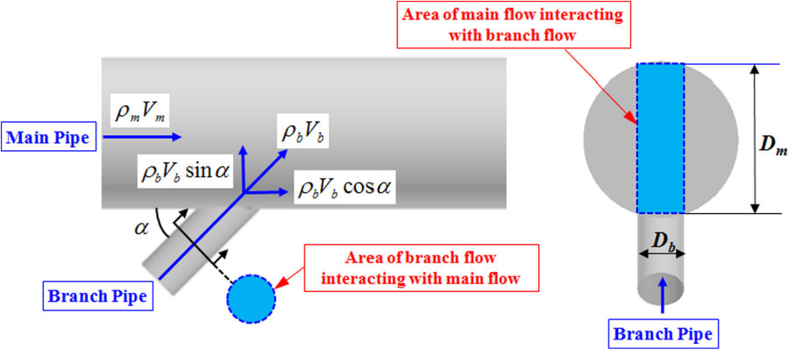
Task 2: Sodium Thermal Striping “T” or “Y” Junction Tests
As previously mentioned, thermal striping in reactor piping particularly dangerous due to the relatively small size of pipe walls
This danger is exacerbated depending on the location of thermal striping in the pipe
Location of oscillations determined based on momentum ratio
Main Pipe Momentum: $M_{m}=\left(D_{m}∗D_{b}∗ρ_{m}∗V_{m}^{2}\right)$
Branch Pipe Momentum: $M_{b}=\left(\frac{π}{4}∗D_{b}^{2}∗ρ_{b}∗V_{b}^{2}∗sin⁡(α)\right)$
Momentum Ratio: $M_{R}=\frac{M_{m}}{M_{b}}$
Where D_{m} and D_{b} are hydraulic diameters, V_{m} and V_{b} are the mean cross-sectional velocities and $ρ_{m}$and $ρ_{b}$are the respective fluid densities for each pipe
For a T-junction $α$=90°so sin($α$) goes to 1
Notes:
(momentum per unit time) = (volumetric flow rate) × (momentum per unit volume)

Slide 32
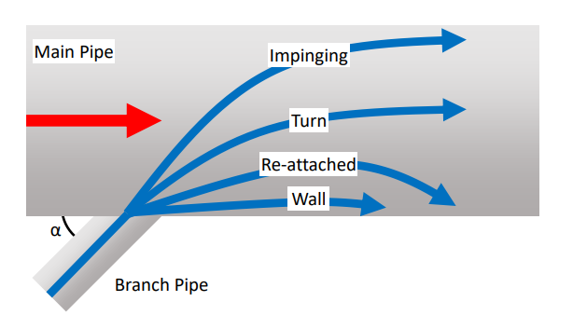
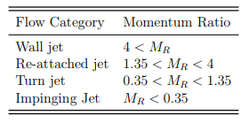
Task 2: Sodium Thermal Striping “T” or “Y” Junction Tests
Momentum Ratio: $M_{R}=\frac{M_{m}}{M_{b}}$
Fig XX: Illustration of Different Branch Jet Classifications
Fig XX: Different Branch Jet Classifications
Fig XX: Flow patterns of branch pipe jet in T-junction piping system (branch pipe jet contains fluorescent dye): Taken from the WATLON water experiment

Slide 33
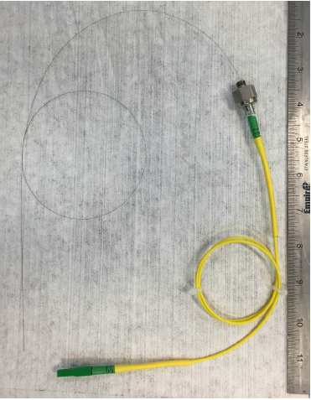
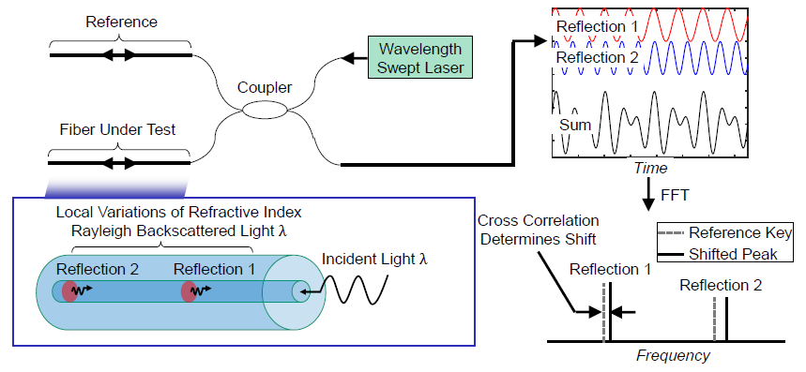
Distributed Optical Fiber Temperature Sensors
Past UW-Madison experiments proved fibers could be used for thermal striping
Rayleigh backscatter-based fiber optic temperature sensors provide high resolution 1D temperature measurements
Near infrared laser shines down optical fiber
Defects in fiber produce Rayleigh backscatter
High spatial temperature measurements
Measurement
every 0.653 mm
To
Interrogator
Termination

Slide 34
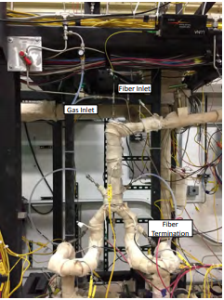
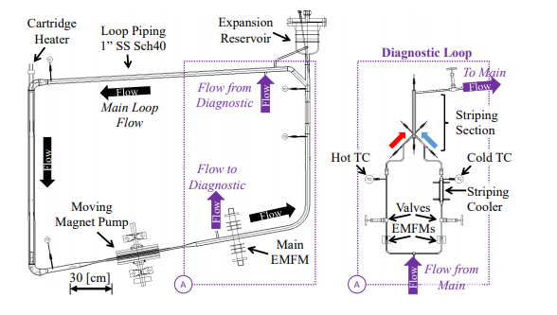
Task 2: Similar Past Experiments of Thermal Striping in “Y” Junctions
(Left) Schematic depicting the capillary tube Y-geometry. (Right) Photograph of Y-test section installed in loop
Sodium loop schematic with striping section Y geometry

Slide 35
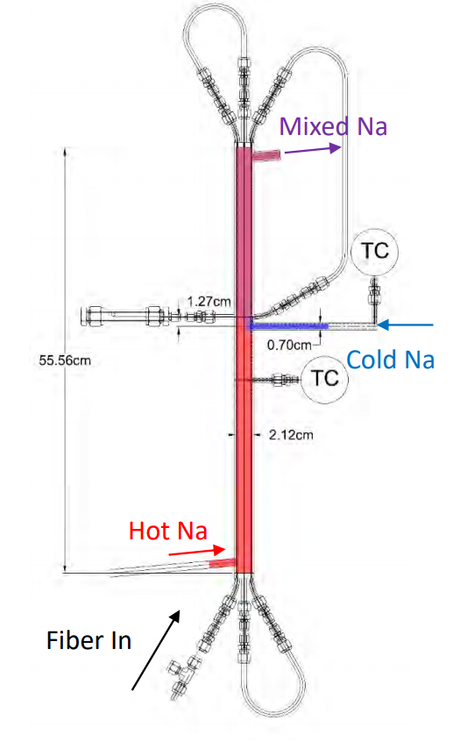
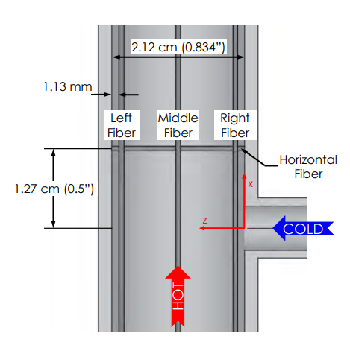
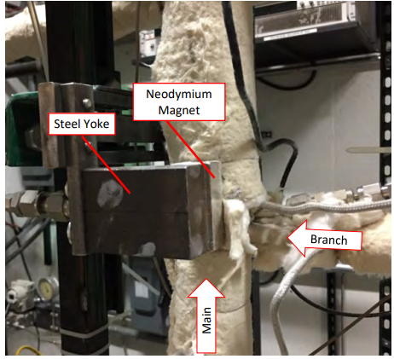
Task 2: Similar Past Experiments of Thermal Striping in “T” and “Y” Junctions
(Left) Schematic depicting the capillary tube T-geometry. (Right) Photograph of T-test section installed in loop
Thermal Striping test section: T-junction

Slide 36
Future Work
Finalize orifice characterization
Assist in task 4 loop design and construction
Pivot back toward two thermal striping tasks
Work with TerraPower to figure out scaling methodology
Find a way to utilize fibers to measure both temperature and structural stress
Design and construct loops for both Task 1 and 2

Slide 37
Questions?

