Slide 1

Heat Exchanger Design for Mars Surface Applications
Nate Colgan

Slide 2
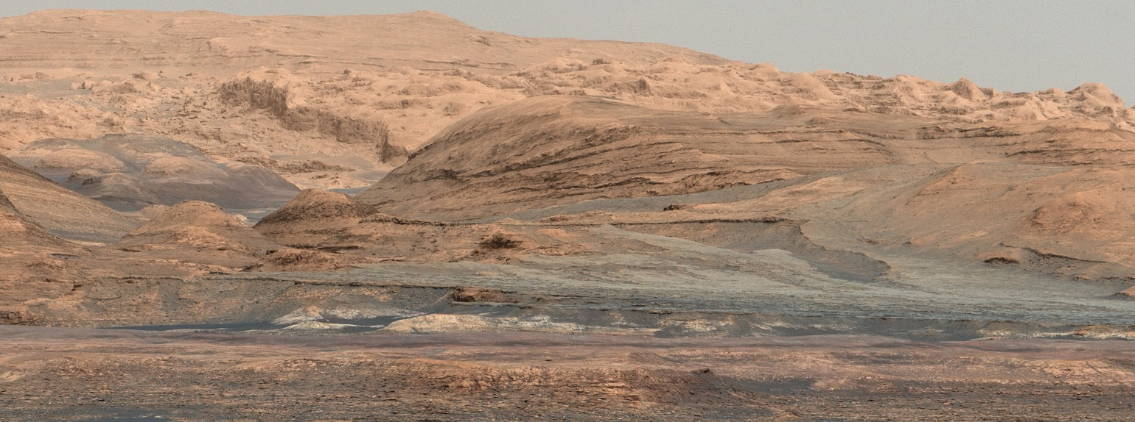
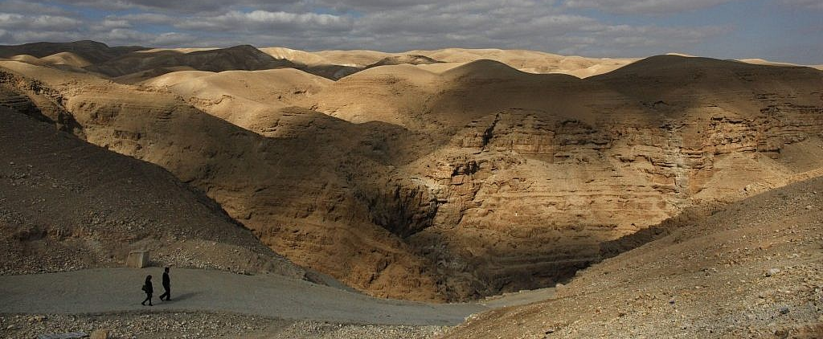
Why Mars?
Mars is very similar to Earth
  24.5 hour days, similar axial tilt and seasonal variation, 38% Earth gravity, volcanoes, polar caps, wind and water erosion features
  Significant evidence that early Mars had oceans, a thick atmosphere, and a magnetic field but these disappeared over time
  Easiest potentially-habitable place in the solar system to travel to and study
Major scientific goals of Mars exploration
  Discover evidence of current or past life to understand how life began on Earth
  Study geophysical processes similar to ancient Earth
Top: Gale Crater, Mars (cr. NASA) Bottom: Judean Desert, Earth (cr. AP)

Slide 3
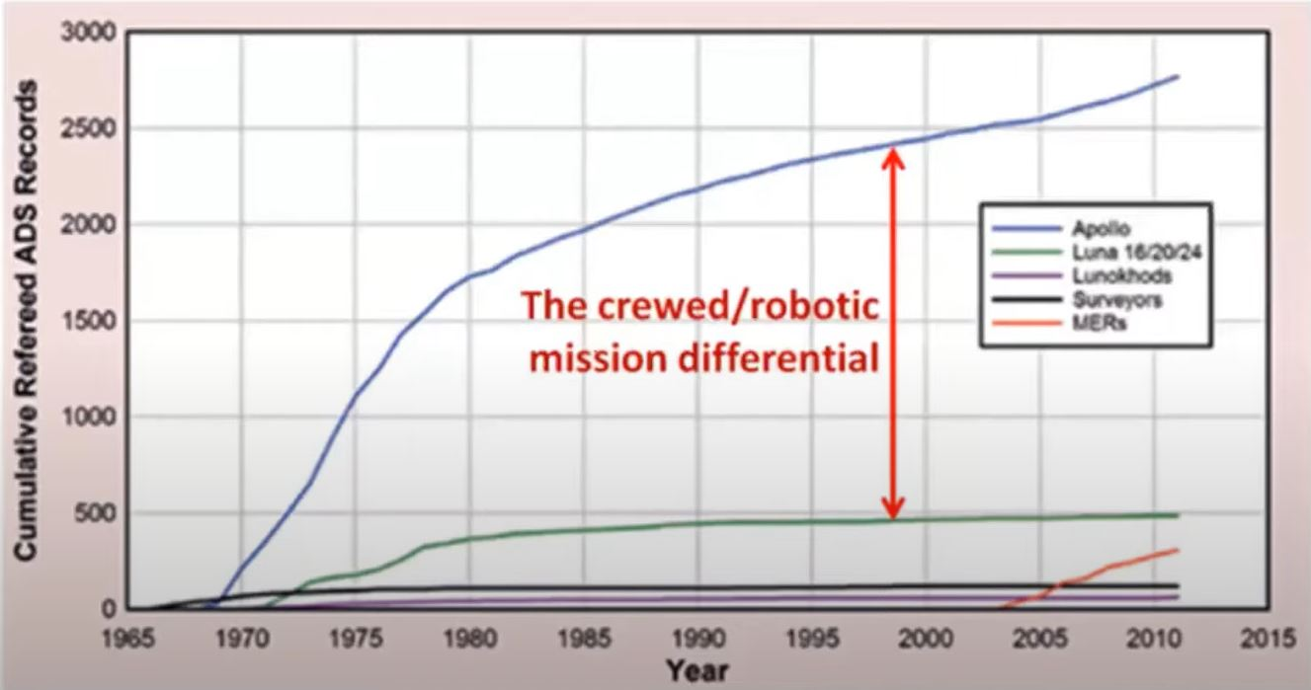
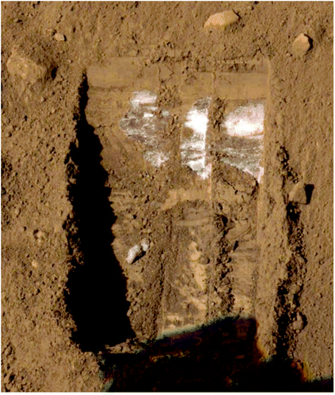
Why Send People?
Remote observation and robotic surface exploration are limited in the types and scope of data they can collect
  Orbital radar observations suggest significant subsurface water deposits that may hold evidence of past life
  Current rovers have been unable to dig more than a few cm into Martian soil, carry only a few 10s of kg scientific payload, and cannot return samples to Earth
Humans are much better scientists than robots
  Capable of independent complex tasks and problem solving
  Can move to new sites much faster than rovers
  Can make much more detailed observations
  Likely need to take direct ice core samples >1m below surface to find direct evidence of life
Top: Comparison of the scientific literature resulting from crewed vs uncrewed missions [Clarke,2021]
Bottom: Sub-surface water ice exposed by the Phoenix lander, NASA

Slide 4
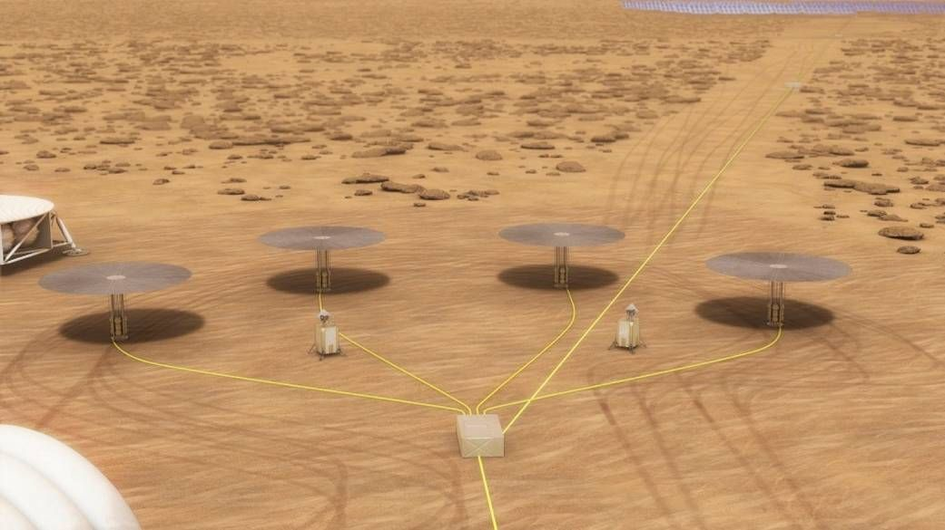

Why Nuclear Power?
Crewed Mars mission will require >40 kWe for 10 years
  Some proposed architectures call for up to 1 MWe
Nuclear fission power is an ideal power source
  Compact, high power density
  Does not rely on local insolation
  Consistent power output, does not require massive energy storage
Current proposed FPSs typically rely on radiator for waste heat rejection
  At high power levels, radiator becomes most massive component
  Drives optimal heat rejection temperature up, reducing power cycle thermal efficiency
KiloPower 10 kWe units. Image credit: NASA

Slide 5
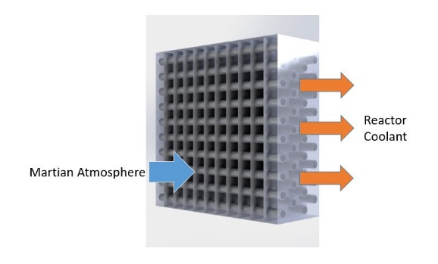
Forced-convection Heat Exchanger
Benefits:
  Higher conductance, weaker temperature dependence than radiator
  Does not require sky exposure to transfer heat, more compact construction
  More easily scalable for range of applications, e.g. cryofuel refrigeration, rover thermal management
Martian atmosphere challenging for convective heat transfer and fan operation
  Average pressure: 600 Pa
  Average temperature: 220 K
  Large diurnal temperature and seasonal pressure variation
Low density leads to low Reynolds number and high Knudsen numbers (near slip-flow regime). Very little data on heat transfer and pressure drop for typical HX designs, or fan performance, in this regime
Low pressure results in low heat transfer coefficients requiring high airflow rate, but also lowers achievable fan pressure rise, limiting maximum airflow rate.
Illustration of a cross-flow finned-tube heat exchanger.
Plane-finned circular tube crossflow HX
Optimization model developed to determine mass-optimal geometry for given heat rejection conditions
Model then integrated into existing HTGR optimization model in place of radiator to determine overall performance benefit
Model inputs:
  Heat rejection rate
  Inlet, outlet temperatures
  Environmental, material parameters
Model outputs:
  Tube length, diameter
  Number of tube columns and rows
  Fin pitch
Constraints
  Maximum size: 4m
  Minimum tube diameter: 0.5mm
  Fan motor specific mass: 6.5 kg/kWe
  25% wall thickness safety margin
Place logo
or company name here

Slide 6
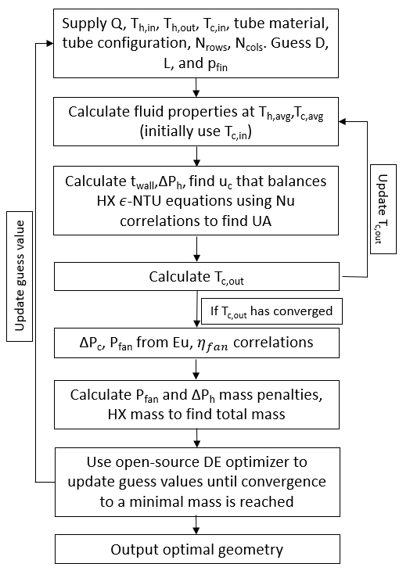
Modelling Approach
For a given set of input parameters, find set of geometrical parameters that minimize effective HX mass
Effectiveness-NTU method used to implicitly find air velocity necessary to produce required cooling rate for a given geometry using Nusselt number correlations
Air-side pressure drop and required fan power calculated from correlations. Mass penalties are then calculated to obtain effective HX mass
As problem is nonlinear and non-differentiable, an open-source adaptive DE optimizer is used to determine optimal geometry.

Slide 7
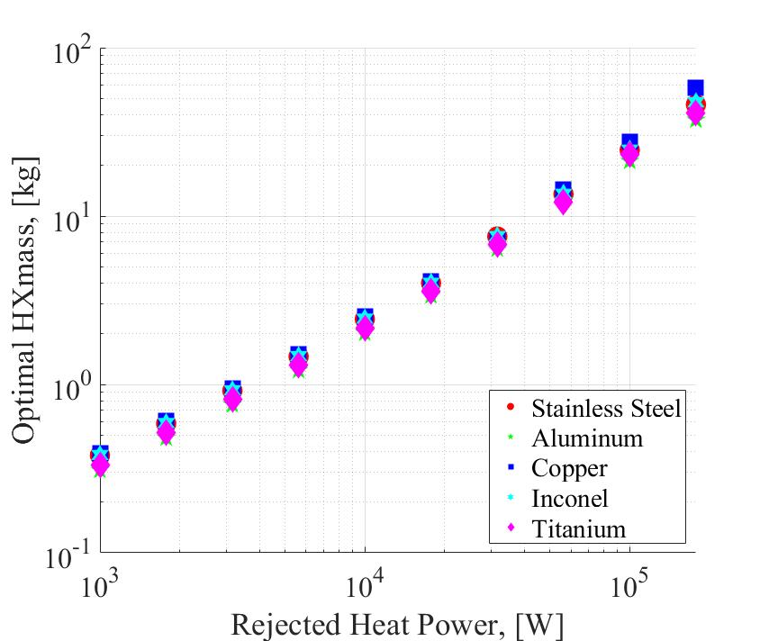
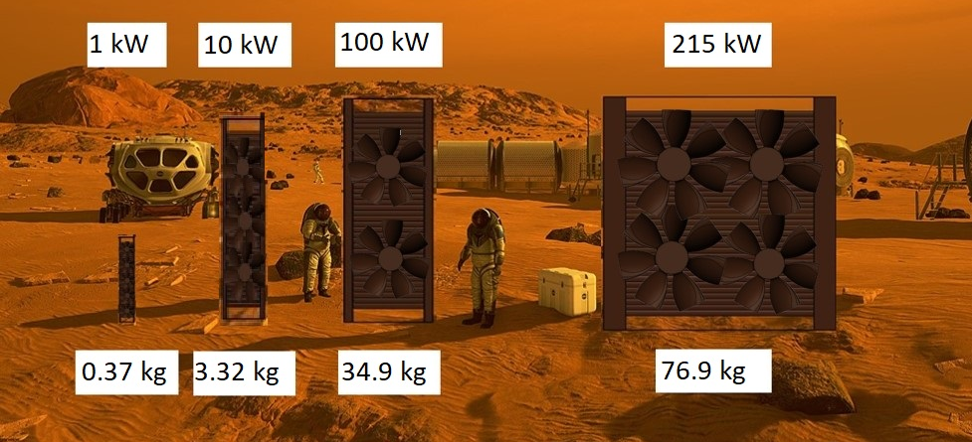
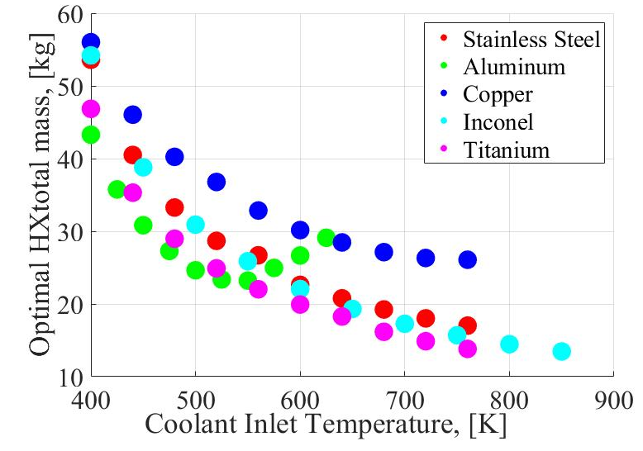
HX Model Results
Optimal geometries at Mars conditions have no fins, very small tube diameters Very few tube columns, wide tube spacing to limit air-side pressure loss in thin atmosphere
Mass increases approximately linearly with rejected heat load up to 250 kW.
Aluminum tubes result in lowest mass below 550K, above which Titanium in the lightest

Slide 8
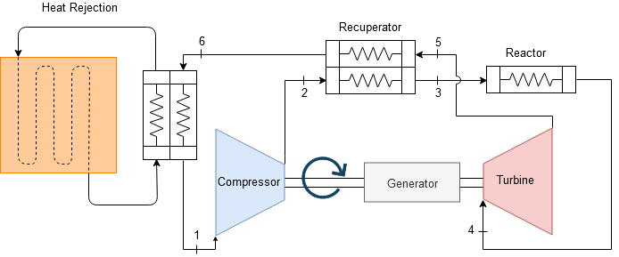
Cycle Optimization Results
HX model integrated into FPS thermal cycle model to determine how forced-convection HX alters the mass-optimal cycle compared to radiator
78% overall mass reduction compared to using radiator for 40 kWe cycle
thermal efficiency increases from 27 to 36%
43 K decrease in heat rejection temperature
94% decrease in frontal area
Typical air velocity: 8-13 m/s
Top Left: Performance comparison between a radiator and steel HX for a 40 kWe system, P_{amb}=600 Pa, T_{amb}=200 K. Top Right: Geometry and performance of optimal-cycle 40 kWe HX.
Bottom: Diagram of investigated thermal cycle

Slide 9
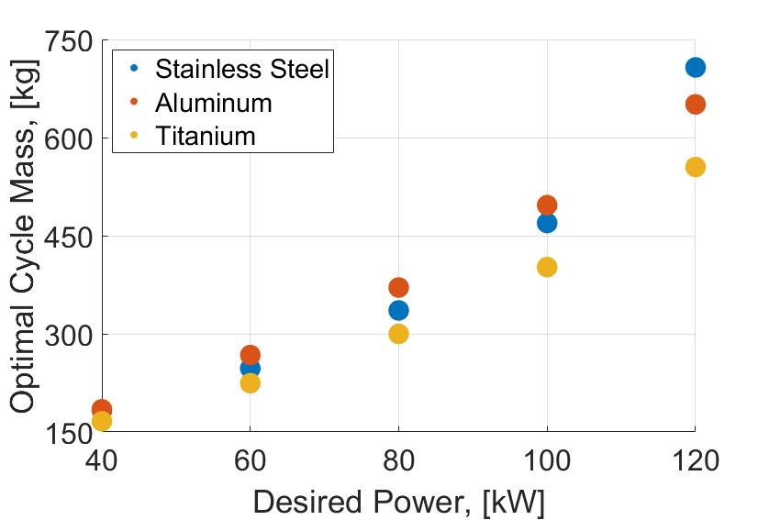
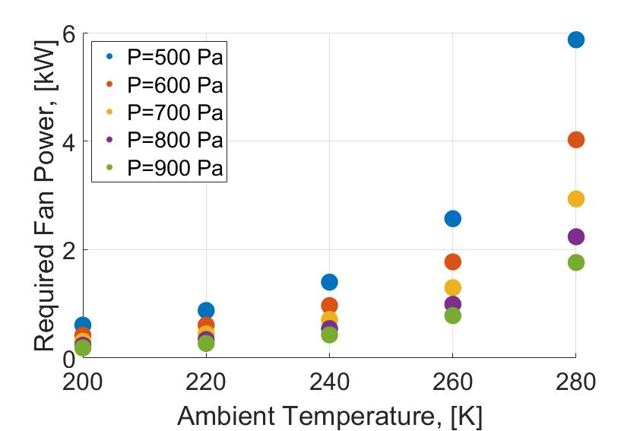
Optimal Cycle Performance
Optimal cycle mass and fan power increase linearly with desired power up to 120 kWe
Required fan power remains below 10% of FPS output for expected range of ambient conditions at potential crewed landing sites (mid-latitudes, low elevation)
Top: Variation of optimal cycle mass vs output power for 3 materials
Bottom: Variation of optimal cycle fan power vs ambient conditions for a 40 kWe cycle
Place logo
or company name here

Slide 10
Experimental Validation
Testing Approach
Models based on correlations validated in Earth-like conditions, no existing correlations for high-Kn, low-Re tube arrays found in literature
Model also assumed uniform axial flow, but fan-induced vorticity may degrade performance
  Likely can't place fan downstream due to low density, high temperature conditions there
Experimental validation of model predictions will result in novel high-Kn correlations for staggered tube bank Nu and Eu
  useful for development of compact convective heat exchangers on Mars or other rarefied environments
Correlations will be incorporated into model resulting in experimentally-validated model for predicting FSPS mass and size for a wide range of potential Mars applications
Constructed a subscale prototype HX and low-pressure test facility to validate model predictions in Mars-like conditions
Test conditions and HX geometry closely match predicted mass-optimal Mars HX design
Collected HX pressure loss and conductance data for range of CO₂ flowrates, heat loads, and ambient pressures
Will vary fan position to test both uniform axial flow and fan-induced vorticity performance to characterize effect
Place logo
or company name here

Slide 11
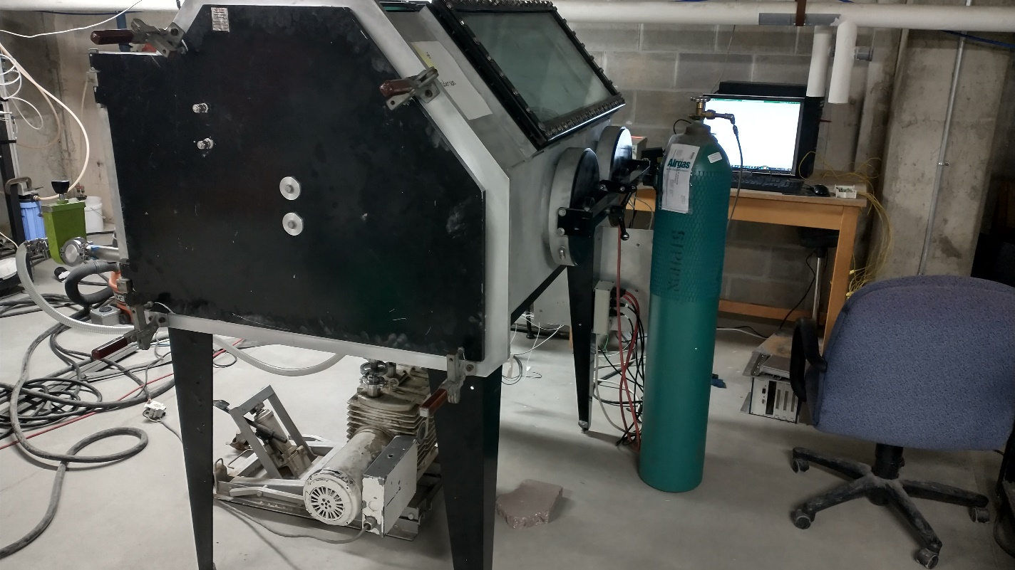
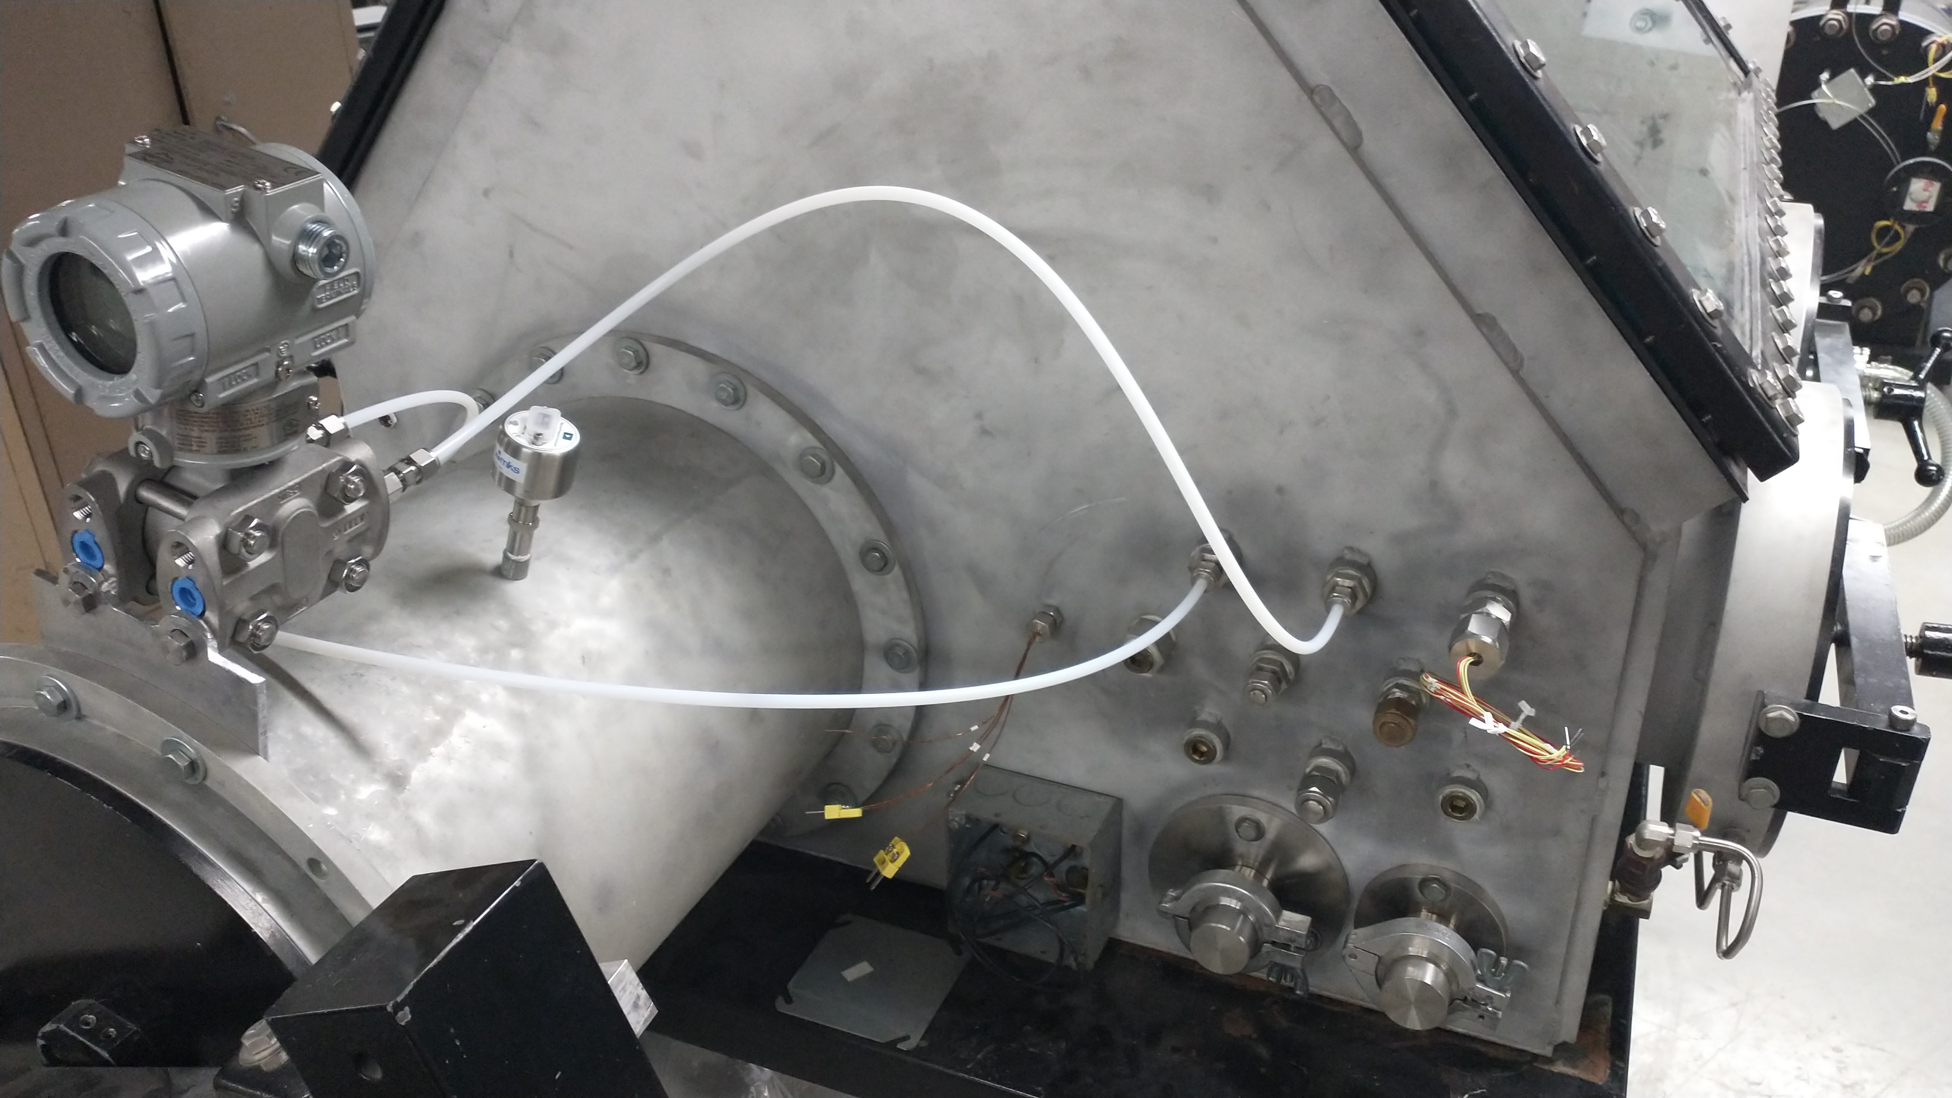
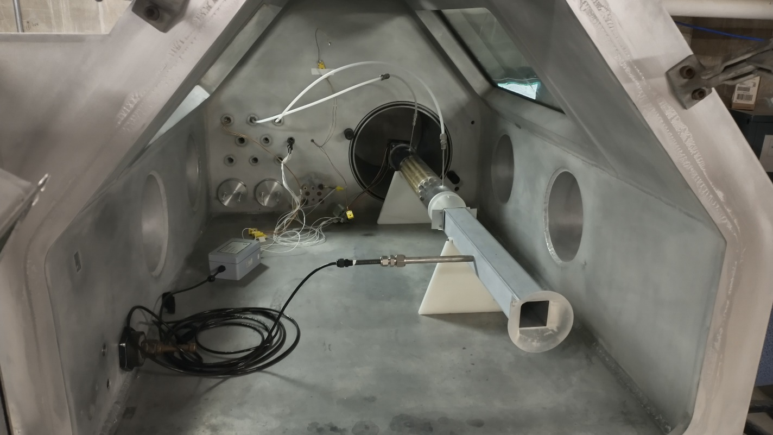

Test Chamber
Test chamber is a vacuum glovebox owned by UW-THL.
Has feedthough ports for electrical power, data, pressure tap lines, vacuum and CO₂ fill lines, and a piezo vacuum gauge
Thermal modelling of test section suggests no active cooling is required to maintain near-ambient temperature during HX operation
Data from sensors monitored on lab PC via NI-DAQ
Vacuum chamber
CO₂ source
Vacuum pump
dP gauge
Vacuum gauge
Calibration setup
Anemometer
Place logo
or company name here
Power, data feedthroughs

Slide 12
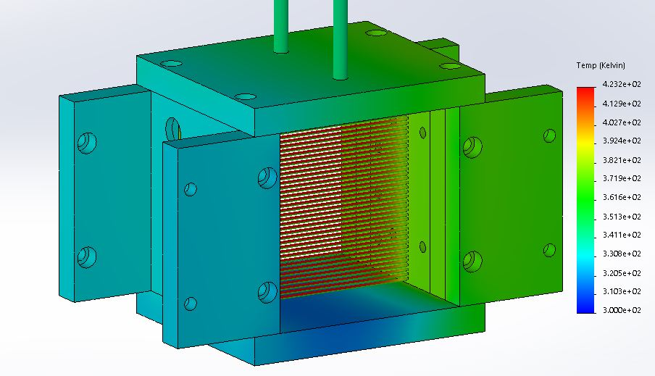
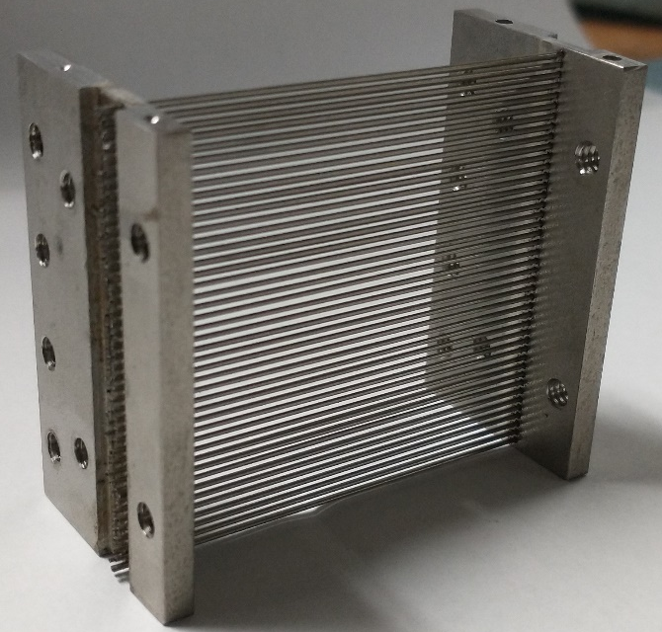
Experimental HX Design
Experimental HX designed to match optimal geometry from model
  2 rows of 0.02” SS tubes at 0.04” spacing, soldered to 2 SS header plates
  Frontal area of HX is 1.75”x1.75”, applied heater power scaled to match heat flux of full-scale 40kWe HX
Electrical current applied across tube array to generate required thermal power.
  To generate 27W, will apply 76A at 0.36V
  Eliminates need for pumping and heating fluid through HX
  Results in axially-consistent surface temperature which reduces measurement uncertainty
  Allows for thermocouples to be placed inside tubes for local temperature measurement without disturbing flow
  Voltage across the tubes measured during testing. Resistance across HX measured prior to testing at range of tube temps using multimeter so dissipated power can be estimated from voltage during testing.
Top: Thermal simulation of HX during operation. Peak expected temperature is 423 K. Bottom: Assembled HX
Place logo
or company name here

Slide 13
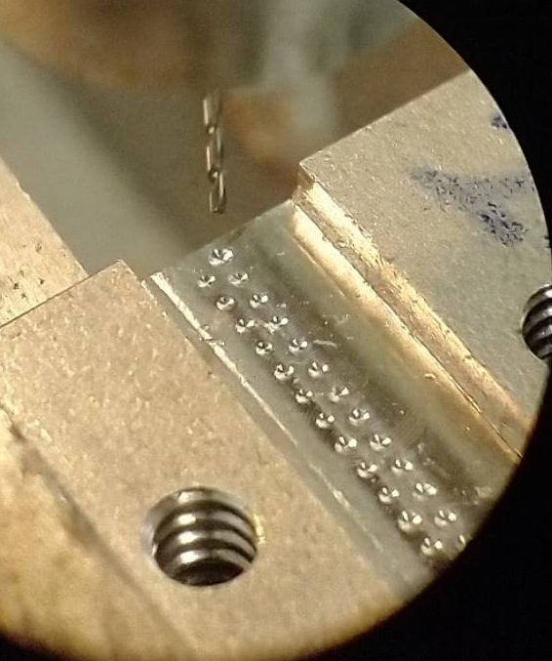
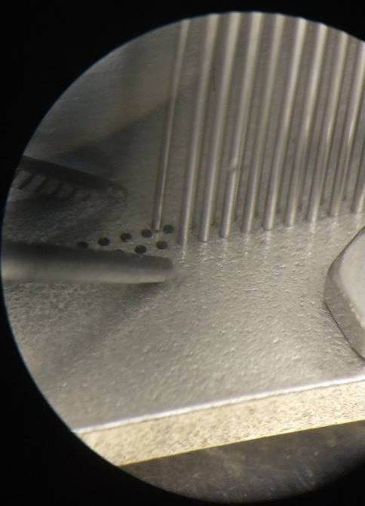
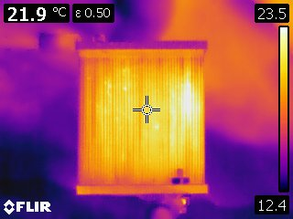
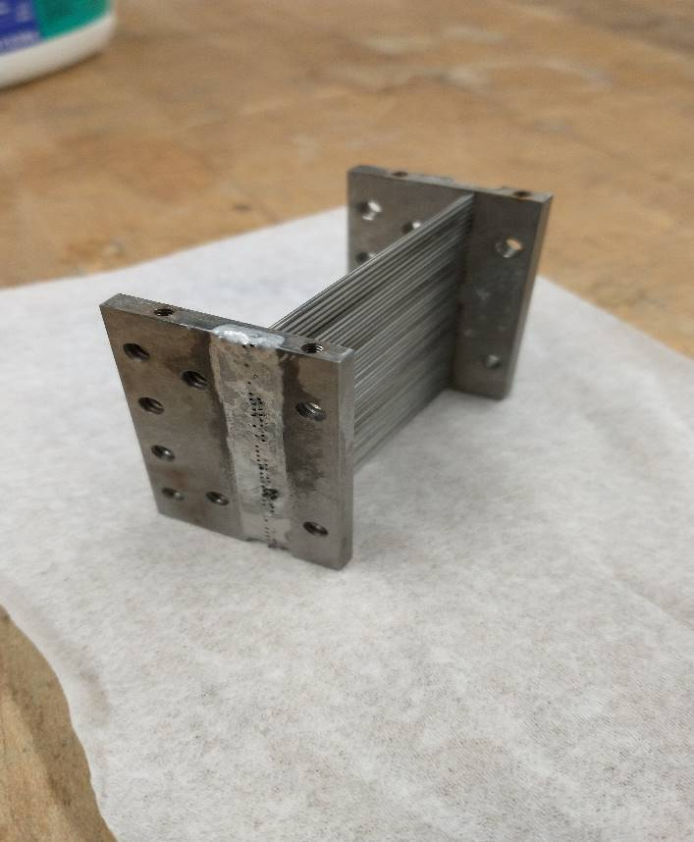
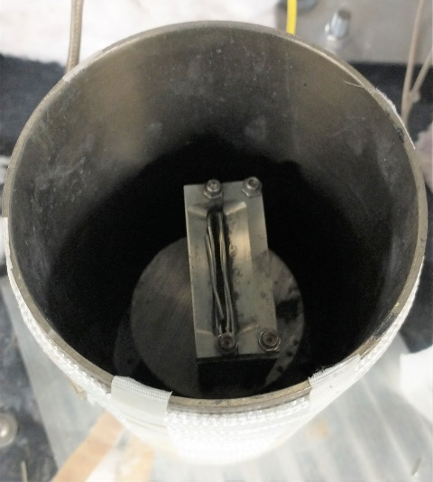
Experimental HX Fabrication
Tubes were cut to length in a diamond saw and deburred with sandpaper
A microdrill and microscope were used to drill the tube holes in the headers
An Aluminum jig was made to hold the headers in place during assembly and soldering
Tubes were inserted into the headers using a microscope and tweezers
The HX was then soldered together using reflow soldering in purpose-built oven
FLIR imaging shows heating across all tubes under DC load, indicating good electrical connections
TCs insulated with BN to isolate from DC current
Place logo
or company name here

Slide 14
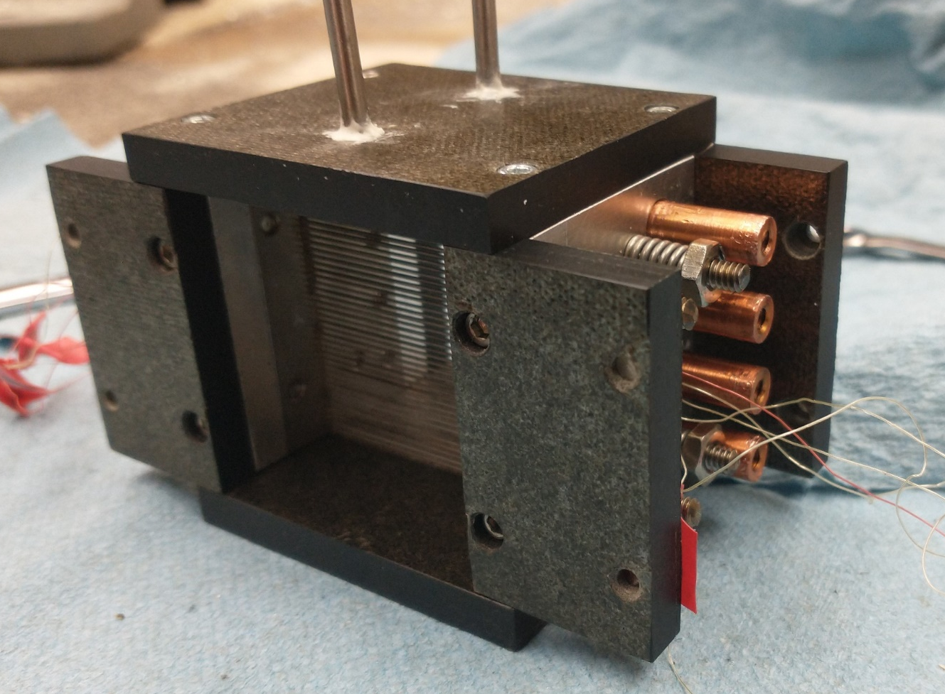
HX Frame
dP gauge taps
Tension springs
¼” MICA plate
Mechanically attaches and electrically insulates HX from test section
Provides fixed support on one end of HX, sprung support on other end to allow for thermal expansion of tubes without deformation
Copper standoffs provide electrical connection between power supply and HX header and ensure even heat flux across tube bank
Pressure taps allow measurement of pressure drop across tube bank with dP gauge outside of vacuum chamber
Cu standoffs
HX
TC wires
MICA and Aluminum HX frame
Place logo
or company name here

Slide 15
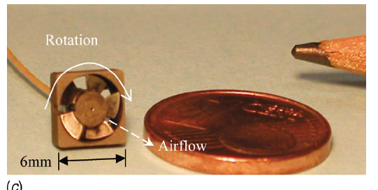
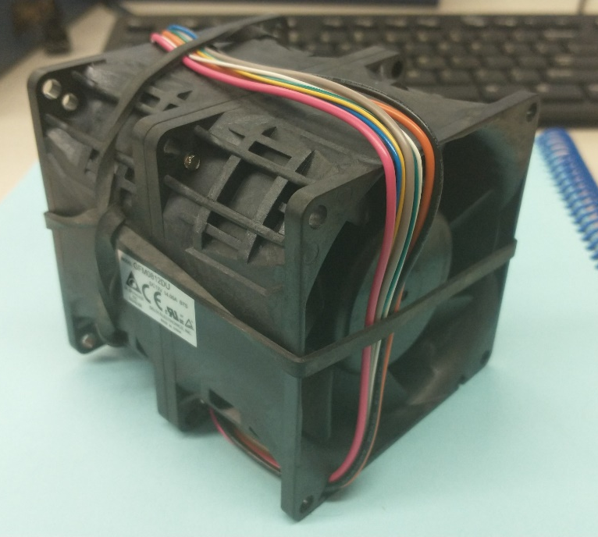
Fan Performance
Fan is required to drive airflow through HX
Low fluid density reduces pressure rise, high fan speeds required
Fan for experiments (~1.5” D) operates at very low (~1000-2000) Re, high M (~.5), not applicable to full scale fan behavior
  High-performance commercial fan purchased for experiment. Same model used elsewhere for Mars wind tunnel experiments
  At 16 krpm, should generate sufficient flow through the HX
  Due to lower-than-expected performance, ended up using 3 fans in series to get desired flowrate, pressure rise
Fan for real Mars HX (~1m D) operates at 16k Re, fan scaling laws should apply, no expected loss of performance
  Ideal speed ~1600 rpm, η~.46
  Will also require active cooling to maintain steady operating temperature, can be looped into main HX with minimal additional mass
Example of a low-Re, fan in Earth conditions. Credit: Quin & Grimes
Fan purchased for experiments
Place logo
or company name here

Slide 16
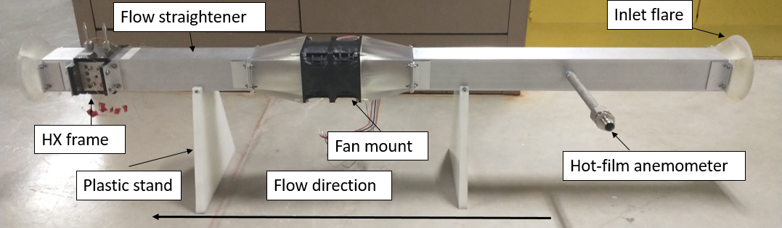
Test Section
3D-printed inlet and outlet flares reduce pressure loss and turbulence
Hot-film anemometer measures CO₂ flowrate upstream of fan to improve accuracy
Flow straightener consisting of tube bundle reduces vorticity from fan
3D-printed fan mount can be positioned either upstream of flow straightener to provide purely axial flow into HX to match assumptions used in model, or directly upstream of HX to reflect a more realistic operational geometry, allowing for direct measurement of the expected performance decrement from non-uniform flow
Plastic stands provide electrical insulation from vacuum chamber
Place logo
or company name here

Slide 17
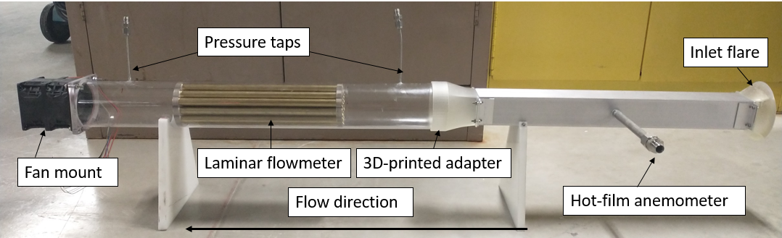
Flow Measurement
Hot film anemometer used for flow measurement due to its low pressure drop, but must be calibrated to accurately measure flowrate in test conditions
Laminar flowmeter constructed to calibrate anemometer
  Consists of a bundle of 19 ½” Diameter tubes, sized to generate sufficient pressure drop at test flowrates and fit within the test chamber
  Pressure drop across tube bundle measured to determine flowrate based on laminar flow correlations
Fan downstream of flowmeter to provide smooth flow through flowmeter
Anemometer calibration factor, determined by comparing anemometer readings to flowrate obtained from laminar flowmeter, used to determine actual flowrates during HX testing
Place logo
or company name here

Slide 18
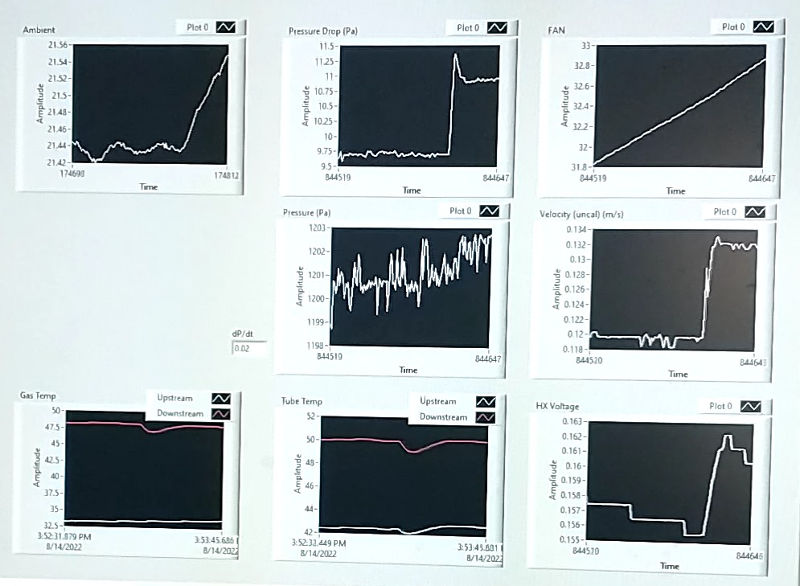
Controls Setup
From L-R, top-bottom:
  Ambient temperature in vac chamber
  Pressure drop across HX
  Fan temperature
  Chamber pressure
  Uncalibrated nemometer velocity reading
  Upstream and downstream CO2 temp
  Upstream and downstream tube temp
  Voltage across HX
HX voltage controlled to maintain constant downstream tube temp
CO2 flowrate controlled to maintain chamber pressure
Fan speed controlled via PWM signal from labview

Slide 19
Test Procedure
Measurement Uncertainties
Seal test section and evacuate air down to approximately 1 torr using vacuum pump
Refill test section to 1 bar with IG CO₂ from a bottle and pump down to test pressure
Fan speed set so that flowmeter reads the desired calibrated flowrate
Apply current to the HX and wait for the temperatures to reach steady state
Record tube center temperatures, CO₂ inlet and outlet temperature, flowrate, pressure drop across the HX, vacuum pressure, HX current and voltage
Record data for range of flow rates and tube temperatures at range of ambient pressures to capture wide range of Re and Kn numbers for both axial flow and swirling flow conditions
Relative uncertainties of important measurement devices
Resulting relative uncertainties of important dimensionless parameters based on uncertainty propagation
Conditions tested so far:
  DT=50,100,150K
  P=1-10kPa
  U=5-25 m/s
  Re=10-200
  Kn=.001-.009
  So far all in CO2, plan to also test in N2, He
Place logo
or company name here

Slide 20
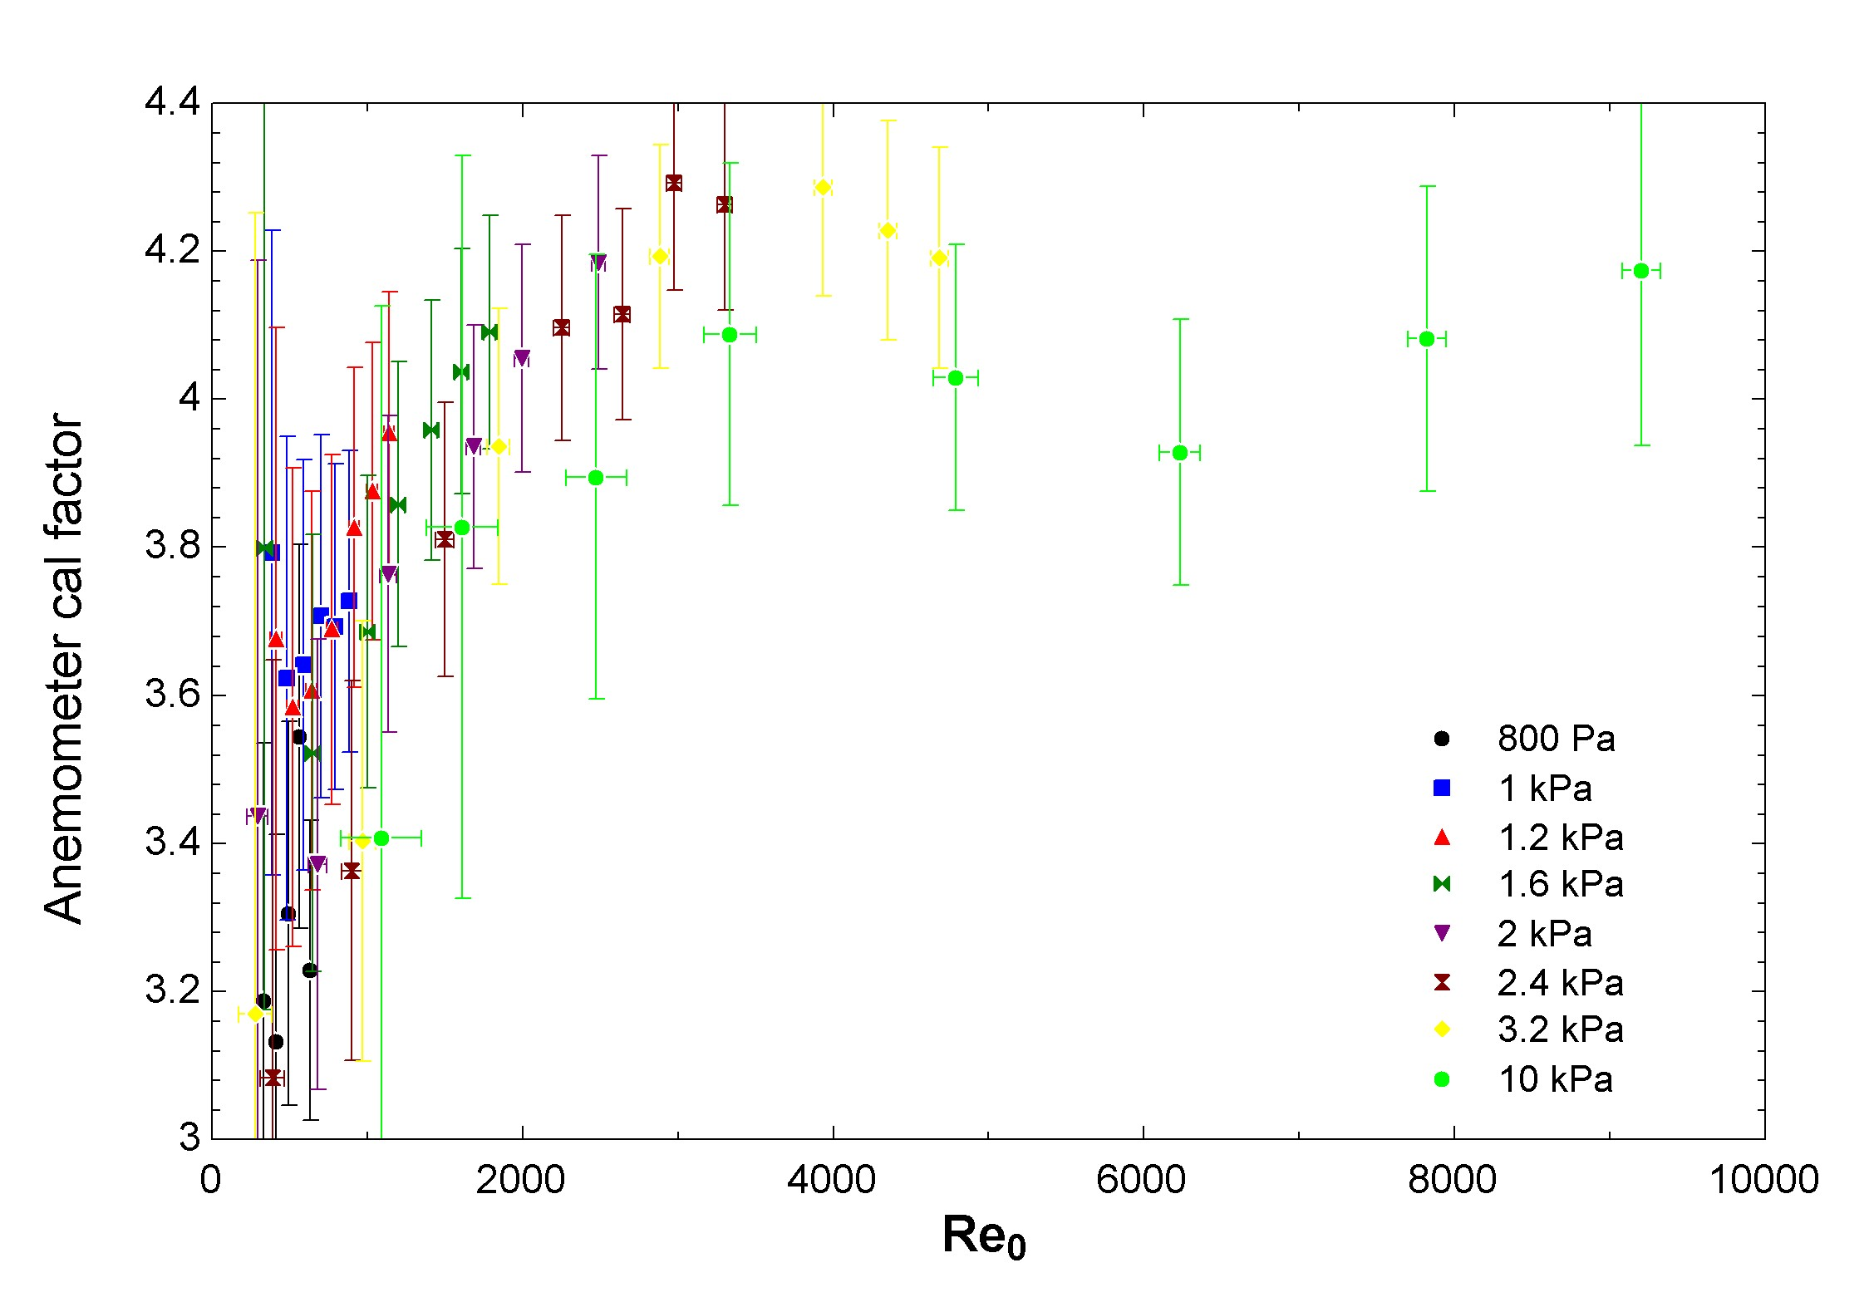
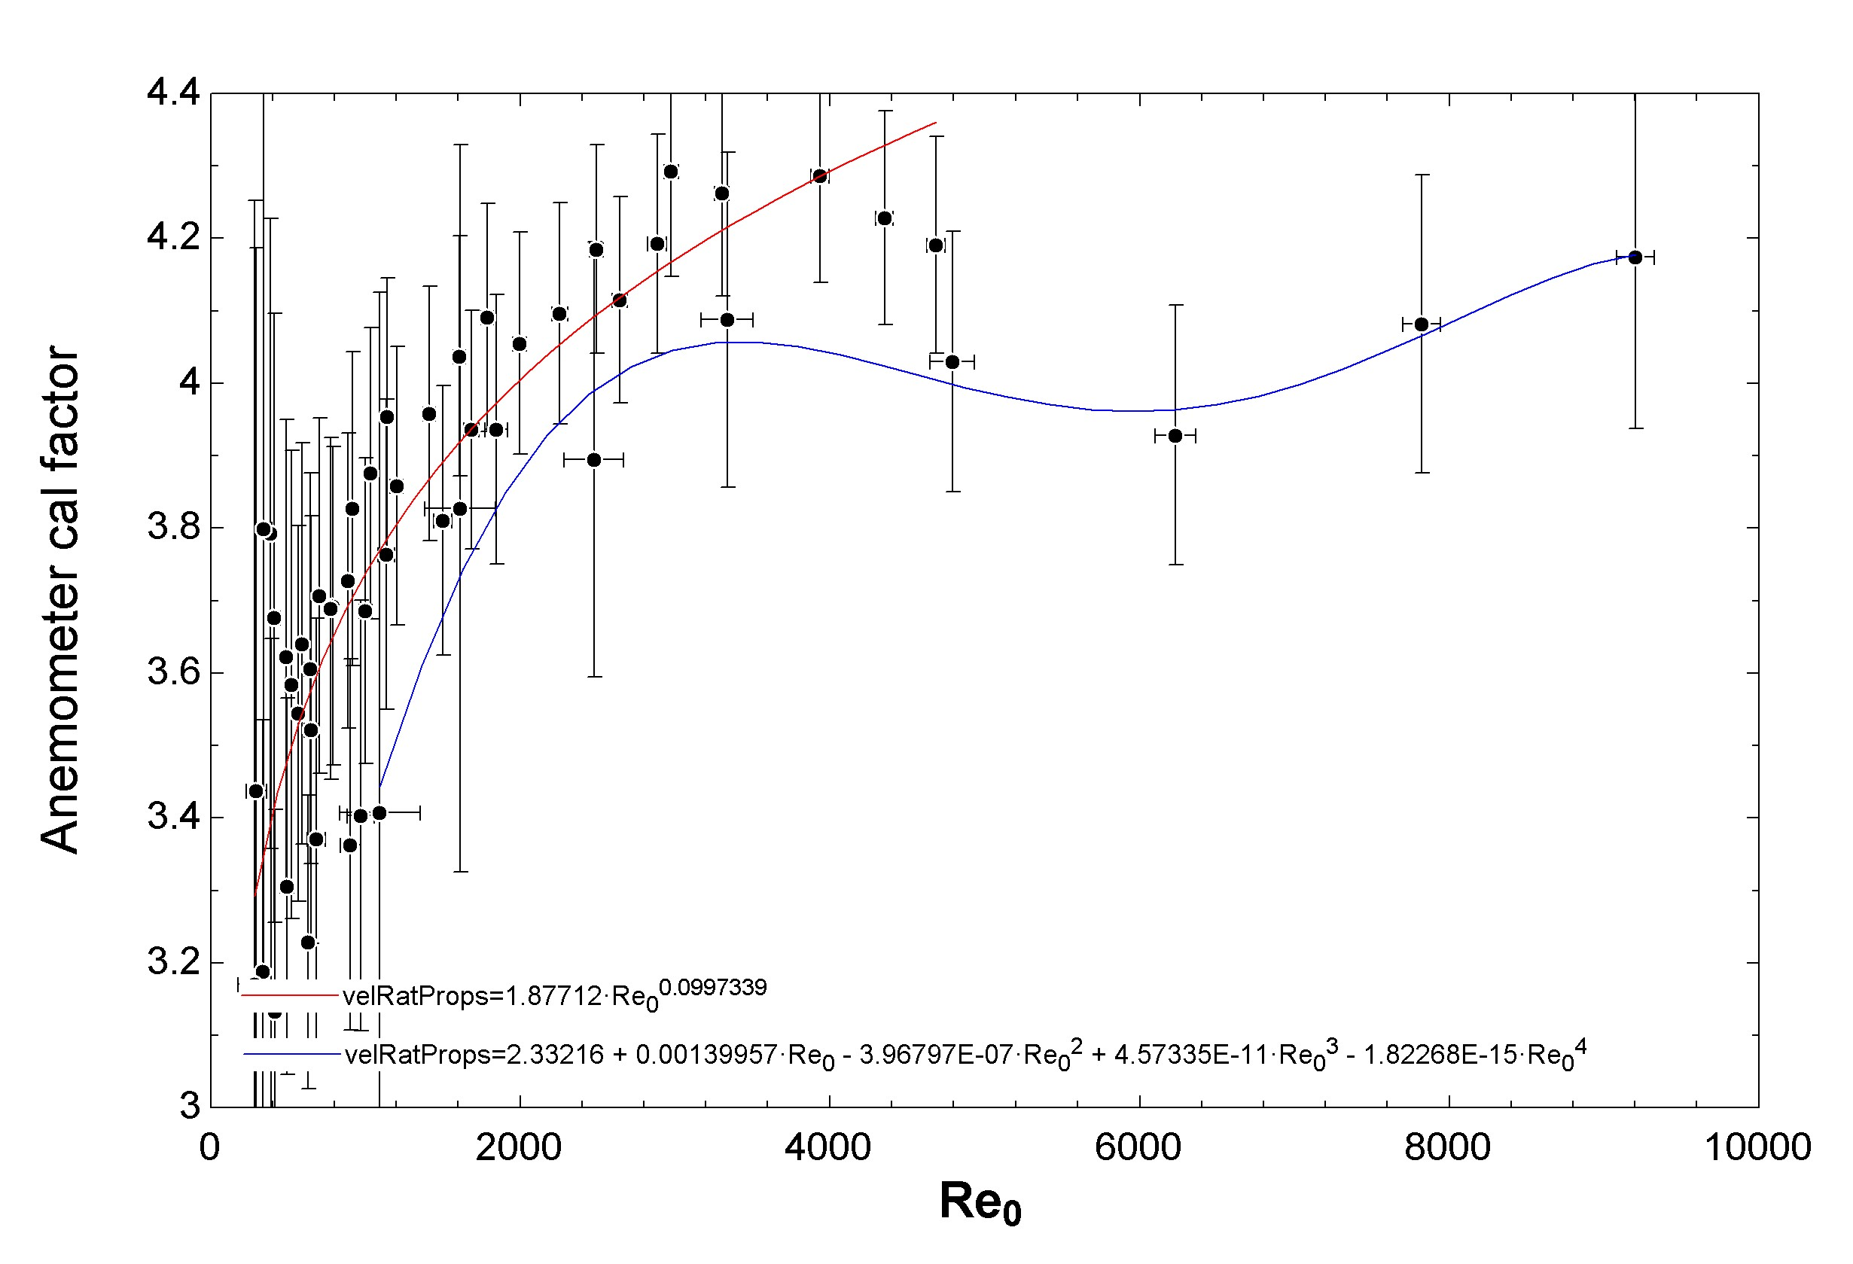
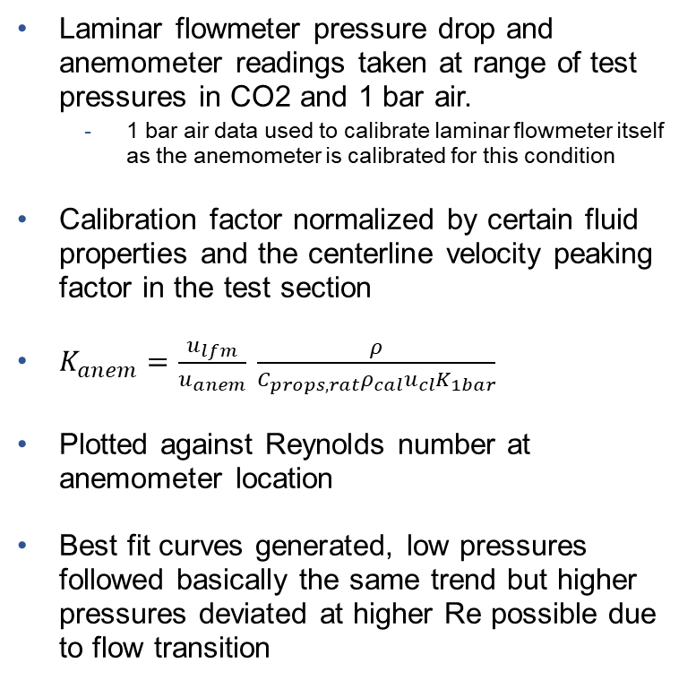
Calibration Results
Laminar flowmeter pressure drop and anemometer readings taken at range of test pressures in CO2 and 1 bar air.
  1 bar air data used to calibrate laminar flowmeter itself as the anemometer is calibrated for this condition
Calibration factor normalized by certain fluid properties and the centerline velocity peaking factor in the test section
$K_{anem}=\frac{u_{lfm}}{u_{anem}} \frac{ρ}{C_{props,rat}ρ_{cal}u_{cl}K_{1bar}}$
Plotted against Reynolds number at anemometer location
Best fit curves generated, low pressures followed basically the same trend but higher pressures deviated at higher Re possible due to flow transition

Slide 21
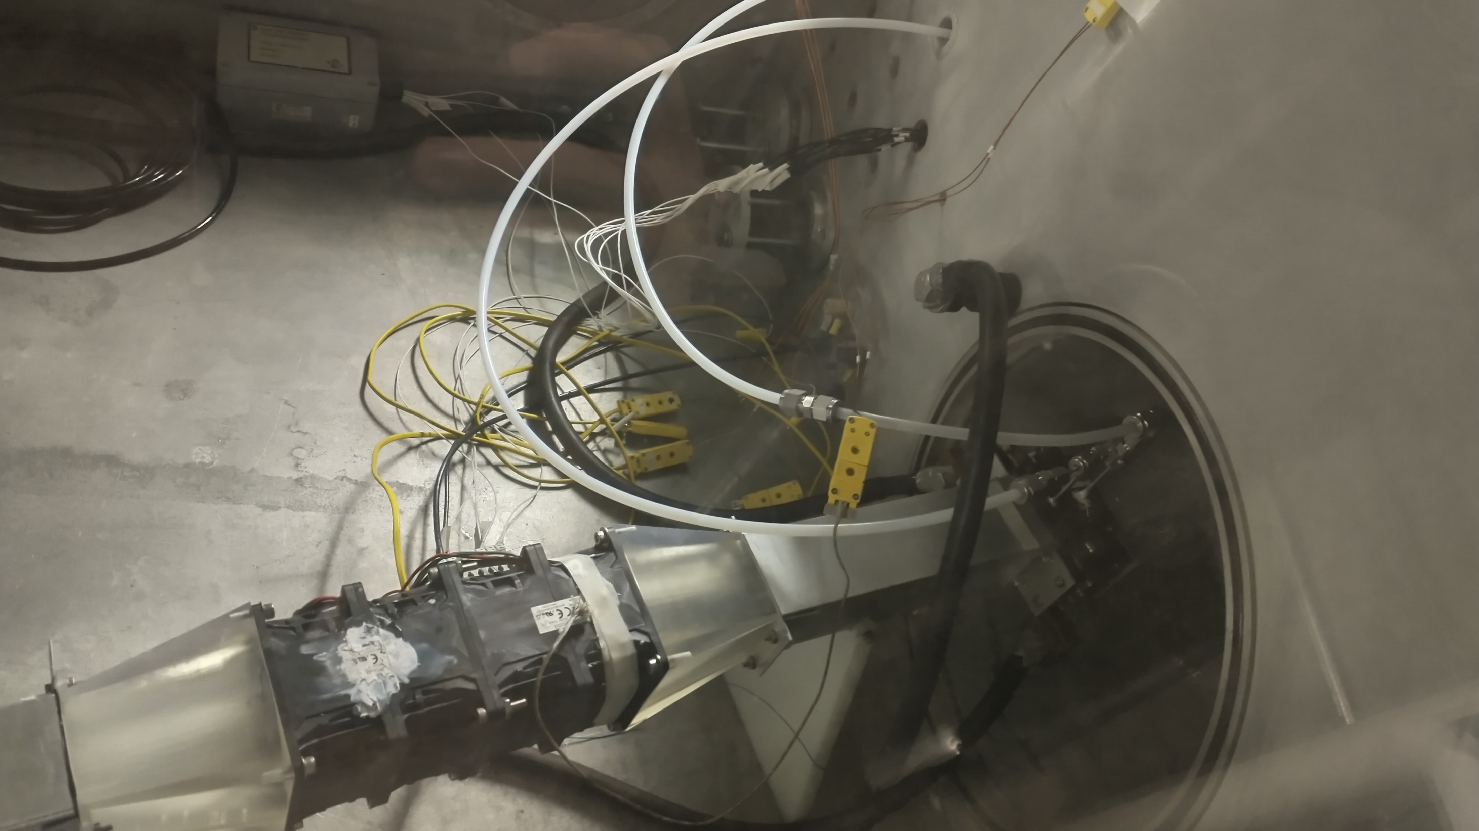
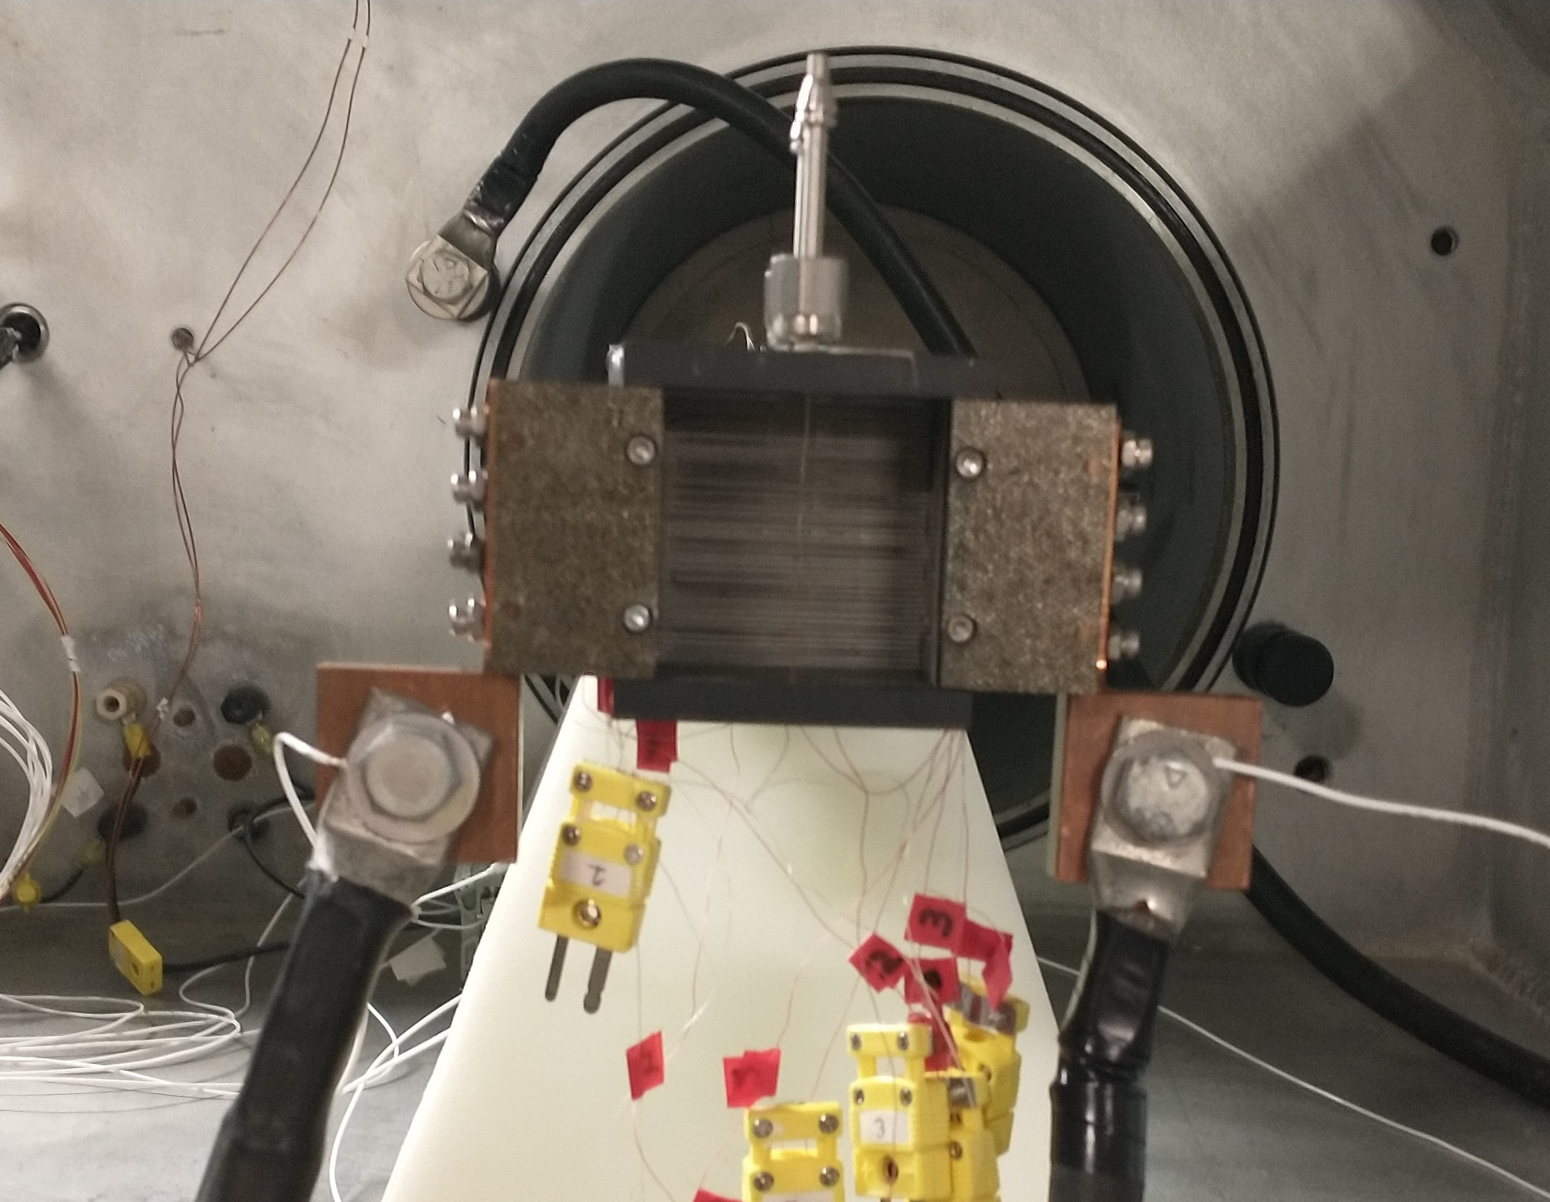
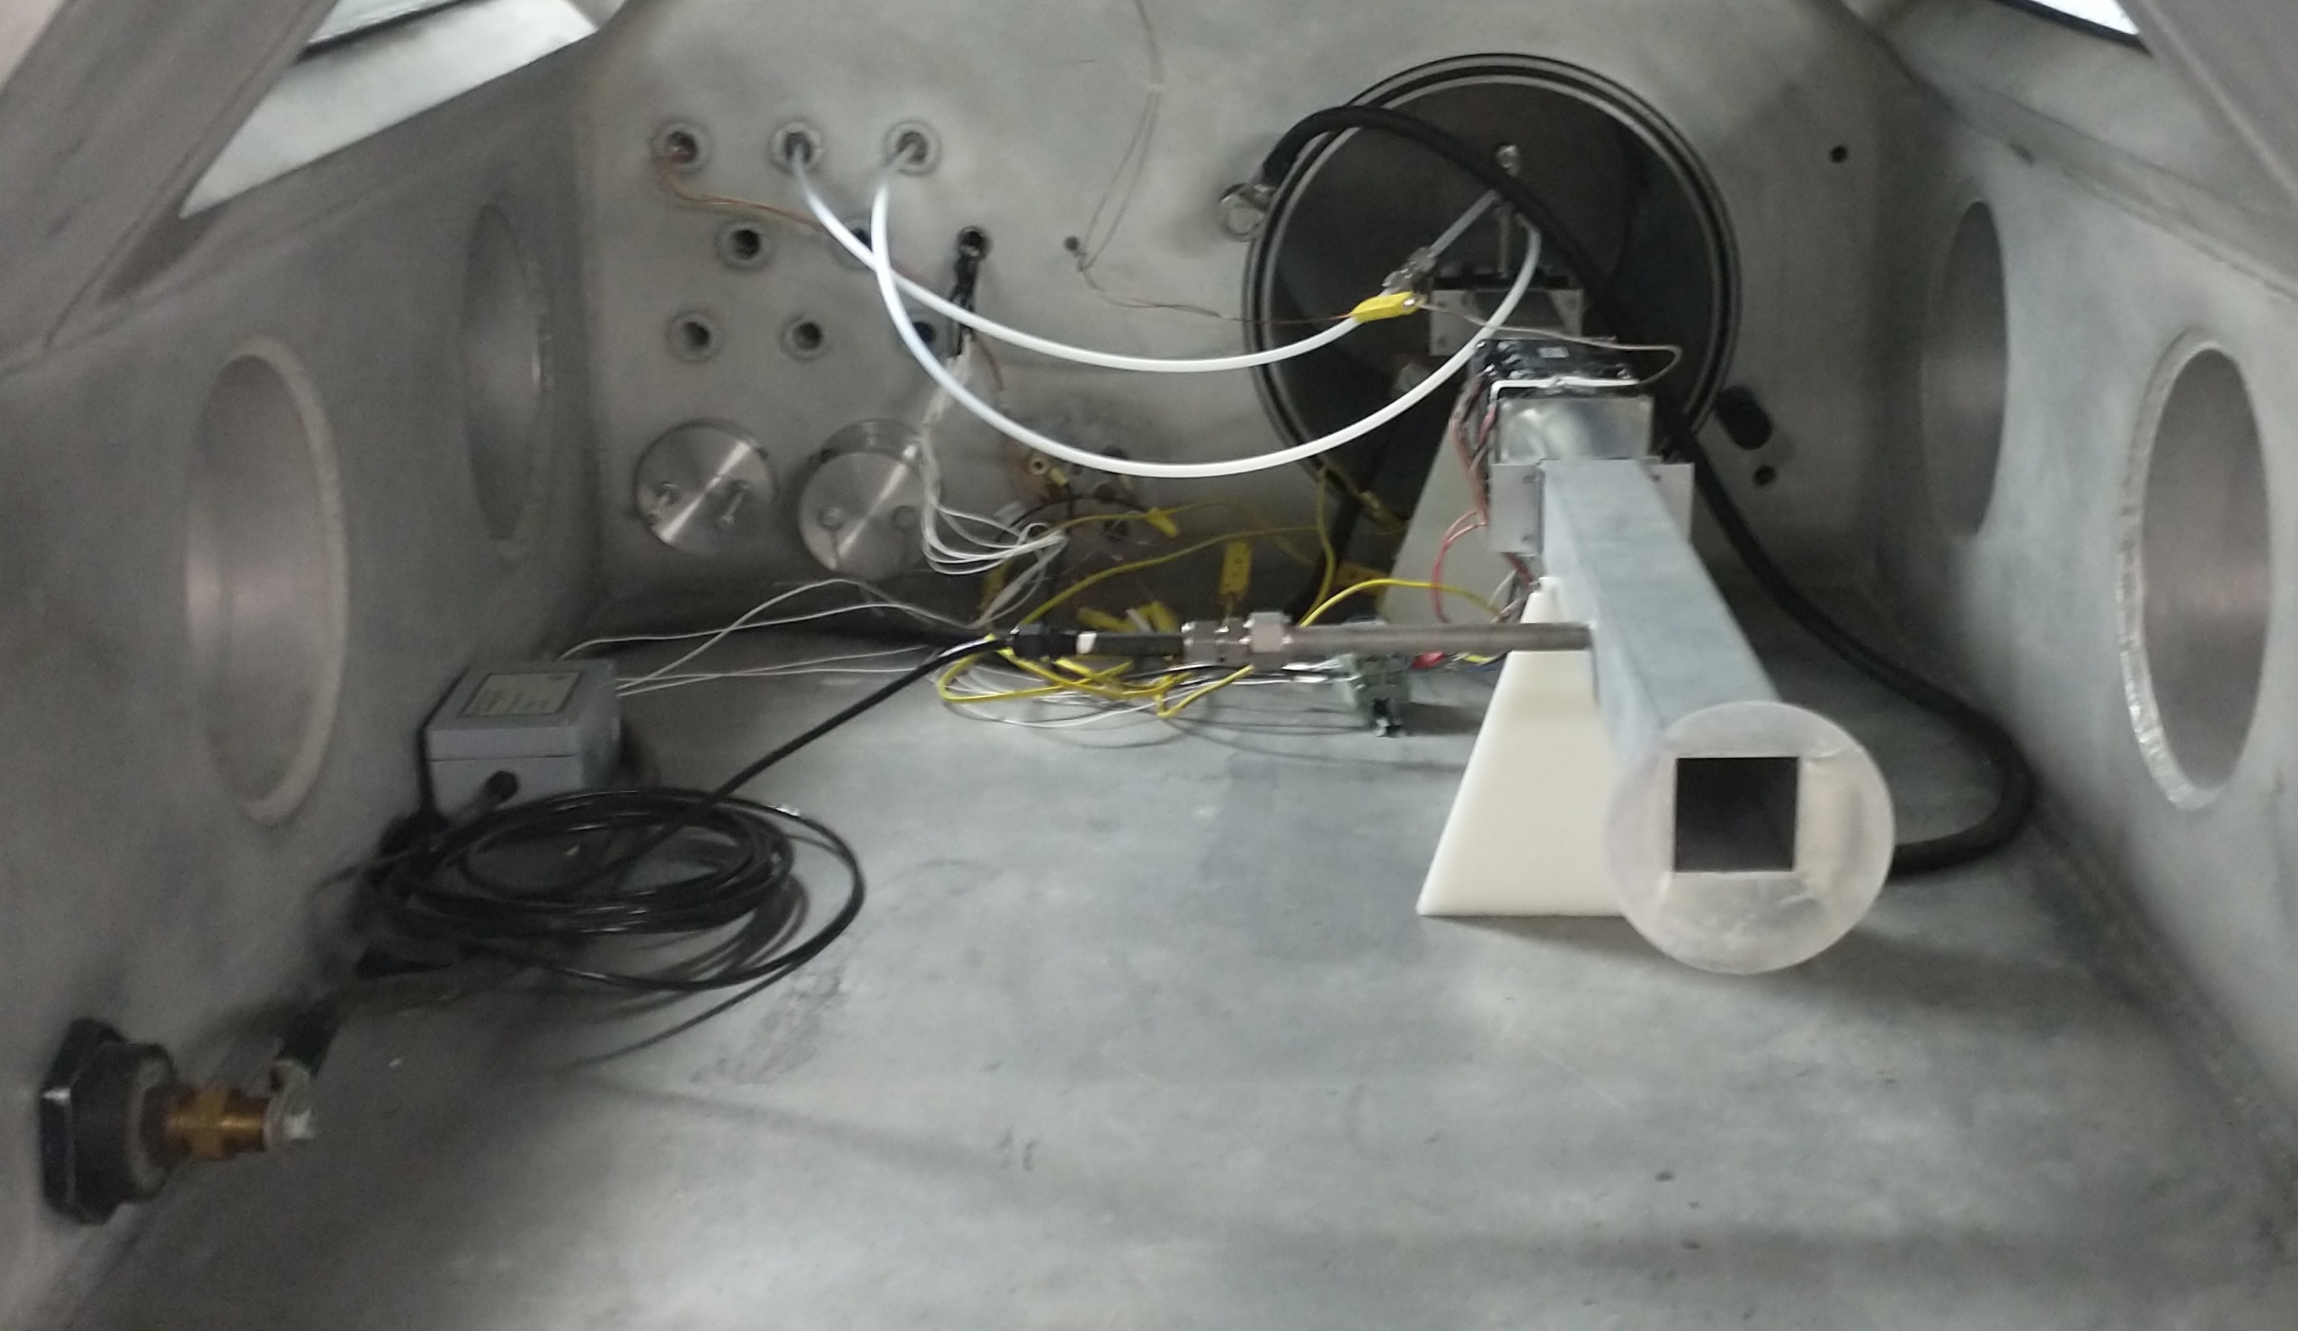
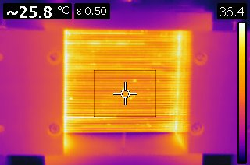
HX Data Collection Setup

Slide 22
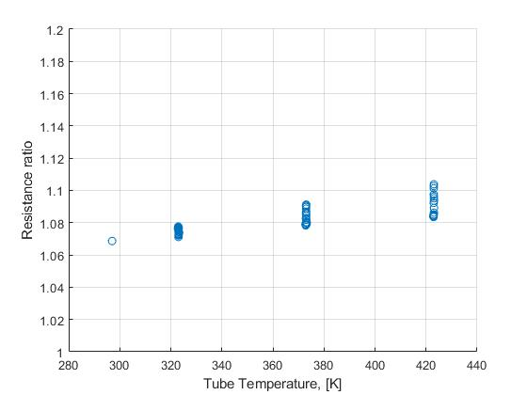
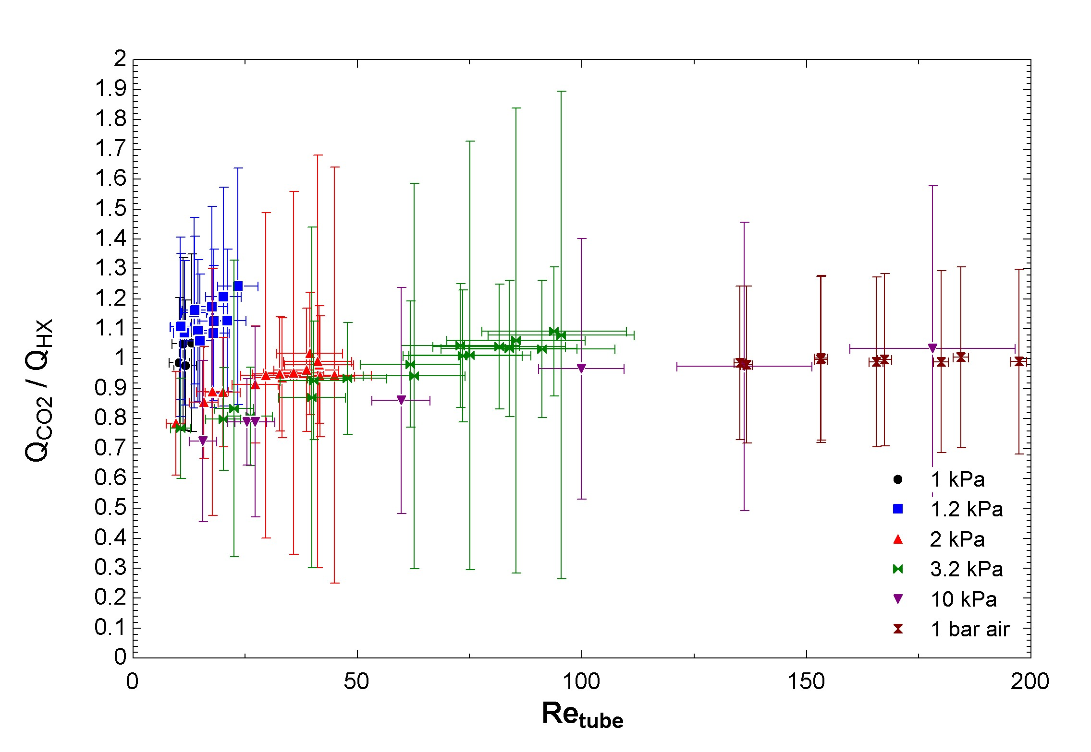
Experimental Results - Energy Balance
To check validity of anemometer calibration approach, calculated the energy balance in the HX for each run
Expect ratio of 1 because very low rates of heat transfer outside of HX at low pressures and low rates of heat generation in HX headers based on the agreement between predicted tube bundle and measured HX resistance
  Voltage leads welded to HX headers, measured HX resistance used to find current, then tube bundle resistance used to find power dissipated by tubes
  Effect of heating from headers ignored because CO2 temps read in middle of the channel ~1” upstream and downstream of tubes, and tube temps read at midline
Large error bars in low-DT data because haven’t calibrated thermocouples yet

Slide 23
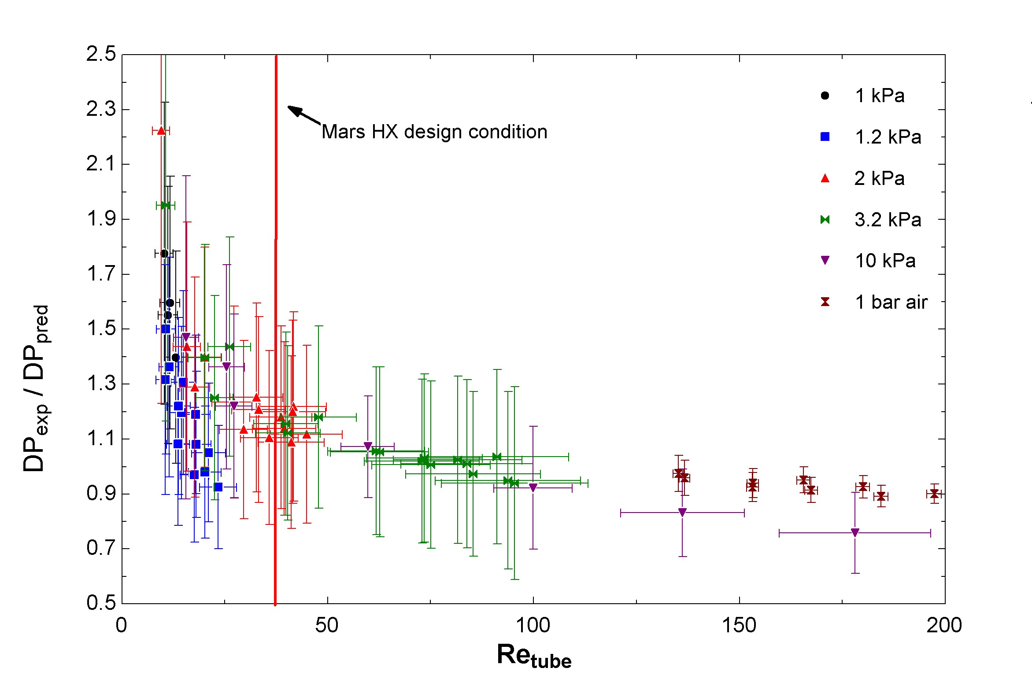
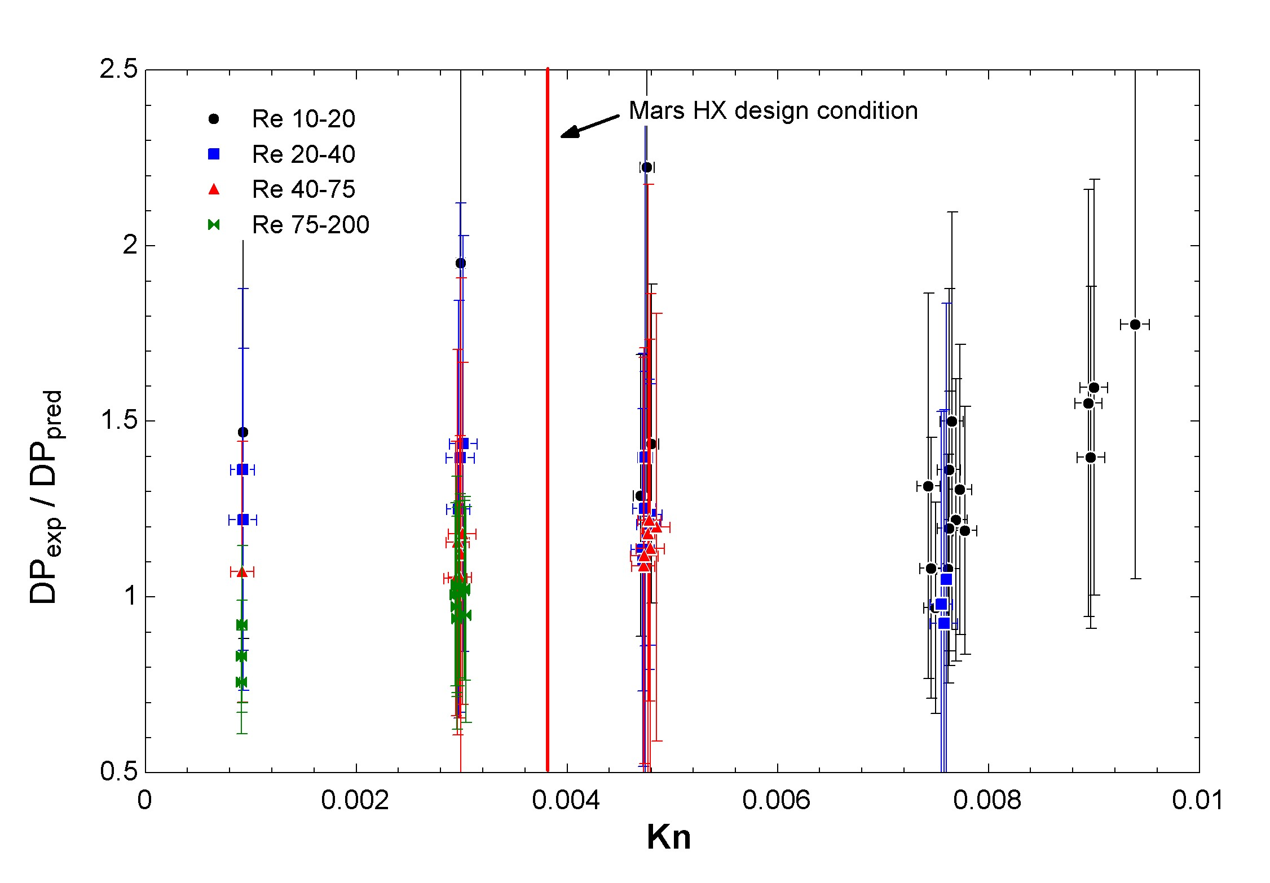
Experimental Results-Pressure Drop
At Re>25, measured DP closely matches correlation
At Re<25, measured DP exceeds expectation, but not expected to significantly change results of HX model at Mars conditions
No significant dependence on Kn for given Re in this regime
Correlation had no values for entry length effects below Re=100
  Might explain deviation, test HX only has 2 rows
  Literature also notes poor agreement between correlations at low Re generally

Slide 24
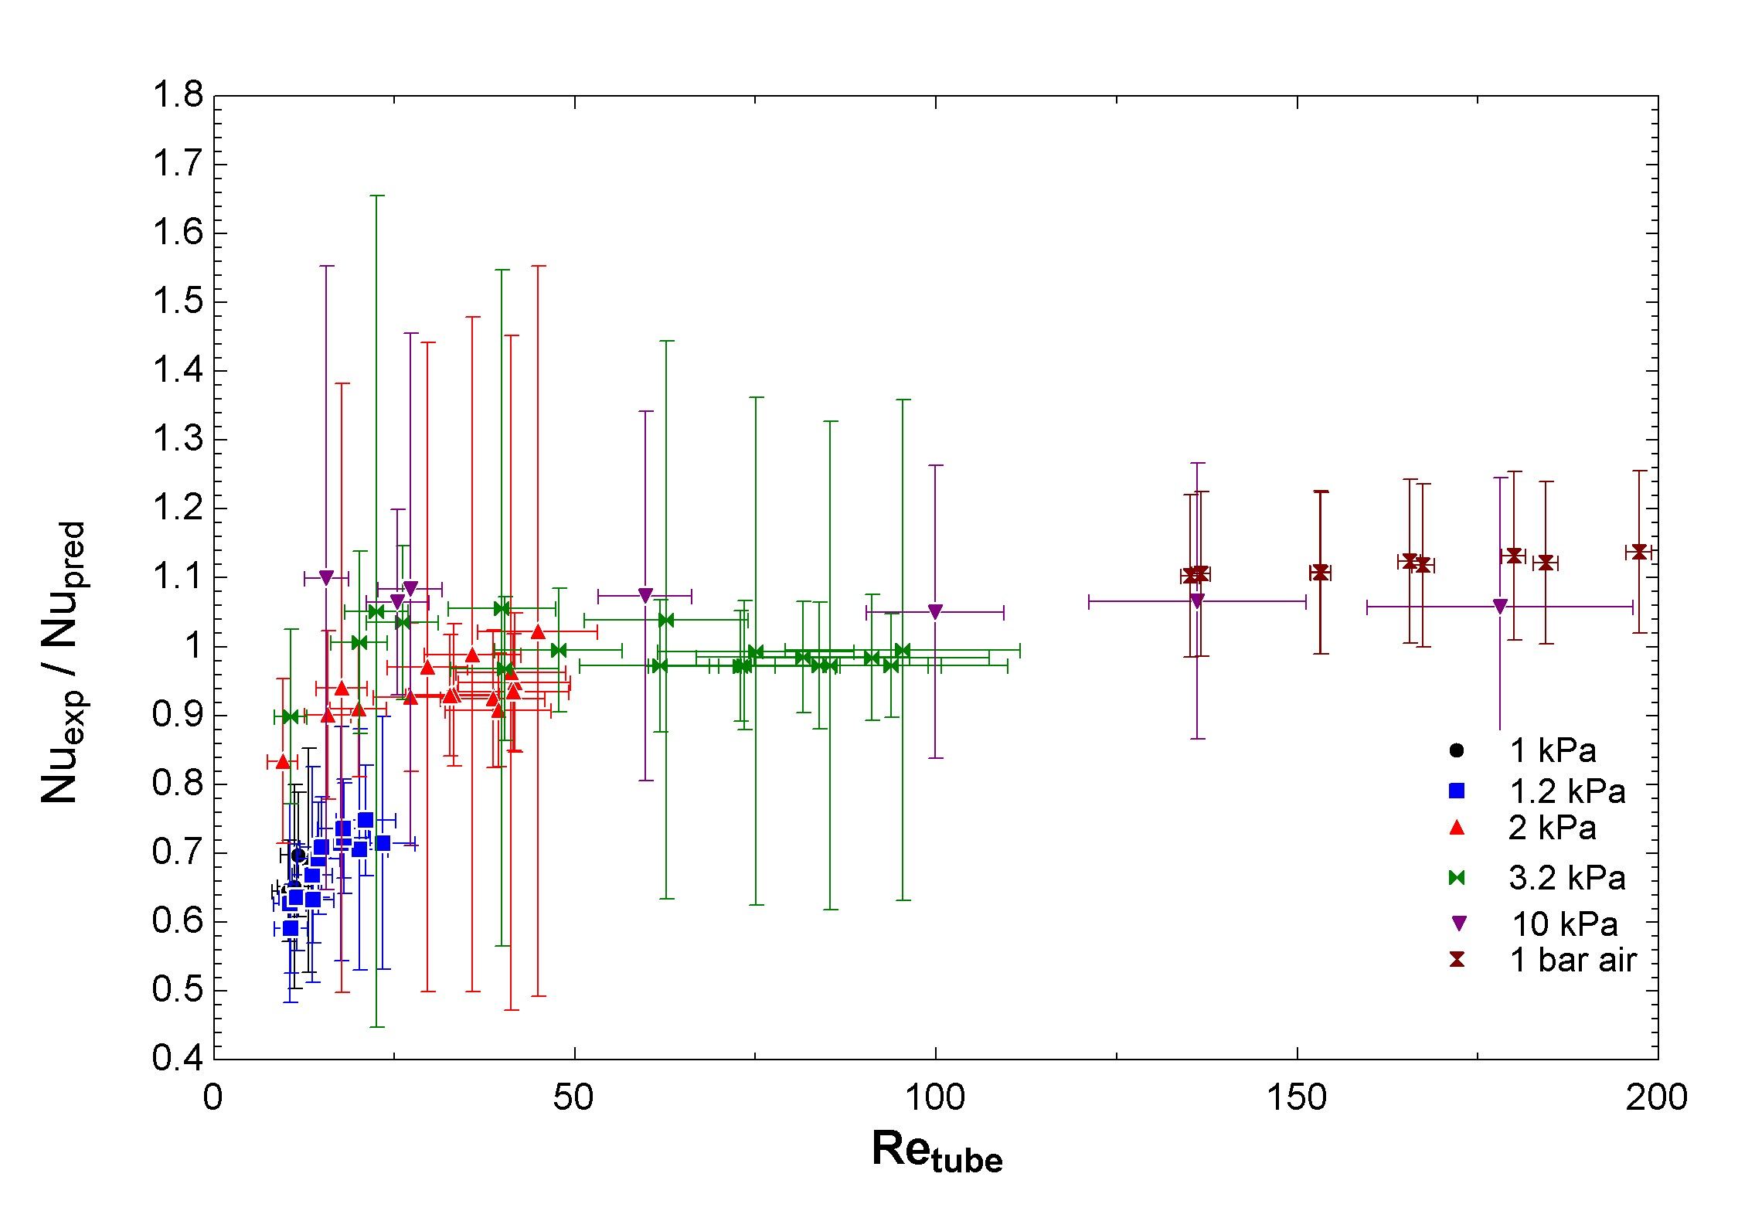
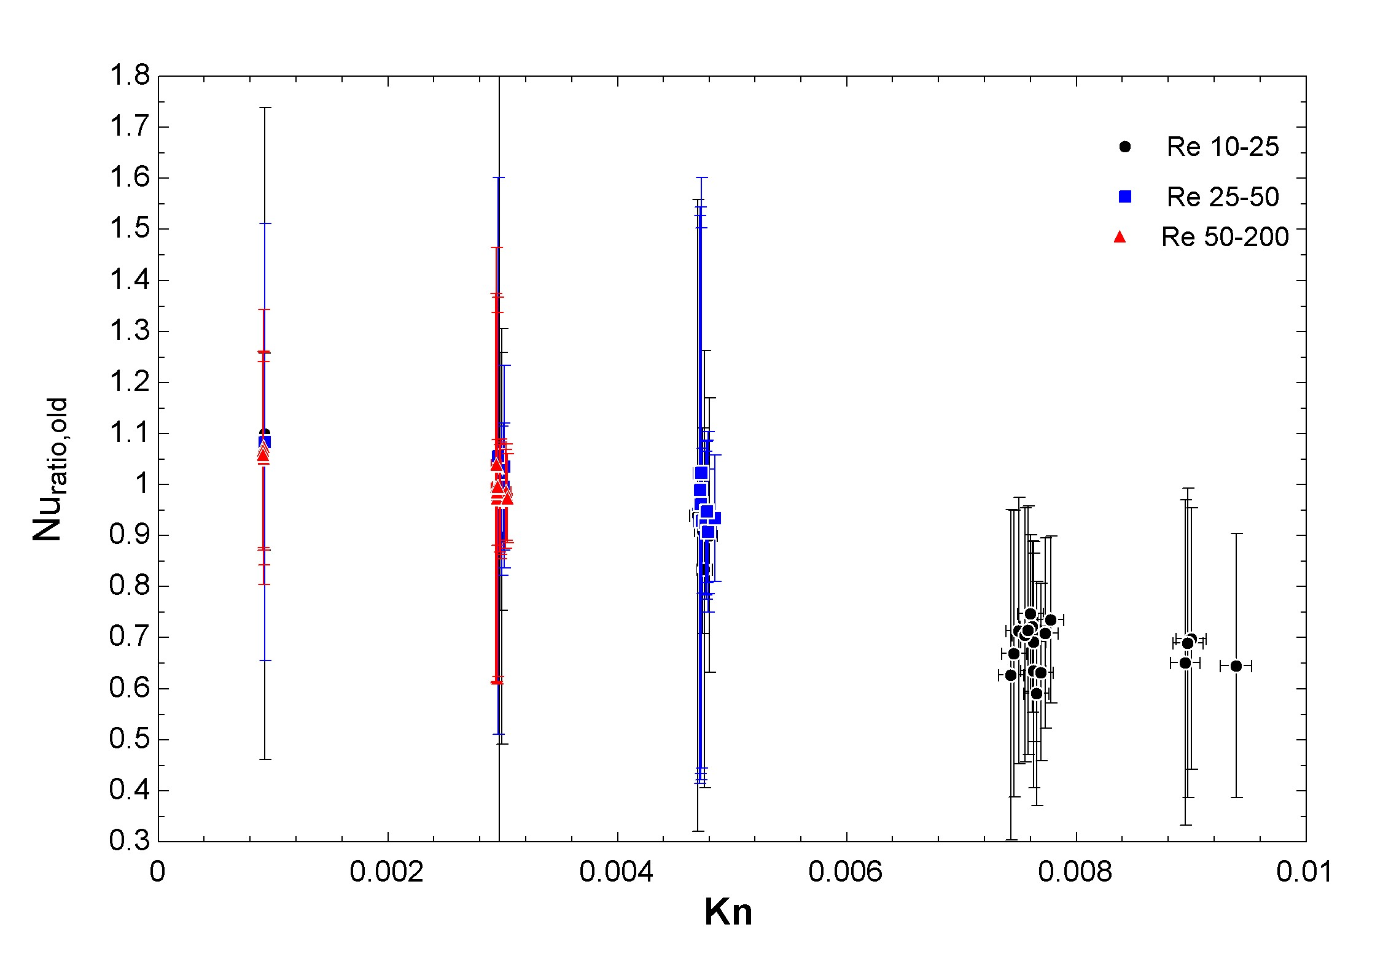
Experimental Results-Nusselt number
Nu generally matches correlation across range of Re and Kn relevant to Mars application
Large error bars in some cases because haven’t calibrated thermocouples yet
However, seems to deviate below correlation at high Kn
  Possibly due to emergence of slip at the walls or altered wake effects decreasing downstream tube heat transfer
    Most likely as leading tubes closely matched single-tube correlations at low Re as expected

Slide 25
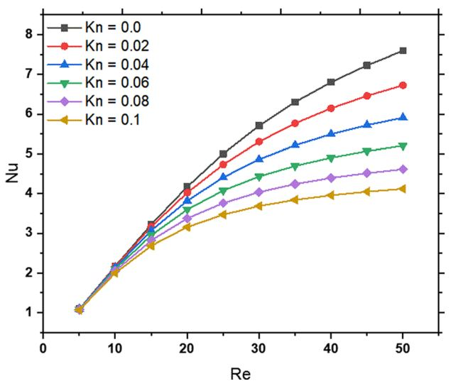
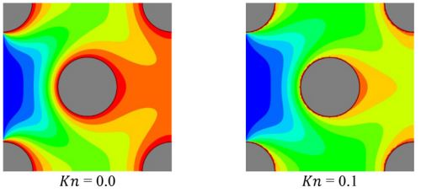
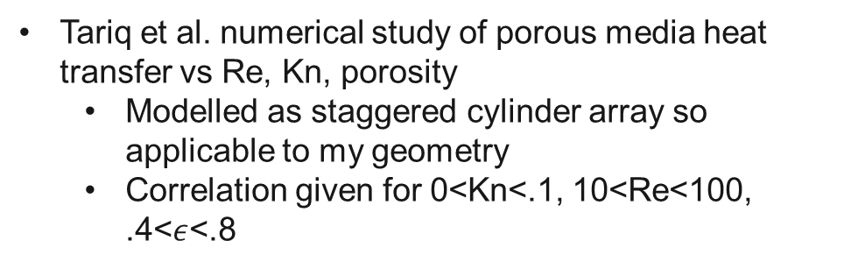
New correlation needed for Nusselt number
Tariq et al. numerical study of porous media heat transfer vs Re, Kn, porosity
  Modelled as staggered cylinder array so applicable to my geometry
  Correlation given for 0<Kn<.1, 10<Re<100, .4<$ε$<.8
Both figures from Tariq et al.

Slide 26
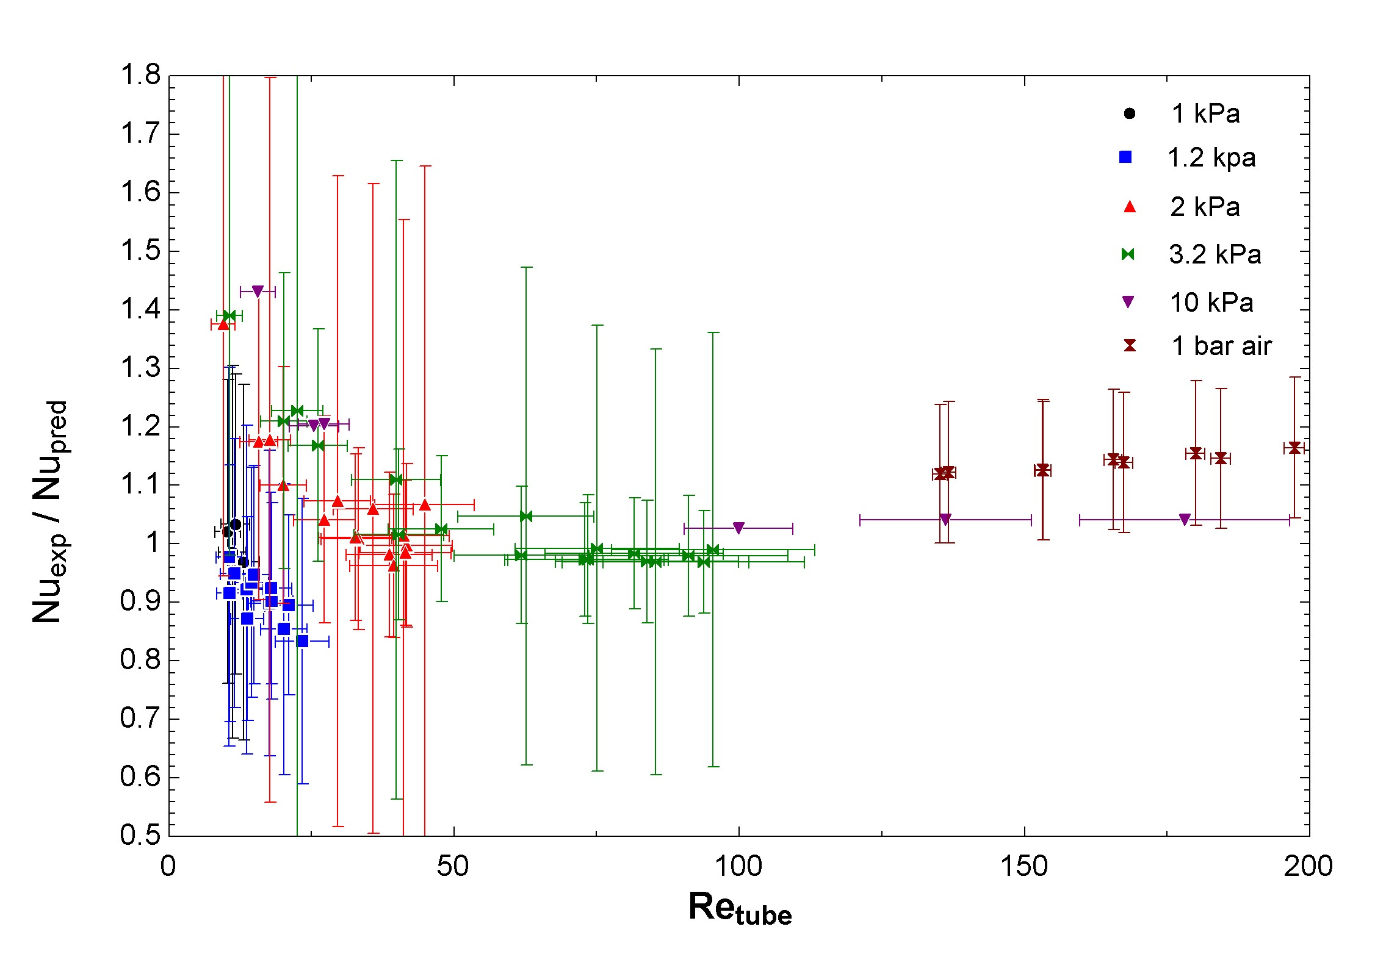
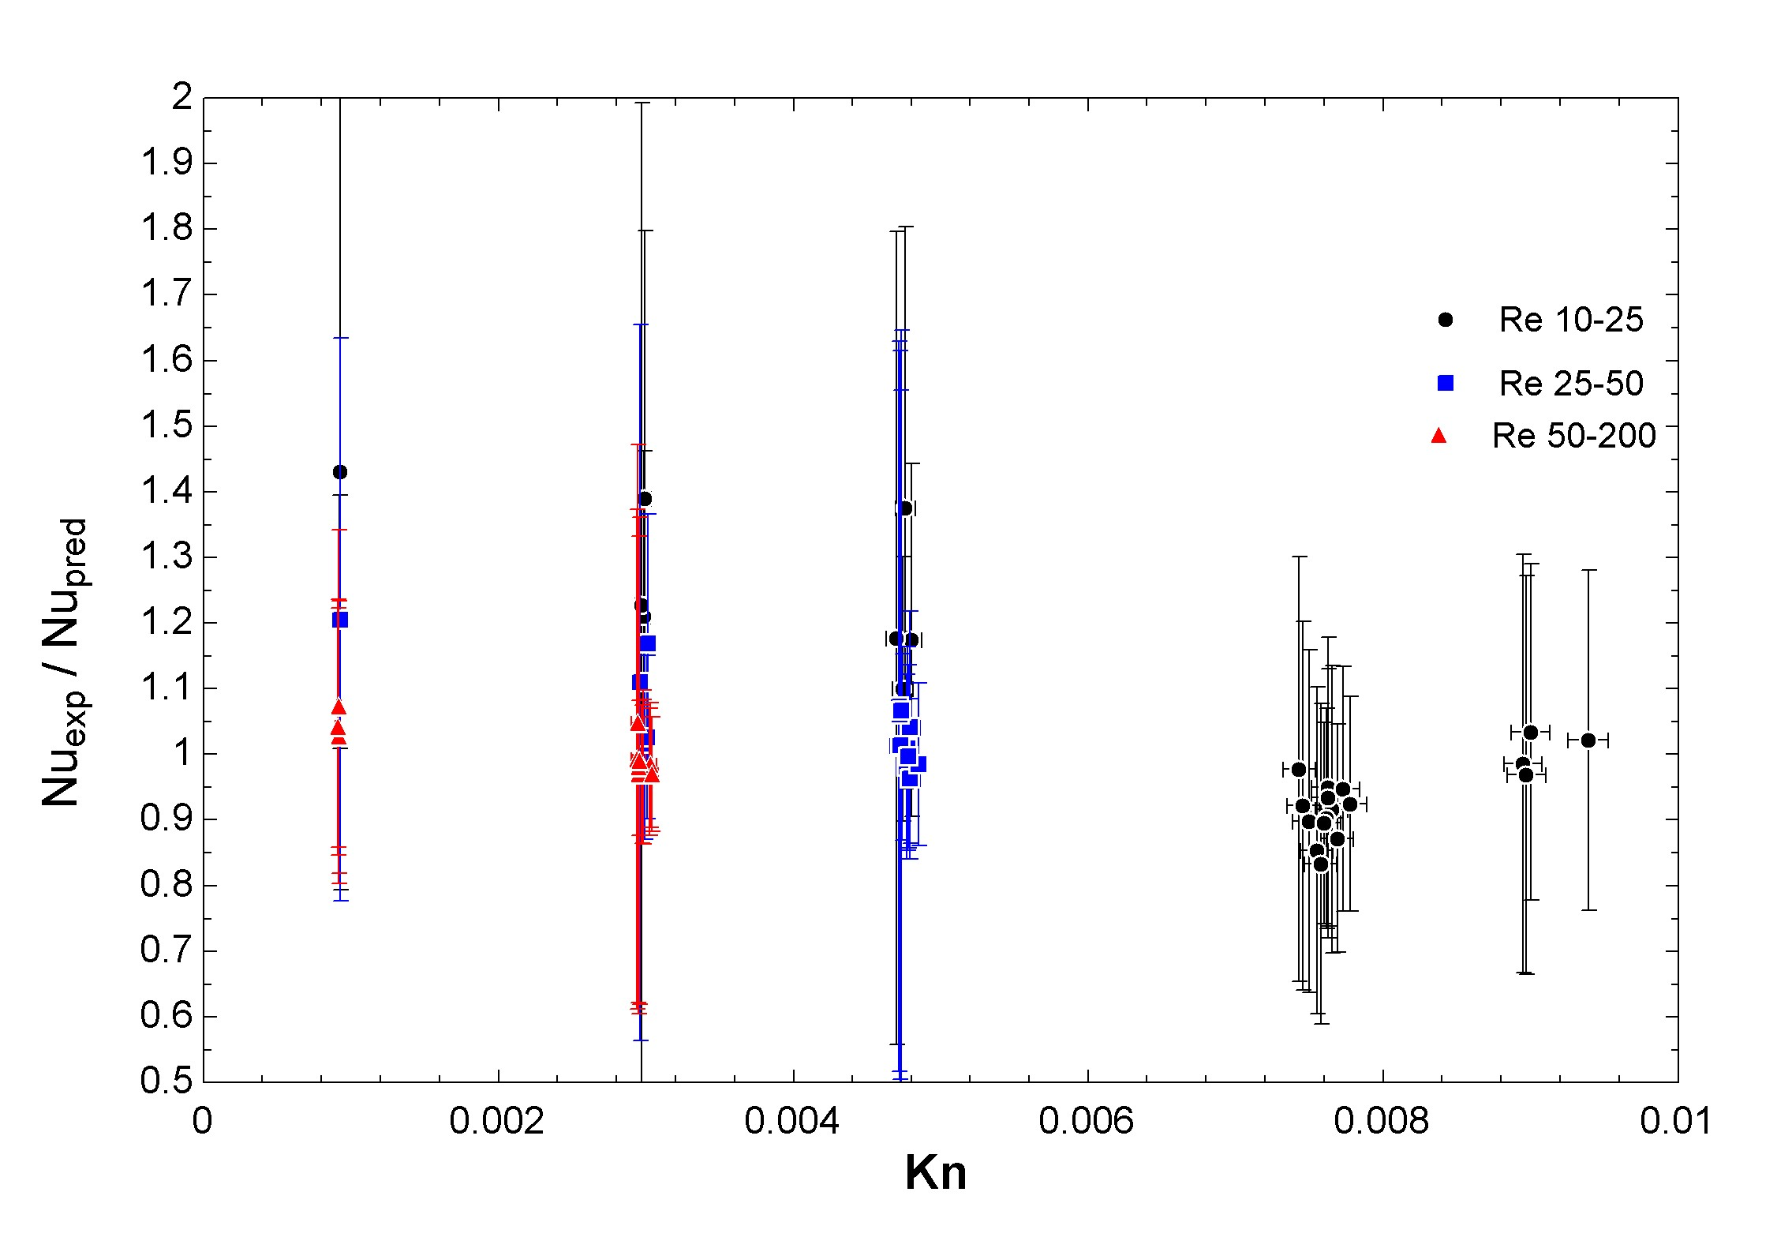
Experimental Results-Nusselt number
  Tariq correlations accounts for most of observed Kn dependence
  Will update correlation in model to reflect change
  Don’t expect significant degradation of predicted HX performance

Slide 27
Summary
Modelled HX performance in Mars surface conditions using existing pressure drop and heat transfer correlations
Modelling predicts significant mass savings compared to using a radiator
Constructed prototype HX to validate modelling predictions in Mars-like conditions
Collected HX performance data across range of pressures, temperatures, and flow velocities
Experimental data closely matches predicted performance at Mars-like conditions
Collected novel data on tube bank pressure drop and heat transfer near the slip-flow regime and at very low Reynolds numbers
Place logo
or company name here

Slide 28
Next Steps
Collect HX data without flow straightener to determine effect of vorticity on performance
Repeat data collection in N2, He to broaden dataset at higher Kn
Construct and test single-tube test article to measure Nusselt number and compare to existing correlations
Develop correlations from data and update model to refine predictions of minimal Mars HX and thermal cycle mass
Place logo
or company name here

Slide 29
Questions?
Place logo
or company name here

