Slide 1
Convective Heat Exchanger for Mars Surface Waste Heat Rejection
Nathan Colgan, Gregory Nellis, Mark Anderson
University of Wisconsin-Madison
Thermal Hydraulics Lab

Slide 2
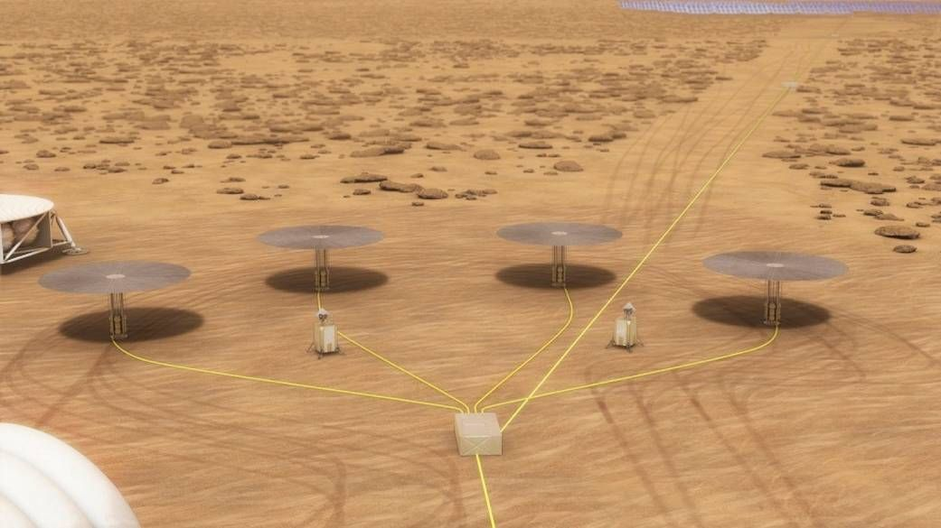
Motivation
Initial crewed Mars mission will require >40 kWe for 10 years
Nuclear fission power is an ideal power source
  Compact, high power density
  Does not rely on local insolation
  Consistent power output, does not require massive energy storage during nights, duststorms
Current proposed FPSs typically rely on radiator for waste heat rejection
  At high power levels, radiator becomes most massive component
  Drives optimal heat rejection temperature up, reducing power cycle thermal efficiency
KiloPower 10 kWe units. Image credit: NASA

Slide 3
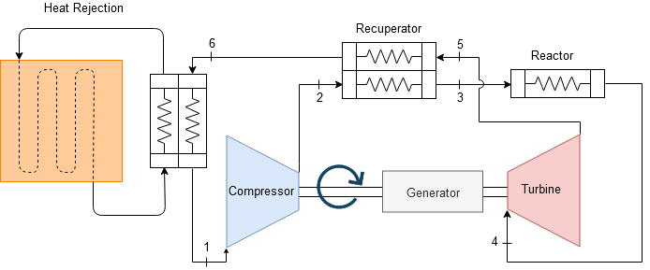
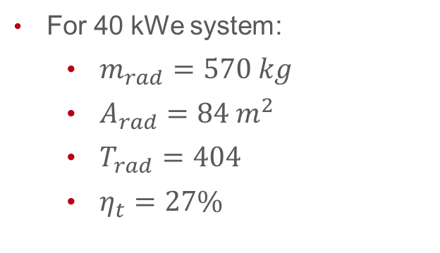
Previous Work at UW THL
Sondelski et al. developed a mass-optimization model of a 40 kWe sCO₂-cooled HTGR coupled with a recuperated Brayton cycle power generator and radiator
Highly-efficient thermal cycle when operating near critical temperature
Reactor mass less dependent on power than radiator mass
For 40 kWe system:
  $m_{rad}=570 kg$
  $A_{rad}=84{ m}^{2}$
  $T_{rad}=404$
  $η_{t}=27\%$
Top: T-S diagram of mass-optimal cycle
Bottom: Diagram of recuperated Brayton cycle.
Image credit: Sondelski et al.

Slide 4
Forced-convection Heat Exchanger
Convective heat exchanger has much higher conductance, weaker temperature dependence than radiative heat transfer, allowing for smaller size and lower optimal temperature, increasing efficiency
Does not require sky exposure, allowing for compact construction, potentially eliminating complex deployment procedures
Lower coolant pressure drop
Easily scalable, can be used for lower-power applications such as:
  Cryofuel storage refrigeration
  ISRU plant heat rejection
  Rover, habitat thermal regulation
Mars is a challenging environment for convective heat transfer
  Average ambient pressure: 600 Pa
  Average temperature: 220 K
  Large diurnal temperature variation and seasonal pressure variation
Very little data on heat transfer and pressure drop for typical HX designs, or fan performance, in this regime
Low pressure results in low heat transfer coefficients requiring high airflow rate, but also lowers achievable fan pressure rise, limiting maximum airflow rate.
Modelling effort will determine if a HX is capable of operating in these conditions

Slide 5
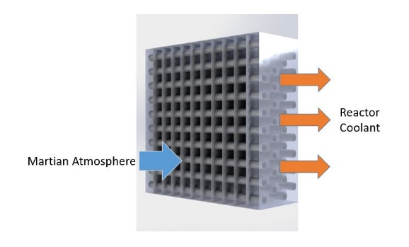
Modelling Approach
Plane-finned tube crossflow HX configuration studied
Mass-optimal geometry for given heat rejection conditions determined
Inputs:
  Heat rejection rate
  Inlet temperature
  Outlet temperature
  Environmental, material parameters
Varied geometrical parameters:
  Tube length
  Tube diameter
  Number of tube columns
  Number of tubes per column
  Fin pitch
Illustration of a cross-flow finned-tube heat exchanger.
Constraints and set parameters:
  Max length and height: 4 m
  Max number of tube columns: 10
  Min tube diameter: 0.5 mm
  Tube/header wall thickness safety factor: 25%
  Fin thickness: 0.1 mm
  Fan power mass penalty: 6.57 kg/kW
  Coolant pressure loss mass penalty: 0.1 kg/kPa

Slide 6
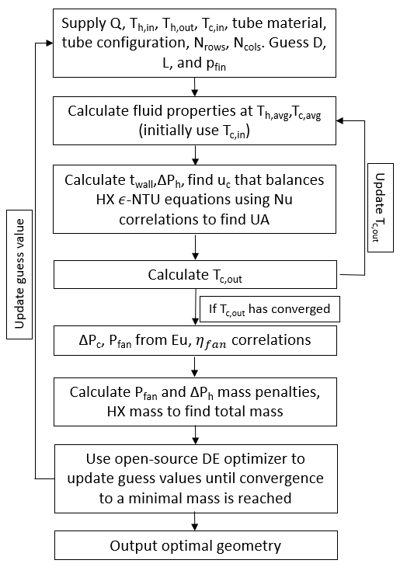
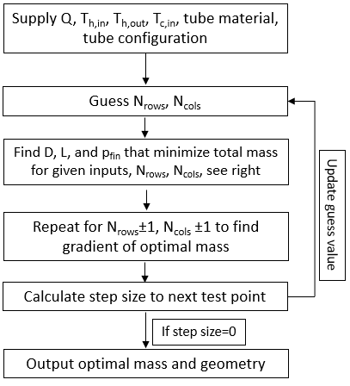
Modelling Approach
For a given number of tube rows and columns, find set of geometrical parameters that minimize effective HX mass
Effectiveness-NTU method used to implicitly find air velocity necessary to produce required cooling rate for a given geometry using Nusselt number correlations
Air-side pressure drop and required fan power calculated from correlations. Mass penalties are then calculated to obtain effective HX mass
As problem is nonlinear and non-differentiable, an open-source adaptive DE optimizer is used to determine optimal geometry.
The number of tube rows and columns is then optimized using a simple gradient descent method to determine optimal effective mass for given heat rejection parameters
Discrete optimization loop
Continuous optimization loop

Slide 7
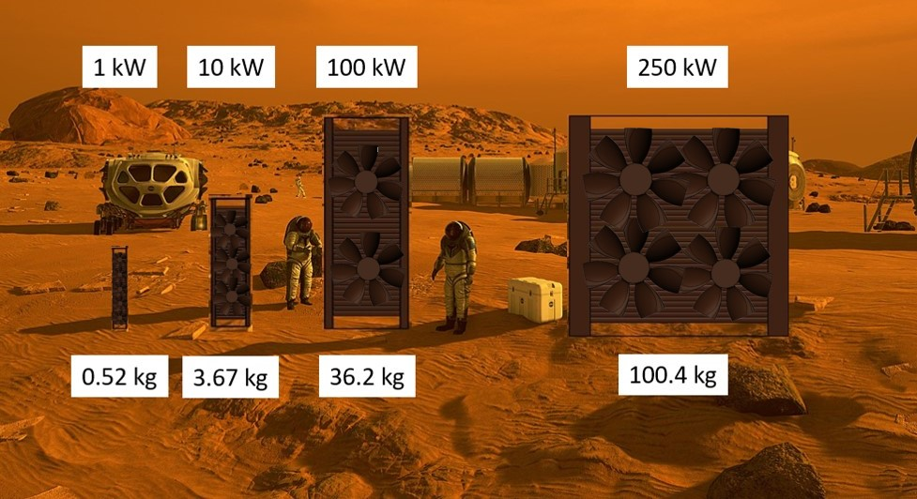
HX Model Results
Optimal geometries at Mars conditions have no fins, very small tube diameters compared to optimal HX at 1 bar (note 1 bar HX limited to 1 m length and height)
Very few tube columns to limit air-side pressure loss
Top: Optimal geometries and masses of steel, staggered-tube HXs of various rejected heat loads. Tube P/D=2, T_{amb}=220K, P_{h}=9MPa
Left: Illustration of HX size for various rejected heat loads. Background image credit: NASA

Slide 8
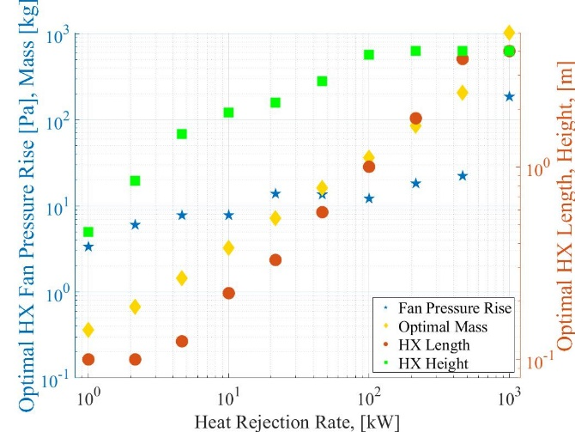
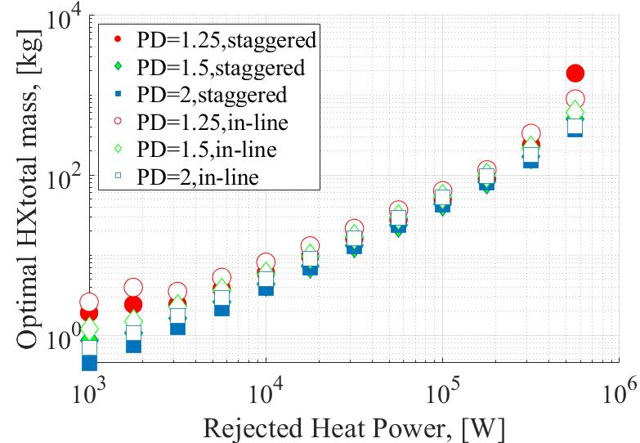
HX Model Results
As power increases, optimal HX geometry grows fastest in height, followed by length.
Once height and length reach the upper limit at approximately 300 kW, pressure drop rises considerably as the number of tube columns and air velocity must increase to accommodate additional power load.
Pressure drop quickly exceeds an attainable fan pressure rise in this regime, approx. 25 Pa based on commercial fans and appropriate scaling factors.
Higher power loads would require additional HXs
Optimal tube configuration found to be a staggered arrangement with a pitch to diameter ratio of 2
Top: Variation of optimal HX length, height, mass, and pressure drop with rejected heat load
Left: Comparison of various tube configurations

Slide 9
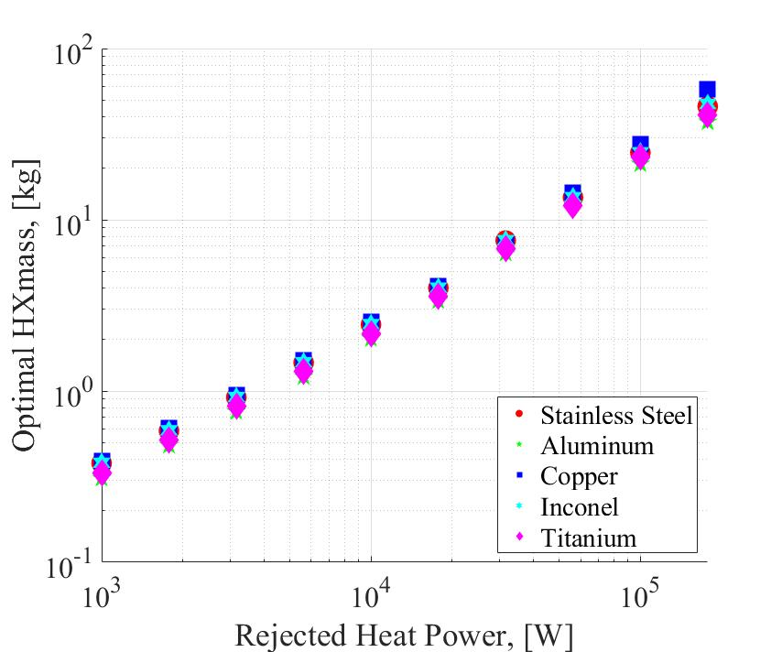
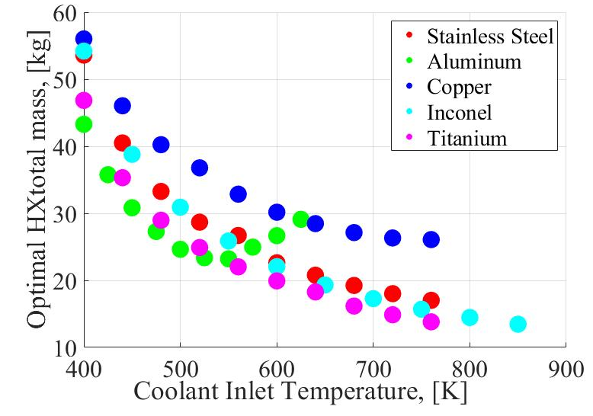
HX Model Results
Staggered tubes with a Pitch to diameter ratio of 2 resulted in lowest mass. This configuration is assumed throughout the remaining figures
Mass increases approximately linearly with rejected heat load up to 250 kW.
Aluminum tubes result in lowest mass below 550K, above which Titanium in the lightest
Top: Optimal HX mass vs rejected heat load
Left: Optimal HX mass vs coolant inlet temperature

Slide 10
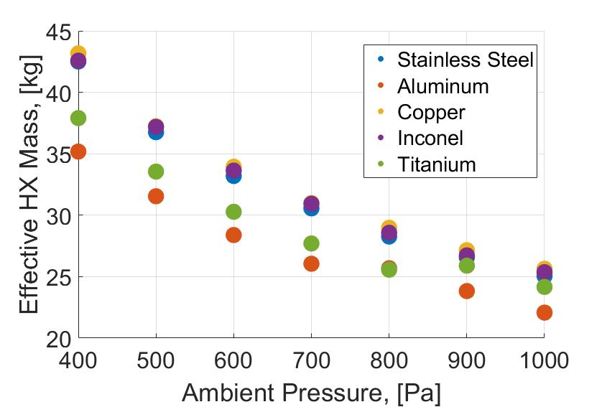
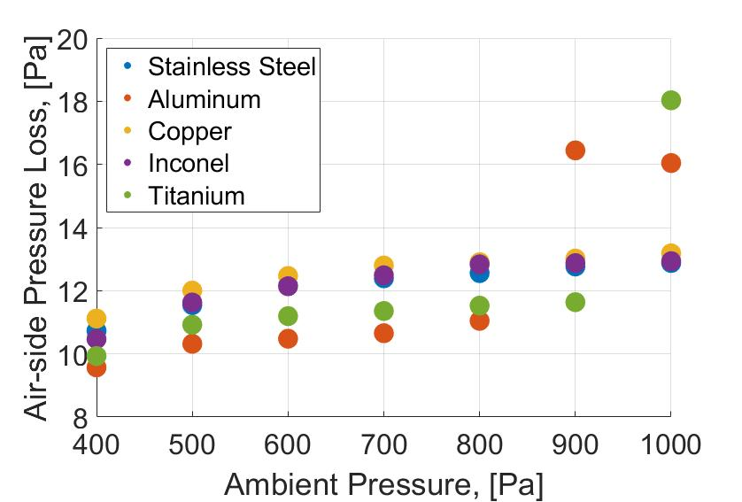
Effect of Ambient Pressure on Optimal HX Effective Mass
Optimal HX effective mass increases with decreasing ambient pressure due to increasing required volumetric flow rate at lower density
Air-side pressure loss stays within feasible limit so HX operation appears feasible below at least 5 km elevation
Higher elevations were not examined due to landing site elevation constraints

Slide 11
Overall Cycle Optimization
HX model was integrated with Sondelski’s fission power system optimization model by replacing the existing radiator model to determine how the use of a forced-convection HX alters the mass-optimal cycle for a given desired electrical power output, HX material, and ambient conditions.
80% overall mass reduction
thermal efficiency increases from 27 to 36%
42 K decrease in heat rejection temperature
94% decrease in frontal area
Typical air velocity: 8-13 m/s
Left: Performance comparison between a radiator and steel HX for a 40 kWe system, P_{amb}=600 Pa, T_{amb}=200 K
Right: Geometry and performance of optimal-cycle 40 kWe HX.

Slide 12
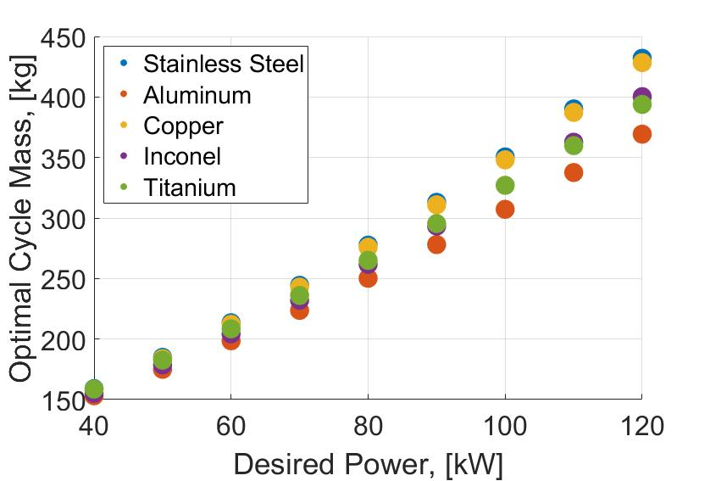
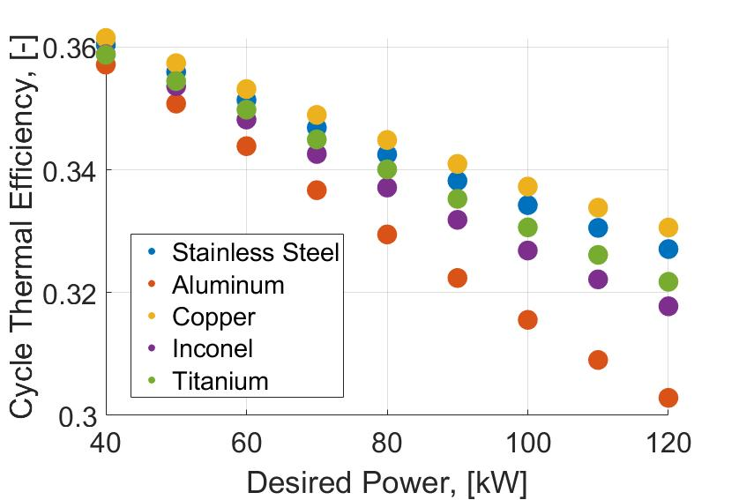
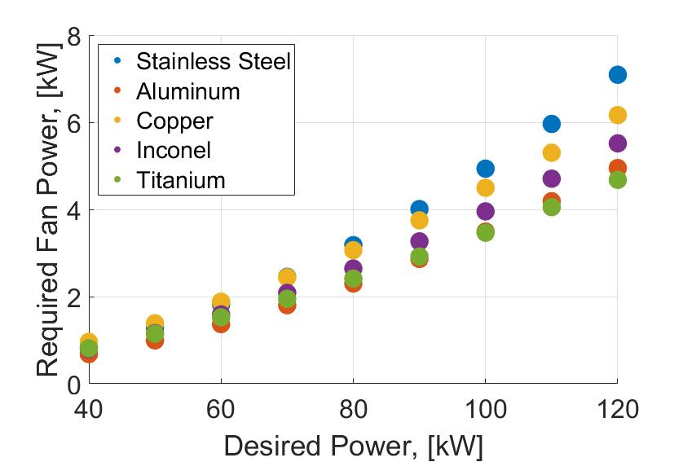
Overall Cycle Dependence on Desired Power Output
Optimal cycle mass and fan power increase linearly with desired power up to 120 kWe
Thermal efficiency decreases with increasing power
Aluminum results in lowest overall cycle mass

Slide 13
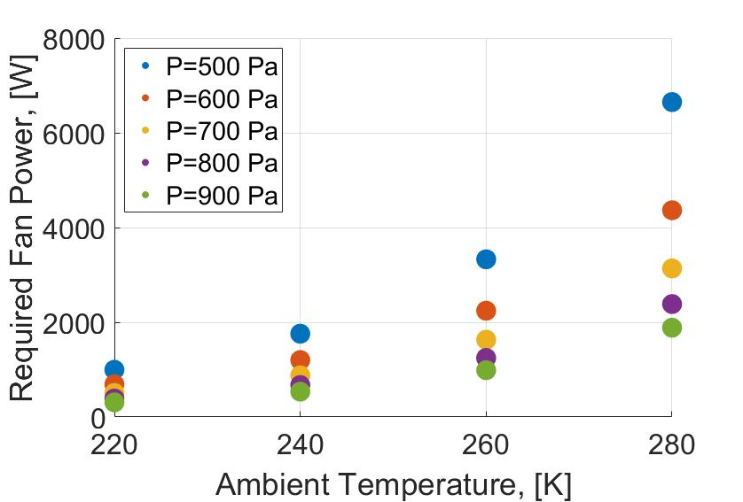
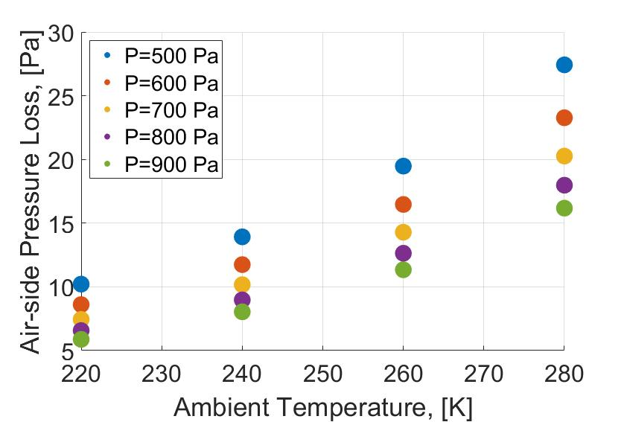
Optimal Cycle Response to Local Ambient Condition Variation
Ambient conditions will vary during operation
HX must maintain sufficient heat dissipation with a constant geometry solely by varying fan power.
Variation based on Viking 2 lander but pressure reduced by 200 Pa to investigate upper range of landing elevation
Pressure drop and fan power increase with increasing temperature and decreasing pressure but remain within acceptable limits for all realistic conditions
Increased fan power may result in 10% reduction of available power in worst conditions

Slide 14
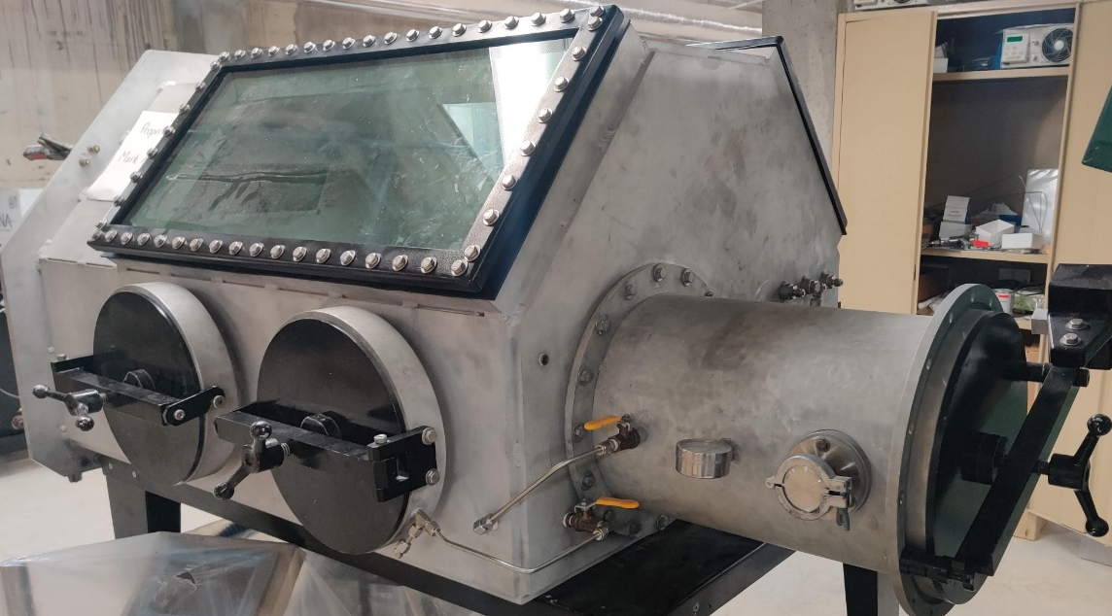
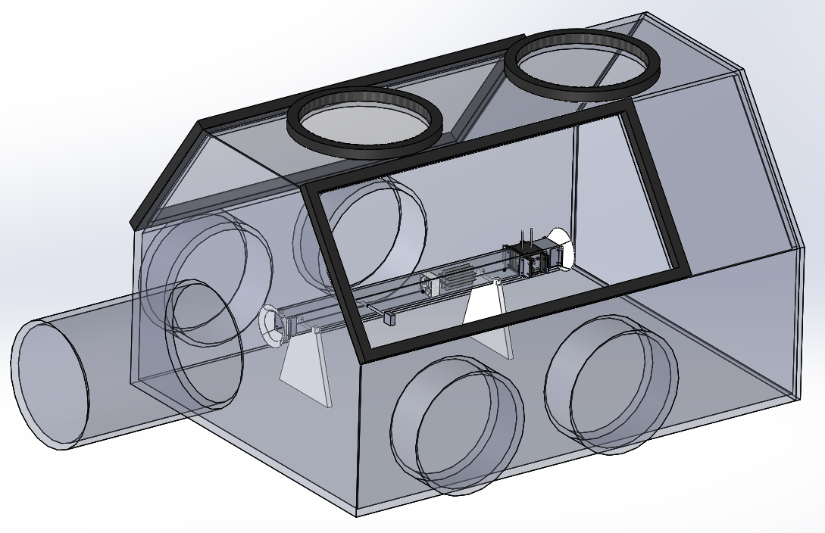
Experimental Validation
Constructing low-pressure test facility to operate prototype HXs in Mars-like environment
Will collect HX pressure loss and conductance, flow rate and fan pressure rise and efficiency data for range of fan speeds, heat loads, and ambient pressures for various HX designs
Test chamber is a vacuum glovebox owned by UW-THL. Will be evacuated and filled with CO₂ to a density of 0.144 kg/m³.
  Has feedthough ports for electrical power, data, pressure tap lines, vacuum and CO₂ fill lines, and a piezo vacuum gauge
Top: Photograph of vacuum glovebox
Bottom: Render of test section with the glovebox

Slide 15
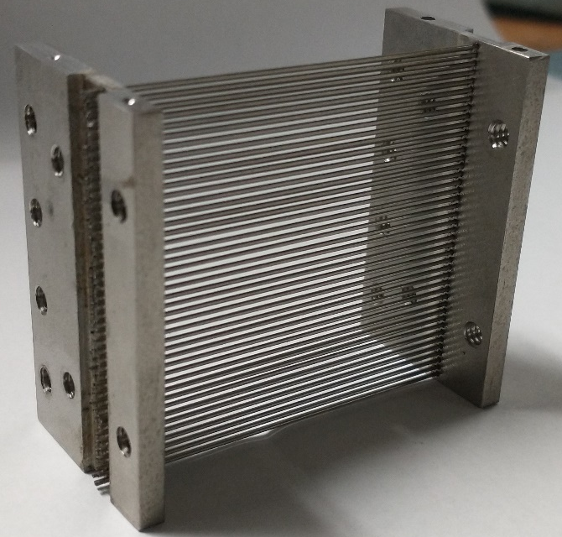
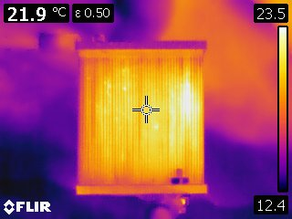
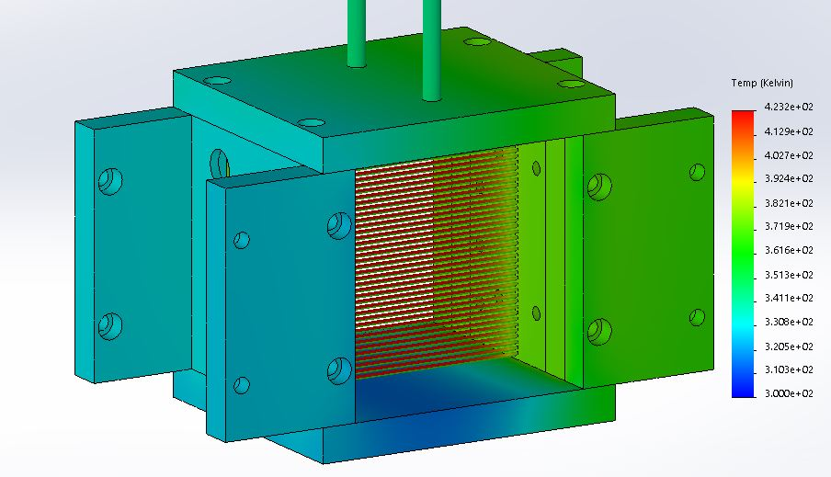
Experimental HX Design
Experimental HX designed to match optimal geometry from model
  2 rows of 0.02” SS tubes at 0.04” spacing, soldered to 2 SS header plates
  Frontal area of HX is 1.75”x1.75”, applied heater power scaled to match heat flux of full-scale 40kWe HX
  Plan to also construct 3-column and 0.042” tube HX’s to collect wider data set and investigate effects of geometry on performance.
Electrical current applied across tube array to generate required thermal power.
  To generate 27W, will apply 76A at 0.36V
  Eliminates need for pumping and heating fluid through HX
  Results in axially-consistent surface temperature which reduces measurement uncertainty
  Allows for thermocouples to be placed inside tubes for local temperature measurement without disturbing flow
Top Left: FLIR image of prototype HX demonstrating heat generation within tubes
Bottom Left: Thermal simulation of HX during operation. Peak expected temperature is 423 K. Right: Completed HX

Slide 16
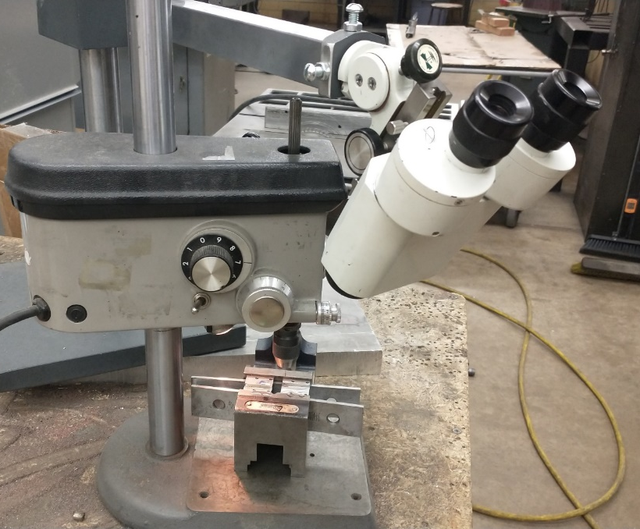
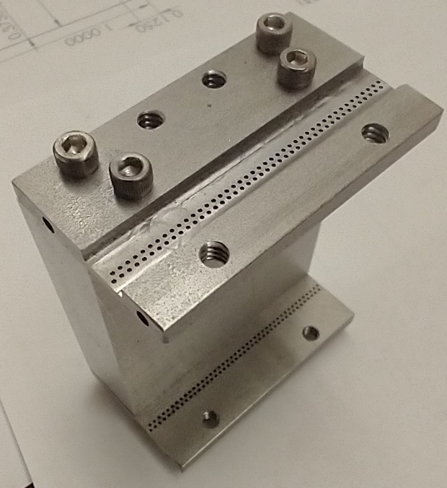
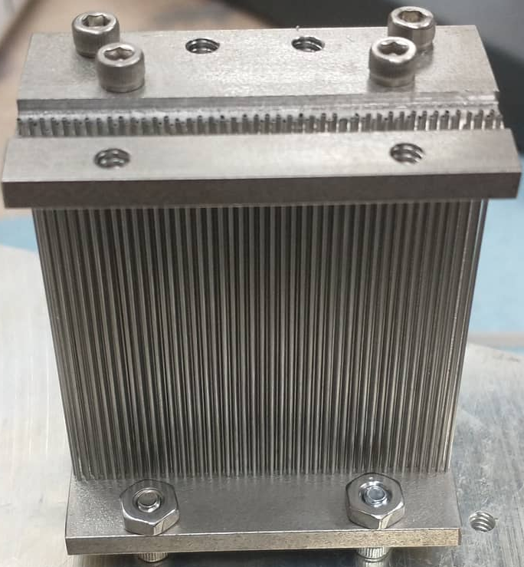
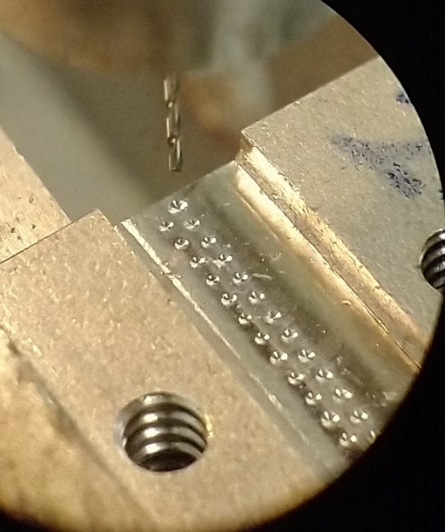
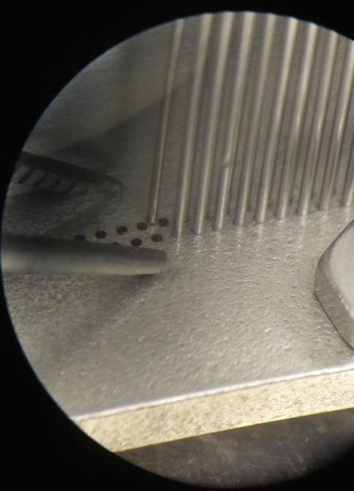
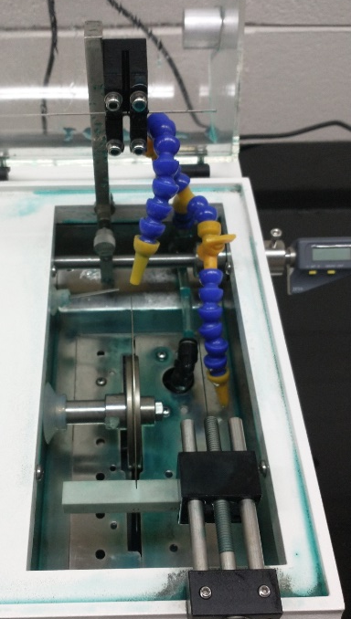
Experimental HX Fabrication
Tubes were cut to length in a diamond saw and deburred with sandpaper
A microdrill and microscope were used to drill the 0.021” tube holes in the headers
An Aluminum jig was made to hold the headers in place during assembly and soldering
Tubes were inserted into the headers using a microscope and tweezers
The HX was then soldered together

Slide 17
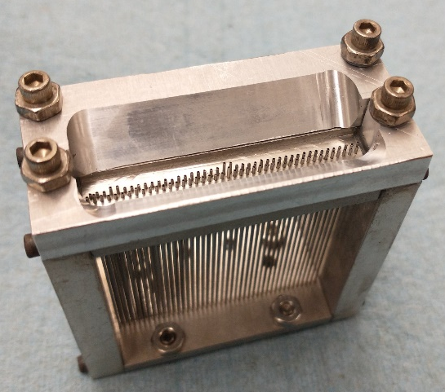
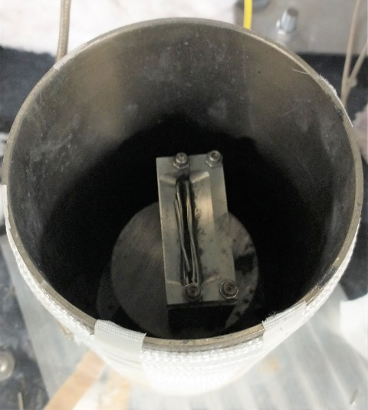
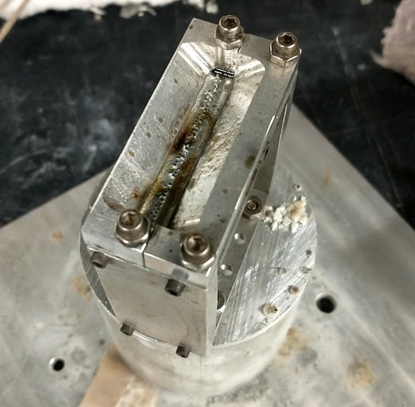
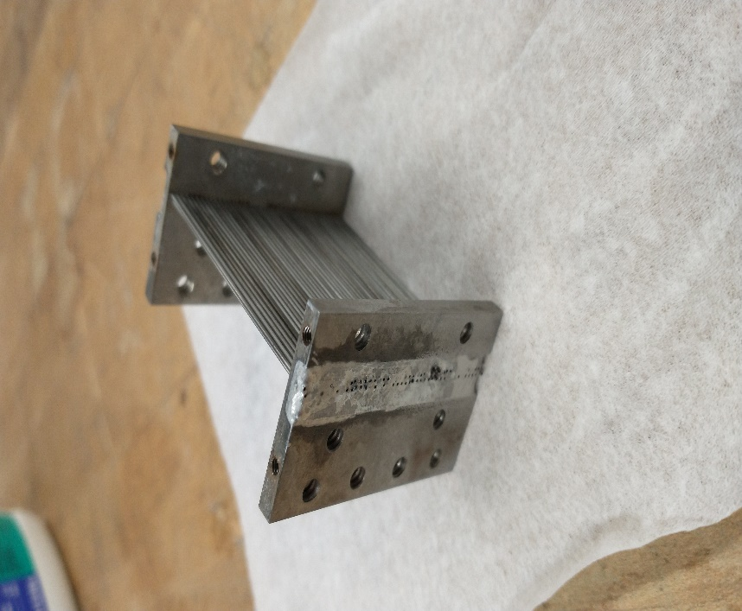
HX Soldering
Process
  Sonicated HX components and assembled them in jig
  Used wire brush to break up oxide layer and applied very strong acid flux
  Placed pieces of solder wire on the HX and heated in oven and with heat gun
    Oven made from 3” pipe section wrapped in PID-controlled tape heater
  Once solder started melting, added more flux as necessary to get solder to flow between tubes, and more solder wire to fill channel
  Allowed part to cool, then repeated on second side
  Rinsed in water and baking soda to remove residue and neutralize acid flux

Slide 18
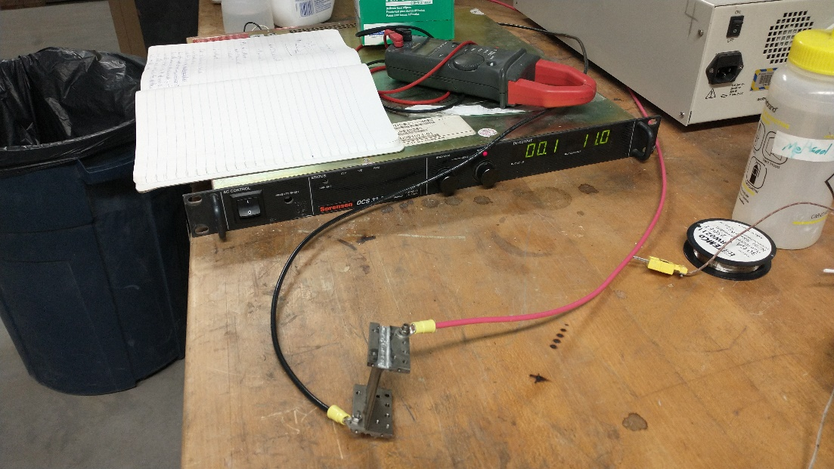
HX soldering
Tested electrical resistance with DC power supply
  Measured 0.1V at 11.0A, res<.009 Ω
  Predicted resistance with perfect connections=.006Ω
FLIR imaging shows heating across all tubes, indicating good electrical connections

Slide 19
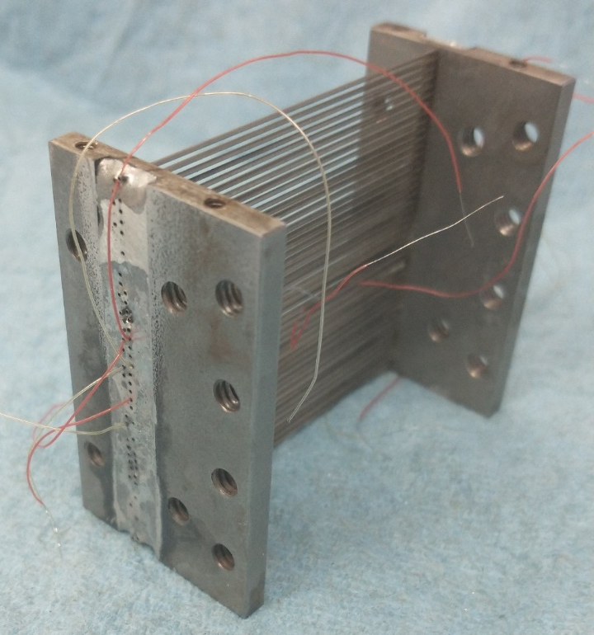
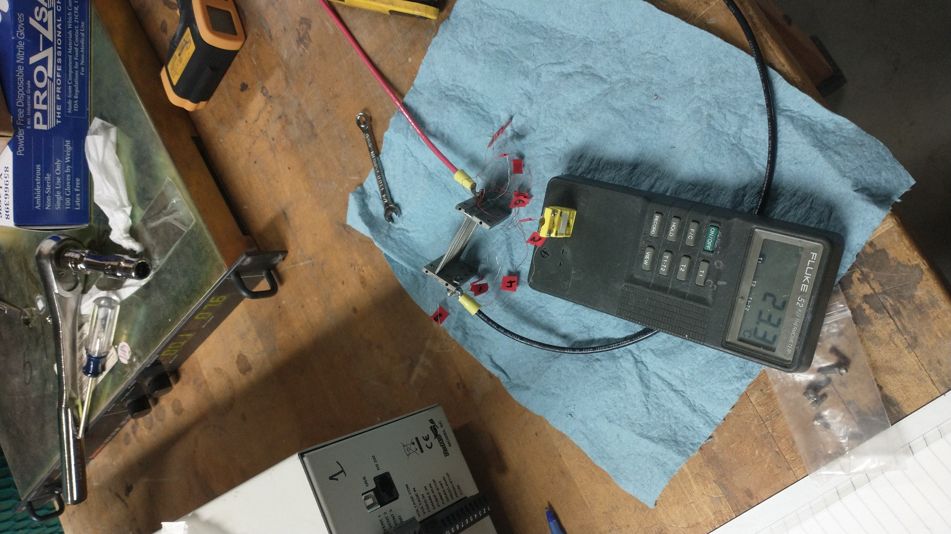
TC wiring
Threaded 6 TC wires through HX tubes, 3 in each column
Spot welded TC junctions and aligned junction with center of tubes
Tested TCs while electrically-heating HX to see if the current running through the tubes messes with the TC reading
Will also integrate upstream and downstream gas TCs into HX frame

Slide 20
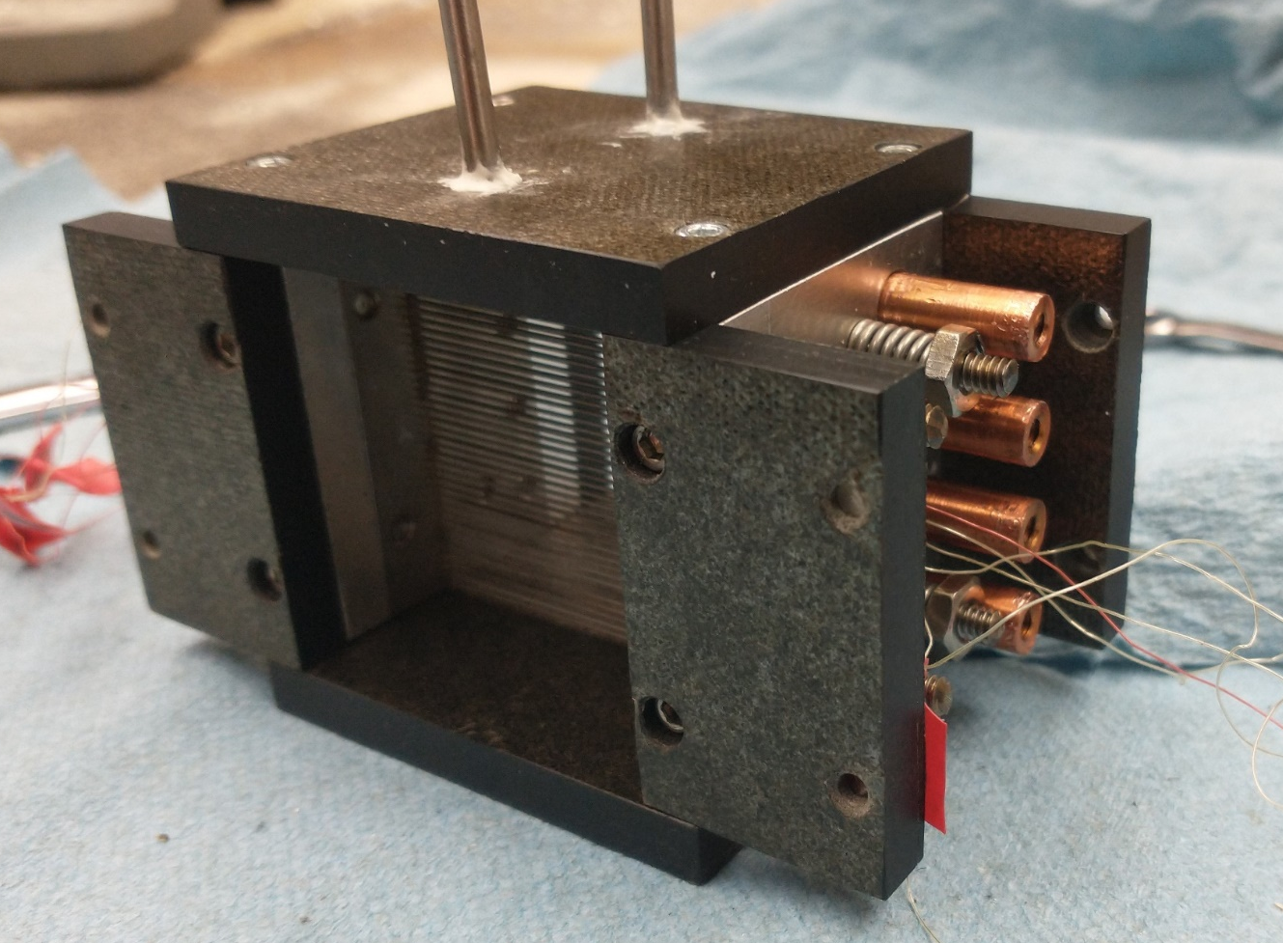
HX Frame
dP gauge taps
Tension springs
¼” MICA plate
Mechanically attaches and electrically insulates HX from test section
Provides fixed support on one end of HX, sprung support on other end to allow for thermal expansion of tubes without deformation
Copper standoffs provide electrical connection between power supply and HX header and ensure even heat flux across tube bank
Pressure taps allow measurement of pressure drop across tube bank with dP gauge outside of vacuum chamber
Cu standoffs
HX
TC wires
MICA and Aluminum HX frame

Slide 21
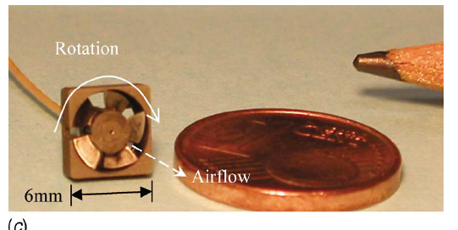
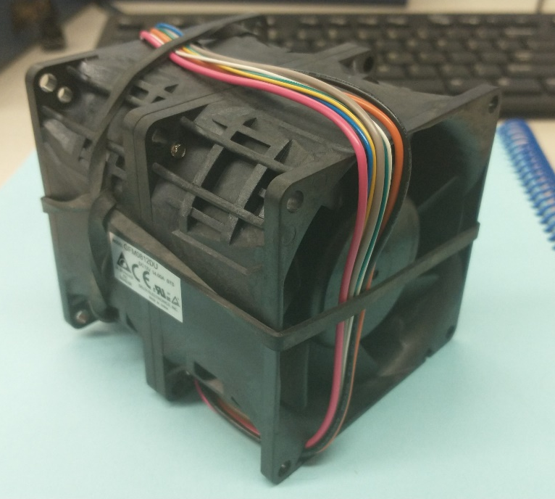
Fan Performance
Fan is required to drive airflow through HX
Low fluid density reduces pressure rise, high fan speeds required
Fan for experiments (~1.5” D) operates at very low (~1000-2000) Re, high M (~.5), not applicable to full scale fan behavior
  High-performance commercial fan purchased for experiment. Same model used elsewhere for Mars wind tunnel experiments
  At 16 krpm, should generate sufficient flow through the HX
Fan for real Mars HX (~1m D) operates at 16k Re, fan scaling laws should apply, no expected loss of performance
  Ideal speed ~1600 rpm, η~.46
Example of a low-Re, fan in Earth conditions

Slide 22
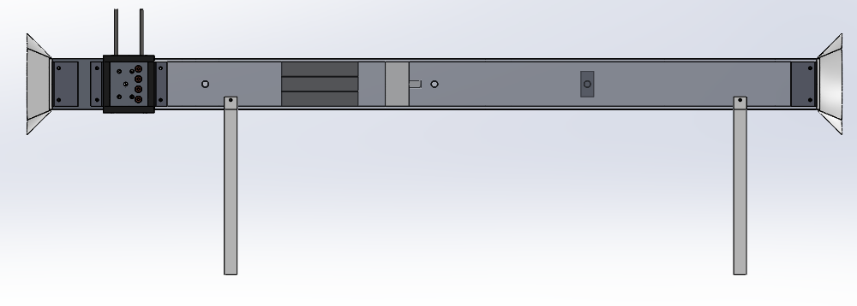
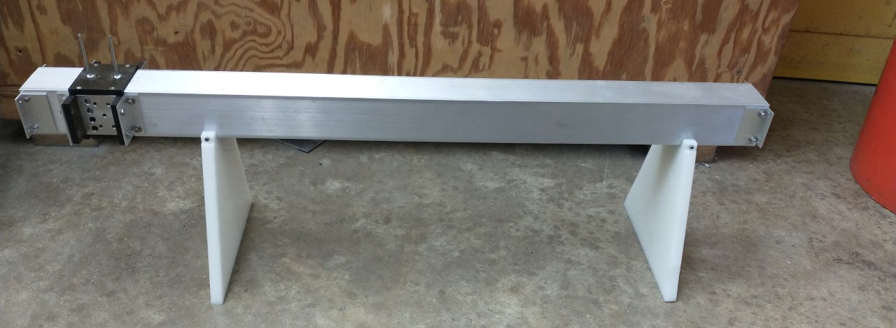
Test Section
Flow direction
Flow straightener
Hot-film anemometer
Outlet flare
3D-printed inlet and outlet flares reduce pressure loss and turbulence
Hot-film anemometer measures CO₂ flowrate upstream of fan to improve accuracy
Flow straightener consisting of tube bundle reduces vorticity from fan
3D-printed fan mount can be positioned either upstream of flow straightener to provide purely axial flow into HX to match assumptions used in model, or directly upstream of HX to reflect a more realistic operational geometry, allowing for direct measurement of the expected performance decrement from non-uniform flow
Plastic stands provide electrical insulation from vacuum chamber
HX frame
Fan mount
Plastic stands
Top: Annotated render of experimental test section
Bottom: Photograph of test section frame

Slide 23
Conclusion
Next Steps
Numerical modelling of forced-convection heat exchanger performance in Mars conditions based on existing correlations indicates that a heat exchanger is able to reject waste heat to the environment much more effectively than a radiator.
Integrating this HX model into an existing HTGR power cycle model reduces total system mass by 80% and improves thermal efficiency by 9%, greatly lowering mission cost and improving scientific payload capacity
A HX suitable for a 120 kWe reactor is compact enough to obviate complex deployment procedures
A HX optimized for average ambient conditions at a typical crewed landing site can operate across the full range of potential ambient condition variation
Install test section internals and 3D-printed components
Leak check vacuum glovebox
Calibrate hot-film anemometer
Install test section into glovebox and set up power and data connections
Collect HX conductance and pressure drop data for a range of flowrates, heat fluxes, Knudsen numbers, and flow conditions
Compare results to correlations used to build model

