Slide 1


Extended Length Helium Pulsating Heat Pipes
Logan Kossel
Advisors: Prof. John Pfotenhauer and Prof. Franklin Miller

Slide 2
Agenda
Pulsating Heat Pipe background
Project Significance
Experiment Design
Results
Future work

Slide 3
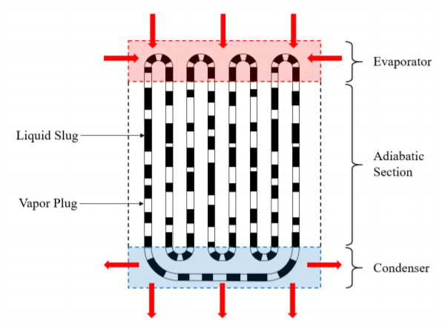
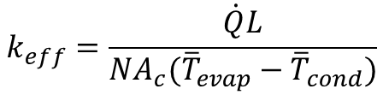

1. Pulsating Heat Pipe Background
Patented by Hisateru Akachi in 1990
Two-phase passive thermal management technology
Many aspects of PHP operation are not well understood
  # of turns?
  Filling ratio?
  Fluid?
  Adiabatic length?
Performance measured with effective conductivity or conductance
  Up to 150 [kW/m-K]
Liquid slug
Vapor plug
$$k_{eff}=\frac{\dot{Q}L}{NA_{c}({\overline{T}}_{evap}−{\overline{T}}_{cond})}$$
$$C_{eff}=\frac{\dot{Q}}{∆\overline{T}}$$

Slide 4
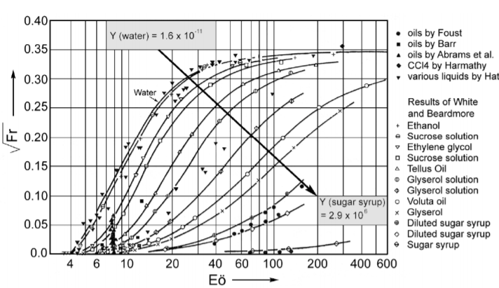
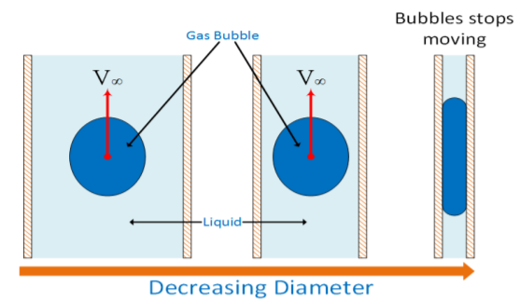
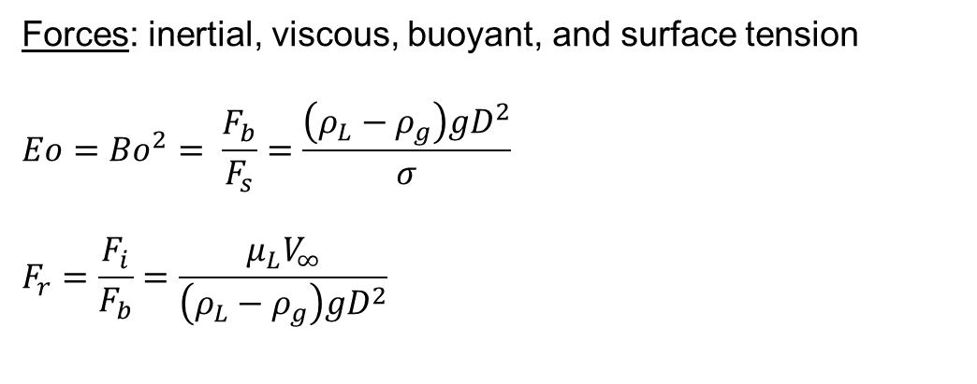
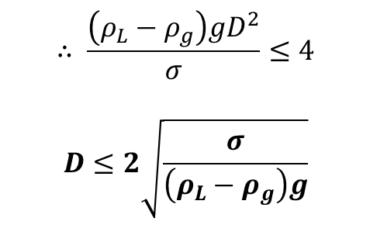
Critical Diameter
Forces: inertial, viscous, buoyant, and surface tension
$$Eo={Bo}^{2}= \frac{F_{b}}{F_{s}}=\frac{\left(ρ_{L}−ρ_{g}\right)gD^{2}}{σ}$$
$$F_{r}=\frac{F_{i}}{F_{b}}=\frac{μ_{L}V_{∞}}{\left(ρ_{L}−ρ_{g}\right)gD^{2}}$$
White and Beardmore (1962)
$$∴ \frac{\left(ρ_{L}−ρ_{g}\right)gD^{2}}{σ}≤4$$
$$D≤2\sqrt{\frac{σ}{\left(ρ_{L}−ρ_{g}\right)g}}$$
Fonseca (2016)

Slide 5
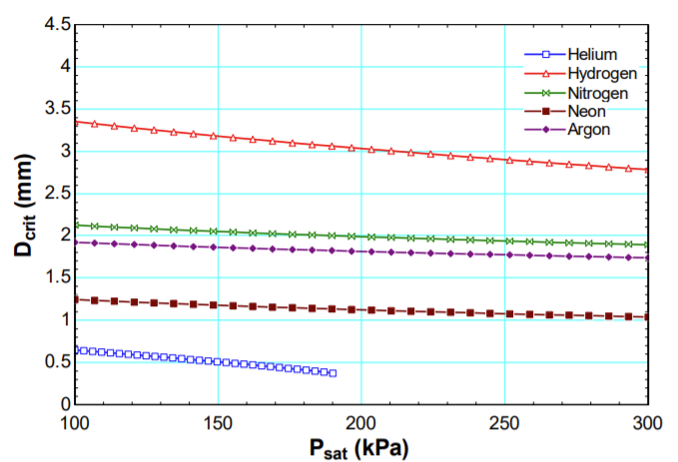

Critical Diameter
$$D≤2\sqrt{\frac{σ}{\left(ρ_{L}−ρ_{g}\right)g}}$$
Fonseca (2016)

Slide 6
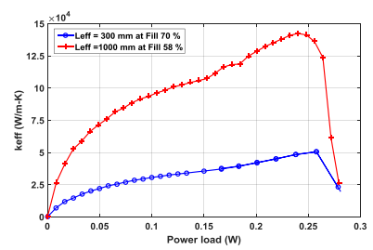
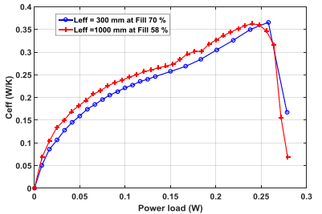

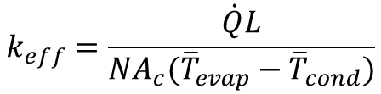
2. Project Significance
Fonseca 2016: Helium PHPs of lengths 300mm and 1000mm displayed the same effective conductance at their respective optimal fill ratios over a range of heat loads
Fonseca (2017)
Fonseca (2017)
$$k_{eff}=\frac{\dot{Q}L}{NA_{c}({\overline{T}}_{evap}−{\overline{T}}_{cond})}$$
$$C_{eff}=\frac{\dot{Q}}{∆\overline{T}}$$

Slide 7
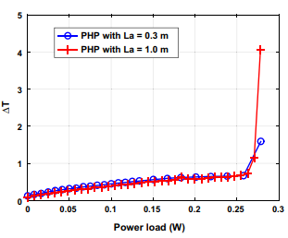
Project Significance
Fonseca (2017)
Objectives:
Characterize the thermal performance of Helium pulsating heat pipes as a function of their adiabatic length.
Determine the limits of length independence for the conductance of Helium pulsating heat pipes

Slide 8
Vertical PHP Experiment Plan
Start with an initial fill ratio of 20%
Increment the heat load from 0 to ~1 W
Take temperature measurements at steady state for each heat load
Compute effective conductivity and conductance
Repeat for initial fill ratios incrementing to 80%
Determine optimal initial fill ratio
Plot all tests on a T-v diagram
Repeat for each PHP length
Also: will test Horizontal PHPs of various lengths in a similar way

Slide 9
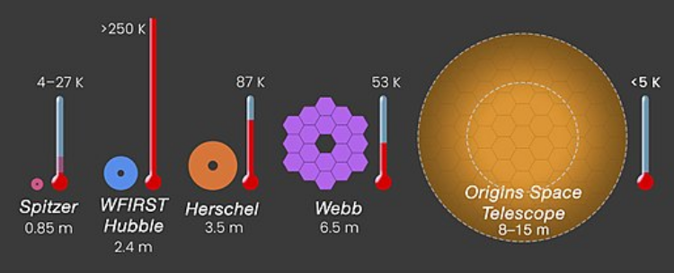
Applications
Zero boil-off liquid fuel storage
Cooling large space telescopes
Liquid Fuel: hydrogen and oxygen
Hard to keep large fuel storage containers at a constant temperature
Larger containers = longer missions
Origins Space Telescope (OST) for the Far-IR surveyor mission (2035)
Larger than previous orbital telescopes
Needs to be near liquid helium temperatures to operate
Also: MRI, SC magnets
1990
2021
2035
OST Mission Flyer (2018)

Slide 10
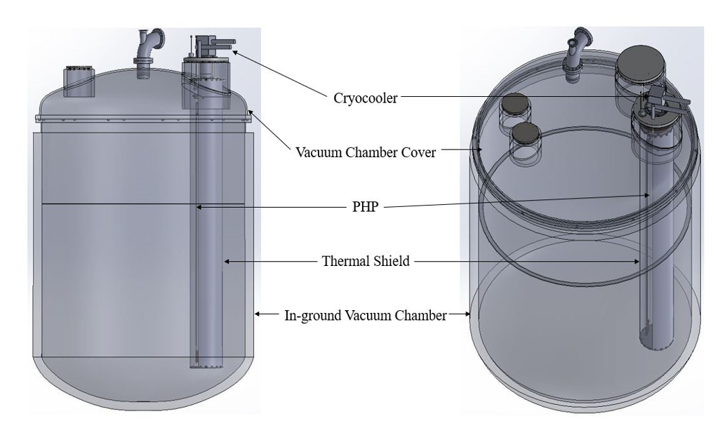
3. Experiment Design

Slide 11
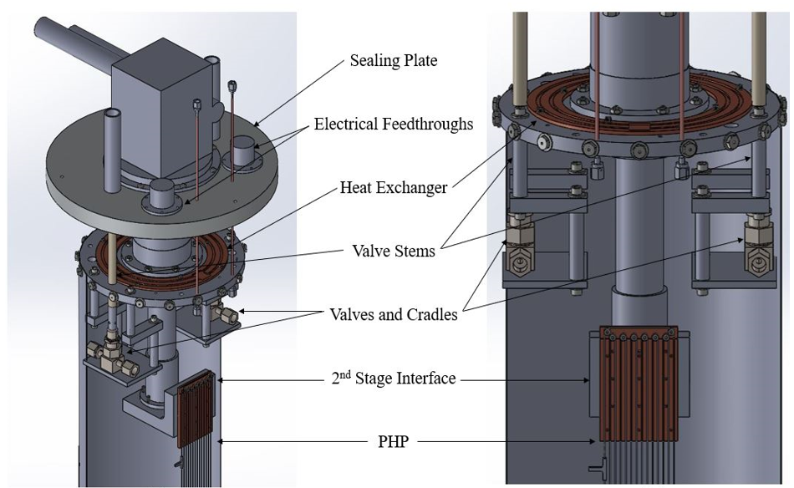
Experiment Design

Slide 12
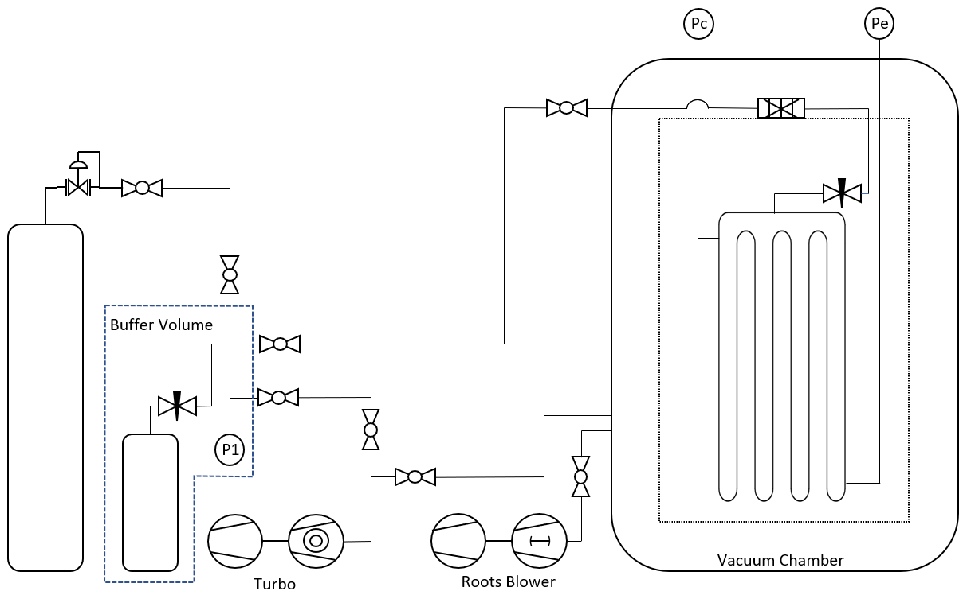

Plumbing
$$FR= \frac{V_{l}}{V_{PHP}}$$

Slide 13
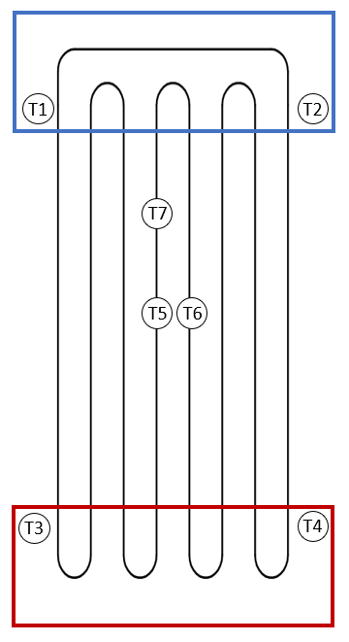
Thermometry
Lakeshore Cernox Cu-1050
Two on each end plate
Three adiabatic locations
Lakeshore PT-103
Five equidistant locations along the radiation shield

Slide 14
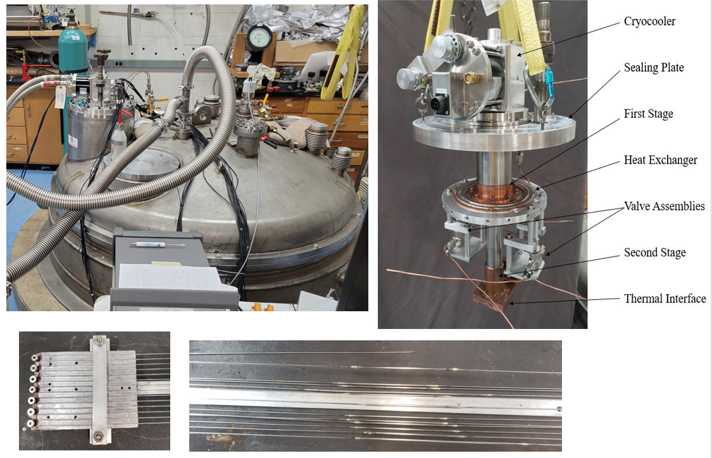
Fabrication

Slide 15
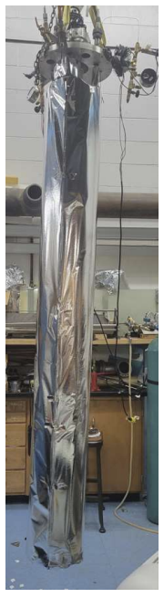
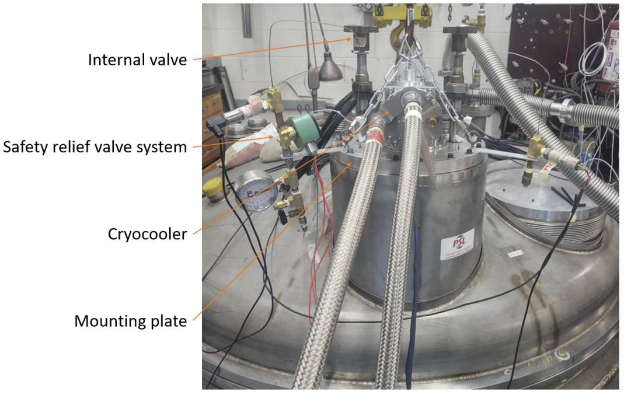
Fabrication

Slide 16

PHP Brazing Technique
Interference fit between PHP tubes and sleeves
Clean all surfaces with alcohol and scotchbrite, including braze alloy
Apply flux between the PHP tube and the sleeve, but not at the end of the PHP tube
Very light torch flame, don’t overheat the tubes – they heat up fast
Soak in detergent soap, scotchbrite the finished joint and clean with alcohol – remove all flux
After every few brazes, measure the flow rate of N2 through the tubes to check for clogs
PHP Tubes
sleeves
Braze joints

Slide 17
4. 1.25-meter Helium PHP Results
Specs:
1250 mm adiabatic length
90 mm evaporator and condenser lengths
55-80% fill ratio
0.5 mm ID tubing
14 parallel tubes
Tests:
Uncontrolled progressive heat load
Controlled progressive heat load at 4K
Controlled progressive heat load matching with Fonseca’s condenser temperature
Random heat load
Constant heat load, varying condenser temperature

Slide 18
Uncontrolled Progressive Heat Load

Slide 19
Controlled Progressive Heat Load @ 4K

Slide 20
Controlled Match Comparison

Slide 21
Conductance per tube

Slide 22
Adiabatic Section Thermometers
Adjacent tubes seem to match with either the condenser or evaporator section

Slide 23
Random Heat Load

Slide 24
Constant Heat, Varying Condenser Temp

Slide 25
5. Future Work
Vertical PHPs
1.25 m PHP: Collect data for low fill ratios 20-50%
  Determine optimal fill ratio
1.5 m PHP
1.75 m PHP
Horizontal PHPs
Design and build test rig
Lengths up to 3 m

Slide 26
Thank you!
Advisers: Prof. John Pfotenhauer, Prof. Franklin Miller
Undergraduate Assistants: Tyler Lee, Jon Carlson, Ziyang Hang
Graduate Colleagues: Bryant Mueller, Jennifer Detlor, Uzo Mmeje, Zhiyi Jiang
NASA Advisers: Wesley Johnson, Diego Fonseca
LHe Facility: Al Yingling, Gabe Bernhardt
“This work was supported by a NASA Space Technology Graduate Research Opportunities Award.”

Slide 27
Questions?

