Slide 1
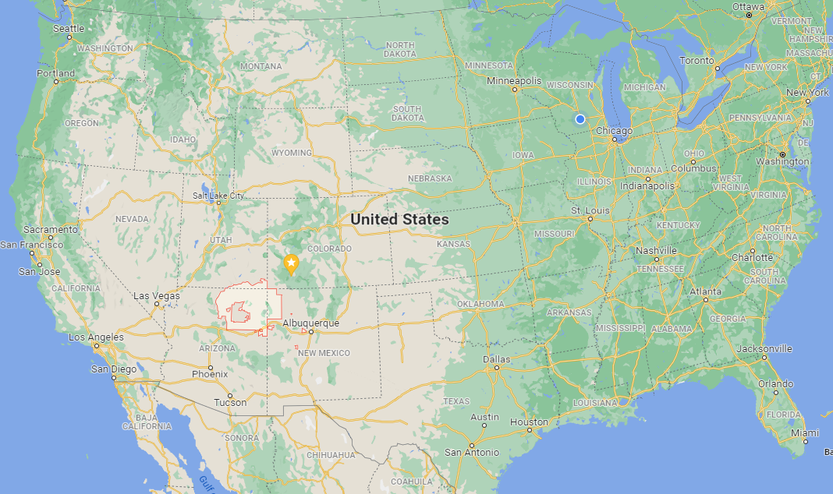
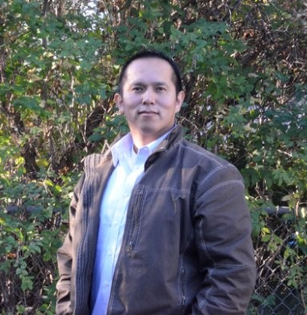
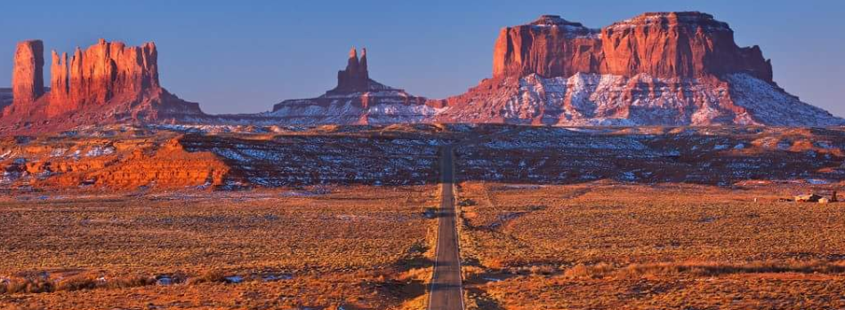
Alastair Big Luna (AL)
Hometown: Kayenta, Arizona
(Navajo: Tó Dínéeshzheeʼ)
Alastair Big Luna (AL)

Slide 2
Optical Fiber Temperature and Stress Measurements

Slide 3
Presentation Outline
Section 1
Discussion on how optical fibers work
Discussion on Rayleigh backscatter
Discussion on OFDR
Discussion on the temperature and strain algorithm
Section 2
Characteristics of the LUNA ODiSI-B and temperature data
Research on using strain data on pressurized vessels to characterize internal pressure

Slide 4
Section 1: Background
Optic fibers, Rayleigh scattering, OFDR, Temperature & Strain Algothrim

Slide 5
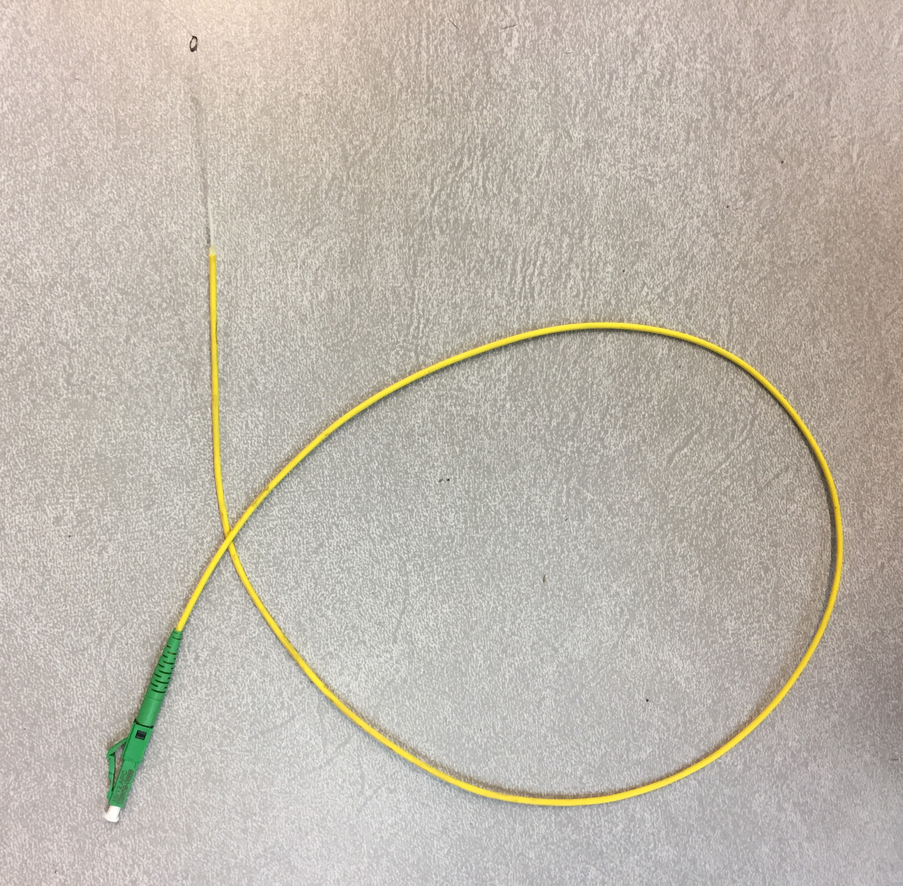
Why use fiber optic sensors
Optical fibers may be used for temperature, strain, pressure.
The spatial resolution is very high. Choice of having 1.25 [mm] at 24 [Hz] or 5 [mm] at 100 [Hz] of spacing between each data point.
For example, in a one-meter sensor, you can have as much 800 points of data for each time step. At 24 [Hz], you have 19,200 points of data for each second.
For this reason, fiber optic sensors are candidates for research, big data collection for machine learning algorithms, and health monitoring of critical components in power plants or facilities.
Figure: Fiber-optic temperature and strain sensor – 1 [m] length

Slide 6
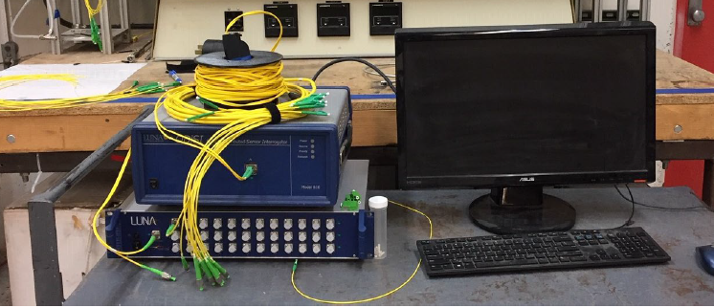
Required components for temperature and strain measurements
Single mode fibers
Tunable laser and reflectometer
Temperature and Strain algorithm

Slide 7
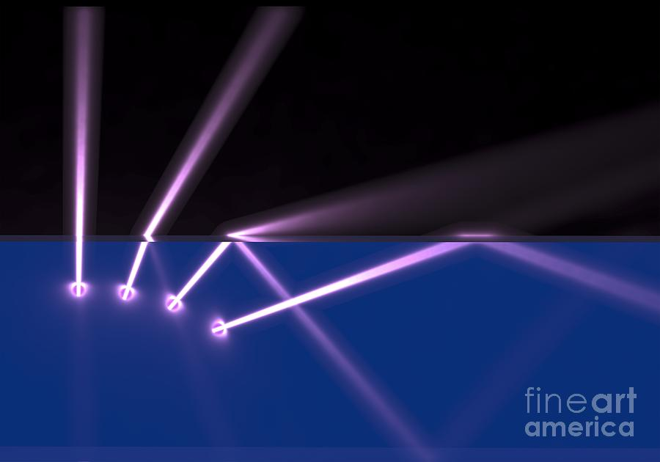
Optical Fiber Theory – Total Internal Reflection
Snell’s law
$$n_{1}sinθ_{1}=n_{2}sinθ_{2}$$
The critical angle
$θ_{C}=\sin^{−1}{(\frac{n_{2}}{n_{1}})}$
The bigger the difference between the indices of refraction in the two optical materials, the larger the critical angle.
The fiber is design to be a light guide.
Figure: Illustration of Total Internal Reflection [1]
[1] https://images.fineartamerica.com/images-medium-large-5/refraction-and-total-internal-reflection-russell-kightley.jpg

Slide 8
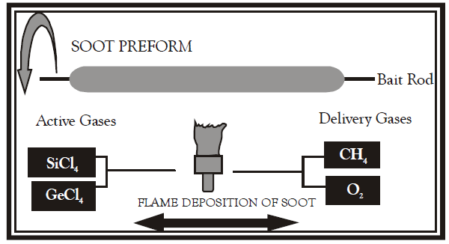
Silica Optical Fiber – Manufacturing process
Outside Vapor Deposition (OVD) process is commonly used in the manufacturing of optical fibers.
3 steps: Laydown, consolidation, and draw.
Laydown process - a soot preform is made from ultra pure vapors as they react in the flame to form fine soot particles of silica or Germania.
Consolidation process – the bait rod is removed and the preform is placed in a furnace. The preform is sintered into a solid glass.
Draw process – the preform is placed in a draw tower and drawn into one continuous strand of silica fiber.
Figure: Illustration of Laydown process [2]
[2] P. Aithal and H. Ravindra, Textbook of Engineering Physics, 1st ed. Acme Learning Private Limited, 2021.

Slide 9
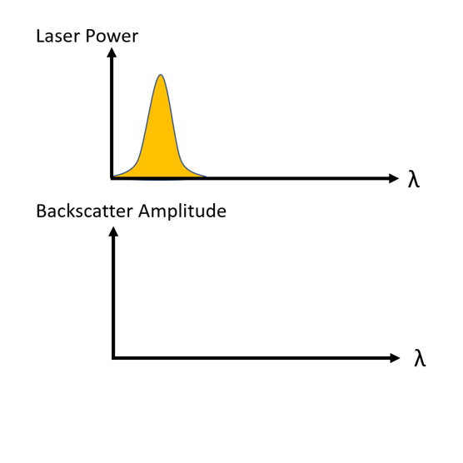
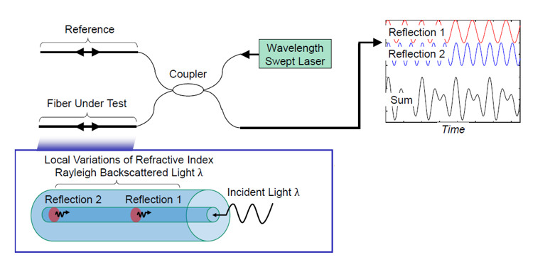
Optical Frequency Domain Reflectometry
First proposed for measuring losses inside single-mode optical fiber system. [3]
Relies on a scan of the Rayleigh backscatter amplitude.
A frequency scan is made by changing the wavelength of the laser and a detector measures the backscatter amplitude
Figure 5: Fiber-optic temperature and strain sensor
[3]W. Eickhoff and R. Ulrich, "Optical frequency domain reflectometry in single‐mode fiber", Applied Physics Letters, vol. 39, no. 9, pp. 693-695, 1981. Available: 10.1063/1.92872

Slide 10
Optical Frequency Domain Reflectometry
First proposed for measuring losses inside single-mode optical fiber system. [3]
Relies on a scan of the Rayleigh backscatter amplitude.
A frequency scan is made by changing the wavelength of the laser and a detector measures the backscatter amplitude
Figure 5: Fiber-optic temperature and strain sensor
[3]W. Eickhoff and R. Ulrich, "Optical frequency domain reflectometry in single‐mode fiber", Applied Physics Letters, vol. 39, no. 9, pp. 693-695, 1981. Available: 10.1063/1.92872

Slide 11
Optical Frequency Domain Reflectometry (OFDR)-Algorithm
I
ω
[2]M. Froggatt and J. Moore, "High-spatial-resolution distributed strain measurement in optical fiber with Rayleigh scatter", Applied Optics, vol. 37, no. 10, p. 1735, 1998. Available: 10.1364/ao.37.001735 [Accessed 30 July 2020].

Slide 12
Optical Frequency Domain Reflectometry (OFDR)-Algorithm
I
I
FFT
ω
x_{m}
X
[2]M. Froggatt and J. Moore, "High-spatial-resolution distributed strain measurement in optical fiber with Rayleigh scatter", Applied Optics, vol. 37, no. 10, p. 1735, 1998. Available: 10.1364/ao.37.001735 [Accessed 30 July 2020].

Slide 13
Optical Frequency Domain Reflectometry (OFDR)-Algorithm
Gage length
I
I
FFT
ω
x_{m}
X
[2]M. Froggatt and J. Moore, "High-spatial-resolution distributed strain measurement in optical fiber with Rayleigh scatter", Applied Optics, vol. 37, no. 10, p. 1735, 1998. Available: 10.1364/ao.37.001735 [Accessed 30 July 2020].

Slide 14
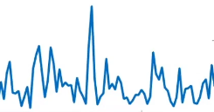
Optical Frequency Domain Reflectometry (OFDR)-Algorithm
Gage length
I
I
I
Reference
FFT
FFT
ω
X
ω
x_{m}
[2]M. Froggatt and J. Moore, "High-spatial-resolution distributed strain measurement in optical fiber with Rayleigh scatter", Applied Optics, vol. 37, no. 10, p. 1735, 1998. Available: 10.1364/ao.37.001735 [Accessed 30 July 2020].

Slide 15
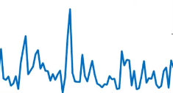
Optical Frequency Domain Reflectometry (OFDR)-Algorithm
Gage length
I
I
I
Reference
FFT
FFT
ω
X
ω
x_{m}
I
Sample
ω
[2]M. Froggatt and J. Moore, "High-spatial-resolution distributed strain measurement in optical fiber with Rayleigh scatter", Applied Optics, vol. 37, no. 10, p. 1735, 1998. Available: 10.1364/ao.37.001735 [Accessed 30 July 2020].

Slide 16
Optical Frequency Domain Reflectometry (OFDR)-Algorithm
Gage length
I
I
I
Reference
FFT
FFT
ω
X
ω
x_{m}
I
Cross Correlated
I
Sample
Δω
ω
Δω_{m}
[2]M. Froggatt and J. Moore, "High-spatial-resolution distributed strain measurement in optical fiber with Rayleigh scatter", Applied Optics, vol. 37, no. 10, p. 1735, 1998. Available: 10.1364/ao.37.001735 [Accessed 30 July 2020].

Slide 17
Optical Frequency Domain Reflectometry (OFDR)-Algorithm
Gage length
I
I
I
Reference
FFT
FFT
ω
X
ω
x_{m}
Δω
I
I
Cross Correlated
Sample
Δω_{m}
Peak Correlated to a specific location
x_{m}
X
Δω
ω
Δω_{m}
[2]M. Froggatt and J. Moore, "High-spatial-resolution distributed strain measurement in optical fiber with Rayleigh scatter", Applied Optics, vol. 37, no. 10, p. 1735, 1998. Available: 10.1364/ao.37.001735 [Accessed 30 July 2020].

Slide 18
Optical Frequency Domain Reflectometry (OFDR)-Algorithm
Gage length
I
I
I
Reference
FFT
FFT
ω
X
ω
x_{m}
Δω
I
I
Cross Correlated
Sample
Δω_{m}
Peak Correlated to a specific location
x_{m}
X
Δω
ω
Δω_{m}
[2]M. Froggatt and J. Moore, "High-spatial-resolution distributed strain measurement in optical fiber with Rayleigh scatter", Applied Optics, vol. 37, no. 10, p. 1735, 1998. Available: 10.1364/ao.37.001735 [Accessed 30 July 2020].

Slide 19
Optical Frequency Domain Reflectometry (OFDR)-Algorithm
Gage length
I
I
I
Reference
FFT
FFT
ω
X
ω
x_{m}
Δω
I
I
Cross Correlated
Sample
Δω_{m}
Peak Correlated to a specific location
x_{m}
X
Δω
ω
Δω_{m}
[2]M. Froggatt and J. Moore, "High-spatial-resolution distributed strain measurement in optical fiber with Rayleigh scatter", Applied Optics, vol. 37, no. 10, p. 1735, 1998. Available: 10.1364/ao.37.001735 [Accessed 30 July 2020].

Slide 20
Optical Frequency Domain Reflectometry (OFDR)-Algorithm
Gage length
I
I
I
Reference
FFT
FFT
ω
X
ω
x_{m}
Δω
I
I
Cross Correlated
Sample
Δω_{m}
Peak Correlated to a specific location
x_{m}
X
Δω
ω
Δω_{m}
[2]M. Froggatt and J. Moore, "High-spatial-resolution distributed strain measurement in optical fiber with Rayleigh scatter", Applied Optics, vol. 37, no. 10, p. 1735, 1998. Available: 10.1364/ao.37.001735 [Accessed 30 July 2020].

Slide 21
Optical Frequency Domain Reflectometry (OFDR)-Algorithm
Gage length
I
I
I
Reference
FFT
FFT
ω
X
ω
x_{m}
Δω
I
I
Cross Correlated
Sample
Δω_{m}
Peak Correlated to a specific location
x_{m}
X
Δω
ω
Δω_{m}
[2]M. Froggatt and J. Moore, "High-spatial-resolution distributed strain measurement in optical fiber with Rayleigh scatter", Applied Optics, vol. 37, no. 10, p. 1735, 1998. Available: 10.1364/ao.37.001735 [Accessed 30 July 2020].

Slide 22
Optical Frequency Domain Reflectometry (OFDR)-Algorithm
Gage length
I
I
I
Reference
FFT
FFT
ω
X
ω
x_{m}
Δω
I
I
Cross Correlated
Sample
Δω_{m}
Peak Correlated to a specific location
x_{m}
X
Δω
ω
Δω_{m}
[2]M. Froggatt and J. Moore, "High-spatial-resolution distributed strain measurement in optical fiber with Rayleigh scatter", Applied Optics, vol. 37, no. 10, p. 1735, 1998. Available: 10.1364/ao.37.001735 [Accessed 30 July 2020].

Slide 23
Section 2 Distributed Temperature Sensing
LUNA ODiSI-B and ODiSI-6000

Slide 24
Furnace Setup
Temperature fiber sensors

Slide 25
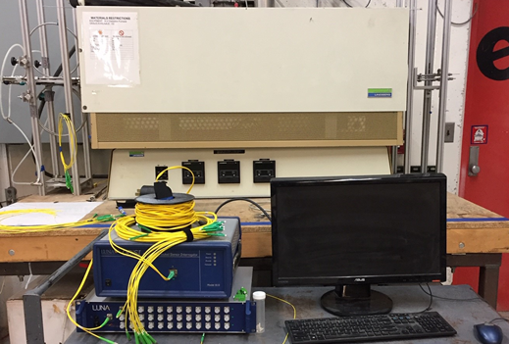
High Temperature Characteristics of the LUNA ODiSI-B and SMF

Slide 26
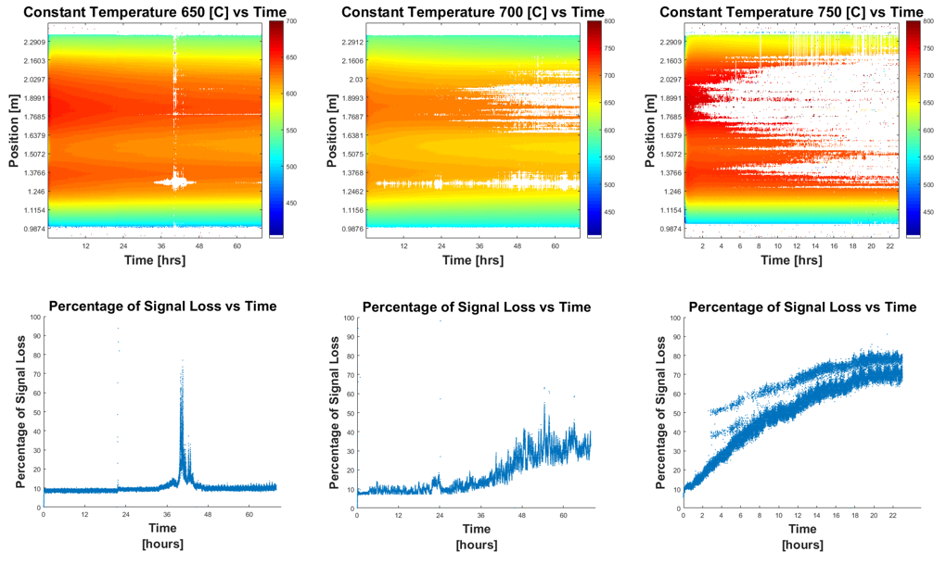
High Temperature Characteristics of the LUNA ODiSI-B and SMF

Slide 27
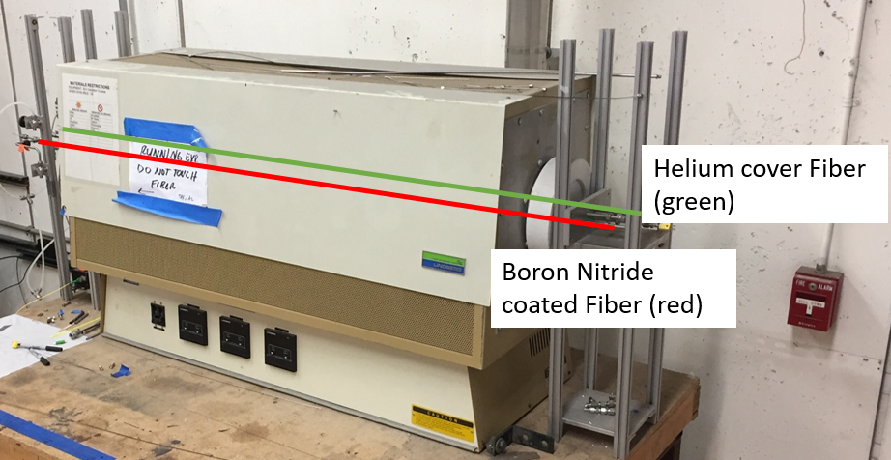
SMF modifications to withstand High Temperature Environments
Test Parameters | 750 [C] - HE | 750 [C] - BN
Interrogator System | Luna ODiSI-B | Luna ODiSI-B
Type of Optical Fiber | Single mode (SMF-28e) | Single mode (SMF-28e)
Heater Type | Tube Furnace | Tube Furnace
Anneal Type | 800 [C] for 2 [hrs] | 800 [C] for 2 [hrs]
Typical Experimental Timeframes | Until failure | Until failure
Termination End Types | ~30 degree polish | ~30 degree polish
Backfilled Gas Type | Helium | Air with Boron Nitride coating
Optical Fiber Coating | Mechanically Removed | Mechanically Removed

Slide 28
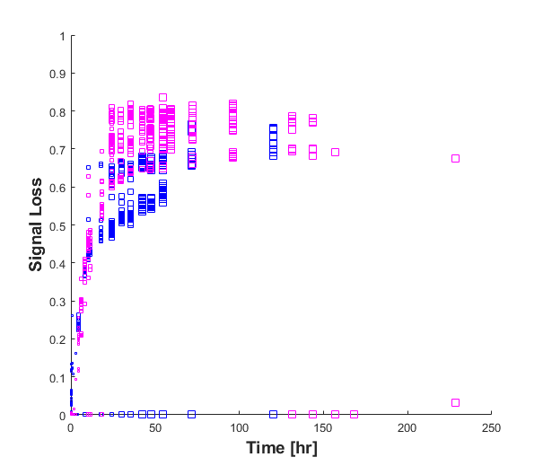
Optical fiber temperature sensors survivability test in 750 [C] furnace
Corning SMF-28 Ultra can survive 750 [C] temperatures for 1780 hours (10.6 weeks) when protected with Helium gas cover or Boron Nitride coating
If we consider a 50% signal threshold for both He and BN fibers as a metric, then this test shows BN helps the fiber maintain signal more than the Helium backfilled gas by about 24 hours.
31 reference keys were made for both the Helium fiber and BN fiber. Creating numerous reference keys is not ideal to maintain signal, and therefore, we are searching for fibers that have enhanced Rayleigh scatter signals.
42.4 [hrs] – BN
18.6 [hrs] – He
Plot shows the signal loss for the initial keys of Helium fiber (magenta) and BN fiber (blue). Red line shows 50% signal loss threshold. Helium and BN exceeded the 50% line at 18.6 [hr] and 42.4 [hr], respectively.

Slide 29
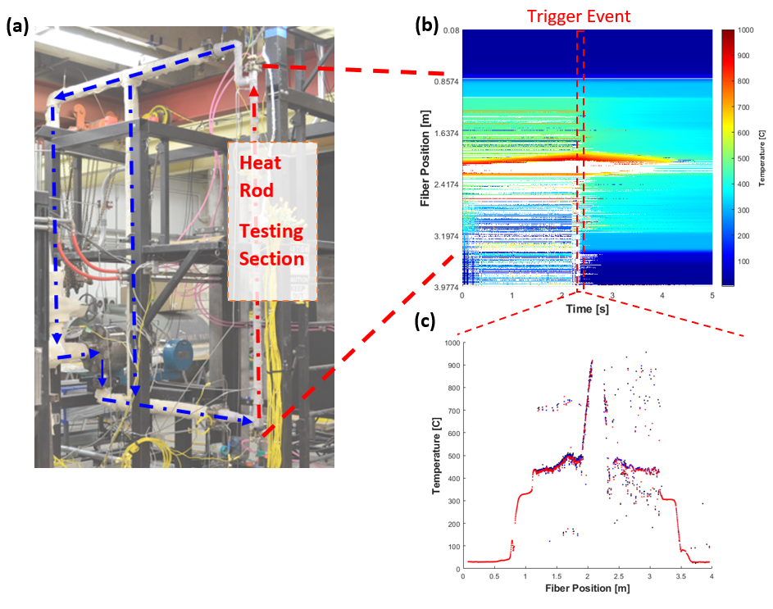
Health Monitoring via Distributed Temperature Measurements
UW-Madison’s high pressure testing loop can simulate PWR conditions using single or multiple heating rods.
PWR conditions can reach temperatures up to 400 [C] and pressures up to 25 [MPa].
Fiber optic sensor (FOS) system used to capture distributed temperature measurements with spatial resolution ranging from 1.25 [mm] to 5 [mm].
Critical Heat Flux (CHF) events detected, and trigger shut down of experiment to protect heat rod and testing facility.
Figure: (a) High pressure testing loop. (b) Experimental temperature profile [C] mapped on Position [m] vs Time [s] plot. White spots represent no data. (c) Temperature [C] vs Position plot [m] of CHF event.

Slide 30
Distributed Strain Sensing
LUNA ODiSI-B

Slide 31
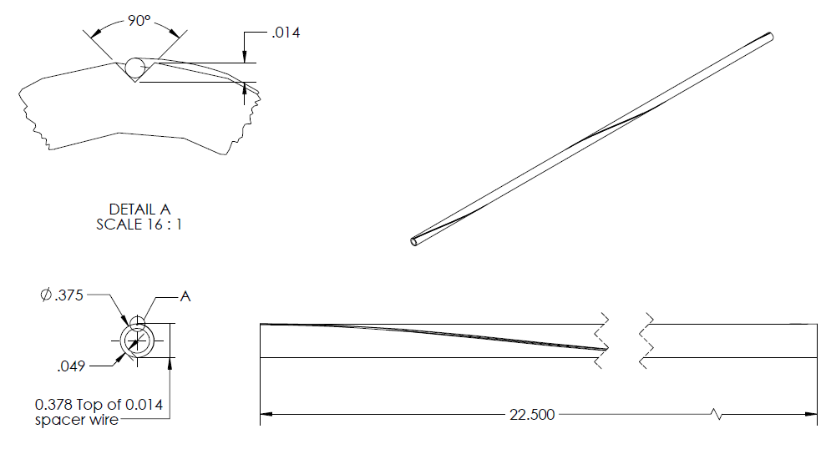
Health Monitoring via Distributed Strain Measurements
Conduct research on embedding fiber optical sensors (FOS) onto the surface of tubes for monitoring internal pressure.
FOS are wrapped and bonded around tubes in a helical orientation or in a helical trench. The helical configuration allows for the optical strain sensor to be decomposed into its axial and circumferential components.
Develop a methodology for collecting strain data in high-temperature and high-pressure environments. The strain data needs to be compensated for temperature influence.
Figure: Schematic of helical trench on a 3/8 [in] O.D. tube w/ 22.5 [in] length.

Slide 32
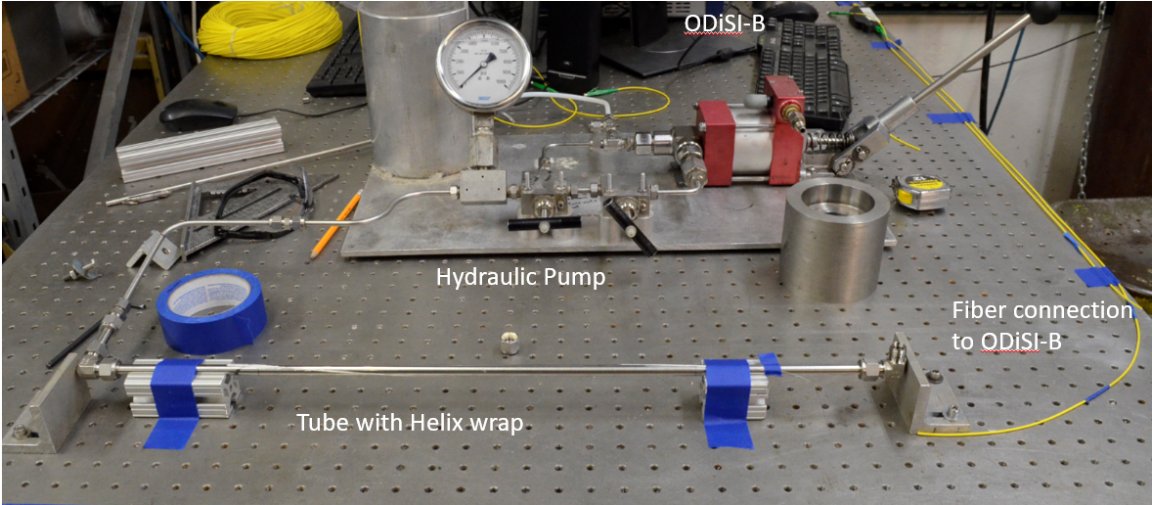
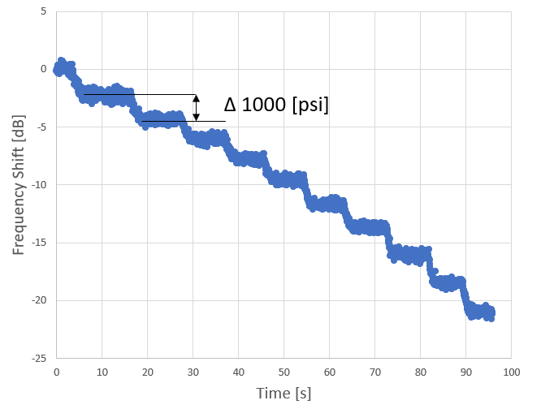
Experimental Setup and Correlation Methodology for the ODiSI-B
A single-mode fiber from Corning (SMF 28-Ultra) was wrapped in the helix groove and adhered with Ceramabond 668, a high-temperature ceramic adhesive.
Luna ODiSI-B was used to interrogate the SMF 28-Ultra fiber.
A hydraulic pump was used to pressurize the 3/8-inch SS tube up to 10,000± 100 [psi].
Frequency shift response to 1,000± 100 [psi] stages in internal pressure up to 10,000± 100 [psi] were measured.
Figure: Experimental setup (top). Frequency shift response to ten 1000± 100 [psi] stages(bottom).

Slide 33
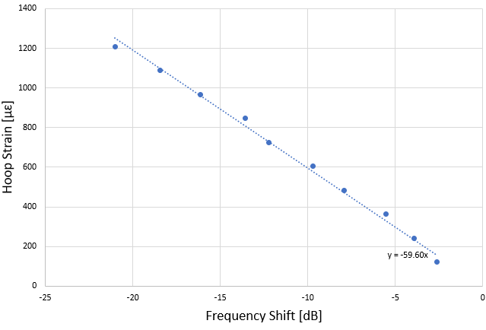
Luna ODiSI-B Correlation for Hoop Strain
Internal pressure was converted to hoop strain using pressurized vessel equations.
Hoop strain was plotted against frequency shift.
MS Excel was used to find a linear fit for a correlation.
New correlation is ε=-59.60υ where υ is the frequency shift values.
Figure: Hoop strain plotted against Frequency shift [dB]. MS Excel was used to find a linear fit.

Slide 34
Thank you

