Slide 1
Learned Productivity Under Variable Solar Conditions
Graduate Researcher: Matthew Mullin
Advisors: Michael Wagner, Gregory Nellis

Slide 2
Table of Contents:
Problem Statement
Goals and Objectives
Description of Methodology
Background Material & Results
Future Plans
Issues/Discussion
Citations

Slide 3
Problem Statement

Slide 4
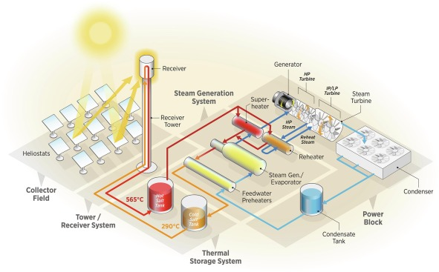
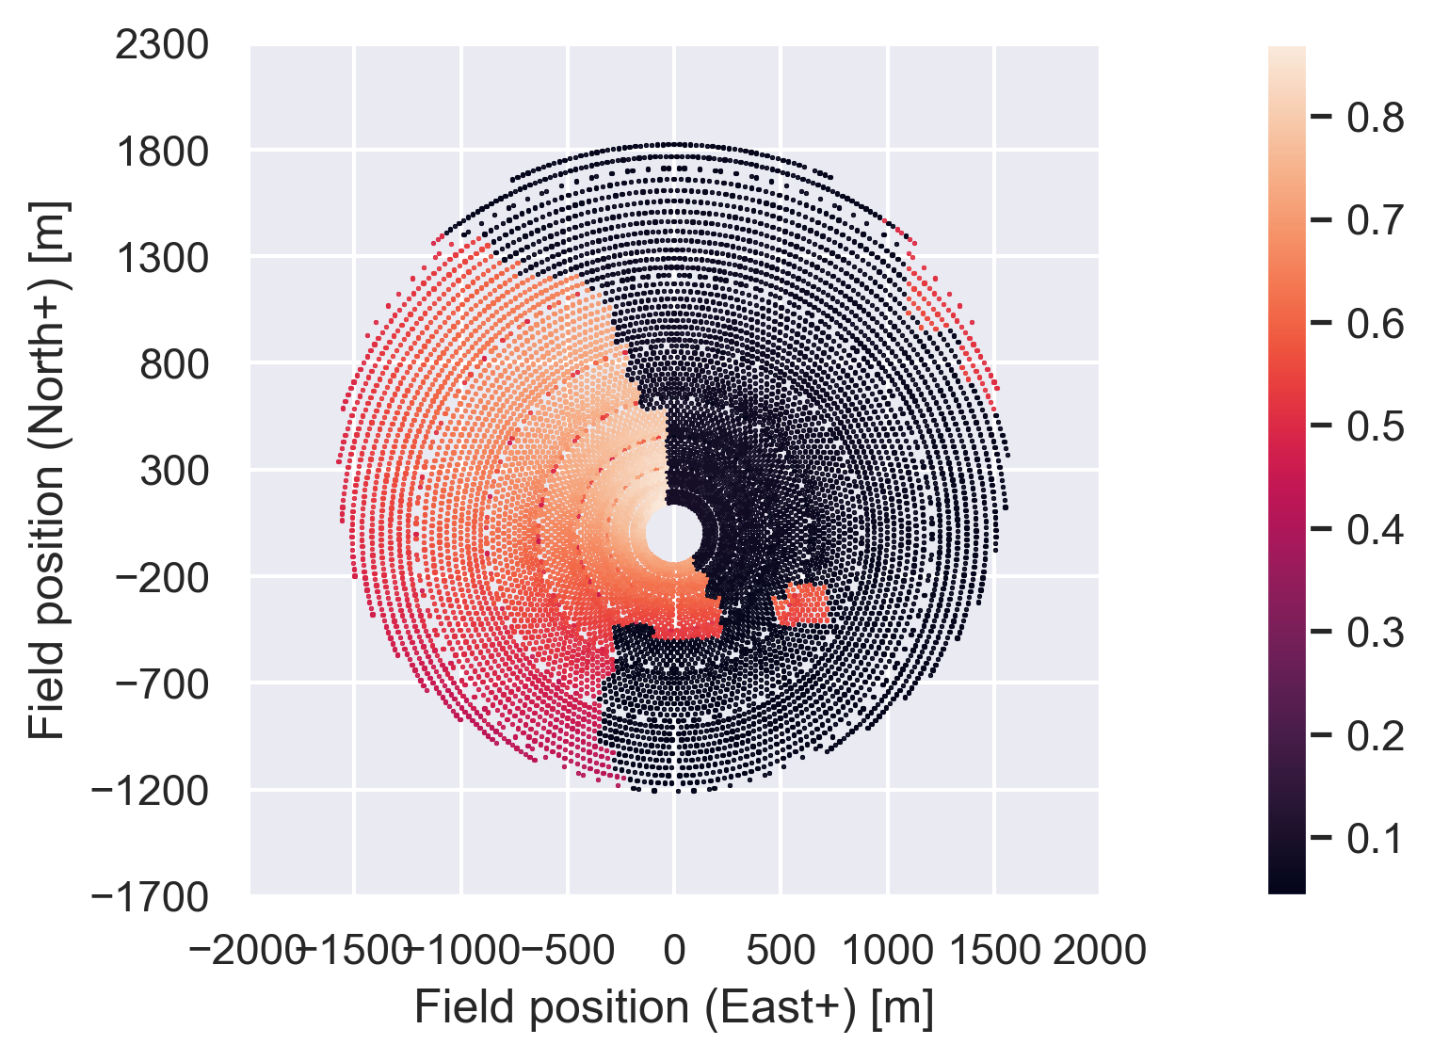
CSP and Clouds
Concentrating Solar Power (CSP)
Power Tower/Central Receiver Plant
Billion $ investments
Relies on direct normal irradiation (DNI) or beam radiation from sun, reflected by heliostat mirrors
Thick water clouds completely block beam radiation while thin ice clouds reduce DNI depending on optical thickness
Occurs in a non-spatially uniform way
thermal stress/cycling on the receiver
operating range ~700-1000K, heat flux of ~300-1000 kW/m^2
Central Receiver Plant Diagram (Hamilton, 2020)
Water Cloud passing over heliostat field

Slide 5
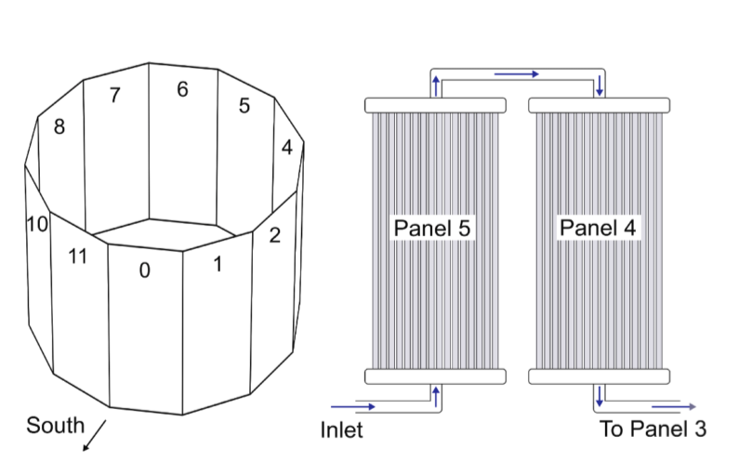
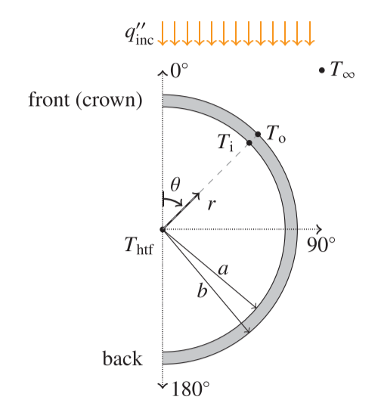
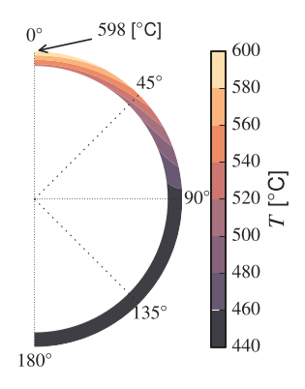
Receiver Geometry
Geometry of solar receiver (external):
Consists of thin tubes (316 SS, Inconel 740H, Haynes 230)
Coated in solar absorbing black “Pyromark®”paint
External Receiver (tubes subject to oxidation, wind, etc.) with highest flux on the north side
Tubes full of Heat Transfer Fluid (molten salt). HTF alternates. Cold fluid enters on North (high flux) side and exits hot on the south (low flux) side.
Tubes are assumed to be adiabatic on back, solar flux normal to crown (θ = 0° on receiver)
Data from Solar II test plant from Sandia:
During cloud passage receiver can safely change 565C-290C in <1 min
Tubes fixed at top, allowed to expand downwards. Tube clips (not shown) prevent tubes from moving laterally
Cylindrical External Receiver Geometry (Martinek, 2021)
Half Cross-Section of a Tube (Logie, 2018)
Thermal Cross-Section of a Tube (Logie, 2018)

Slide 6
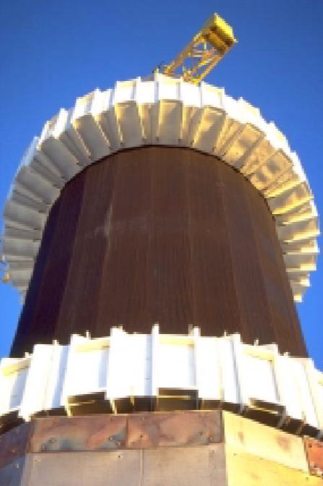
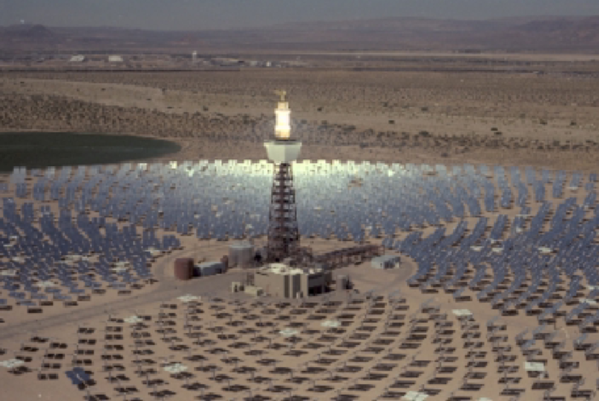
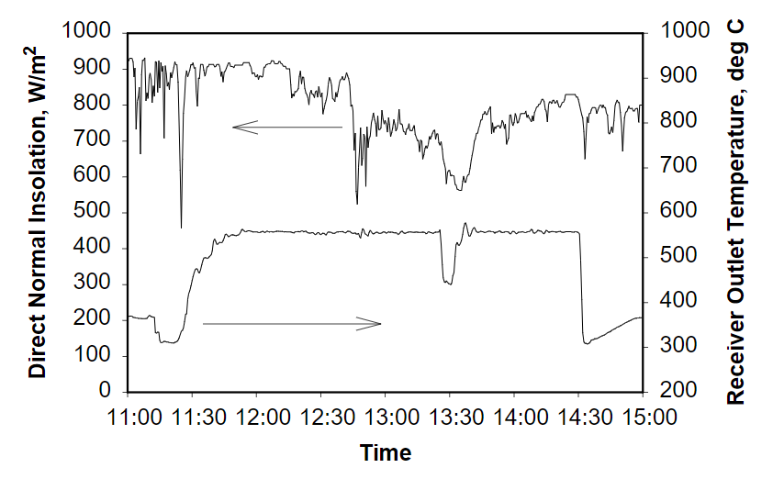
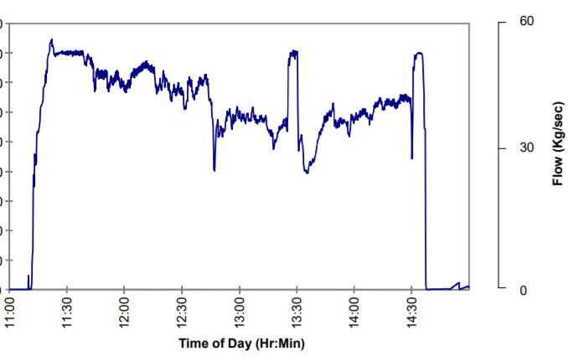
How Plants Account For Variability
When clouds pass over - cloud standby mode (see figures at ~13:25):
DNI low -> heat transfer fluid (HTF) ṁ increased -> reduces outlet temperatures
Loss in electricity
If: ṁ decreased -> cloud leaves field -> temperatures increase -> lifetime reduced*
Because tubes heat up < 1 min
Instead: make this decision quantitatively:
Based on cost of the damage to the receiver, electricity prices, thermal storage etc.
Ivanpah can lose $200,000 per day of maintenance on electricity revenue alone (Noc, 2019).
Plants are designed conservatively:
High* safety factors, uses ASME B&PV Nuclear codes
Better modeling -> reduced safety factors -> more economic designs (Kistler, 1987)
Solar II Test Plant (left), Closeup of Central Receiver (right) (Pacheco, 2002)
DNI/Temperature for Solar II (Pacheco, 2002)
ṁ for Solar II (Pacheco, 2002)

Slide 7
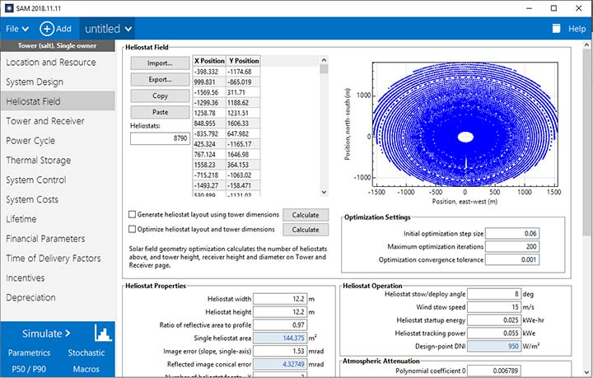
System Advisor Model
System Advisor Model (SAM)
SAM has a CSP model that uses SolarPILOT (analytical central receiver simulation tool), and various subsystems modules.
Solves Mixed Integer Linear Program (MILP) to produce optimal heliostat layout, receiver parameters, and optimize thermal storage for some desired variable such as Levelized Cost of Electricity (LCoE)
Current status of SAM:
Takes in scalar uniform flux/weather data
Does not account for spatial variation in flux/temperature
Data usually not directly available but can be correlated to PV Panel readings on individual heliostats
SAM is a Design Tool, not an operating tool.
SAM CSP optimization
Ashalim Solar plant DNI from Solar Cells (Minis, 2019)

Slide 8
Problem Statement
Problems:
What should the operator do during times of variability?
Quantitatively, what is the damage/cost to the lifetime of the receiver when clouds cause thermal stresses? How do damage mechanisms vary with different design regimes (700K vs 1000K)? Can this cost be assessed in real time?
Can we produce some algorithm that optimizes the inherent trade-off between the damage done to the receiver by operating during a cloud event and the current and future price of electricity, given current and predicted cloud conditions in a short-term timeframe? And how can we optimize new plant designs if we better account for variability?
Central Receiver Plant Diagram (Hamilton, 2020)
Cloud passing over heliostat field

Slide 9
Goals and Objectives

Slide 10
Goals and Objectives
Partners: UW, NREL, and Bright Source Energy (BSE)
Overall Project:
Measure and forecast variable DNI data over a heliostat field with ~1 m spatial resolution and ~30 s temporal resolution for an 8 hour time horizon, accounting for uncertainty and making use of existing infrastructure (PV panels on heliostats).
Use ML where possible to decrease computing time and errors.
Develop a first principles model that goes from solar irradiance data to lifetime receiver cost/damage
Quantify how transient models in (3) affect LCoE in modified SAM optimization model. Create a DL/Reinforcement Learning Model, trained with past operator decisions and against robust global optimization solvers, to give plant operator decision suggestions during times of variability in a ~30s time window, which yields 5% revenue improvement.
My part: (3) integrating/developing first principles models, (2) ML heuristics; (4) explore how transient models affect SAM/optimized plant design

Slide 11
Breakdown of My Goals
3) First-principles baseline modeling (NREL, UW)
create a thermal model of the receiver from first principles that can then be fed as input to an ML program, which is trained on observed receiver thermal data to reduce errors between the model and observed data
3.1) Optical modeling modifications
Adjusting SolarPILOT/CoPylot to work with transient cloud time series data
2) ML Model Development - Solar Field Production (BSE, UW, NREL)
Using the model from (3) as input and observed data as the training set, the goal is to create a multidimensional neural network to reduce error between the input model and the observed data.
2.2) Receiver thermal production prediction (UW)
Developing a ML model to predict thermal data from solar flux and other weather inputs
4) Application and optimization (UW, NREL)
Modifying optimization model to deal with variability factors. Explore how these factors impact initial design modeling and long-term system performance.

Slide 12
Methodology

Slide 13
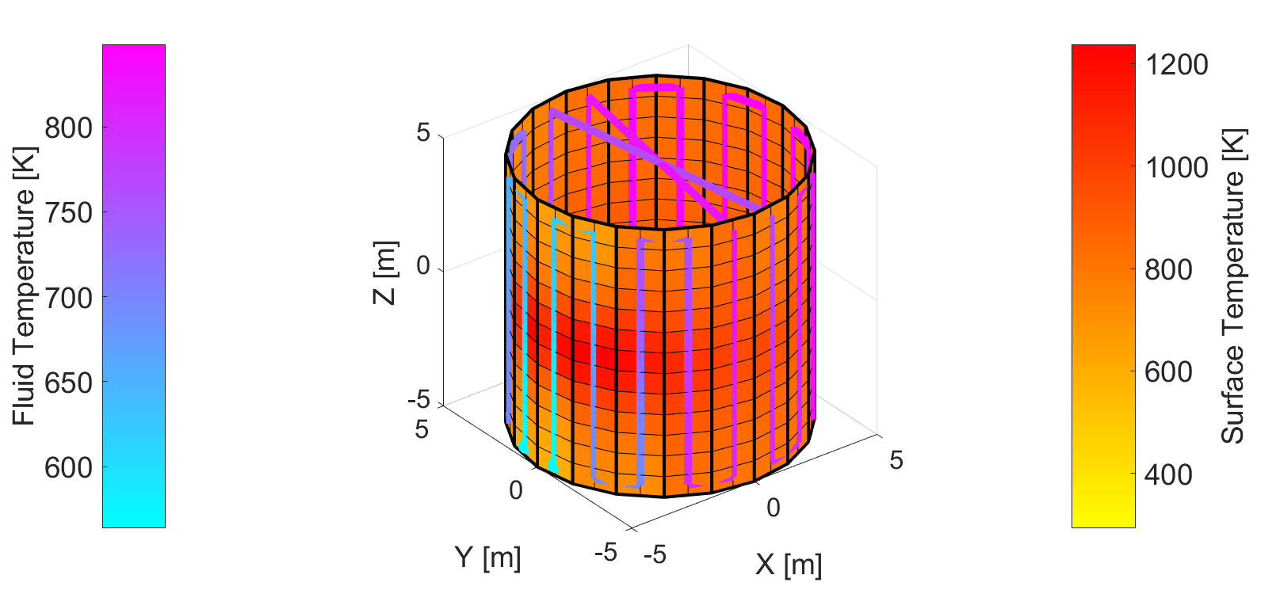
First Principles (FP)
Workflow
DNI Nowcasting & Forecasting
BSE:
Spatial irradiance map at time ‘t’
Heliostat Aimpoints
Operator
Parameter:
$$θ_{i}∈n_{hel}$$
SolarPILOT/CoPylot optical receiver model
UW:
Mass Flow Rates
Receiver Solar Flux Map
Operator
Parameter: ṁ(t)
Flexible thermal receiver model
Metal Surface Temp Map
Fluid Pressure
Fluid Temp Map
Thermal Losses
NREL/BSE:
Thermal stress model ‘srlife’ (ANL)
Multi-dimensional stress profiles
UW/BSE:
Receiver Lifetime/ Cost Calculation
UW:
Lifetime estimate
Cost for dispatch

Slide 14
Machine Learning (ML)
Workflow
BSE
DNI Nowcasting & Forecasting
-Low-Res Spatial irradiance map at time ‘t’
-Weather data
Heliostat Aimpoints
Operator
Parameter:
$$θ_{i}∈n_{hel}$$
ML weather to Thermal Model
Operator
Parameter: ṁ(t)
Mass Flow Rates
Metal Surface Temp Map
Fluid Pressure
Fluid Temp Map
Thermal Losses
UW
ML Thermal to Stress/ Lifetime Cost Model
BSE
Lifetime estimate
Cost to dispatch
UW

Slide 15
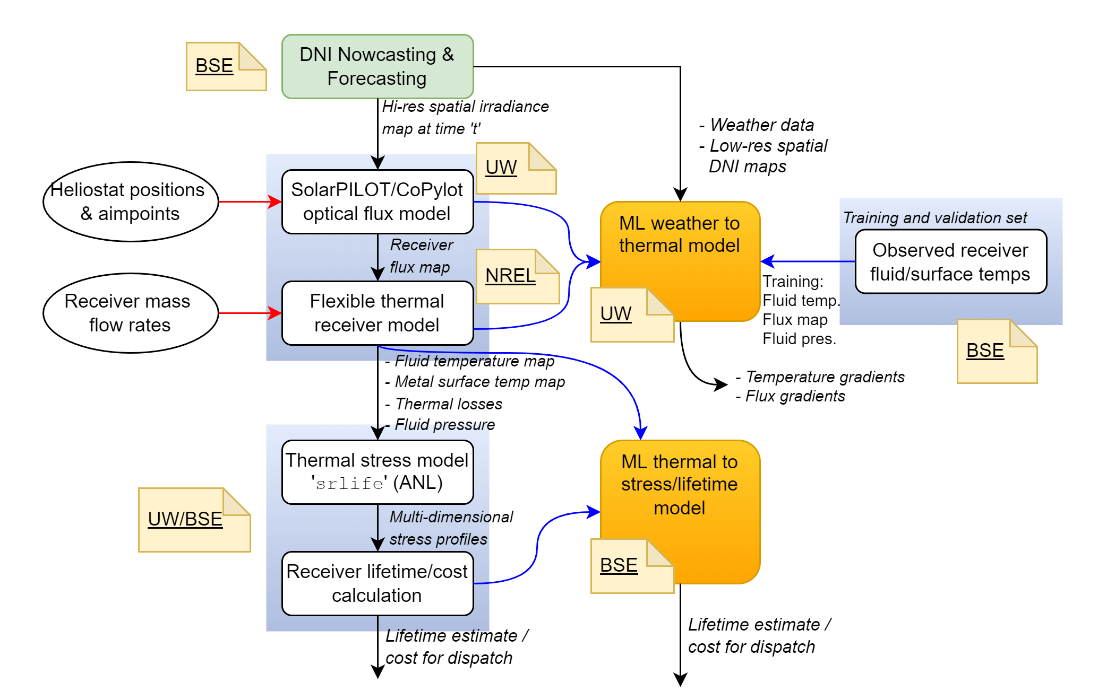
FP & ML
Workflow

Slide 16
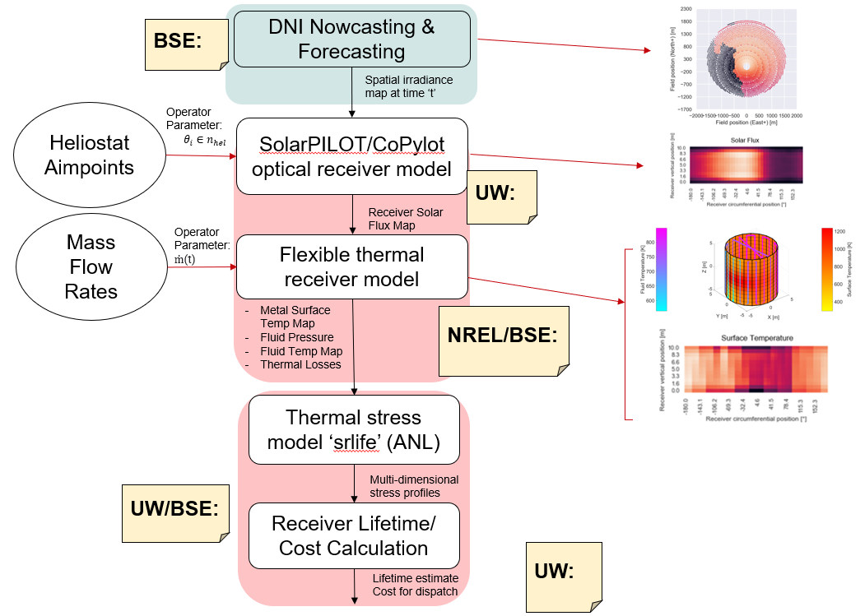
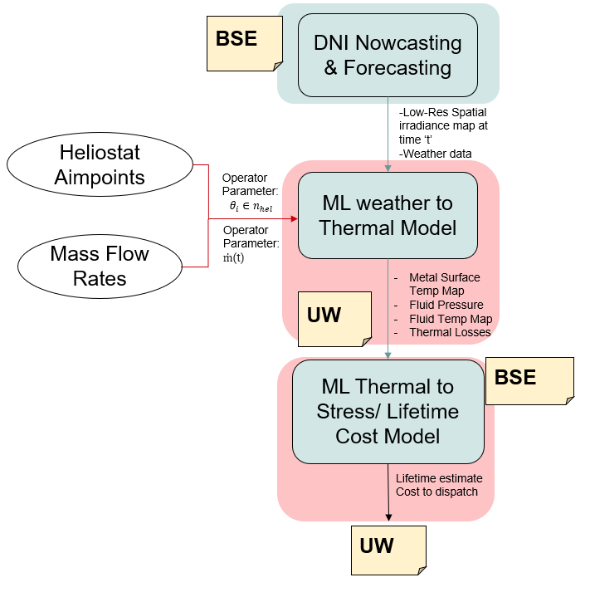
Description of Methodology
Present:
We have developed functions that use cloud masks (from total sky imaging or DNI nowcasting) as inputs and maps clouds onto a heliostat field.
Using Solar Pilot’s Python API CoPylot, we can simulate a heliostat field subject to these cloud masks leading to the solar flux distribution on a receiver.
The receiver flux distribution is a boundary condition for a thermal model of the receiver that is written in MATLAB in order to obtain surface temperature maps, fluid temperatures, etc.
Using the receiver flux map and fluid temperatures as boundary conditions, we are using Argonne National Lab’s srlife python package to model stress and generate receiver damage data (from creep and fatigue) for modified SAM.
Future:
We plan on using the Pytorch/FastAI library to train a neural net or ML regressor to reduce error between our first principles model and observed thermal data, and possibly train Image-To-Image ML models to speed up the process.
FP Work Flow
ML Work Flow

Slide 17
Background Material & Results

Slide 18
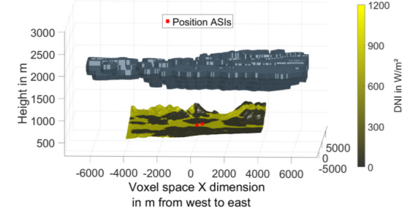
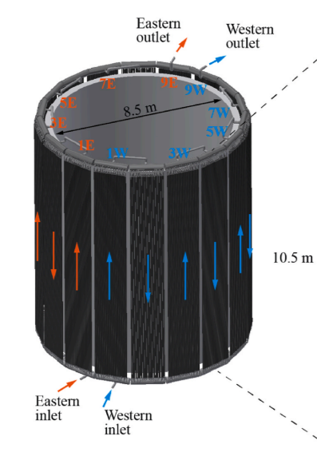
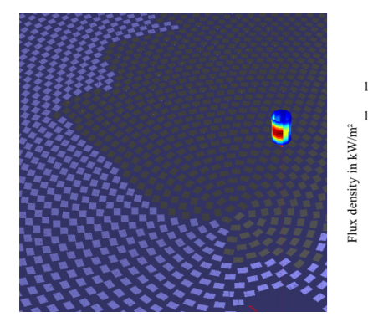
Literature Review
DNI nowcasting has been validated in the field with high spatial and temporal resolution (Nouri, 2020).
Current research focuses on heliostat aimpoint strategies & control algorithms to achieve fixed outlet temperatures during transience (Schwager, 2019).
Lifetime transient research is limited. One study claims 73.8% of receiver damage from creep but does not account for spatial DNI variation, sensitivity analysis is limited,uses HTF routing that is not typical (Laporte-Azcue, 2022)
This work will quantify how spatial DNI variability produces local thermal cycling and determine the associated cost to the overall lifetime of the receiver. This work + SAM allows the ability to use ML to optimize operations on a short timestep and to better optimize the design of plants.
Example of DNI map from 2 TSI’s (Nouri, 2020)
Heliostat Aimpoint Strategies Under Variability (Schwager, 2019)
Unconventional HTF Routing (Laporte, 2022)
Notes:
Do similar works exist?
Using TSI’s - total sky imagers, can get 1-minute time resolution data and 1-m spatial resolution using what are essentially surveillance cameras.
Works best in 15-30 min ahead time intervals, but when combined with a weather station and NWP, can work in a sub 6h range.

Slide 19
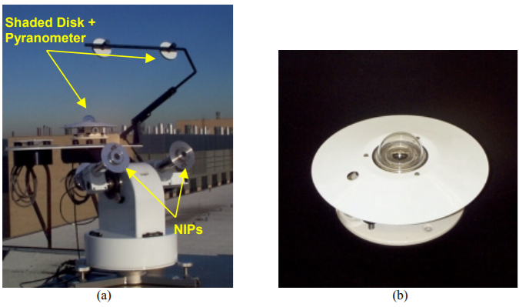
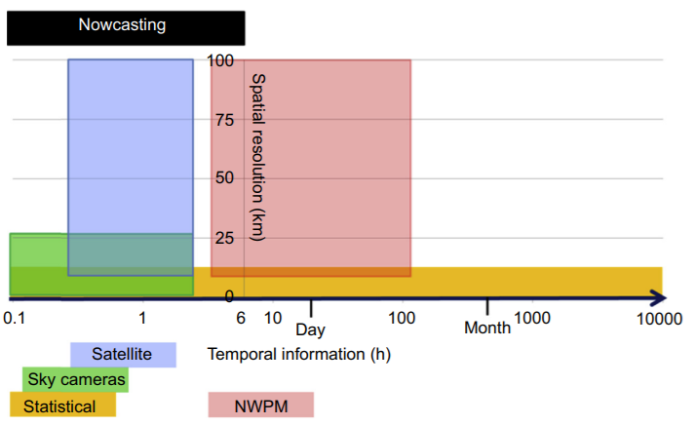
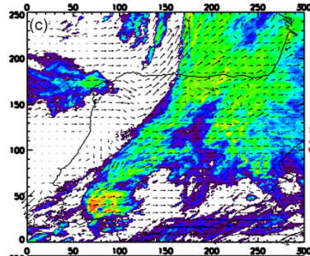
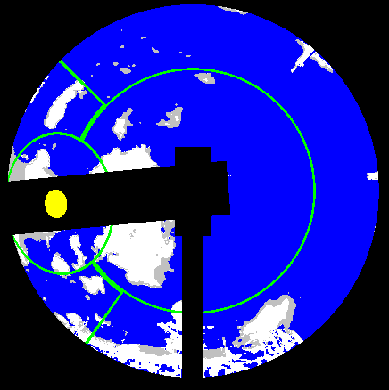
Review of DNI Forecasting
DNI Nowcasting & Forecasting
Structure of DNI Forecast Data(?)
pyrheliometers scattered in heliostat field for scalar DNI values
Interpolation errors + expensive for spatial data -> PV Panel Correlation
Available Satellite Datasets:
Sentinel-2: spatial resolution 10x10m, time resolution ~5 days (Sentinel Online, 2021)
MSG/SEVIRI: spatial 3x3 km, time ~15 min (Sirch, 2017)
GOES-R: spatial 0.5-2km, time ~5-15 min (GOES-R, 2021)
TSI: Total Sky Imagers
Security cameras with mechanical/software shade arms/discs
High spatial resolution ~1m, high temporal resolution <30s, limited by where you can place hardware
Weather Station Data
Used in Numerical Weather Prediction Models (NWPMs)
Collected by NWS, ~100km spatial resolution (NWS, 2021)
Spatial irradiance map at time ‘t’
BSE:
Pyrheliometers at Solar II (Pacheco, 20002)
SEVIRI Cloud Mask (Sirch, 2017)
TSI Cloud Mask (Morris)
Nowcasting resolution chart (Ramirez, 2017)
Notes:
What data is typically available to operators and for nowcasting. What can we expect from BSE in terms of spatial, temporal accuracy.
Using TSI’s - total sky imagers, can get 1-minute time resolution data and 1-m spatial resolution using what are essentially surveillance cameras.
Works best in 15-30 min ahead time intervals, but when combined with a weather station and NWP, can work in a sub 6h range.

Slide 20
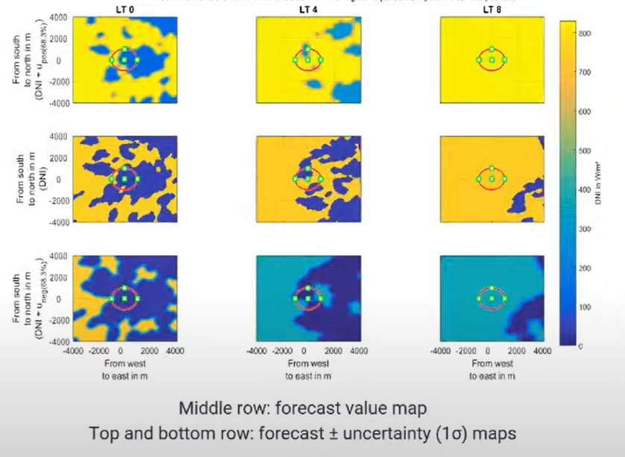
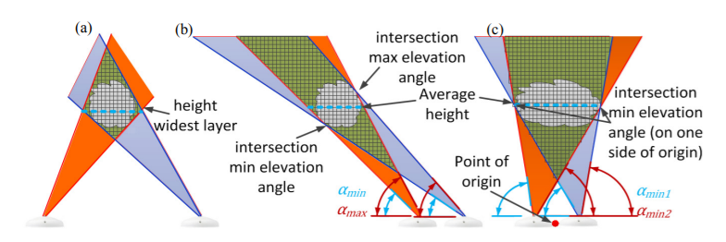
DNI Forecasting Data
TSIs: best for creating DNI maps for heliostat fields
analogous to PV output from Ashalim plant
Other sources needed to increase forecast horizon
Satellite: ~2 hours
NWPM: ~8 hours
Uncertainty increases with increasing time horizons
Forecasting Papers:
TSIs (local) include Coimbra et al. and Nouri et al. 2020
~15% mean error for 7.5 minute ahead forecast
2 TSI’s, proprietary software spinoff company
Satellite Data (mesoscale) include Sirch et al. 2017
5 min ahead: 95% accuracy
2 hr ahead: 80% accuracy, 2X accurate over persistence
Note:
Convolution neural networks (CNNs) & ML techniques predict cloud motion vectors (speed, direction) and masks (position) at future timesteps.
predictions with large absolute errors at 2-8 hour time horizon may still result in “better” operations outcomes than baseline
Accuracy of 10 min-2 hour forecast may have use in heliostat aimpoints, weighting any decisions, etc.
Representative DNI Cloud Masks (Nouri, 2019)
Nouri et al. voxel 2-TSI forecasting (Nouri, 2018)
Notes:
Using TSI’s - total sky imagers, can get 1-minute time resolution data and 1-m spatial resolution using what are essentially surveillance cameras.
Works best in 15-30 min ahead time intervals, but when combined with a weather station and NWP, can work in a sub 6h range.

Slide 21
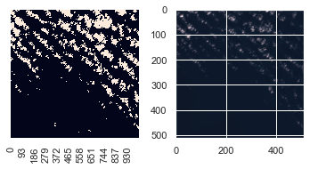
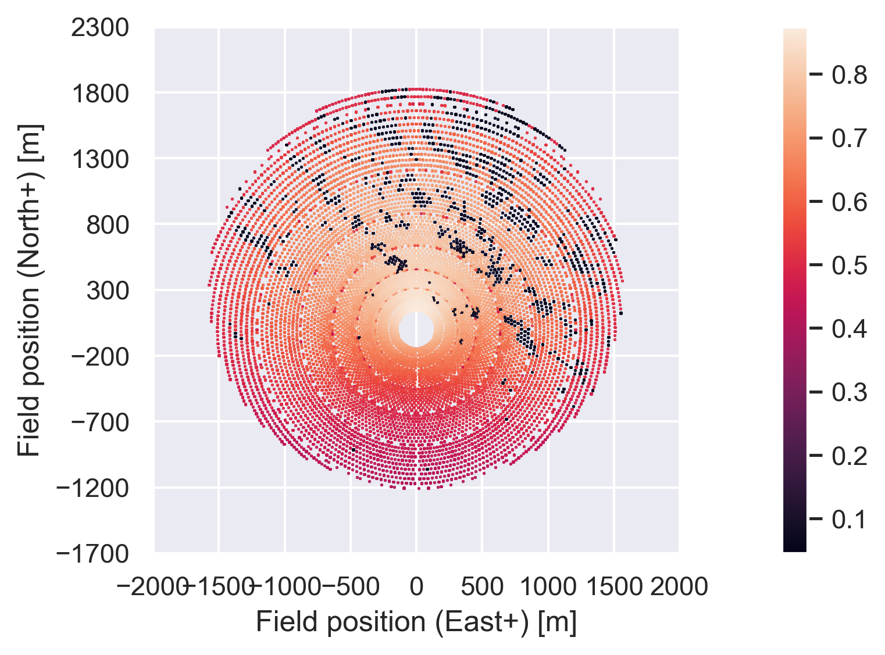
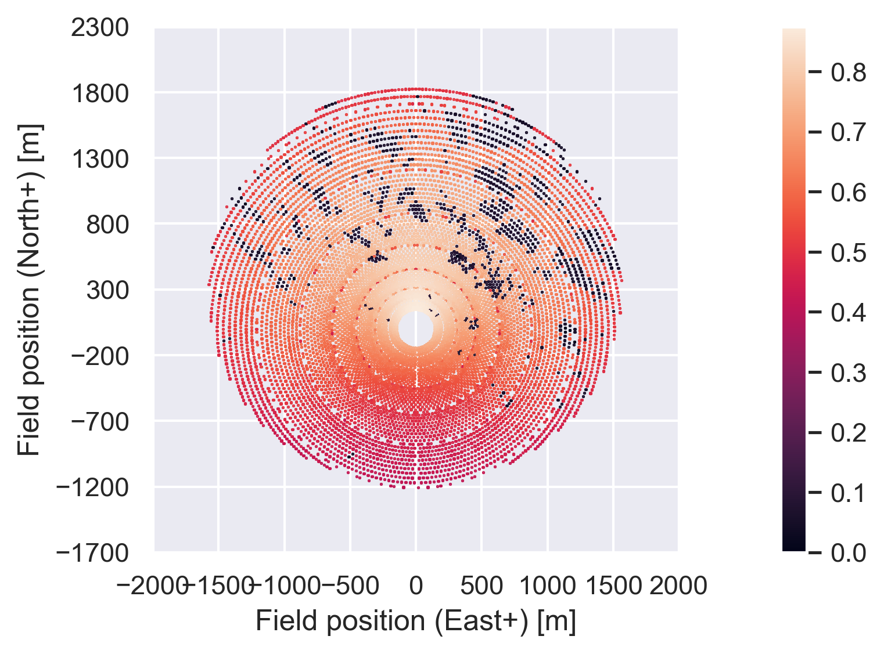
CoPylot Results
UW:
Spatial irradiance map at time ‘t’
Cloud masks database:
TSI + CNN: A comprehensive dataset for the accelerated development and benchmarking of solar forecasting methods (Pedro, 2019)
Satellite image:
20 x 20 m resolution
Sentinel-2 Cloud Mask Catalogue (Francis, 2020)
Cloud masks either:
Directly mapped to heliostats
Approximated into a set of polygons (Scikit Image)
Cloud masks contain:
Binary of total DNI
Fraction of total DNI (ice clouds)
SolarPILOT/CoPylot optical receiver model
Receiver Solar Flux Map
Sentinel-2 Data: Cloud mask (left) and Image (right) (Francis, 2020)
Cloud Mask mapped to Heliostat Soiling Parameter
Cloud Mask Method
Polygon Method

Slide 22
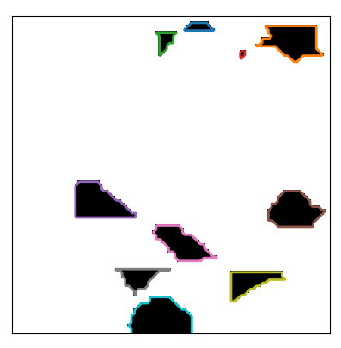
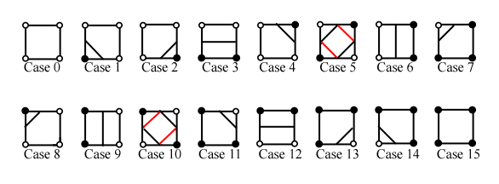
Polygon Method Results
Solar Pilot/CoPylot meant to take cloud shapes as vertices of polygons.
Sci-kit image library find-contours function
Marching squares algorithm // marching cubes algorithm
Lorensen, William and Harvey E. Cline. Marching Cubes: A High Resolution 3D Surface Construction Algorithm. Computer Graphics
Threshold value selected, and the image is converted into a binary map above and below value
Binary map is discretized further consisting of 4 pixel grid, and each grid is assigned to a case in parallel (see figure)
Ambiguous cases (5 & 10) are then connected such that contours close
Contours generate/connect counterclockwise
Finding contours function on synthetic cloud mask
Cases of marching square algorithm (Lingrand)

Slide 23
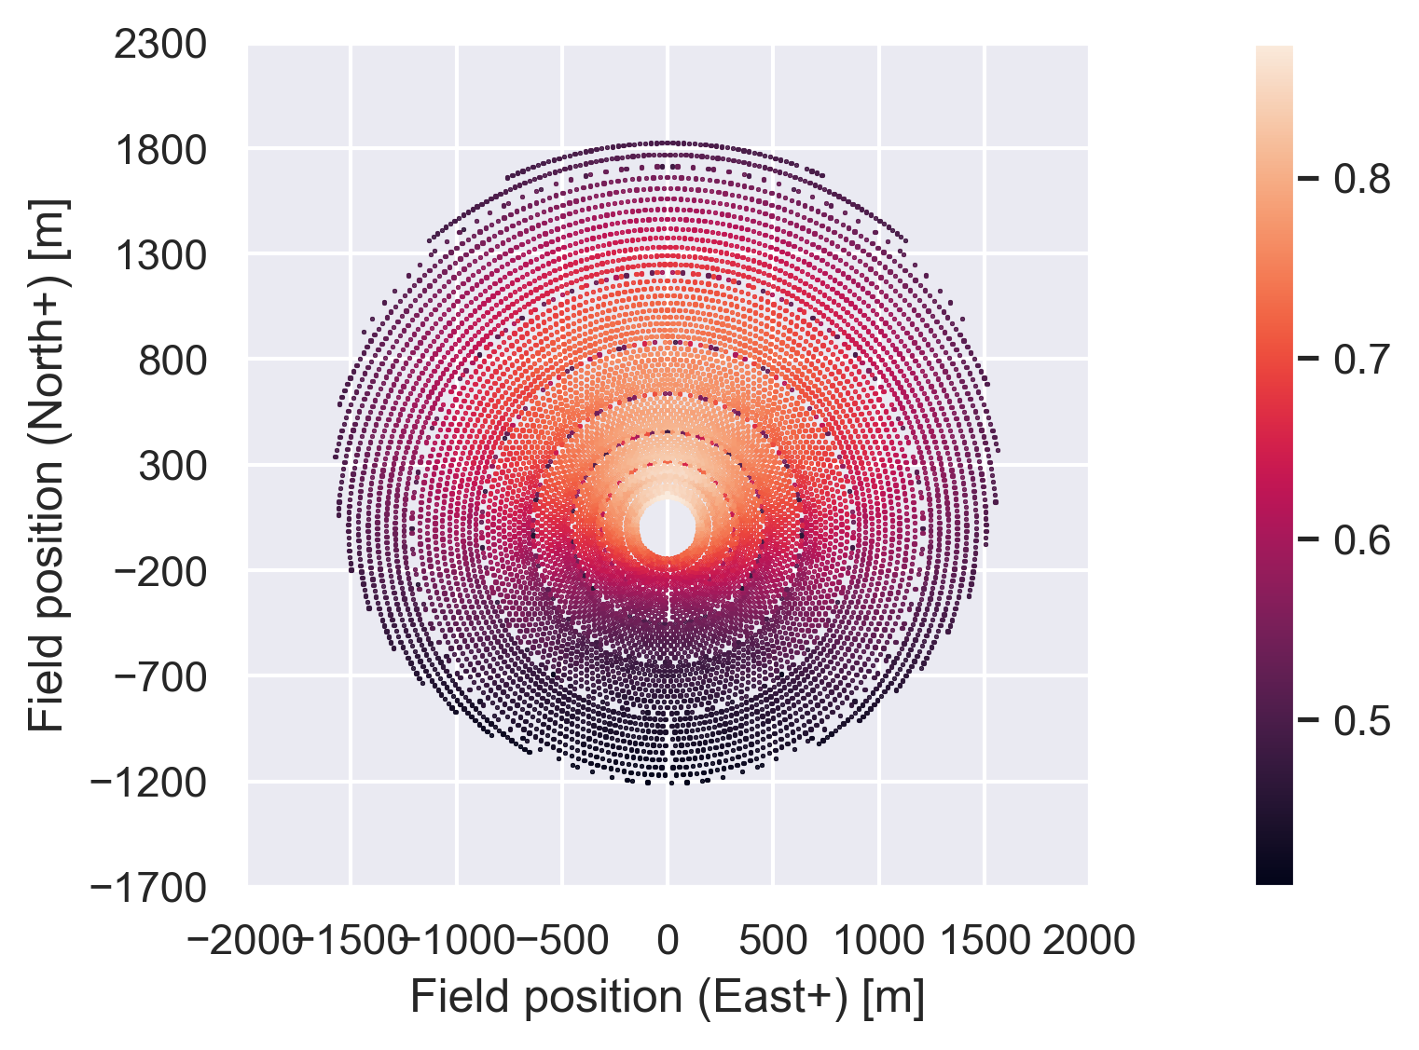
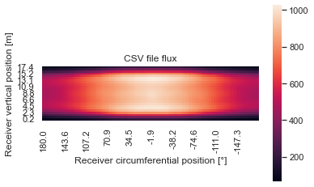
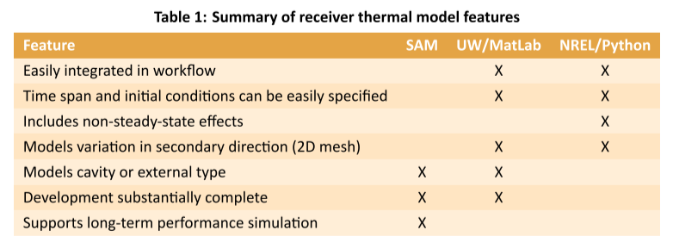
Receiver Model Results
Receiver Solar Flux Map
Flexible thermal receiver model
Currently using flexible thermal model developed by Kerkhoff and Wagner (2021) to take receiver flux map from CoPylot and obtain thermal data
A Flexible Thermal Model for Solar Cavity Receivers Using Analytical View Factors
For internal cavity receivers but adapted to external receiver case
Will be replaced/supplemented by model from NREL that more accurately models external receivers and is integrated into SAM
Metal Surface Temp Map
Fluid Pressure
Fluid Temp Map
Thermal Losses
NREL/BSE:

Slide 24
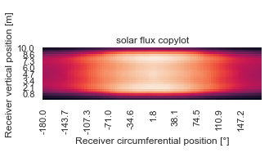
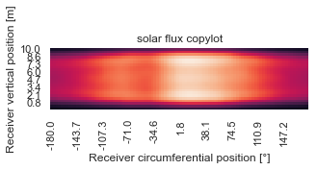
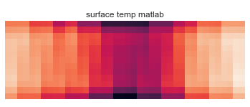
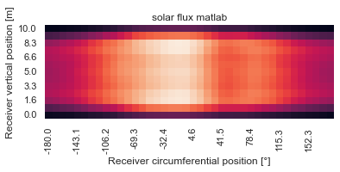
Receiver Model Results
Flux map is taken from CoPylot and mapped onto finite elements/mesh of receiver in MATLAB code
High temperature fluid (HTF) ṁ calculated using thermal receiver model in MATLAB or time series if data is provided for operator decisions
Given ṁ(t), surface & fluid temperature of receiver is iteratively calculated in receiver model code using energy balance, 2-band analytical radiative heat transfer model, and Nusselt number correlations. Assumes steady state.
CoPylot Base Case (no clouds)
MATLAB: Base Case simulation
base ṁ:
Left: 123.7 [kg/s]
Right: 124.1 [kg/s]
base T_{out}:
Left: 848.2 [K]
Right: 848.1 [K]
CoPylot Cloud Case
MATLAB: Cloud Case
T_{out}:
Left: 835.8 [K]
Right: 858.0 [K]

Slide 25
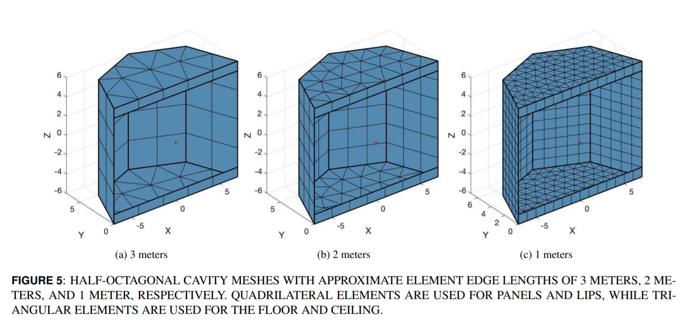
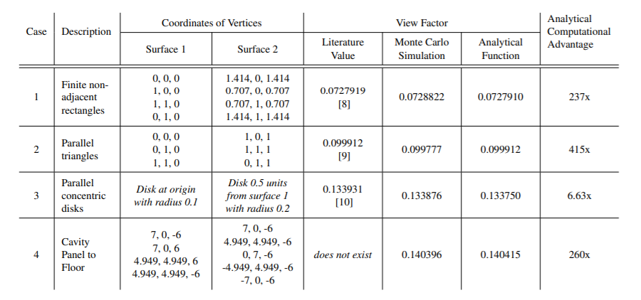
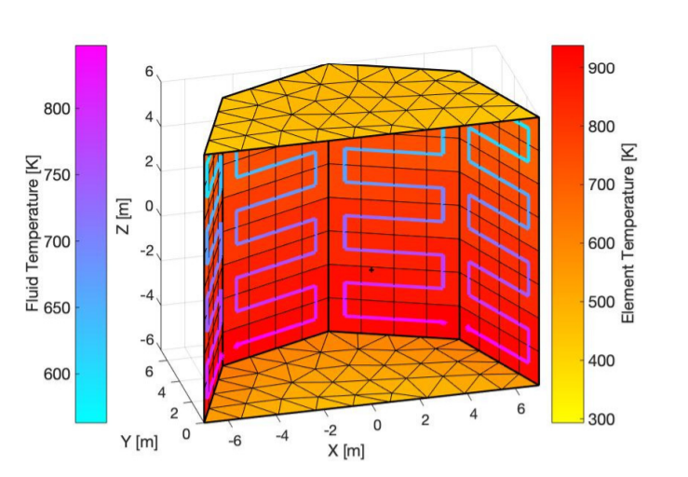
Receiver Model Description
Uses analytical view factors for radiation. An analytic expression for radiation view factor between two arbitrarily oriented planar polygons was programmed.
View factors used in F-hat method & energy balance for each element:
Mesh size and fluid routing path can be specified as parameters
Receiver Mesh Size
Parametric Fluid Routing
Analytical View Factor Function Compared to MCRT

Slide 26
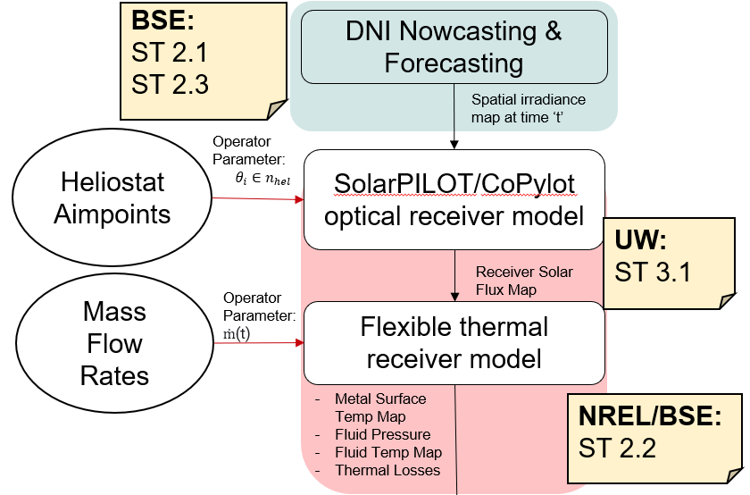
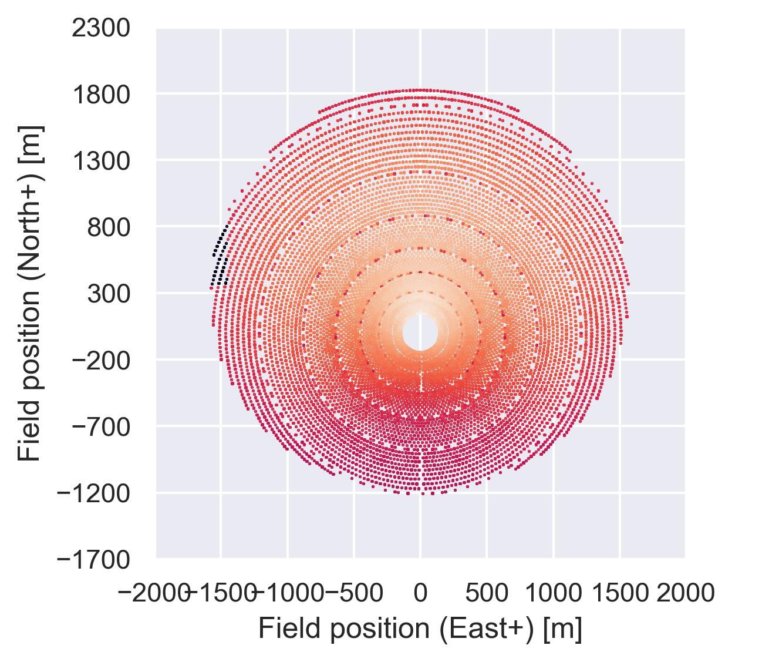
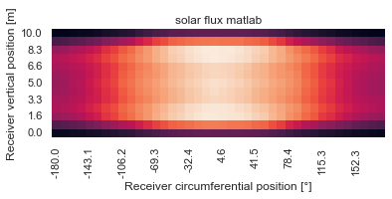
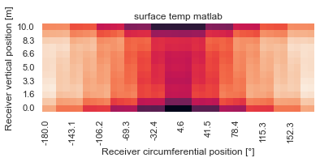
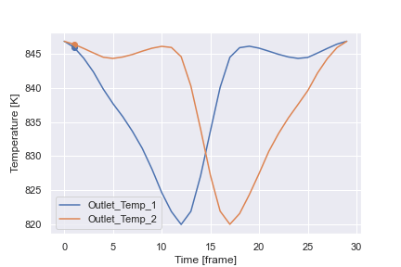
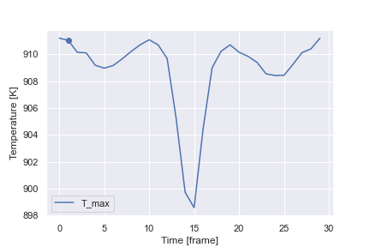
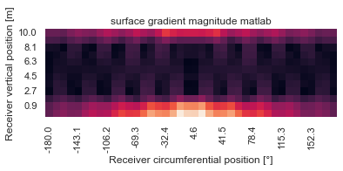
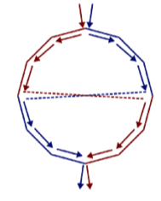
Example: Square Cloud
Solar Field: CoPylot
Receiver Model: MATLAB
Outlet Temperatures
Max Surface Temp
Outlet 2: SW
Outlet 1: SE

Slide 27
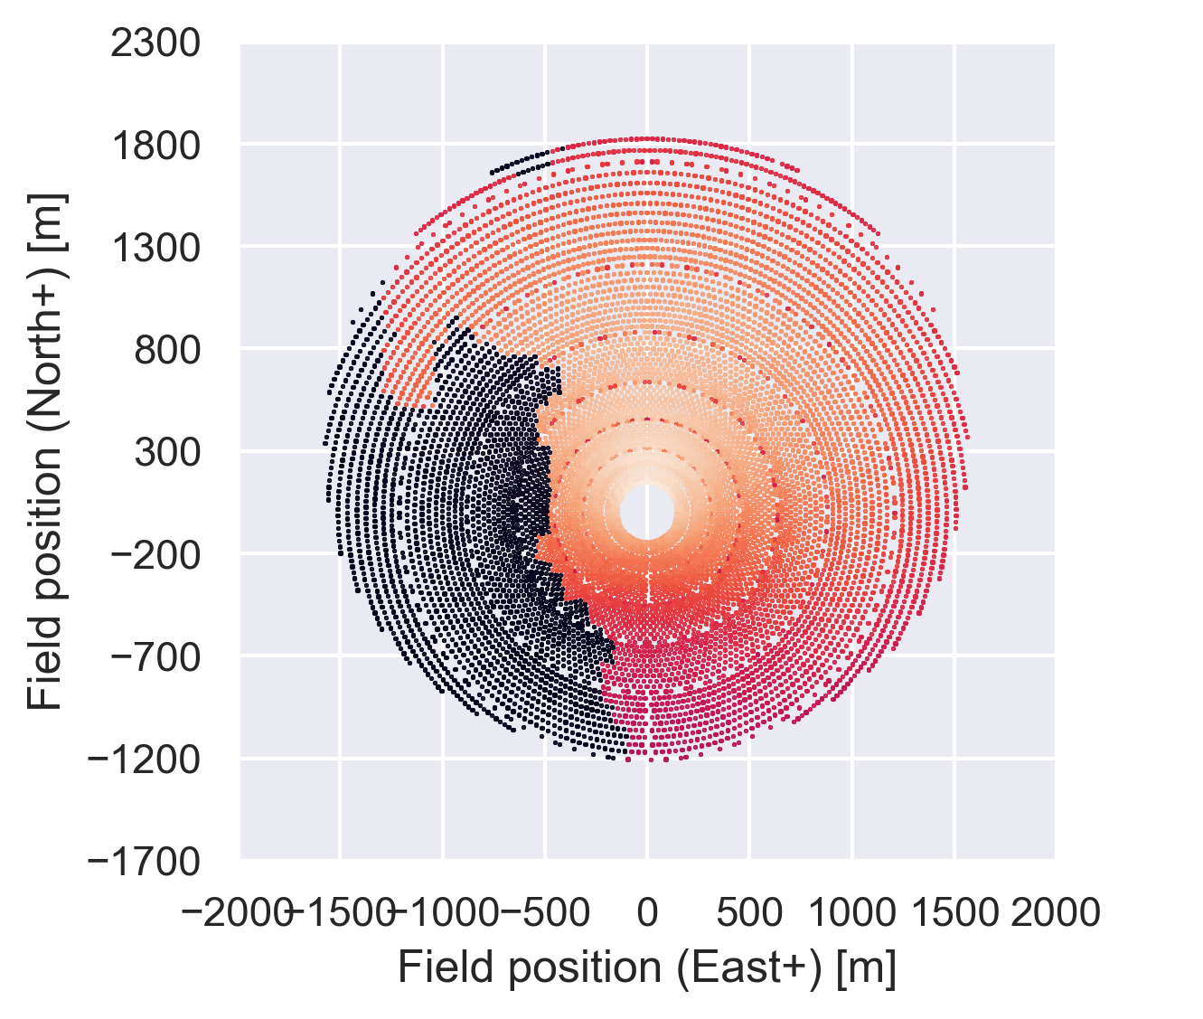
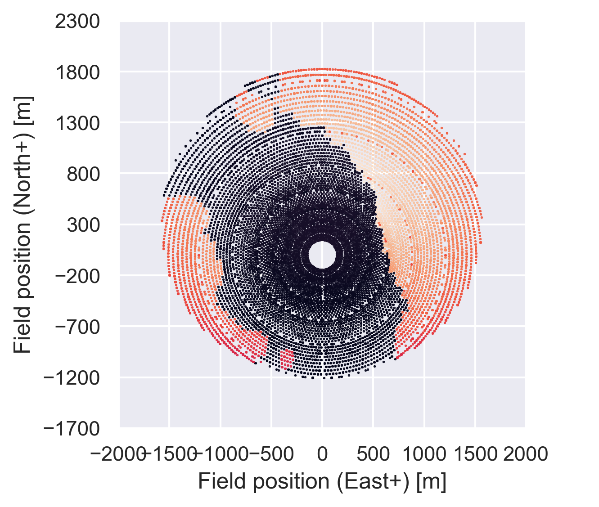
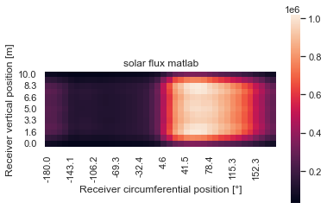
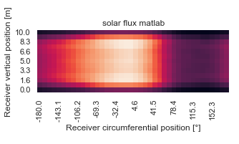
TSI Cloud Mask Demo
(a)
(b)
(c)
Solar Flux
Solar Flux
Solar Flux
(d)
(e)
(f)
Surface Temperature
Surface Temperature
Surface Temperature
(g)
(h)
(i)
T_{max} = 858.3 [K]
T_{max} = 771.0 [K]
T_{max} = 817.4 [K]
base pipe output temperatures [848.1500000000004,848.1499999999997]
pipe output temperatures [850.4808400525063,841.8382003052941]
check pipe output temperatures [790.8780761159504,892.6318143487324]
check pipe output temperatures [881.4462935739169,804.3617185874275]

Slide 28
Future, Issues, and Discussion

Slide 29
Future Work
Begin work on Application and Optimization work:
Document and integrate srlife.
Create a decision factor/cost for SAM.
Continue work ML Models & First Principles model:
Generate synthetic dataset for training ML models.
Identify and implement ML models.
Test speed of first principles model and clean up code.

Slide 30
ML Model Review
First Principles model likely deviate from observed thermal data due to:
Assumptions in SolarPILOT
Dynamic heliostat mapping
Receiver geometry deviates from model
Assumptions in thermal model
Steady state
Convection correlations
Identified 2 approaches to correct for errors in models using ML:
Support Vector Regression (SVR) model (error correcting)
Can map an input vector to an output vector with highly non-linear relationship
Gonzalez-Gonzalez et. al. used a year of commercial CSP data to predict gross power of power block for trough plant to within 1 MW error
Image-to-Image Translation (Isola et. al, 2017)
Uses conditional Generative Adversarial Networks (GANs)
General purpose, can transform a variety of images as GANs can learn any loss function
Can take DNI map as input and output thermal maps or stress maps using GPU speeds
CSP Trough Power Block SVR (Gonzalez-Gonzalez, 2021)
Working principle of cGANs (Isola et. al.)
Notes:
Using TSI’s - total sky imagers, can get 1-minute time resolution data and 1-m spatial resolution using what are essentially surveillance cameras.
Works best in 15-30 min ahead time intervals, but when combined with a weather station and NWP, can work in a sub 6h range.

Slide 31
Receiver Lifetime
Primary modes of failure and receiver damage have been investigated for clear sky flux distribution at high temperatures
Structural design considerations for tubular power tower receivers operating at 650 C (Neises, 2014)
Developed for sCO2 in receiver tubes at 25 MPa, inside tube tensile thermal stress, outside tube compressive stress; superposition of thermal + pressure stress
Creep/fatigue damage
Lifetime of receiver surface coating also important for maintenance calculations
High‐solar‐absorptance CSP coating characterization and reliability testing with isothermal and cyclic loads for service‐life prediction
Power law fit for the absorptivity of the receiver coating over time due to thermal cycling + formula to describe the oxidation kinetics
Not currently incorporated into lifetime models such as srlife (ANL)
Tangential, Radial, and Longitudinal Stress in Receiver Tubes (Neises, 2014)
Absorptivity of Receiver Coating with time & cycles (Noc, 2019)
Notes:
Using TSI’s - total sky imagers, can get 1-minute time resolution data and 1-m spatial resolution using what are essentially surveillance cameras.
Works best in 15-30 min ahead time intervals, but when combined with a weather station and NWP, can work in a sub 6h range.

Slide 32
Receiver Lifetime
Full transient inelastic analysis ‘srlife’ (ANL) model based on ASME Boiler Codes for Nuclear: (Barua, 2020)
Primary Load
Assumes steady-state thermal analysis
Ratcheting Strain Accumulation
Uses thermal data from transient analyses & Small-deformation linear elastic analysis
Secondary stresses: thermal creep-fatigue
Transient analysis (model created for startup/shutdown)
Larson-Miller Correlation model for creep
Time Independent Buckling (wind lateral loads)
Damage calculated as fraction of total receiver lifetime:
Model is good starting point for calculating total receiver damage during transience
High Temperature, Creep Damage; High Cycling, Fatigue Damage interaction
Example for 5 cloud events + Startup/Shutdown
Notes:
Using TSI’s - total sky imagers, can get 1-minute time resolution data and 1-m spatial resolution using what are essentially surveillance cameras.
Works best in 15-30 min ahead time intervals, but when combined with a weather station and NWP, can work in a sub 6h range.

Slide 33
Issues/Discussion
Access to a database of cloud masks and corresponding observed receiver surface temperature maps is necessary for ML
Fake dataset from ARM data or from Coimbra et al.
Somewhat difficult to translate into usable cloud masks
Code needs to be cleaned up and tested for speed of function executions.
For each phenomenon that affects receiver lifetime a “worst case scenario” calculation needs to be made for bounds
CoPylot API needs minor bug fixes and might need to write functions for adjusting heliostat aimpoints
TSI cloud mask data from ARM

Slide 34
Questions?

Slide 35
Citations
Barua, B., McMurtrey, M., Rupp, R. E., & Messner, M. C. (2020). Design Guidance for High Temperature Concentrating Solar Power Components (No. ANL-20/03). Argonne National Lab.(ANL), Argonne, IL (United States).
Francis, Alistair, Mrziglod, John, Sidiropoulos, Panagiotis, & Muller, Jan-Peter. (2020). Sentinel-2 Cloud Mask Catalogue [Data set]. Zenodo. https://doi.org/10.5281/zenodo.4172871
Feister, U., Shields, J., Karr, M., Johnson, R., Dehne, K., & Woldt, M. (2000, November). Ground-based cloud images and sky radiances in the visible and near infrared region from whole sky imager measurements. In EUMETSAT Satellite Application Facility Workshop, German Weather Service and World Meteorological Organization (pp. 79-88).
GOES-R, Instruments, https://www.goes-r.gov/spacesegment/abi.html (2021)
Hamilton, W. T., Newman, A. M., Wagner, M. J., & Braun, R. J. (2020). Off-design performance of molten salt-driven Rankine cycles and its impact on the optimal dispatch of concentrating solar power systems. Energy Conversion and Management, 220, 113025.
Isola, P., Zhu, J. Y., Zhou, T., & Efros, A. A. (2017). Image-to-image translation with conditional adversarial networks. In Proceedings of the IEEE conference on computer vision and pattern recognition (pp. 1125-1134).Laporte-Azcué, M., González-Gómez, P. A., Rodríguez-Sánchez, M. R., & Santana, D. (2022). A procedure to predict solar receiver damage during transient conditions. Renewable and Sustainable Energy Reviews, 154, 111905.
Kerkhoff, JA, & Wagner, MJ. "A Flexible Thermal Model for Solar Cavity Receivers Using Analytical View Factors." Proceedings of the ASME 2021 15th International Conference on Energy Sustainability collocated with the ASME 2021 Heat Transfer Summer Conference. ASME 2021 15th International Conference on Energy Sustainability. Virtual, Online. June 16–18, 2021. V001T02A014. ASME. https://doi-org.ezproxy.library.wisc.edu/10.1115/ES2021-63810
Lingrand, Diane. http://users.polytech.unice.fr/~lingrand/MarchingCubes/algo.html
Lorensen, W. E., & Cline, H. E. (1987). Marching cubes: A high resolution 3D surface construction algorithm. ACM siggraph computer graphics, 21(4), 163-169.
Morris, V., & Flynn, D. Total Sky Imager (TSICLDMASK). Atmospheric Radiation Measurement (ARM) User Facility. https://doi.org/10.5439/1025306
Narayanaswamy, A., 2015. “An analytic expression for radiation view factor between two arbitrarily oriented planar polygons”. International Journal of Heat and Mass Transfer, 91, pp. 841–847.
National Weather Service, Weather Prediction Center, https://www.wpc.ncep.noaa.gov/sfc/sfcobs/sfcobs.shtml (2021)
Neises, T. W., Wagner, M. J., & Gray, A. K. (2014). Structural design considerations for tubular power tower receivers operating at 650 C (Vol. 45868, p. V001T02A045). American Society of Mechanical Engineers.

Slide 36
Citations
Noč, L., Šest, E., Kapun, G., Ruiz-Zepeda, F., Binyamin, Y., Merzel, F., & Jerman, I. (2019). High-solar-absorptance CSP coating characterization and reliability testing with isothermal and cyclic loads for service-life prediction. Energy & Environmental Science, 12(5), 1679-1694.Sentinel Online, Resolutions, https://sentinels.copernicus.eu/web/sentinel/user-guides/sentinel-2-msi/resolutions (2021)
Nouri, B., Wilbert, S., Blum, N., Kuhn, P., Schmidt, T., Yasser, Z., ... & Pitz-Paal, R. (2020, December). Evaluation of an all sky imager based nowcasting system for distinct conditions and five sites. In AIP Conference Proceedings (Vol. 2303, No. 1, p. 180006). AIP Publishing LLC.
Nouri, B., Wilbert, S., Kuhn, P., Hanrieder, N., Schroedter-Homscheidt, M., Kazantzidis, A., ... & Pitz-Paal, R. (2019). Real-time uncertainty specification of all sky imager derived irradiance nowcasts. Remote Sensing, 11(9), 1059.[2] Schwager, C., Boura, C. J. T., Flesch, R., Alexopoulos, S., & Herrmann, U. (2019, July). Improved efficiency prediction of a molten salt receiver based on dynamic cloud passage simulation. In AIP Conference Proceedings (Vol. 2126, No. 1, p. 030054). AIP Publishing LLC.
Nouri, B., Kuhn, P., Wilbert, S., Prahl, C., Pitz-Paal, R., Blanc, P., ... & Heineman, D. (2018, November). Nowcasting of DNI maps for the solar field based on voxel carving and individual 3D cloud objects from all sky images. In AIP Conference Proceedings (Vol. 2033, No. 1, p. 190011). AIP Publishing LLC
Pacheco, J. E., Bradshaw, R. W., Dawson, D. B., De la Rosa, W., Gilbert, R., & Goods, S. H. (2002). Final test and evaluation results from the solar two project. SAND2002-0120, 1-294.
Pedro, H.T.C., Larson, D.P., Coimbra, C.F.M., 2019. A comprehensive dataset for the accelerated development and benchmarking of solar forecasting methods. Journal of Renewable and Sustainable Energy 11, 036102. https://doi.org/10.1063/1.5094494
Ramirez, L., & Vindel, J. M. (2017). Forecasting and nowcasting of DNI for concentrating solar thermal systems. Advances in Concentrating Solar Thermal Research and Technology, 293-310.
Sci-kit image, https://scikit-image.org/docs/0.8.0/api/skimage.measure.find_contours.html
Sirch, T., Bugliaro, L., Zinner, T., Möhrlein, M., & Vazquez-Navarro, M. (2017). Cloud and DNI nowcasting with MSG/SEVIRI for the optimized operation of concentrating solar power plants. Atmospheric Measurement Techniques, 10(2), 409-429.
Srlife https://srlife.readthedocs.io/en/latest/

Slide 37
Extras

Slide 38
Tasks
Task 3: First-principles baseline modeling
Given solar resource data from Task 1 and Task 5, the goal is to create a thermal model of the receiver from first principles that can then be fed as input to an ML program, which is trained on observed receiver thermal data to reduce errors between the model and observed data
Task 2: ML Model Development - Solar Field Production
Using the model from Task 3 as input and observed data as the training set, the goal is to create a multidimensional neural network to reduce error between the input model and the observed data.
Mathematically, the function minimized is:
Task 4: Application and optimization // shared responsibility
- Modifying optimization model to deal with variability factors. Explore how these factors impact initial design modeling and long-term system performance.

Slide 39
Sub-Tasks
Task 3: First-principles baseline modeling (NREL, UW)
Sub Task 3.1: Optical modeling modifications
Adjusting SolarPILOT/CoPylot to work with transient cloud time series data
Task 2: ML Model Development - Solar Field Production (BSE, UW, NREL)
Sub Task 2.1: Variability classification model
Developing a ML model to correlate Heliostat PV output with DNI
Sub Task 2.2: Receiver thermal production prediction
Developing a ML model to predict thermal data from solar flux and other weather inputs
Sub Task 2.3: Solar resource forecasting
Developing a ML model to predict spatial DNI data at future timesteps
Task 4: Application and optimization (UW, NREL, BSE)

Slide 40
3D Receiver Model Images

Slide 41
Srlife

