Slide 1
THERMAL HYDRAULICS LABORATORY
Versatile Test Reactor Sodium Chemistry Control & Monitoring
Andrew Napora
Advisor: Mark Anderson
9/14/21
Mech. E

Slide 2
Andrew Napora

Slide 3
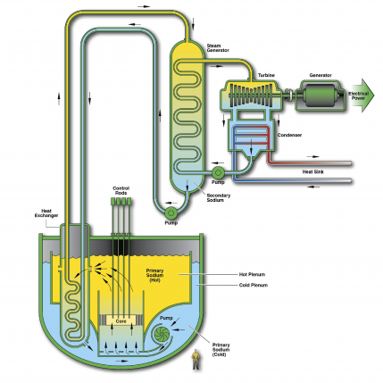
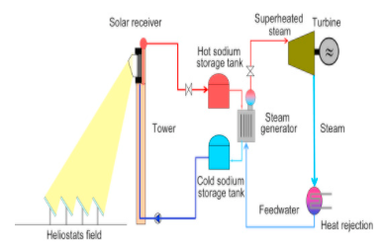
Background- Liquid Sodium
Good heat transfer fluid
High thermal conductivity (64 W/m-K at 500 C)
Low melting temperature (97.8 C), high boiling point (~880 C)
Doesn’t moderate neutrons
Uses:
Coolant in nuclear reactors
Heat transfer medium in solar tower
Exhaust valves in sports cars
[1] energy.gov, Advanced Reactor Systems
[2] Romero, Advances in Concentrating Solar Thermal Research and Technology

Slide 4
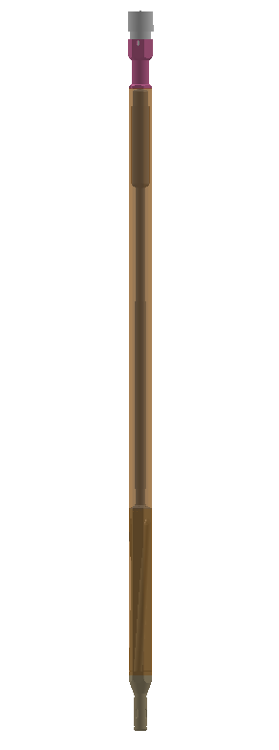
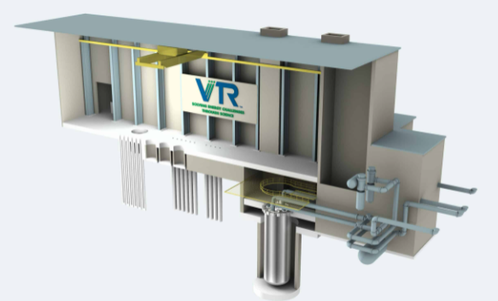
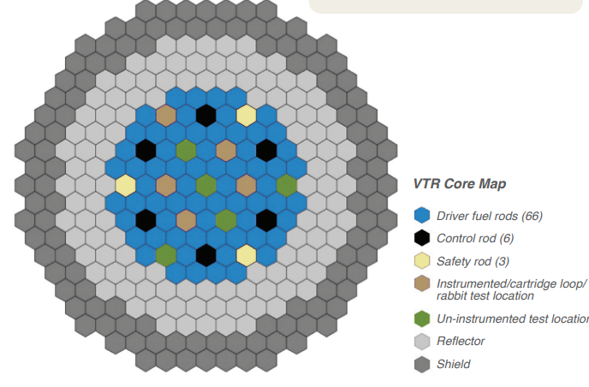
Background- Versatile Test Reactor
DOE announced February 2019, led by INL, ANL, LANL, ORNL, PNNL, SRNL
Test bed for Gen-IV reactor concepts (sodium, helium, lead, molten salt)
Sodium reactor with cartridge loop experiments instead of certain fuel rods
Allows irradiation under high neutron energy flux, materials testing, development of necessary instruments
[3] inl.gov/vtr
[4] https://www.energy.gov/sites/default/files/2019/11/f68/19-50625_VTR_R7_0.pdf

Slide 5
SFR Cartridge Project Partners
Perform experiments investigation thermal-hydraulic performance of the cartridge loop
Provide data for loop analysis tool validation
Develop instrumentation and methods to control and monitor oxygen concentration in sodium in-situ
Provide project integration, develop and validate detachable cartridge pump concept/instrument harness
Provide analysis tools, safety analysis
Develop design for SFR cartridge loop

Slide 6
Impurities in Sodium
Sodium is very reactive
For stainless steel systems, higher sodium oxygen content means higher corrosion rates
Hydrogen is of interest in secondary system- heat exchanged with water for power generation. Desirable to keep levels low for leak detection purposes
Other impurities- carbon, nitrogen, and in fuel pin failure fission products
How to control and measure oxygen level?
[1] energy.gov, Advanced Reactor Systems

Slide 7
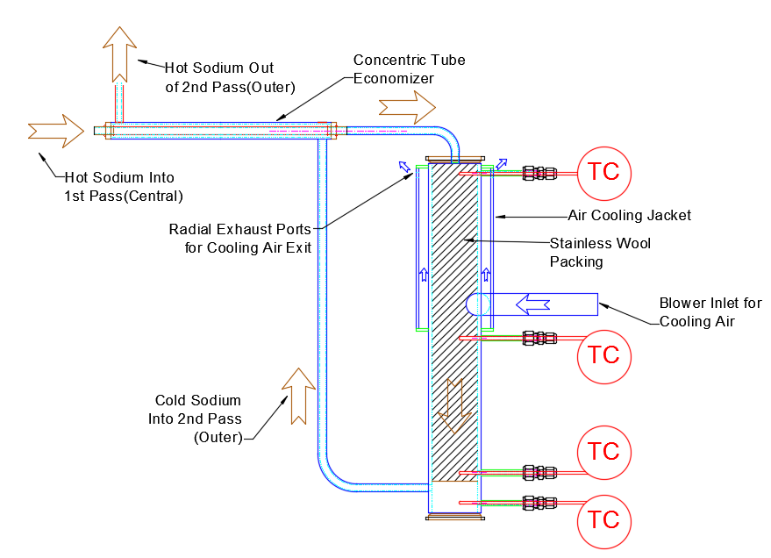
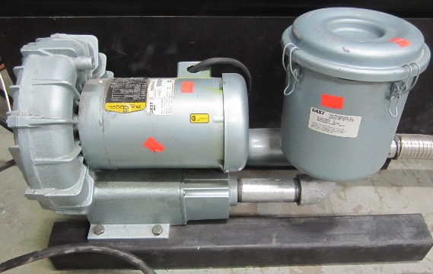
Oxygen Control- Cold Trap
Solubility of oxygen in sodium is positively temperature-dependent
Cold trap is the conventional method for controlling oxygen- sodium is cooled, oxides precipitate out and are filtered
[5]
Cold trap and concentric tube economizer
Regenerative Blower for Forced Air Cooling
[5] RDT F-340T Amendment 2, p. 24

Slide 8
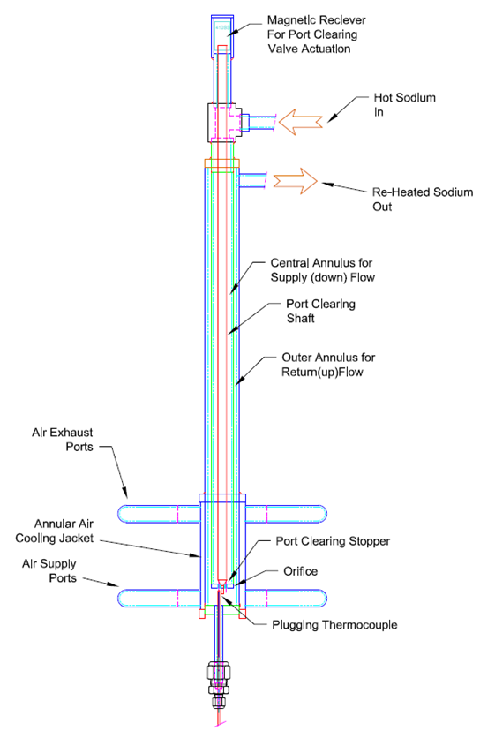
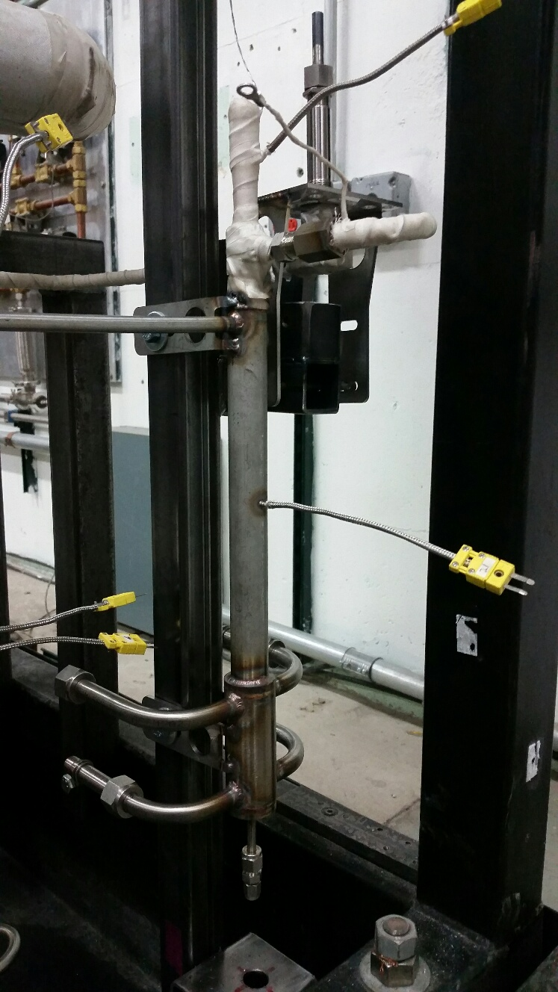
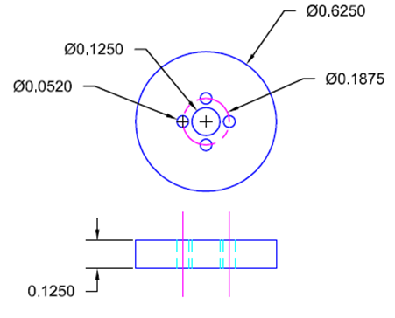
Oxygen Measurement-Plugging Meter
Standard method for measuring impurities, same principle as cold trap
Side flow cooled, passed through an orifice plate, oxide precipitates out
Flow rate reduces as orifice plate is plugged
Flow heated, impurities able to dissolve back into sodium flow, flow recovers
Can determine saturation temperature, oxygen concentration (a bit open to operator interpretation)
NOT oxygen-specific, though if you can assume hydrogen isn’t being actively introduced to system (no water loop), generally make the assumption that oxygen is what’s plugging

Slide 9
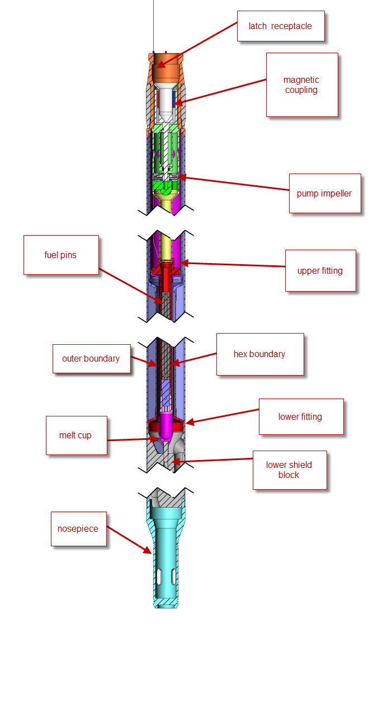
VTR Challenges
Hard to implement these traditional systems in a cartridge loop- space considerations (limiting radius 5.5 cm), challenges of gas cooling under sodium
Ideal to minimize connections to SFR cartridge (electrical only)
Motivation for investigating new methods

Slide 10
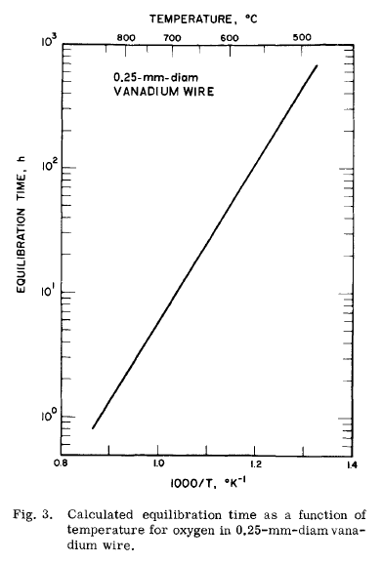
Vanadium Wire Equilibration
Instead of plugging meter (gas cooling, economizer, flow rate measurement) save space in cartridge using vanadium wire technique
Thin vanadium wire is submerged in sodium flow at high temps (typically 700-750C), oxygen diffuses into the vanadium, by LECO inert gas fusion can determine oxygen in sodium
Selects for oxygen, need to correlate this with plugging meter data as this is the useful standard for sodium systems
Advantages
Heating in core is easier than cooling
Small volume, only electrical connections
Independent of operator interpretation
No online measurement
RDT standard equilibration at 750C- want to quantify sensitivity of technique to temperature and time, can we equilibrate closer to cartridge temp?
[5] Smith, An Equilibration Method for Measuring Low-Oxygen Activities in Liquid Sodium
Distribution coefficient

Slide 11
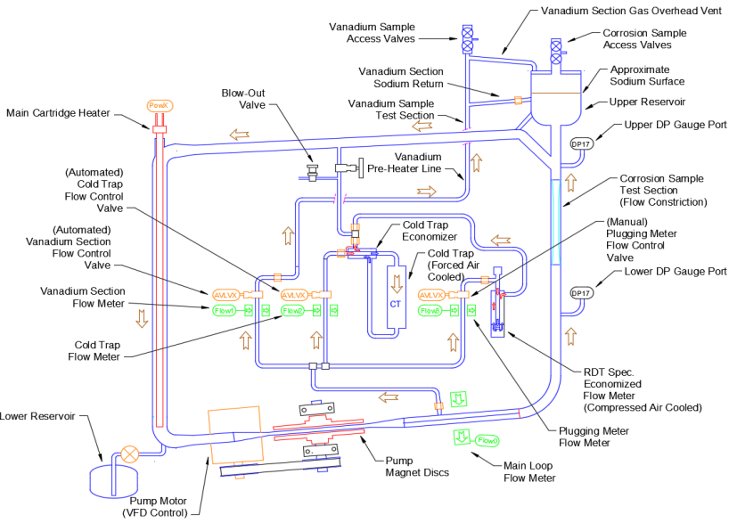
Loop Schematic
Loop incorporates cold trap, plugging meter, vanadium wire
What’s involved in a vanadium wire test?

Slide 12
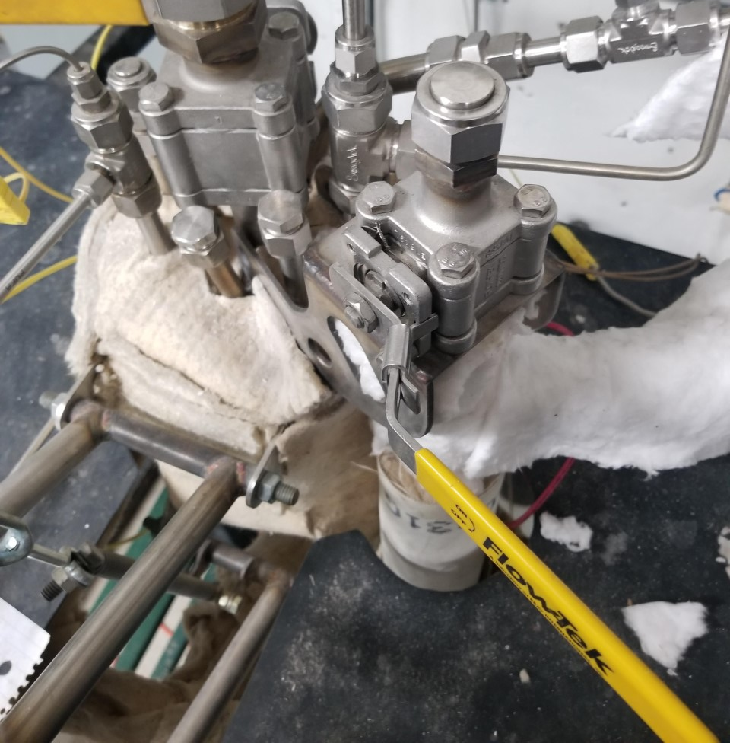
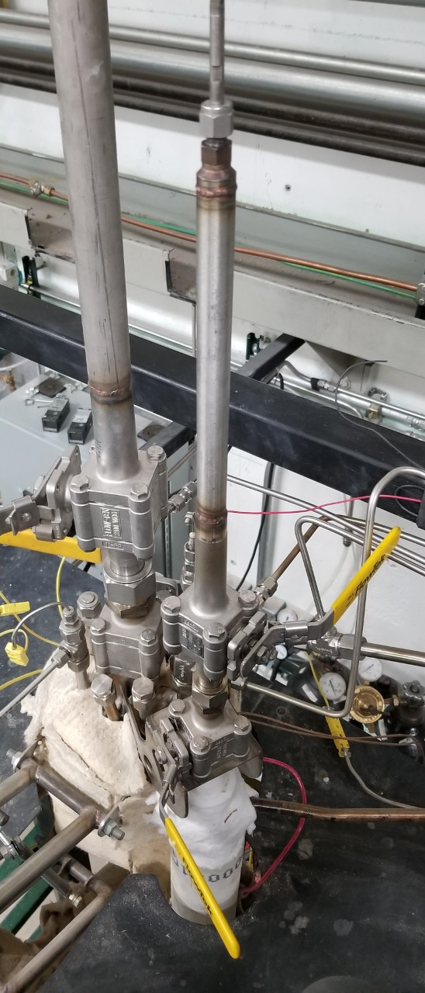
Vanadium Wire Equilibration
T-bar
Usable length: 8-9 cm
Wire Holder
Vanadium section access port
Test Section
Removable ball valve assembly

Slide 13
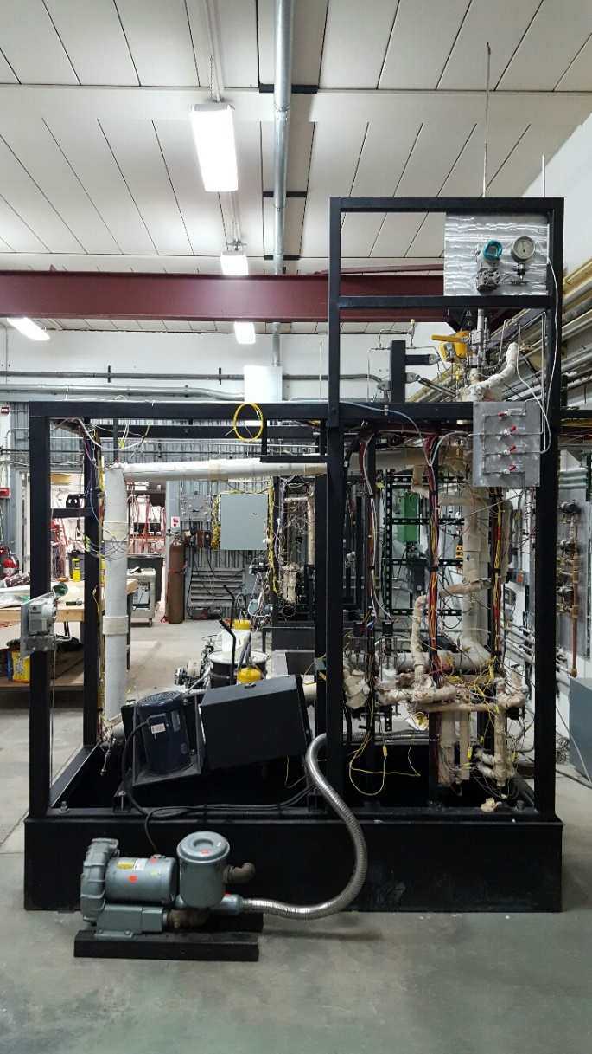
Vanadium Wire Test
Loop filled, cold trapped to set level
Heat to test temp
Vanadium inserted
PM readings during equilibration time
Measurements from vanadium can be correlated with PM readings
Reservoir
Vanadium
Main heater
Pump
CT
PM
Diagnostics Loop

Slide 14
V wire results
Several experimental campaigns complete at different oxygen levels, equilibration temps/times
700C equilibrations agree well with PM from 6-12 ppm, hit saturation limit of vanadium past this
750C equilibrations seem to display the same behavior, but theoretically should be able to measure up to 16ppm- more tests needed
Extended duration tests show positive relationship between oxygen content and exposure time- possible experimental error
3 tests at 700C, 4ppm waiting on analysis
Tests at lower temps near zero oxygen planned

Slide 15
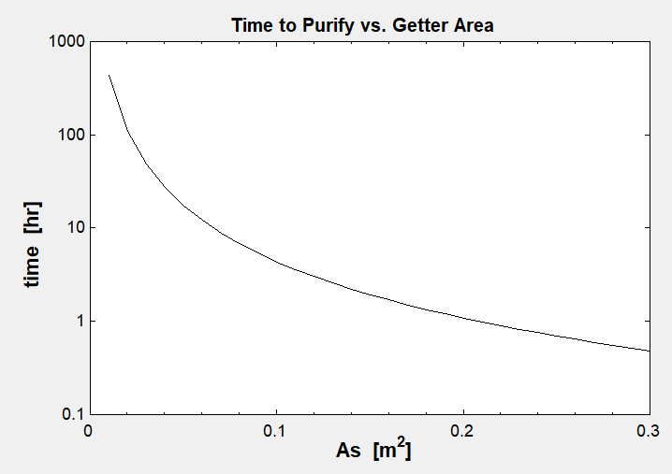
Hot Trapping
For our system, determined needed surface area based on 24-hour startup time from 10 ppm oxygen at fill:
A thermoelectric cold trap was investigated (solid state heat pump)
Doable, but would take up a lot of space in the cartridge, require large power feed-throughs, performance in radiation field unknown
Focus shifted to hot trapping
Use 1-2mm zirconium granules to chemically getter oxygen from sodium system at high temps
At elevated temperatures Zr will reduce sodium oxide
Ideal for VTR because downside (consumable) is nullified by experiment timeline
= ~100 mg
Oxidative weight gain per unit area
0.05 m^2
where at 650C
Theoretical capacity of trap = 29g of oxygen
[6] Atomics International, Control of Oxygen Concentration in a Large Sodium System

Slide 16
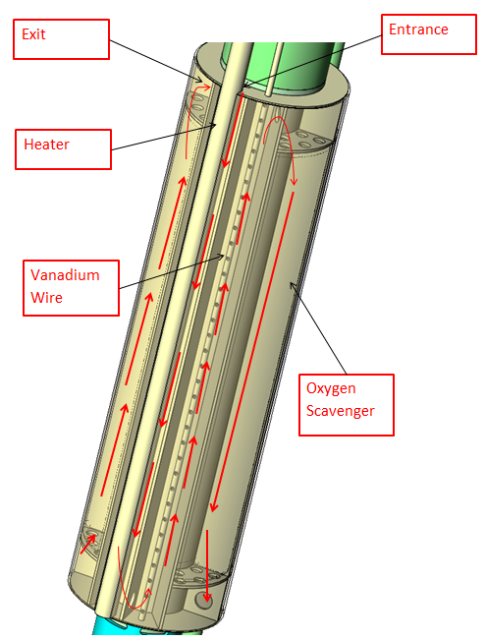
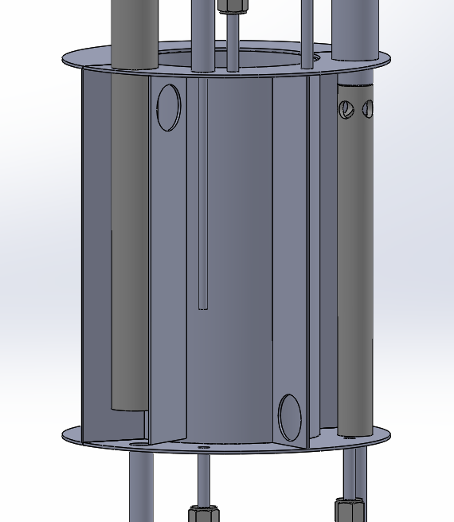
Hot trap design (Framatome)
Worked with Framatome to develop an experimental design in parallel with conceptual design, similar form factor
Removable filter section, in-line heating
Primary focus to quantify effectiveness/rate constant of hot trap across range of temps/flow rates
Confirm satisfactory performance of vanadium wire alongside hot trap
Validate theoretical pressure drop across packed bed filter from Ergun equation
0.2-0.6 psi from 0.2-0.4 lpm
Ergun equation
Vanadium wire
Oxygen getter
Heater cartridge
Inlet
Outlet
Framatome design
UW experimental design
16

Slide 17
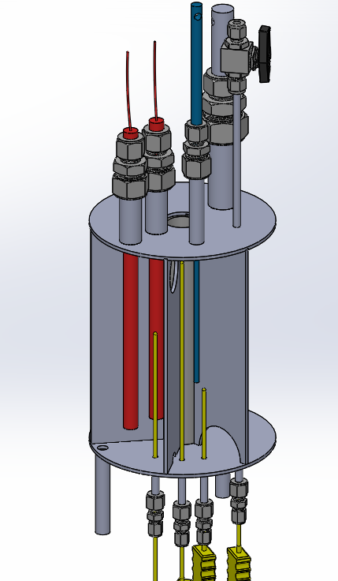
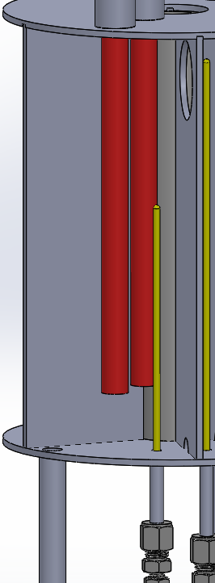
Hot trap design
Heater section
Overall iso
To vanadium section
(2) 500-watt cartridge heaters directly in flow
Inlet

Slide 18
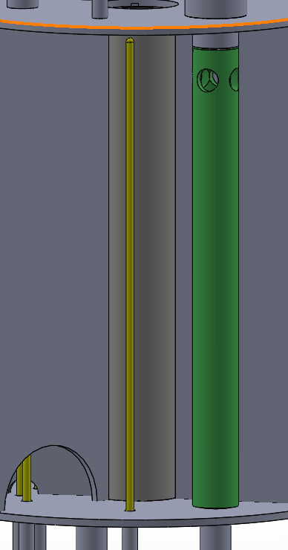
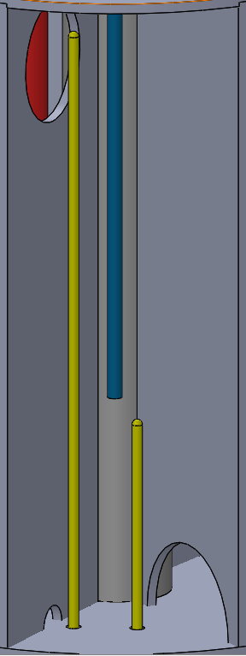
Hot trap design
Vanadium wire
From heater
To hot trap
From vanadium
Outlet

Slide 19
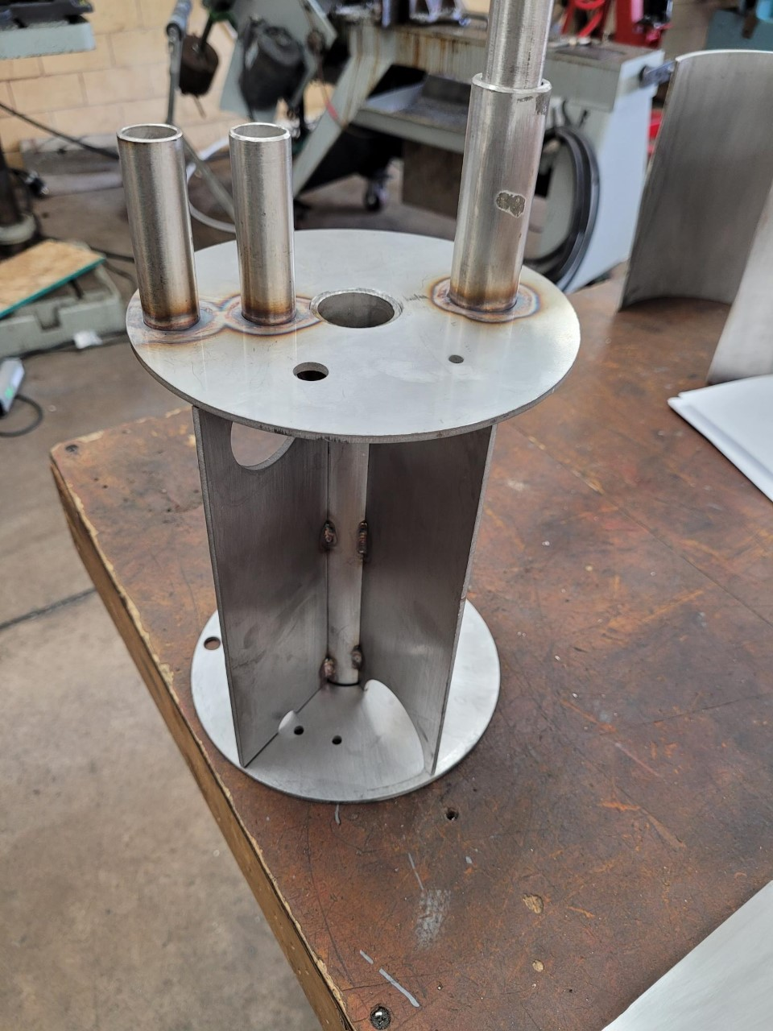
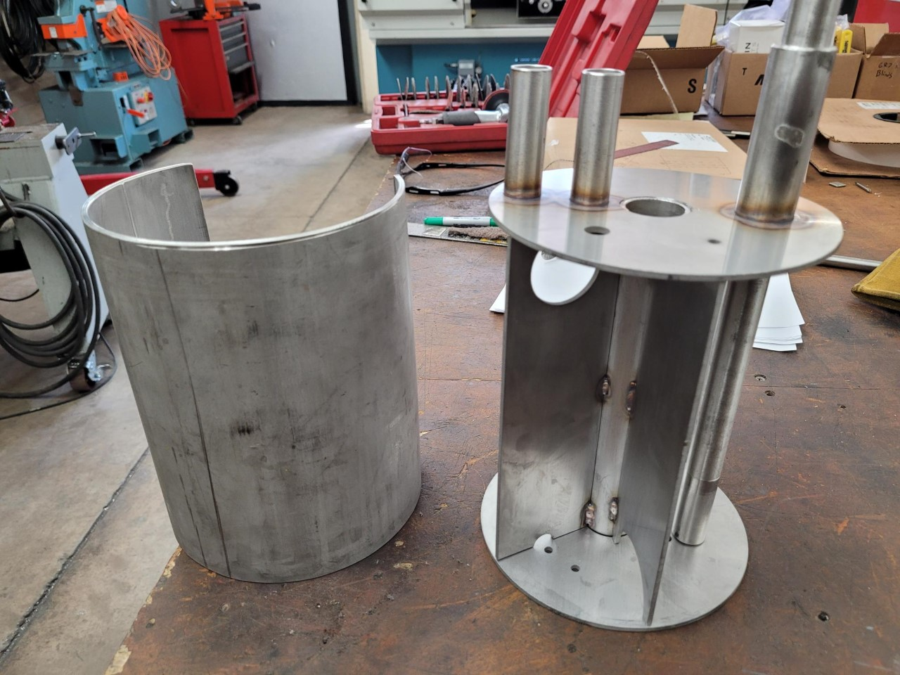
Hot trap fabrication

Slide 20
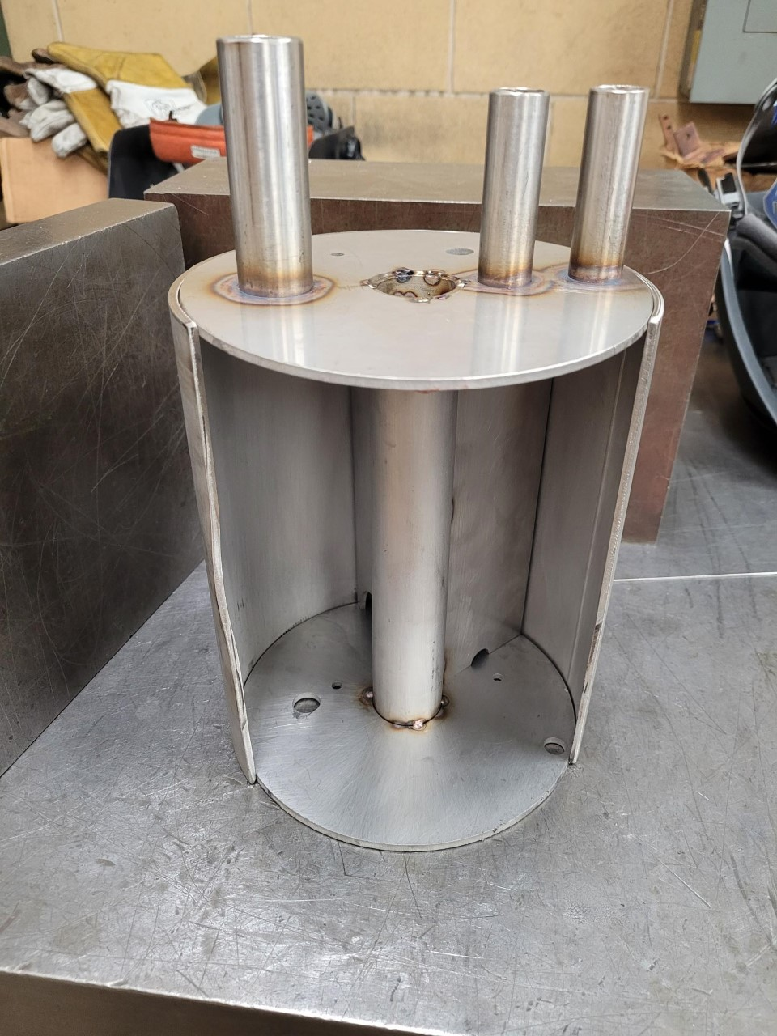
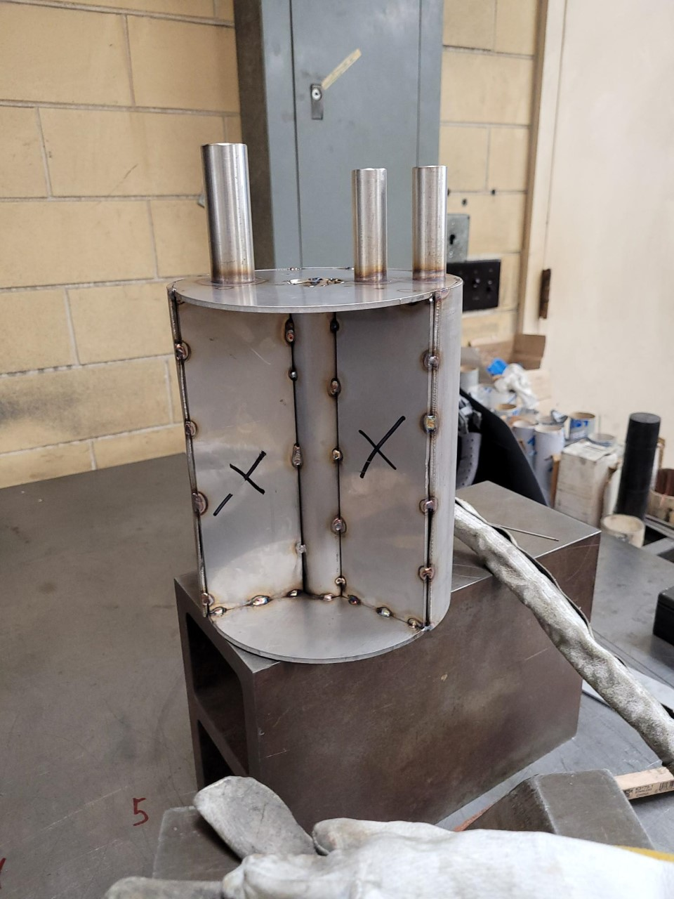
Hot trap fabrication

Slide 21
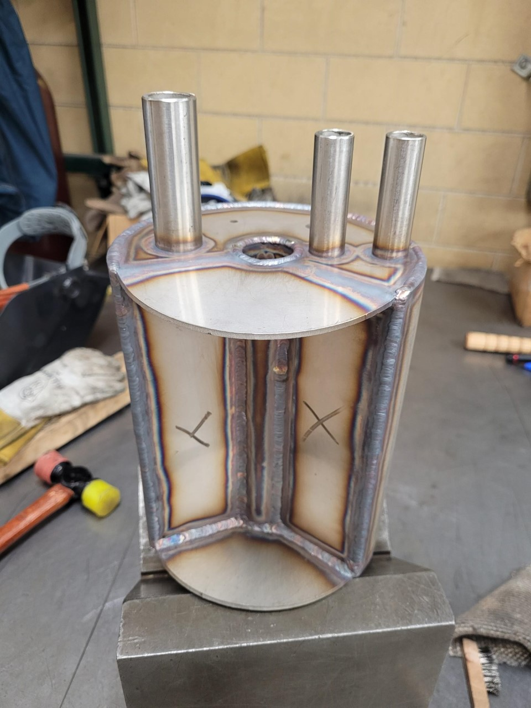
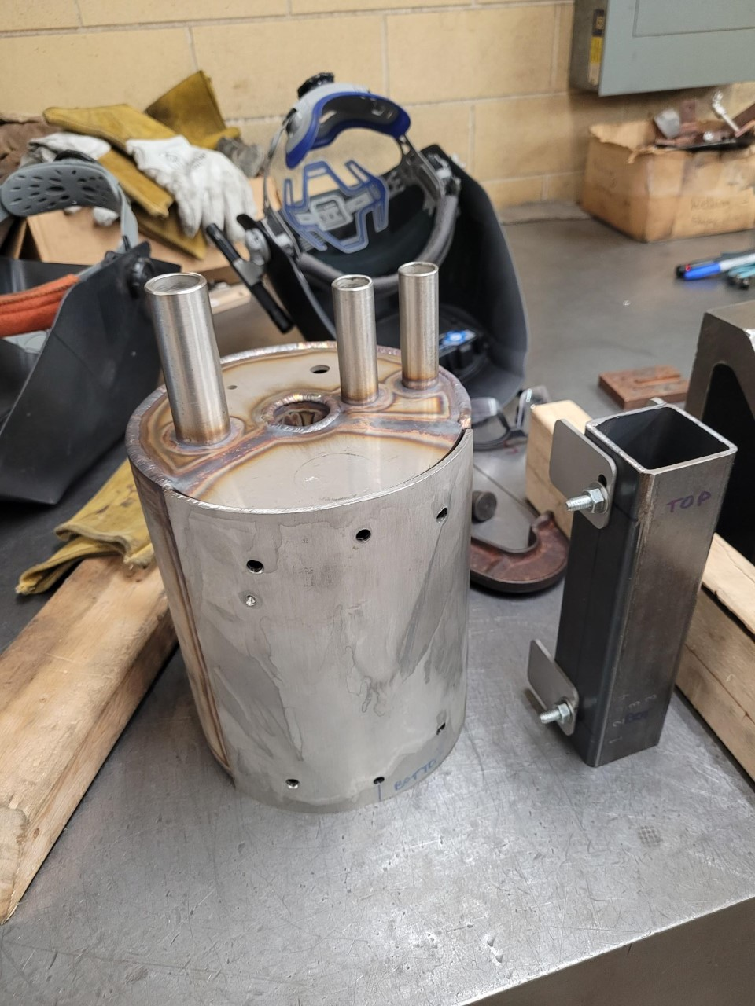
Hot trap fabrication

Slide 22
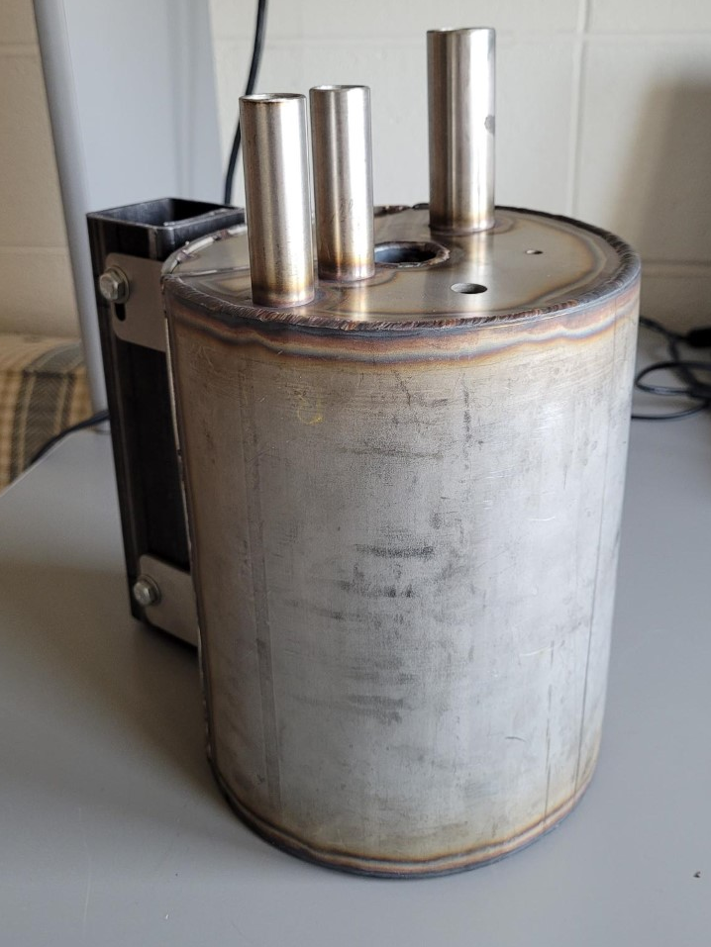
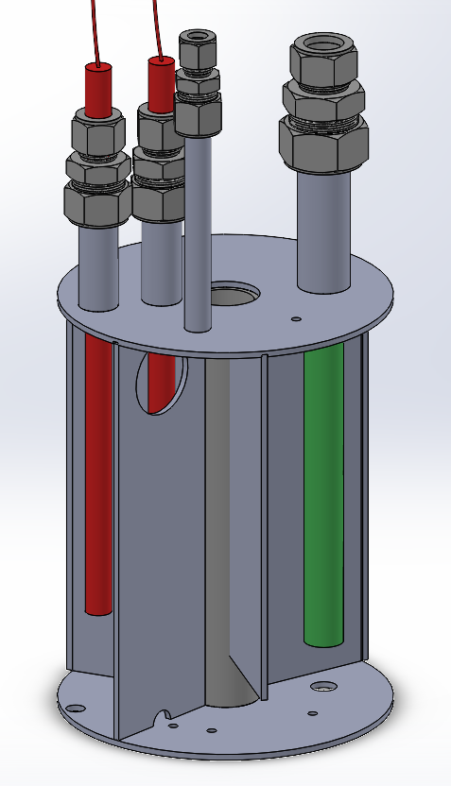
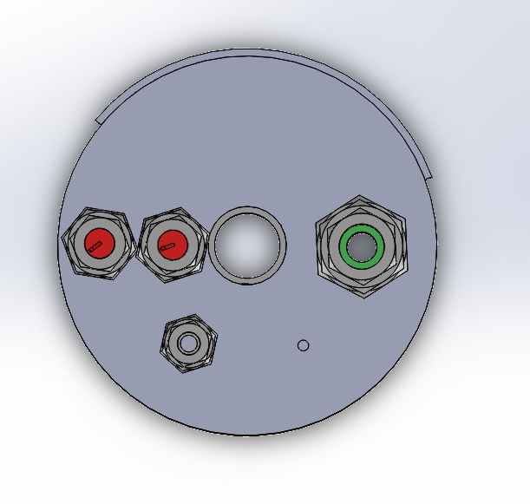
Hot trap fabrication

Slide 23
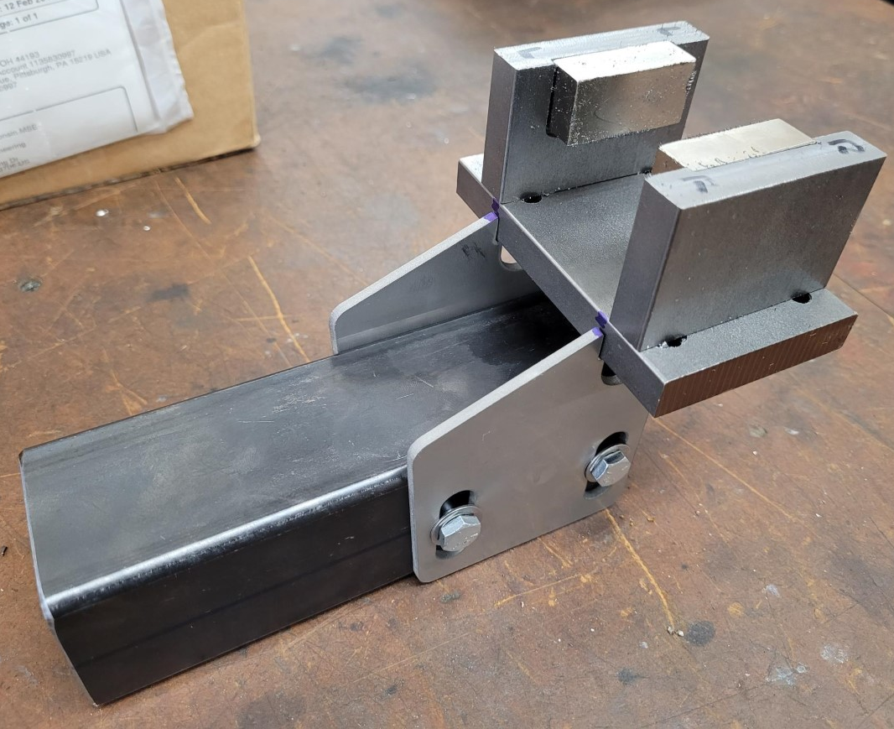
Hot trap fabrication
Filter cartridge with retaining screen
Welded, threaded
EM flowmeter for hot trap section

Slide 24
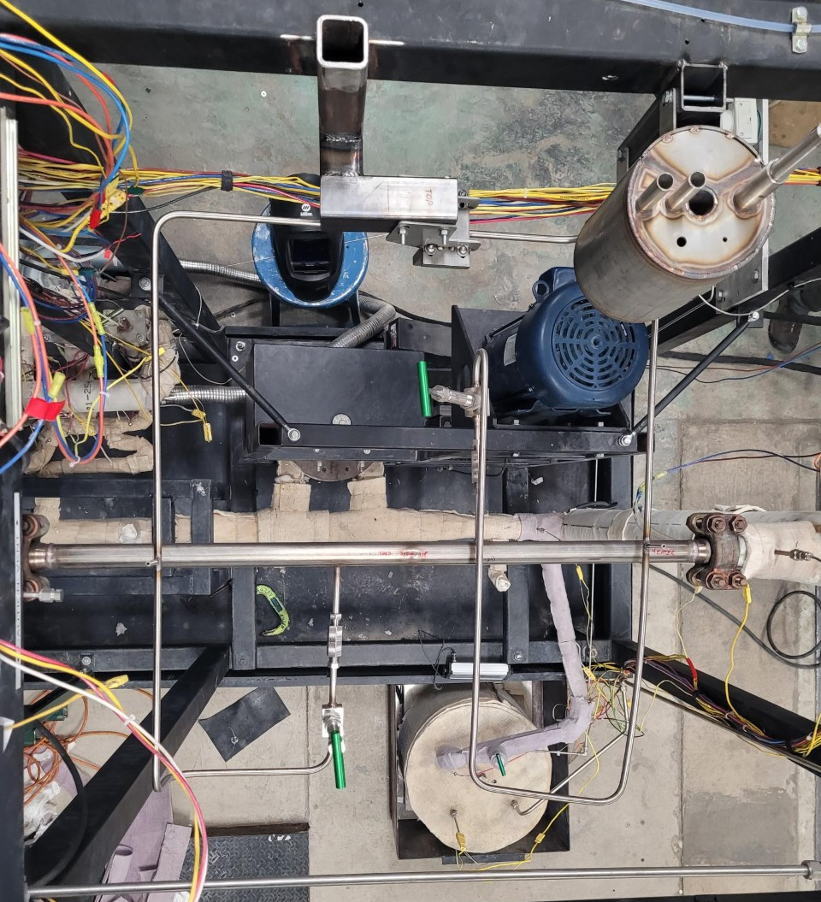
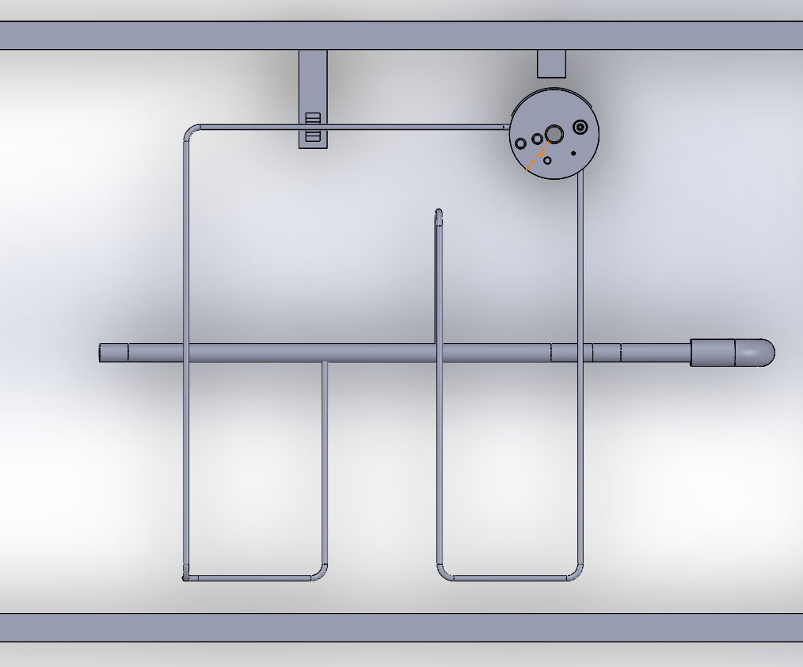
Hot trap fabrication

Slide 25
Hot trap testing
Initial:
Obtain differential pressure measurements across hot trap
Confirm trapping capability at 550, 600, 650C
Comprehensive:
Determine oxidative weight gain rate constant k, compare with theory
Quantify performance at different temperatures, flow rates, qualify use of unalloyed zirconium granules at these temperatures
Validate use of vanadium wire technique in conjunction with hot trapping in sodium loop

Slide 26
Summary
Investigating methods of oxygen removal in sodium systems where available space and access are limited
Correlating the vanadium wire method with standard plugging meter measurements
Quantifying the performance of a zirconium hot trap in cartridge conditions
Questions?

Slide 27
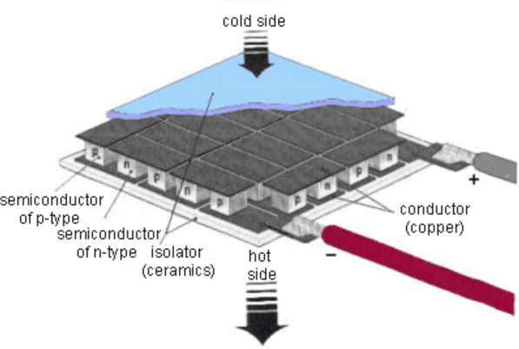
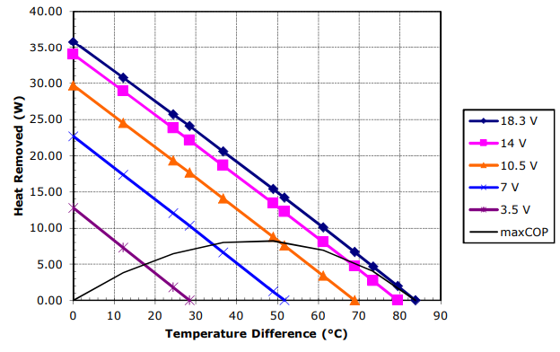
Peltier Cold Trap
Investigated possibility of a cold trap using thermoelectric cooling
Peltier devices are the inverse of a thermocouple
Create a temperature difference across the faces
Given adequate cooling this is a solid-state heat pump
Challenges-
Max temp for commercial devices is 200C
LARGE temperature differential between the cartridge coolant and the primary coolant, ~200C
[6] http://www.digit-life.com/articles/peltiercoolers
[7] T. Technology, High-Temperature Modules

Slide 28
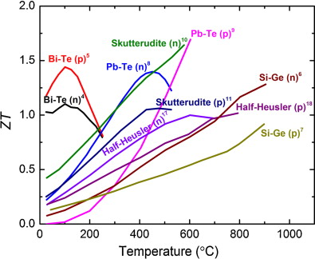
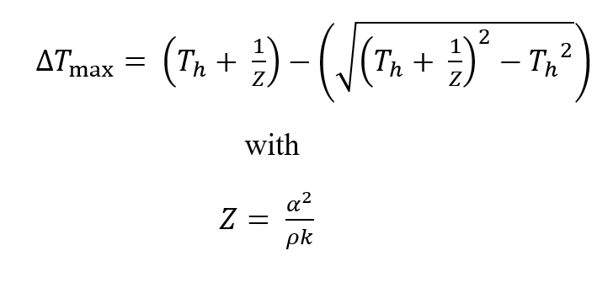
Peltier Cold Trap
Candidate materials (Half-Heusler) were selected for chemical stability and mechanical strength
Based on average process temp properties and theoretical performance, determined that a TEC device would need to have multiple stages
[7] S. Chen and Z. Ren, Recent progress of half-Heusler for moderate temperature thermoelectric applications
[8] Yan, Thermoelectric Property Study of Nanostructured p-Type Half-Heuslers (Hf, Zr, Ti)CoSb0.8Sn0.2
[9] S. Chen, Effect of Hf Concentration on Thermoelectric Properties of Nanostructured N-Type Half-Heusler Materials HfxZr1-xNiSn0.99Sb0.01

Slide 29
Peltier Cold Trap
Ultimately, the device would need to pump 6W across a ~200C delta T
Doable, but would take up a lot of space in the cartridge, require large power feed-throughs
Questions about the continued function of thermoelectric devices in a radiation field
Shifted focus to hot trapping as means of oxygen removal

