Slide 1
Sodium Heat Pipes for Microreactors
Erik M. Tillman
SEL Seminar
3-22-2022

Slide 2
About Me
MS student
Advisors: Mark Anderson & Greg Nellis
Hometown: Maple Grove, MN
Interests:
Reading
Movies
Cooking
Hiking

Slide 3
Microreactors

Slide 4
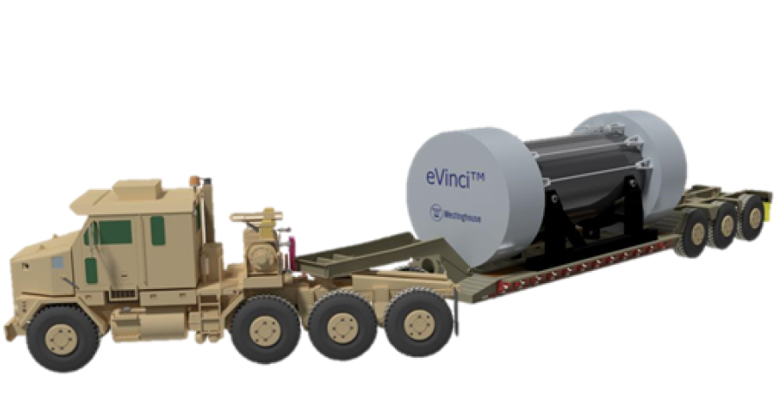
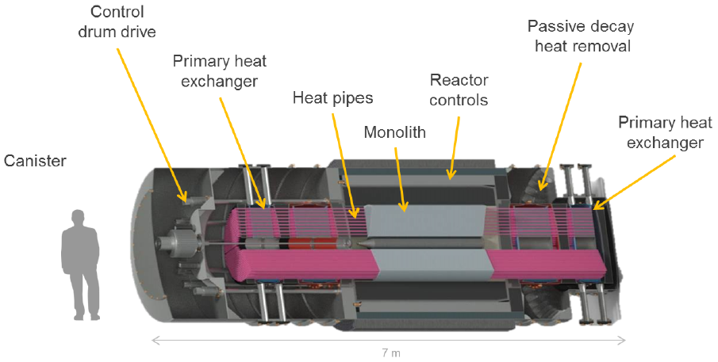
Microreactors
Small scale (<20 MWt) nuclear reactors [1]
Applications:
Defense
Remote communities
Microgrids
Disaster relief
Benefits:
Portable
Factory fabrication
Factory refueling
Small footprint
Simple design
Self-regulating [2]
Passive safety systems
These applications are often served by Diesel generators
(2021, February 26). What is a Nuclear Microreactor? Energy.gov. https://www.energy.gov/ne/articles/what-nuclear-microreactor
Zohuri, B. (2020). Nuclear Micro Reactors. Springer Nature, Switzerland. DOI: https://doi.org/10.1007/978-3-030-47225-2
Image Credits: Westinghouse Electric
Notes:
SMR is 20-300 MWt (INL)

Slide 5
The Need for Microreactors
Alaska: 2 [GW] installed microgrid capacity (typically 1-50 [MW] per site) [3]
Remote mining camps often require 10-50 [MWe]
Diesel must be transported to the site by truck, ship, or even plane
Image Credit: Westinghouse Electric
3. Holdmann, G. and Asmus, P., 2019. Microgrid Innovation in the Circumpolar Arctic: Lessons for Developing World Markets. Navigant Research.

Slide 6
Westinghouse eVinci Microreactor
Anticipated market entry of 2026-2027
LCOE of $250-$450/MW [4]
Off-grid “nuclear battery” applications [7]
$5,000,000 ARPA-E funding (DoE)
20% enriched uranium fuel
Factory refueling on a 10-year cycle
Provides power and heat through Rankine or sCO2 Brayton cycle
Up to 1200 ℃ core temperature [6]
Uses sodium heat pipes for heat transfer
Self-regulating “semi-solid state” core
4. Swartz, M. M., Byers, W. A., Lojek, J., & Blunt, R. (2021). Westinghouse eVinci Heat Pipe Micro Reactor Technology Development. Proceedings of the 2021 28th International Conference on Nuclear Engineering.
5. Levinsky, A., van Wyk, J. J., Arafat, Y., & Smith, M. C. (2018). Westinghouse eVinci reactor for off-grid markets. Transactions of the American Nuclear Society 119. pp. 931-934.
6. Mcclure, P. R., Poston, D. I., Dasari, V. R., & Reid, R. S. (2015). Design of Megawatt Power Level Heat Pipe Reactors.
7. Hernandez, R., Todosow, M., & Brown, N. R. (2019). Micro heat pipe nuclear reactor concepts: Analysis of fuel cycle performance and environmental impacts. Annals of Nuclear Energy 126, pp. 419-426. DOI: https://doi.org/10.1016/j.anucene.2018.11.050
eVinci Reactor core. Image credit: Swartz et. al. (2021).

Slide 7
Heat Pipe Basics
Components, Principles, and Applications

Slide 8
Anatomy of a Heat Pipe

Slide 9
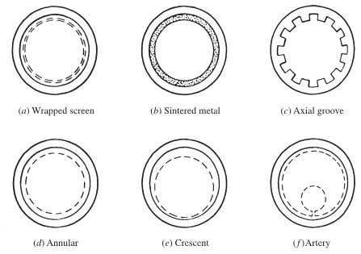
Heat Pipe Wick
Examples of wick types:
Porous structure to induce capillary flow of liquid condensate back to the evaporator
Allows the heat pipe to operate in orientations other than vertical
Distinguishes heat pipe from thermosyphon
Simplest wick types are screen wire mesh, sintered metal, or axial groove [8]
Some heat pipes combine multiple wick types (i.e. axial grooves and screen)
8. Peterson, G. P. (1994). An introduction to heat pipes: Modeling, testing, and applications. John Wiley & Sons, New York, NY.

Slide 10
Capillary Flow in the Wick
Surface tension creates a capillary pumping pressure [9]:
$$P_{cp}=\frac{2σ}{r_{c}}$$
This is the pressure that is available to overcome gravity and frictional pressure drops
Capillary radius $r_{c}$ depends on the wick geometry
Wick Type | Correlation [10]
Screen Wick | $$r_{c}=\frac{d+w}{2}=\frac{1}{2N}$$
Sintered Wick | $$r_{c}=0.41r_{s}$$
Grooved Wick | $$r_{c}=w$$
9. Faghri, A. (1995). Heat pipe science and technology. Taylor & Francis, Washington, D. C.
10. Chi, S. W. (1976). Heat pipe theory and practice: A sourcebook. Hemisphere Publishing Corporation, Washington, D. C.

Slide 11
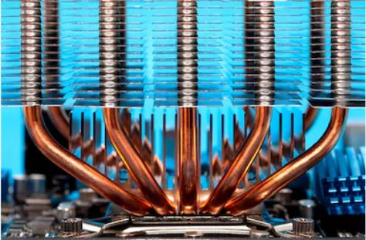
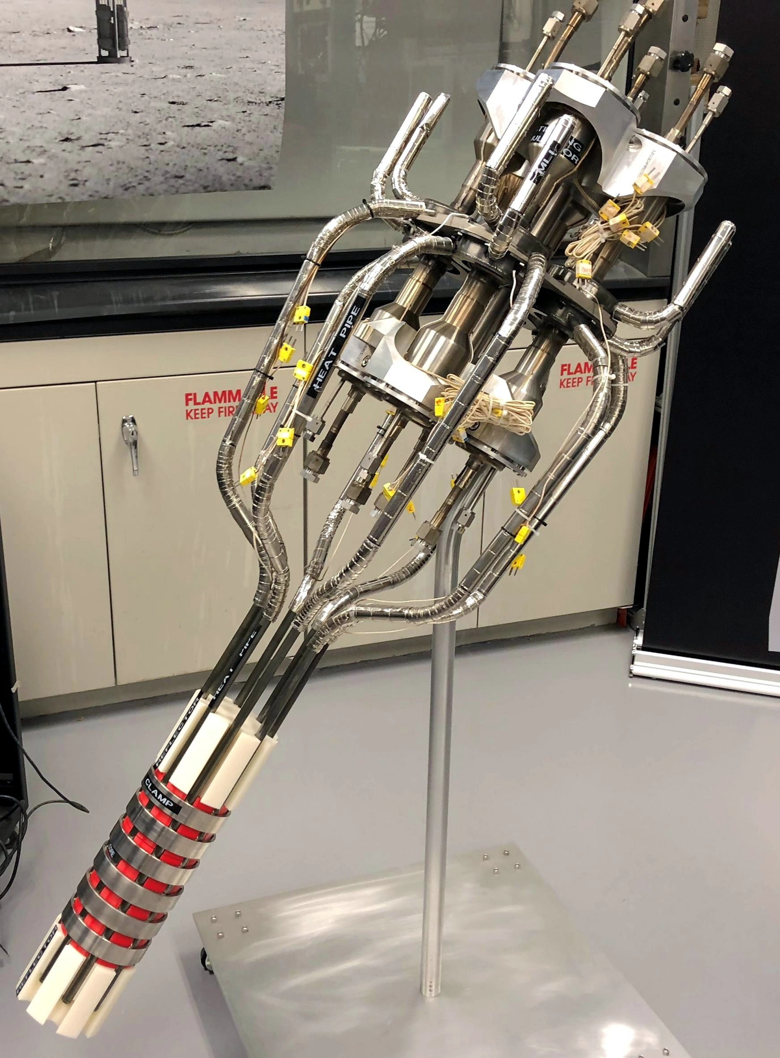
Heat Pipe Applications
Electronics cooling
Typically copper with water working fluid
Nuclear Reactors
Liquid metal (often sodium) for high temperature heat pipes
Passive heat removal from LWRs [11]
Spacecraft
Reactors [12]
Thermal regulation [9]
11. Mochizuki, M., Singh, R., Nguyen, T., & Nguyen, T. (2014). Heat pipe based passive emergency core cooling system for safe shutdown of nuclear power reactor. Applied Thermal Engineering 73, pp. 699-706.
12. Beard, D., Anderson, W. G., & Tarau, C. (2016). Self-Venting Arterial Heat Pipes for Spacecraft Applications. AIAA Propulsion and Energy Forum, July 25-27, 2016, 14th International Energy Conversion Engineering Conference. DOI: 10.2514/6.2016-4603
9. Faghri, A. (1995). Heat pipe science and technology. Taylor & Francis, Washington, D. C.
NASA Kilopower reactor

Slide 12
Benefits of Heat Pipes for Microreactors
Many microreactor concepts are centered around sodium heat pipes for primary heat transfer
Including Westinghouse eVinci [4]
Compact heat transfer from reactor core
Minimal moving parts (no pumps) [13]
Passive heat removal [14]
No intervention required for emergency heat removal
This allows the reactor to be “self-regulating”
Low temperature drop across the heat pipe [4]
Low operating pressure reduces the danger of leaks
13. Arafat, Y, & Van Wyk, J. (2019). eVinci Micro Reactor. Nuclear Plant Journal, March-April 2019, pp 34-37.
14. Zohuri, B. (2019). Heat pipe applications in fission driven nuclear power plants. Springer Nature, Switzerland. DOI: https://doi.org/10.1007/978-3-030-05882-1
4. Swartz, M. M., Byers, W. A., Lojek, J., & Blunt, R. (2021). Westinghouse eVinci Heat Pipe Micro Reactor Technology Development. Proceedings of the 2021 28th International Conference on Nuclear Engineering.

Slide 13
Sodium as a Working Fluid
Alkali metals have been considered for high temperature heat pipes since the 1960’s [4]
Sodium is often selected due to it being one of the most available materials in this group
Important properties of sodium:
Property | Sodium @ 800 [C] | Water @ 90 [C]
Melting Point [C] | 97.7 | 0
Boiling Point [C] | 883 | 100
Thermal Conductivity [W/m-K] | 51.1 | 0.67
Viscosity [Pa*s] | 0.00017 | 0.00031
Surface Tension [C] | 0.128 | 0.061
Specific Heat [J/kg-K] | 1260 | 4205
Density [kg/m^3] | 763 | 965
4. Swartz, M. M., Byers, W. A., Lojek, J., & Blunt, R. (2021). Westinghouse eVinci Heat Pipe Micro Reactor Technology Development. Proceedings of the 2021 28th International Conference on Nuclear Engineering.

Slide 14
Project Motivation & Partners
LANL & INL are supporting Westinghouse’s development of the eVinci microreactor with experimentation and modelling
LANL is working on design and manufacturing of high-performance sodium heat pipes
INL is developing Sockeye, a heat pipe modelling program to assist in design and licensing of microreactors
Working with Texas A&M to produce experimental data to validate Sockeye models

Slide 15
My Project Goals
Manufacture kilowatt-scale sodium heat pipes for experimentation
Operate heat pipes at conditions similar to microreactor application
Measure heat pipe internal temperature distribution
Thermocouples
FO-DTS measurements
Measure sodium liquid pressure distribution in the wick
Visualize flow phenomena inside heat pipe using X-ray radiography
Investigate transient behavior of sodium heat pipe
Startup (frozen sodium slug in pipe)
Restart (frozen sodium in wick)

Slide 16
Heat Pipe Theory & Modelling

Slide 17
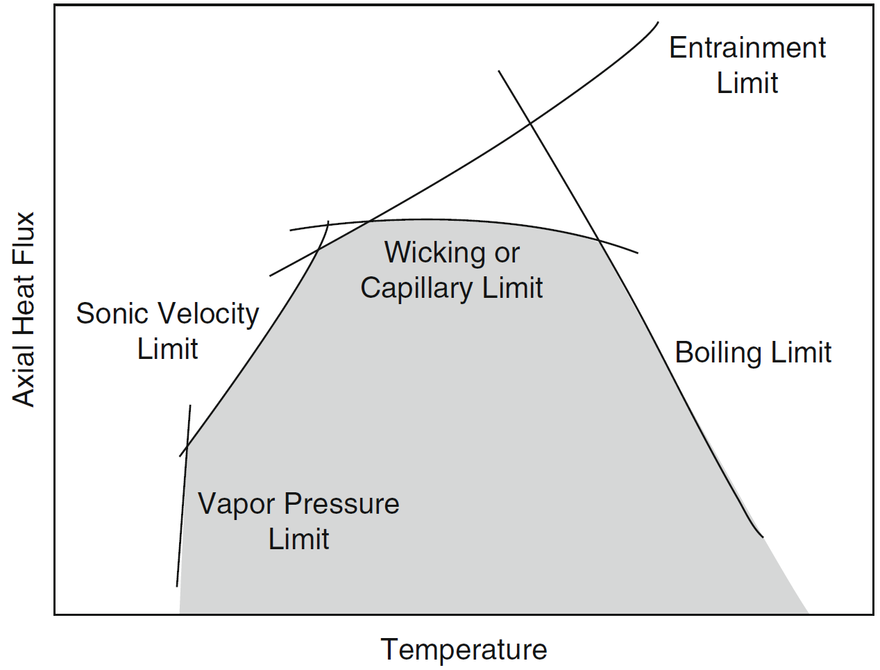
Heat Transfer Limitations
It has long been recognized that there are limits on the heat transfer ability of a heat pipe [16]
Sonic Limit: vapor flow can become choked if Mach # = 1
Considered a non-critical limitation
Entrainment Limit: high velocity vapor can shear liquid droplets from wick, leading to dry out in the evaporator
Capillary Limit: there must be enough capillary pressure in the wick to return liquid to the evaporator
Main HT limitation for a high-performance heat pipe [15]
Boiling Limit: vapor bubbles form in the wick, obstructing liquid flow and leading to dry out in the evaporator
If the entrainment, capillary, or boiling limits are reached, evaporator dry out may occur, resulting in a critical failure
Image Credit: Zohuri (2016) pp. 133 [16]
15. Kemme, J. E. (1967). High Performance Heat Pipes. Proceedings of the 1967 Thermionic Conversion Specialist Conference, Palo Alto, California.
9. Faghri, A. (1995). Heat pipe science and technology. Taylor & Francis, Washington, D. C.
10. Chi, S. W. (1976). Heat pipe theory and practice: A sourcebook. Hemisphere Publishing Corporation, Washington, D. C.
16. Zohuri, B. (2016). Heat pipe design and technology. (2nd Ed.). Springer International Publishing, Switzerland
Notes:
Choked flow: mass flow rate does not increase for a decrease in downstream pressure.

Slide 18
Heat Transfer Limitations
Based on the methods of S. W. Chi [10]
$$Q_{sonic}=A_{v}ρ_{o}λ\sqrt{\frac{γ_{v}R_{v}T_{o}}{2(γ_{v}+1)}}$$
$$Q_{entrainment}=A_{v}λ\sqrt{\frac{{σρ}_{v}}{2r_{h,s}}}$$
$$Q_{capillary}=\frac{1}{L_{eff}}\left(\frac{\frac{2σ}{r_{c}}−ρ_{l}gD_{v}\cos\left(θ\right)−ρ_{l}gL_{t}sin\left(θ\right)}{\frac{\left(f_{v}{Re}_{v}\right)μ_{v}}{2{r_{h,v}}^{2}A_{v}ρ_{v}λ}+\frac{μ_{l}}{KA_{w}ρ_{l}λ}}\right)$$
$$Q_{boiling}=\frac{2πL_{e}k_{eff}T_{v}}{λρ_{v}ln\left({r_{i}}/{r_{v}}\right)}\left(\frac{2σ}{r_{n}}−P_{c}\right)$$
10. Chi, S. W. (1976). Heat pipe theory and practice: A sourcebook. Hemisphere Publishing Corporation, Washington, D. C.
Notes:
Lambda is the latent heat of vaporization
Dv is vapor core diameter

Slide 19
Thermal Resistance Network
Chi [10] modelled a heat pipe as a system of thermal resistances through the pipe wall, the wick, & the vapor core
Similar work has been done in recent years at UW Madison [17]
℄
$$T_{v,e}$$
$$T_{v,c}$$
$$R_{v}=\frac{T_{v}(P_{v,e}−P_{v,c})}{ρ_{v}λJQ}$$
Axial Heat Flow Q
$$r_{v}$$
Vapor Core
$$T_{wv,c}$$
$$R_{e,w}=\frac{ln\left({r_{i}}/{r_{v}}\right)}{2πL_{e}k_{e,e}}$$
$$T_{wv,e}$$
$$R_{c,w}=\frac{ln\left({r_{i}}/{r_{v}}\right)}{2πL_{c}k_{e,c}}$$
$$r_{i}$$
Wick
$$R_{e,p}=\frac{ln\left({r_{o}}/{r_{i}}\right)}{2πL_{e}k_{p}}$$
$$T_{pw,e}$$
$$R_{c,p}=\frac{ln\left({r_{o}}/{r_{i}}\right)}{2πL_{c}k_{p}}$$
$$r_{o}$$
Pipe Wall
$$T_{pw,c}$$
$$T_{outer,e}$$
$$T_{outer,c}$$
Evaporator Section
$${(L}_{e})$$
Adiabatic Section
$${(L}_{a})$$
Condenser Section
$${(L}_{c})$$
10. Chi, S. W. (1976). Heat pipe theory and practice: A sourcebook. Hemisphere Publishing Corporation, Washington, D. C.
17. Zhou, Y., Wang, J., Guo, Z., He, Y., Zhang, Y., Qiu, S., Su, G. H., & Corradini, M. L. (2021). 3D-2D coupling multi-dimension simulation for the heat pipe micro-reactor
by MOOSE&SAM. Progress in Nuclear Energy 138. https://doi.org/10.1016/j.pnucene.2021.103790

Slide 20
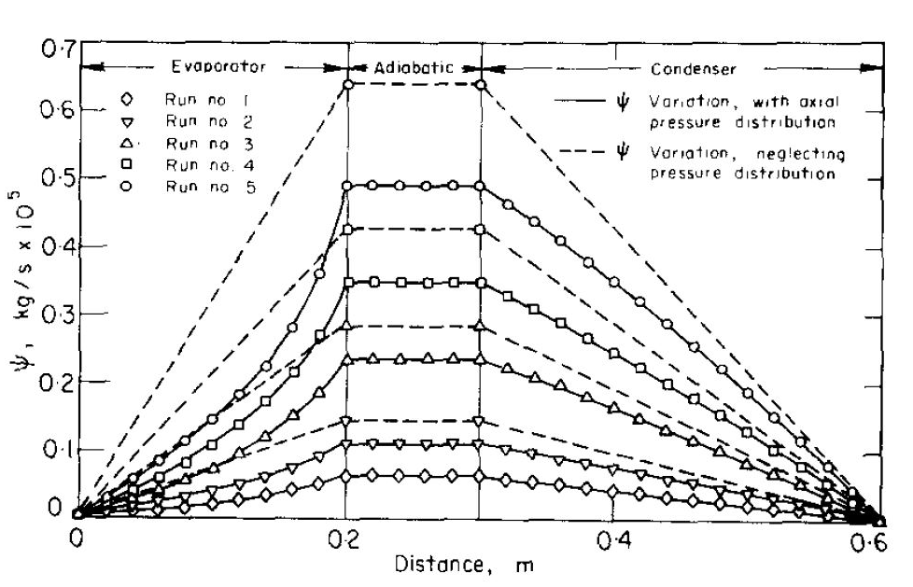
Vapor Flow Theory
Axial Pressure Drop
Axial Stream function
Some numerical work has been done into modelling the vapor flow [18]
Modified NS equations were applied and solved numerically
Pressure drop and then recovery is similar to that seen for subsonic flow in a CD nozzle [19]
Compressibility considerations should be taken into account for the vapor flow
18. Tien, C. L., & Rohani, A. R. (1974). Analysis of the Effects of Vapor Pressure Drop on Heat Pipe Performance. International Journal of Heat and Mass Transfer 17. pp. 61-67.
19. John, J. & Keith, T. (2006). Gas Dynamics (3rd. ed.). Pearson Prentice Hall, Upper Saddle River, NJ.

Slide 21
Heat Pipe Modelling
HTPIPE
Program developed by LANL [20]
Models the pipe as a 1-D cylinder
Calculates axial pressure and temperature distributions & heat transfer limits
Implemented into EES by Prof. Nellis
Sockeye
Currently under development by INL
7-equation two-phase flow model
2-D
Calculates pressure & temperature fields and heat transfer limits
20. Prenger, F. C. (1979). Heat Pipe Computer Program (HTPIPE) User’s Manual. Los Alamos Scientific Laboratory LA-8101-M.
21. Martineau, R. C. (2019). DireWolf: MOOSE-based Multiphysics Simulator for Megawatt Scale Micro-Reactor. GAIN-EPRI-NEI-US NIC Micro-Reactor Workshop, April 3-4, 2019

Slide 22
Sodium Heat Pipe Manufacturing
Process Outline and Challenges

Slide 23
Manufacturing Process Goals
Fill heat pipe with the desired amount of working fluid (sodium)
Underfilling leads to dry-out (critical failure)
Cleanliness of parts and purity of sodium are essential
Noncondensing species such as oxides and gases impede heat transfer [22]
Evacuate heat pipe to desired pressure
Pressure can be manipulated to allow phase change at a desired temperature
Seal heat pipe to prevent atmospheric contamination
Oxygen reacts with sodium to form non-condensables
22. Sunden, B, & Fu, J (2017). Heat Transfer in Aerospace Applications. Elsevier Ltd. ISBN: 978-0-12-809760-1

Slide 24
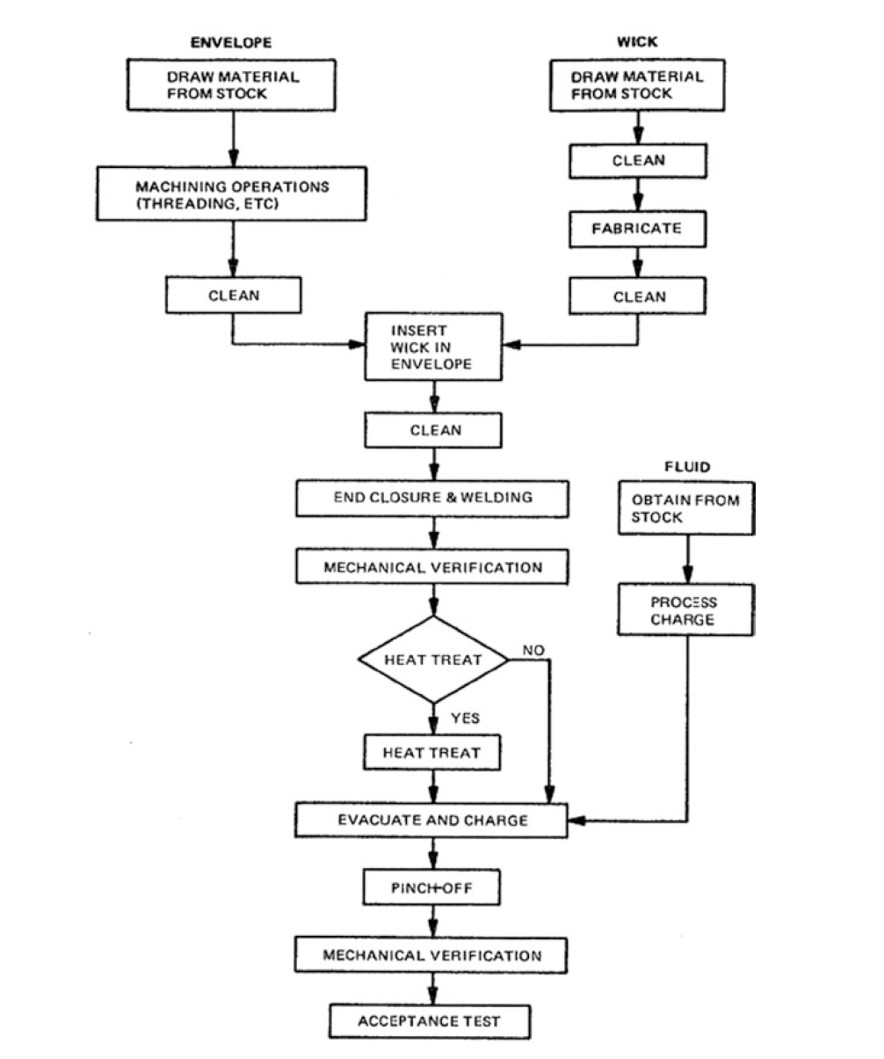
Manufacturing Process Outline
Fabricate pipe and wick
Clean pipe and wick
Assemble & weld together
Evacuate & fill with working fluid
Seal heat pipe
Test and inspection
23. Edelstein, F., & Haslett, R. (1974). Heat pipe manufacturing study. Final Report prepared by Grumman Aerospace Corp. for NASA, Contract No. NASS5-23156.

Slide 25
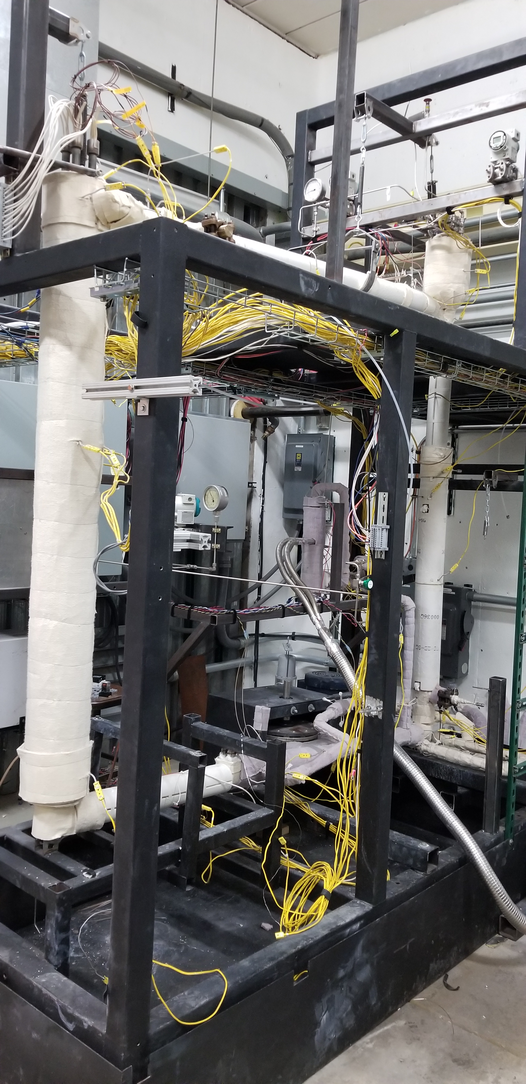
Filling the Heat Pipe
Greatest challenge of working with sodium is preventing oxygen contamination
Heat pipes usually filled inside an inert-gas glovebox [24]
Sometimes liquid sodium loops are employed [25]
THL has developed sodium loops with cold trap technology that can reduce oxide concentration to as low as 2 ppm
Decided to fill the heat pipe on sodium loop to control oxide concentration
24. Martin, J. & Salvail, P. (2004). Sodium heat pipe module processing for the SAFE-100 reactor concept. AIP Conference Proceedings 699, 148. https://doi.org/10.1063/1.1649569
25. Stelman, D. & Newcomb, J. (1993). Filling and sealing sodium heat pipes AIP Conference Proceedings 271, 533. https://doi.org/10.1063/1.43065
23. Edelstein, F., & Haslett, R. (1974). Heat pipe manufacturing study. Final Report prepared by Grumman Aerospace Corp. for NASA, Contract No. NASS5-23156.
THL Tantalus facility sodium loop

Slide 26
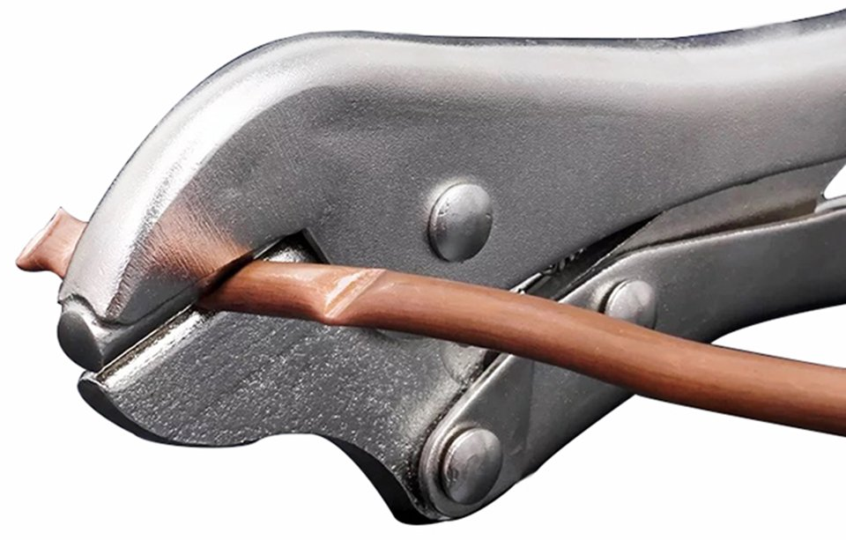
Sealing the Heat Pipe
Once pipe is filled and evacuated, it must be sealed against atmosphere
Oxygen will react with sodium to form non-condensables
Standard procedure is to crimp the heat pipe for a temporary seal, and then weld for a permanent seal
The crimp must be able to hold against atmospheric pressure for at least several minutes
For copper heat pipes or refrigerant tubes, crimp sealing is easy
Copper does not work for this application, so the heat pipe must be made from stainless steel or superalloy
These materials are more challenging to crimp and less work has been done in this area
Working to develop a method for crimp sealing
23. Edelstein, F., & Haslett, R. (1974). Heat pipe manufacturing study. Final Report prepared by Grumman Aerospace Corp. for NASA, Contract No. NASS5-23156.

Slide 27
Heat Pipe Manufacturing Process Development

Slide 28
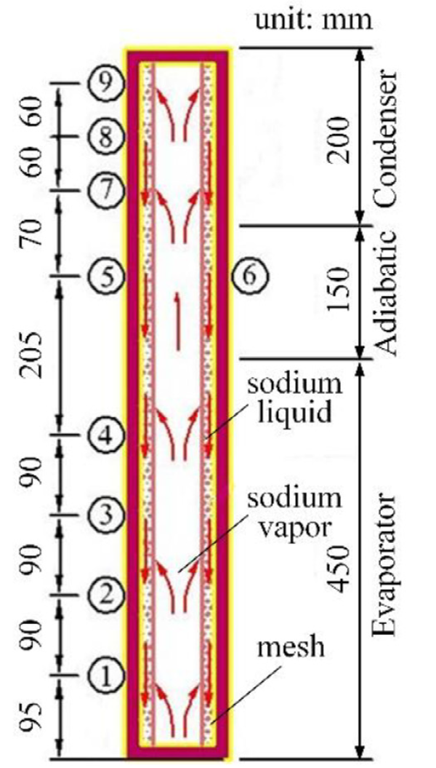
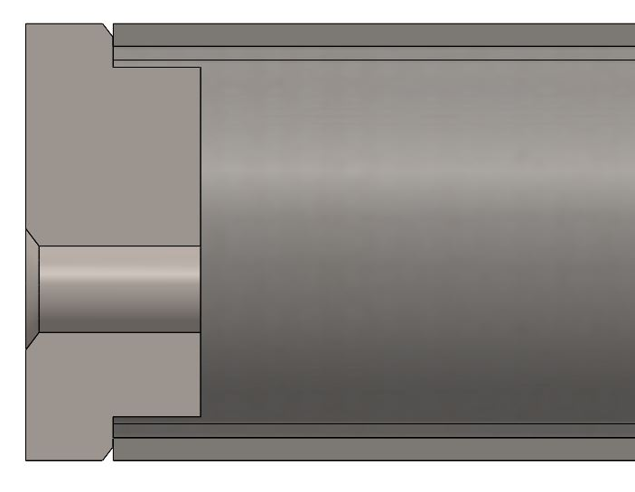
First Iteration Heat Pipe
Parameter | Value
Pipe OD | 1.25 [in]
Pipe ID | 1.12 [in]
Pipe Material | 316 SS
Evaporator Length | 18 [in]
Adiabatic Length | 6 [in]
Condenser Length | 7.5 [in]
Wick Material | 316 SS 20x20 Mesh
Wick Thickness | 2 Layers (0.064 [in])
Sodium Fill | 100 [g]
Max. Heat Rate | 2500 [W]
Max. Temperature | 750 [℃]
Goals:
Develop & validate manufacturing process
Temperature measurements
Internal flow visualization
Selected a heat pipe design based on Teng et. al. [26]
Detail cross-section of end cap
26. Teng, W., Wang, X., & Zhu, Y. (2020). Experimental investigations on start-up and thermal performance of sodium heat pipe under swing conditions. International Journal of Heat and Mass Transfer 152(2020).

Slide 29
Manufacturing Process Outline
Fabricate pipe and wick
Clean pipe and wick
Weld together
Evacuate & fill with working fluid
Seal heat pipe
Test and inspection
23. Edelstein, F., & Haslett, R. (1974). Heat pipe manufacturing study. Final Report prepared by Grumman Aerospace Corp. for NASA, Contract No. NASS5-23156.

Slide 30
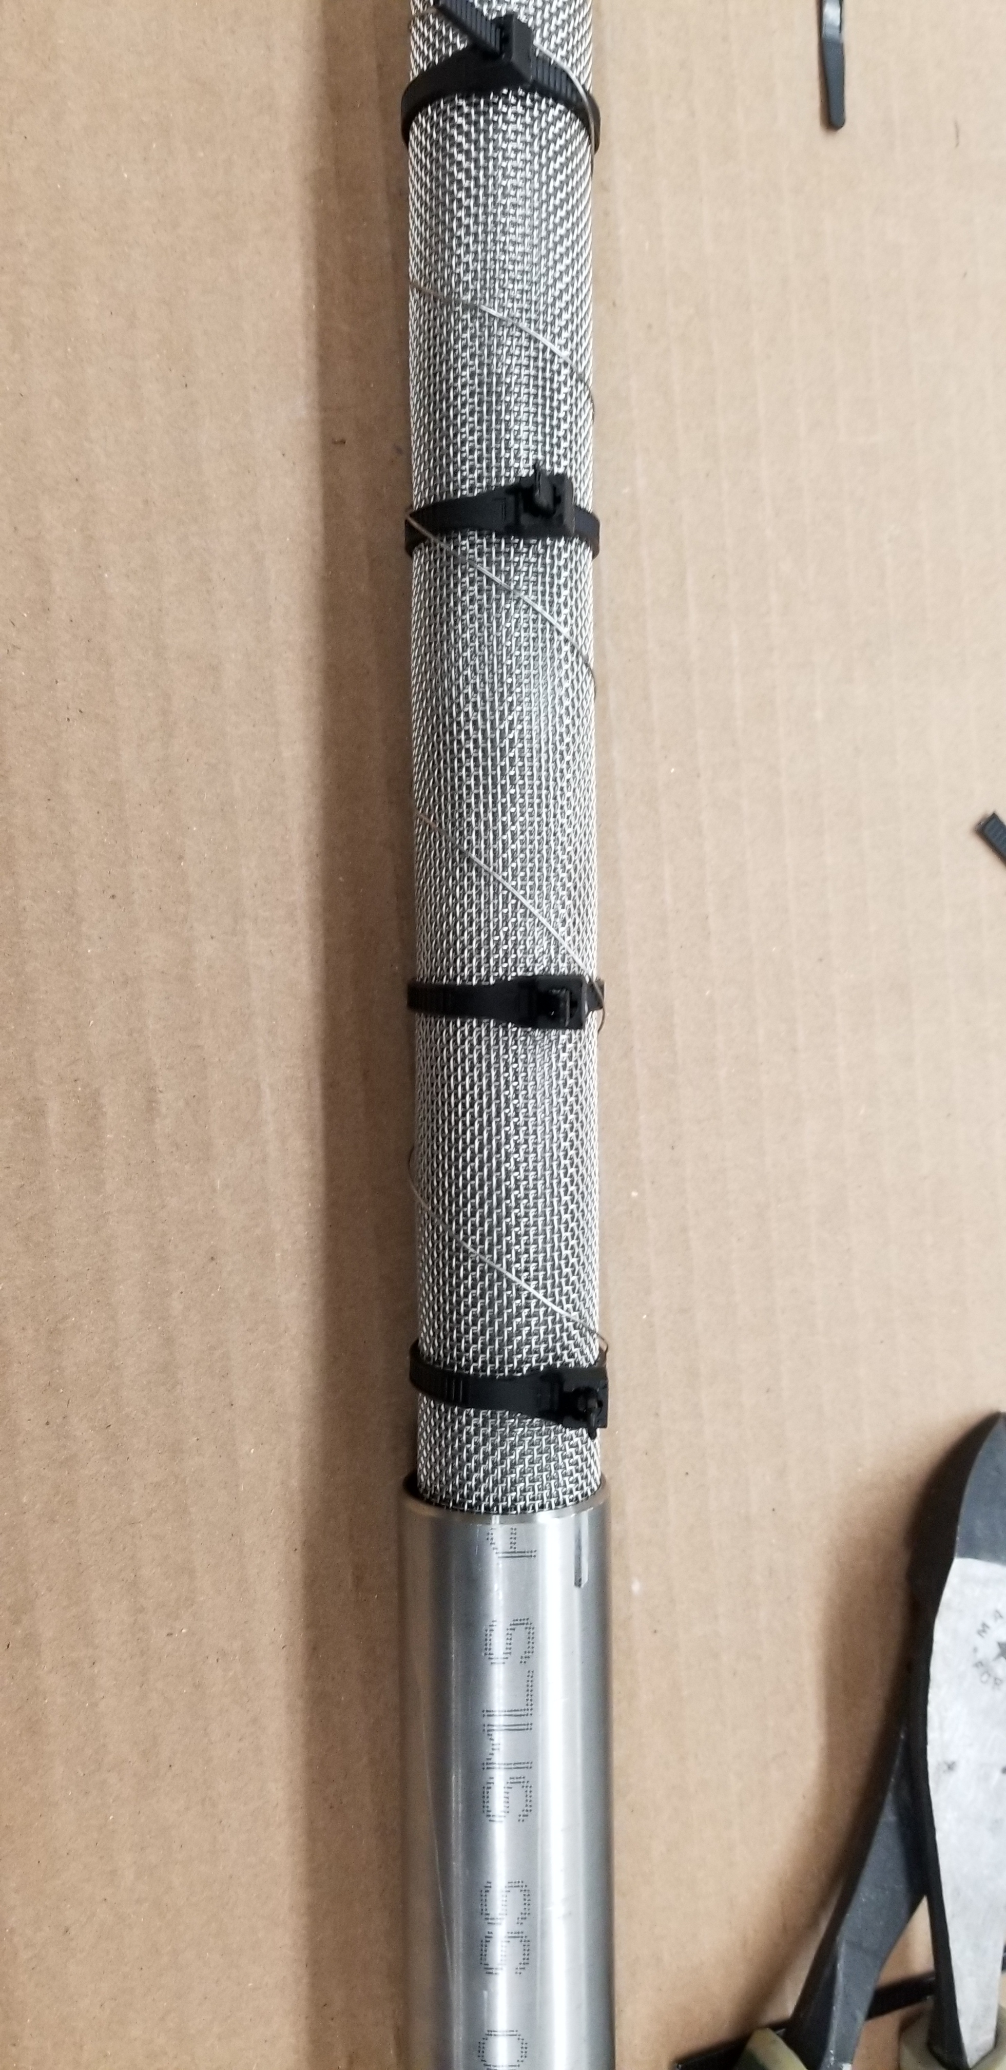
(1) Fabrication & (3) Assembly
Machine pipe and end caps
Cut wire screen mesh to size
Form wire mesh into wick shape
Insert wick into pipe

Slide 31
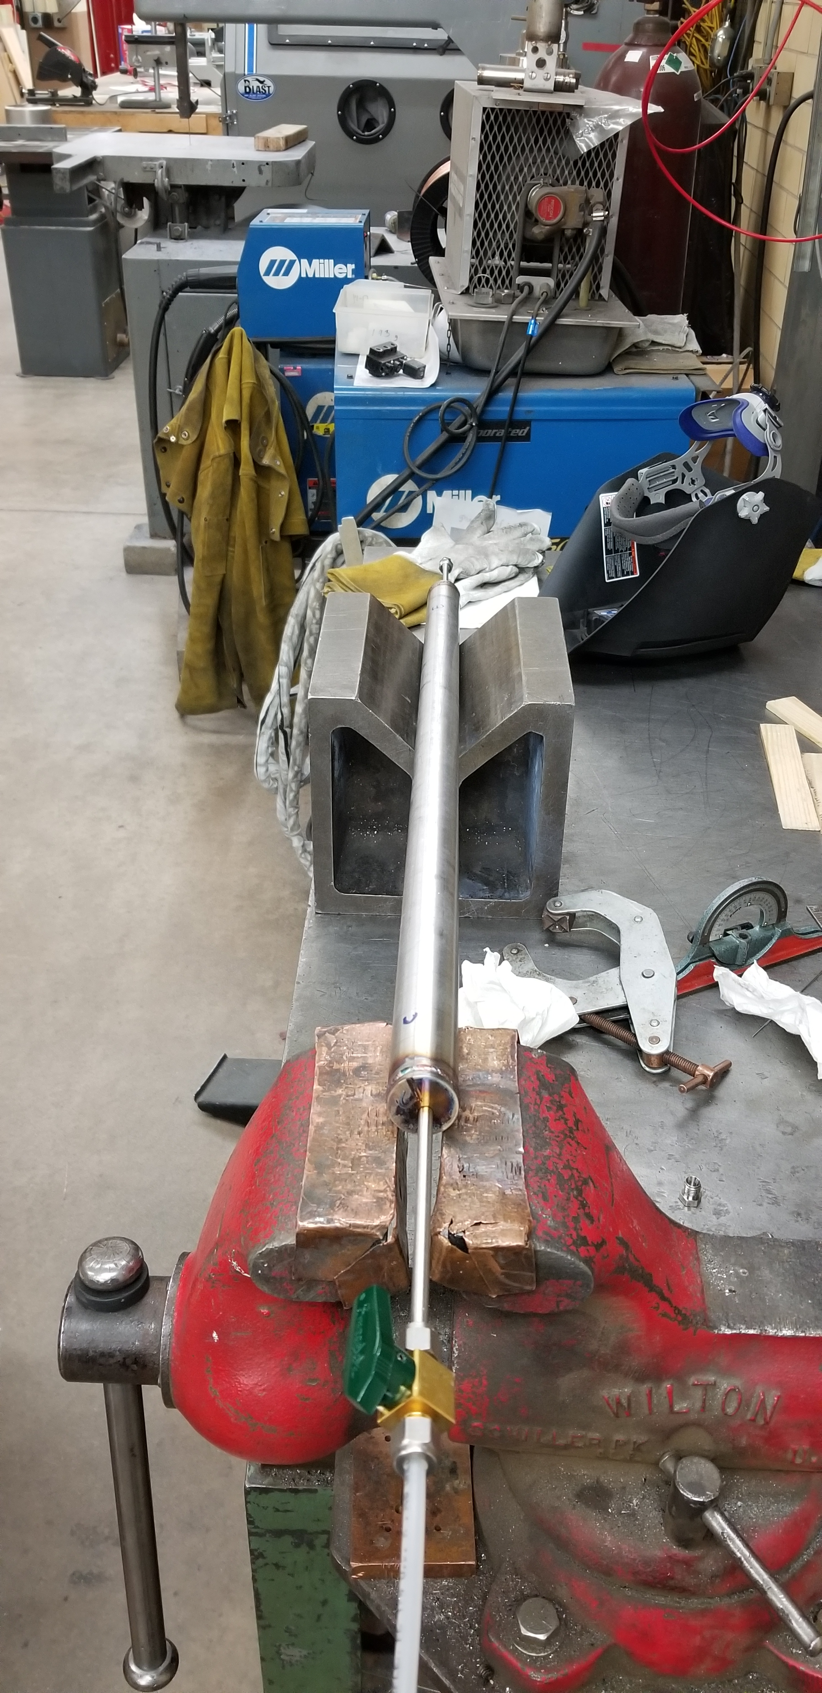
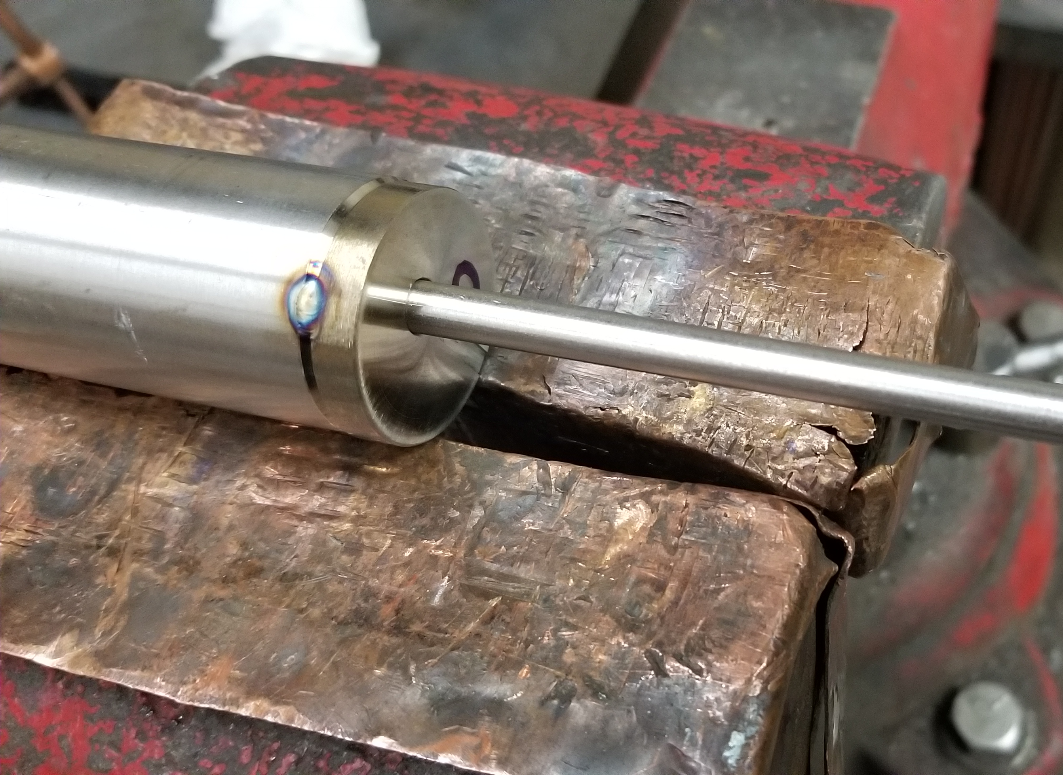
(2) Cleaning & (3) Assembly
Soak components (pipe/mesh, end caps, fill tubes) in Oakite 33 solution at 60 [℃] for 3 hours
Rinse clean with deionized water
Clean fill tubes with isopropyl alcohol
Spray pipe and fill tubes with pressurized air
Weld fill tubes into end caps
Weld end caps onto pipe
Pull 40 [mtorr] vacuum on pipe

Slide 32
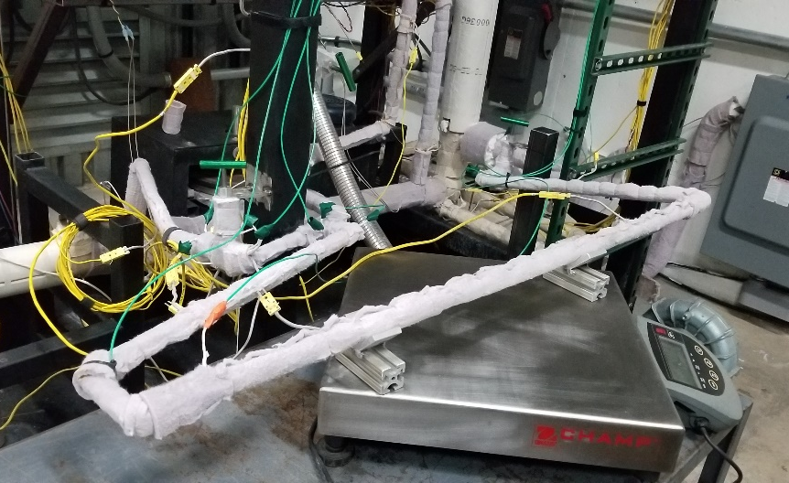
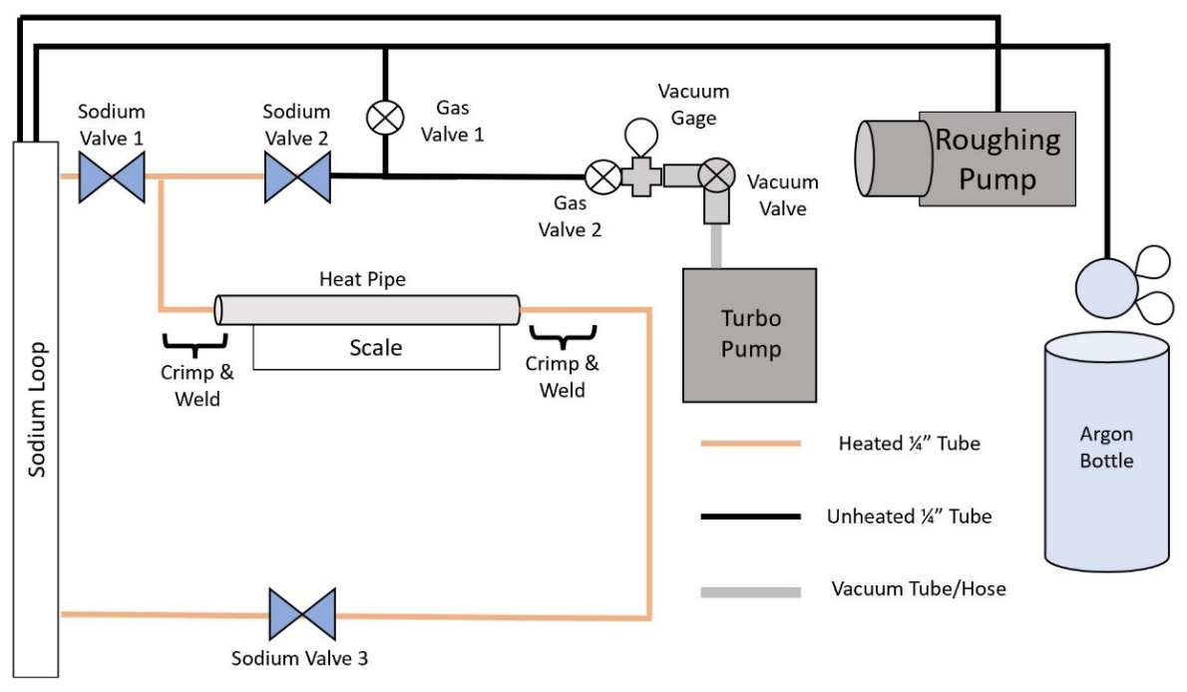
(4) Filling and (5) Sealing
Vacuum bake-out pipe at 400 [℃] and ~30 [mtorr] vacuum
Using loop, flow liquid sodium at 400 [℃] through pipe for 2 hours
Drain sodium from heat pipe until desired level remains
Freeze sodium and vacuum heat pipe to 7E-04 [mtorr] using turbo pump
Crimp both heat pipe fill tubes using hydraulic crimping tool
Weld across the crimped section with a TIG torch to seal & sever
Test section installed on loop (top) & schematic of filling apparatus (bottom)

Slide 33
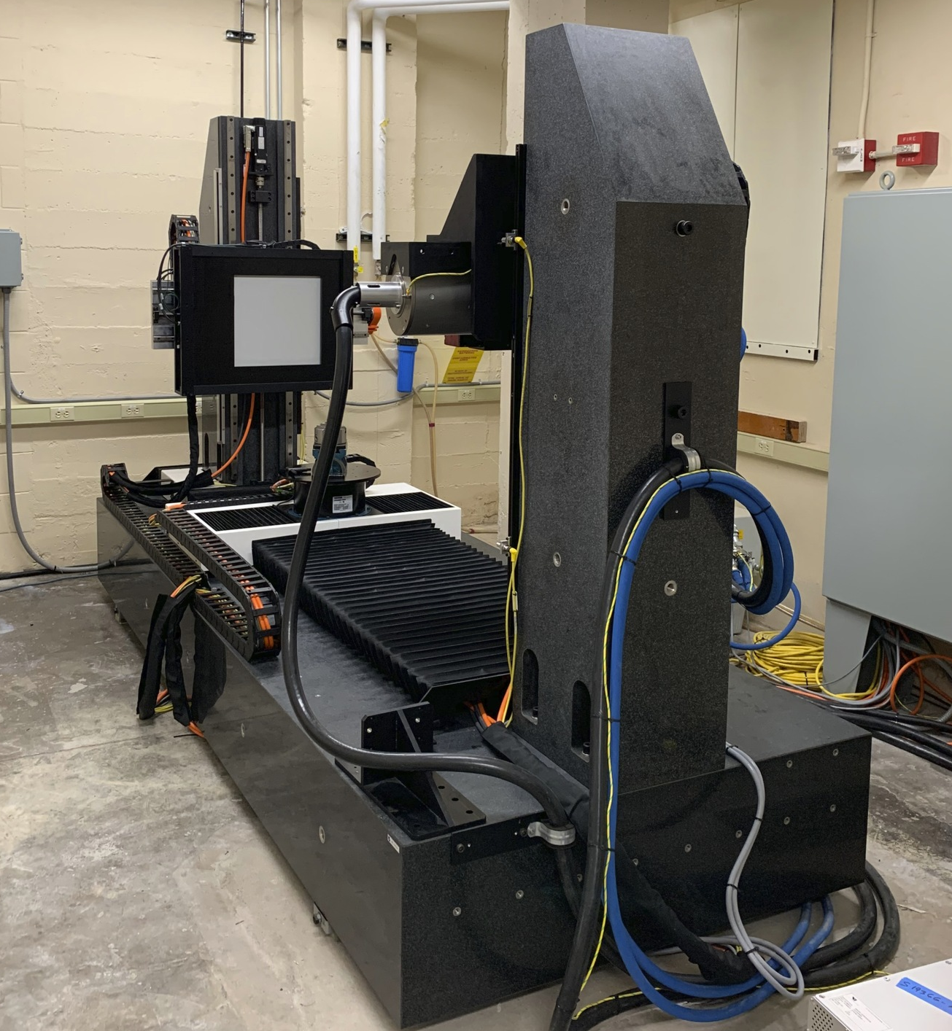
(6) Testing & Inspection
Inspect weld joints by microscope
X-ray heat pipe to verify sodium fill level
Apply up to 2.5 [kW] heat to evaporator and measure axial temperature response
450 kV X-ray CT scanner with fluoroscopy capabilities

Slide 34
Crimp Sealing Process Development

Slide 35
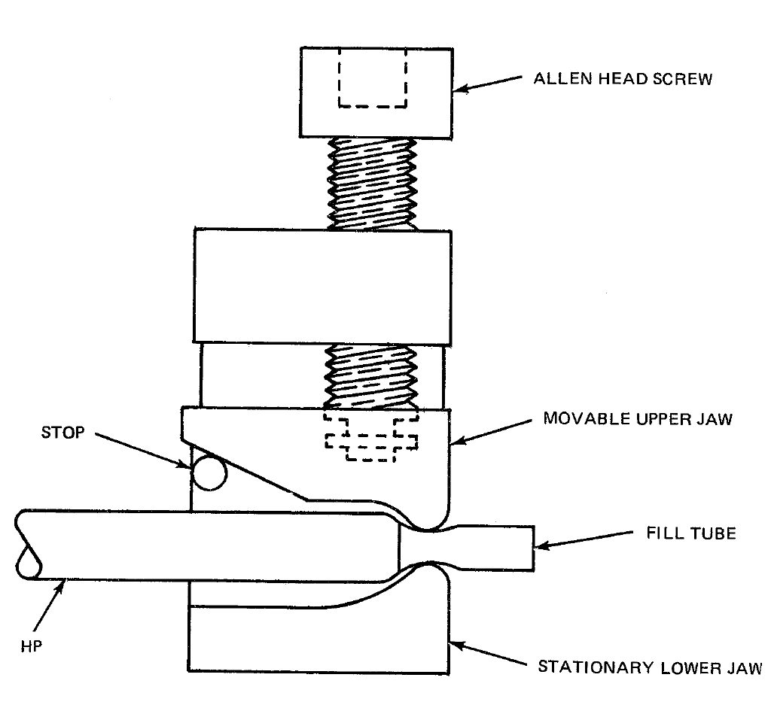
Crimp Sealing
How to crimp seal stainless steel tubing?
Heat pipe is under vacuum, so seal must be able to hold vacuum for at least several minutes until TIG welding (permanent seal) is complete
If seal fails, air will rush in and react with the sodium
Crimp must be completed on the loop since the heat pipe cannot be removed without some sort of seal
Few literature sources describe how this is done
Decided to apply force using a hydraulic tool with shaped dies
Tubing: ¼” x 0.035” 316 SS
Example of crimping setup for copper tubes
23. Edelstein, F., & Haslett, R. (1974). Heat pipe manufacturing study. Final Report prepared by Grumman Aerospace Corp. for NASA, Contract No. NASS5-23156.

Slide 36
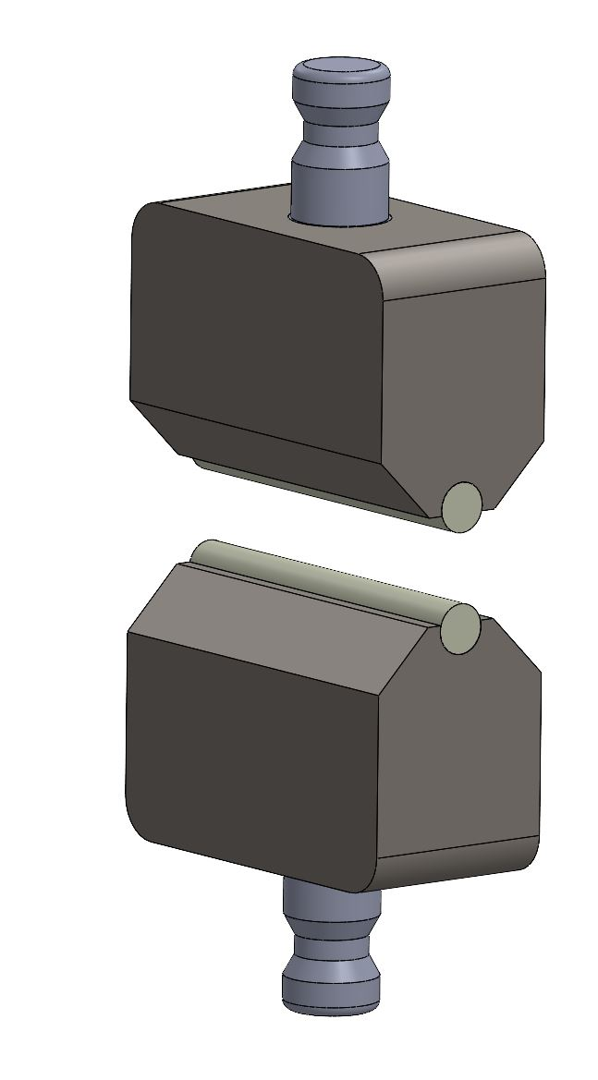
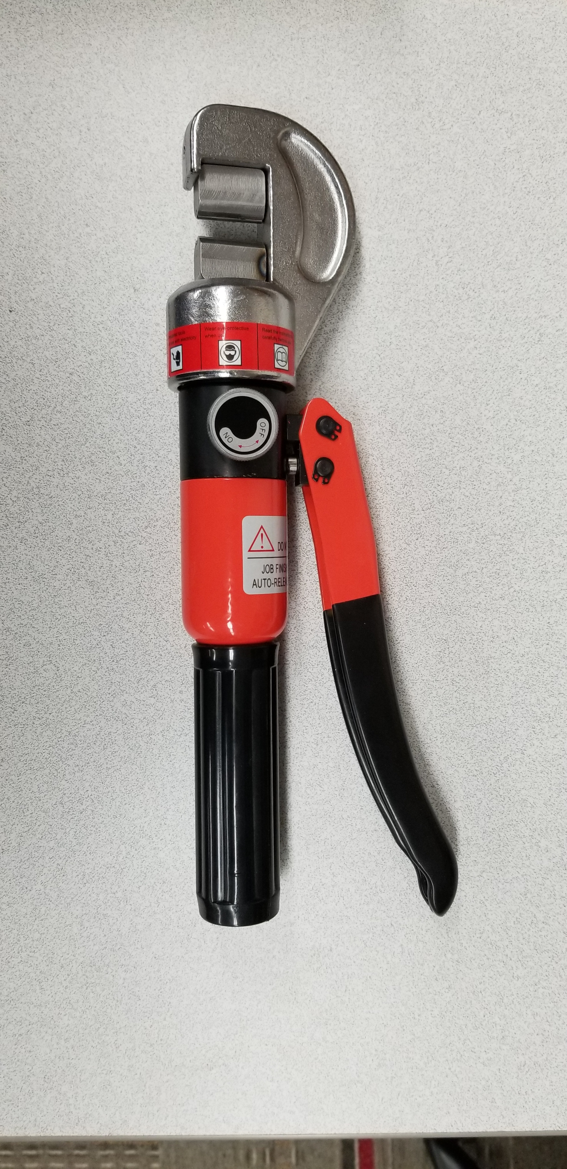
First Crimping Method
Purchased 5 [ton] hydraulic hand crimper
Designed dies with a 1/8” tungsten carbide rod as the pinch point
Soaked the tubing samples in Oakite to match the heat pipe cleaning procedure
Tubing samples were installed on a vacuum pump so vacuum response could be observed

Slide 37
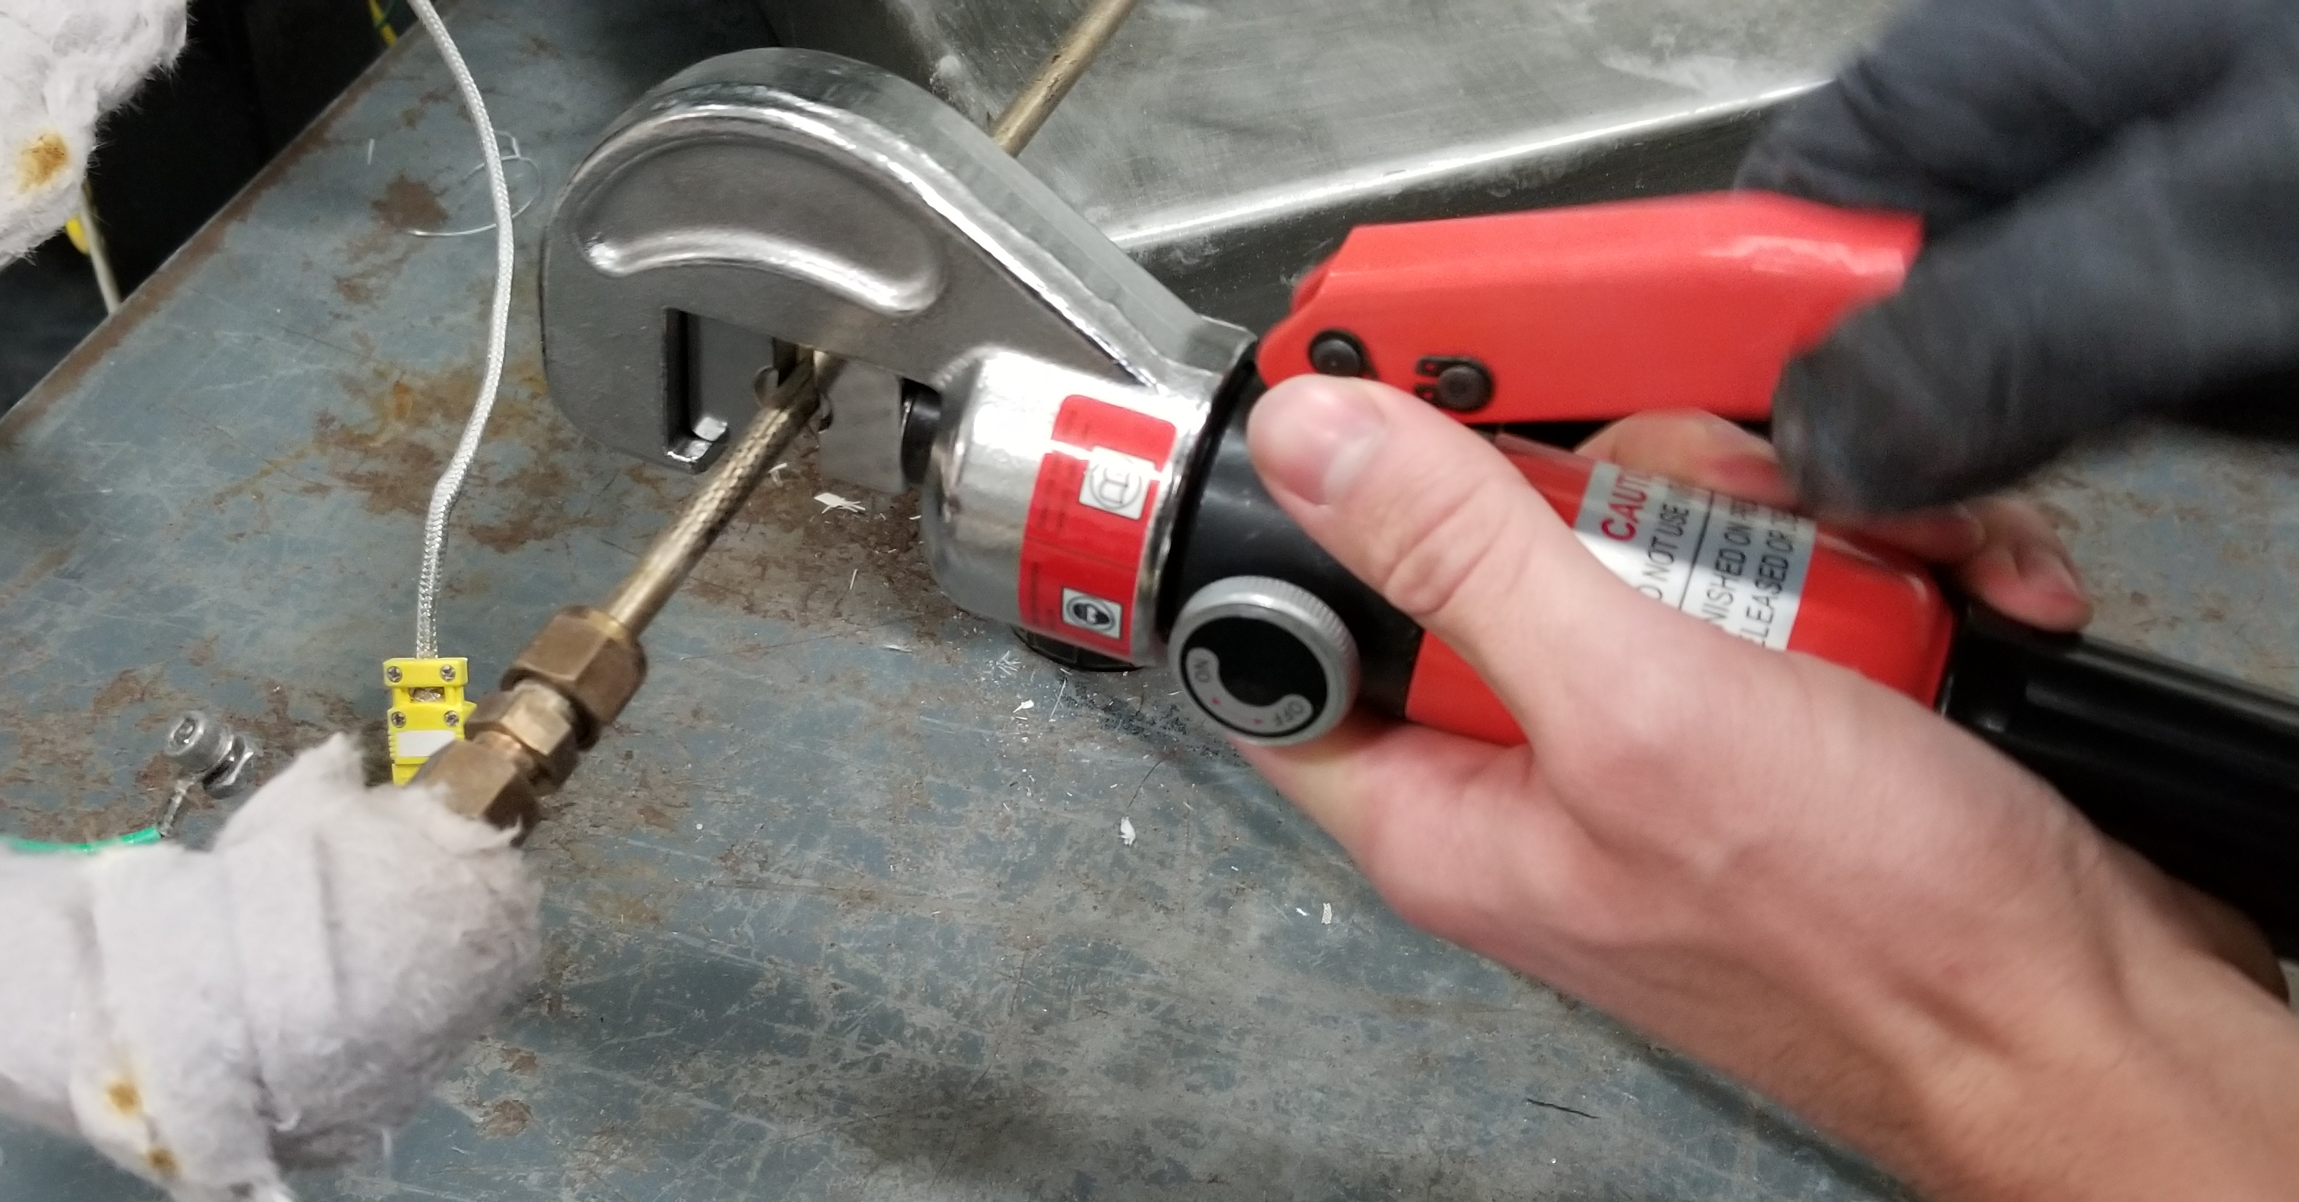
First Crimping Method (Cont.)
Flattened a section of the tube
Heated tube cherry-red with a MAP torch to anneal
Remove torch and then immediately crimp tube
Found that tube cooled down quickly, so heating & crimping cycles were repeated until the crimp thickness was less that 0.050”
Remove end cap and watch vacuum response
Validate seal via helium leak check
Also tested crimps on sodium-wetted tubing from loop to closely match the actual heat pipe fill scenario

Slide 38
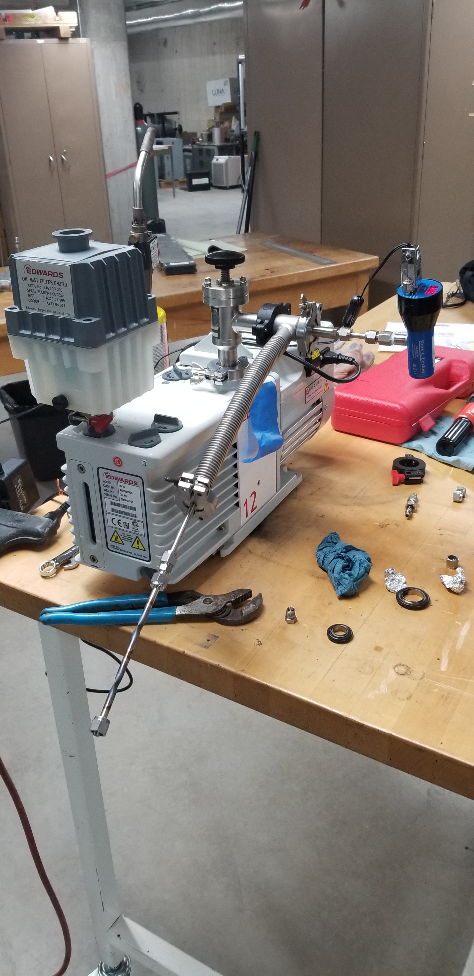
First Crimping Method Results
Bench Test:
11 crimps in a row passed both vacuum and helium leak check
Could withstand 50 [psig] pressure with no detectable leak
Sodium-wetted Test:
Of 8 crimps completed on sodium-wetted tubing, only 2 passed helium leak check
Sodium-wetted crimping test section installed on Tantalus sodium loop

Slide 39
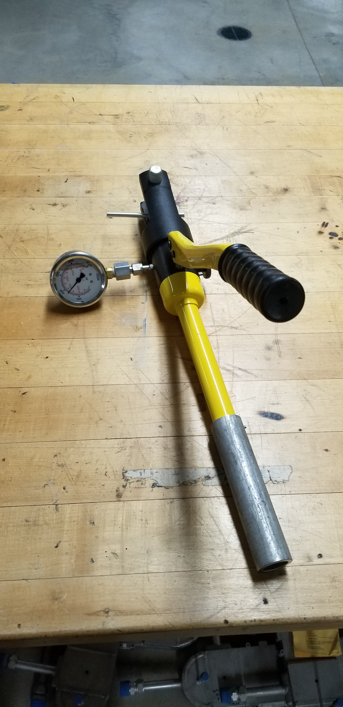
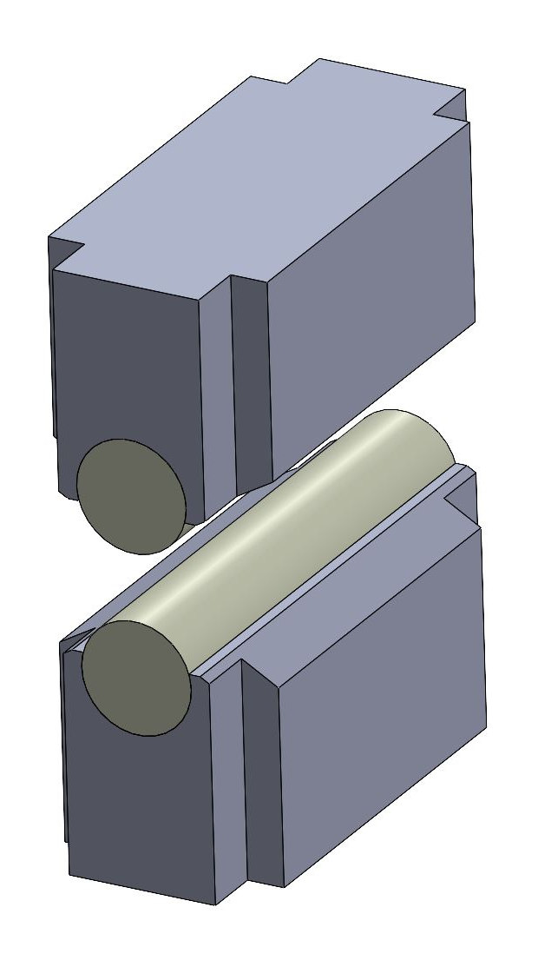
Second Crimping Method
After conversation with LANL, decided to stop heating tubing and apply more force (12 [ton] crimper)
Also decided to measure and control force applied with pressure gauge
Designed new dies with 3/8” tungsten carbide rods for a wider area of contact
New crimper can easily crimp the tube to less than 0.005” thick

Slide 40
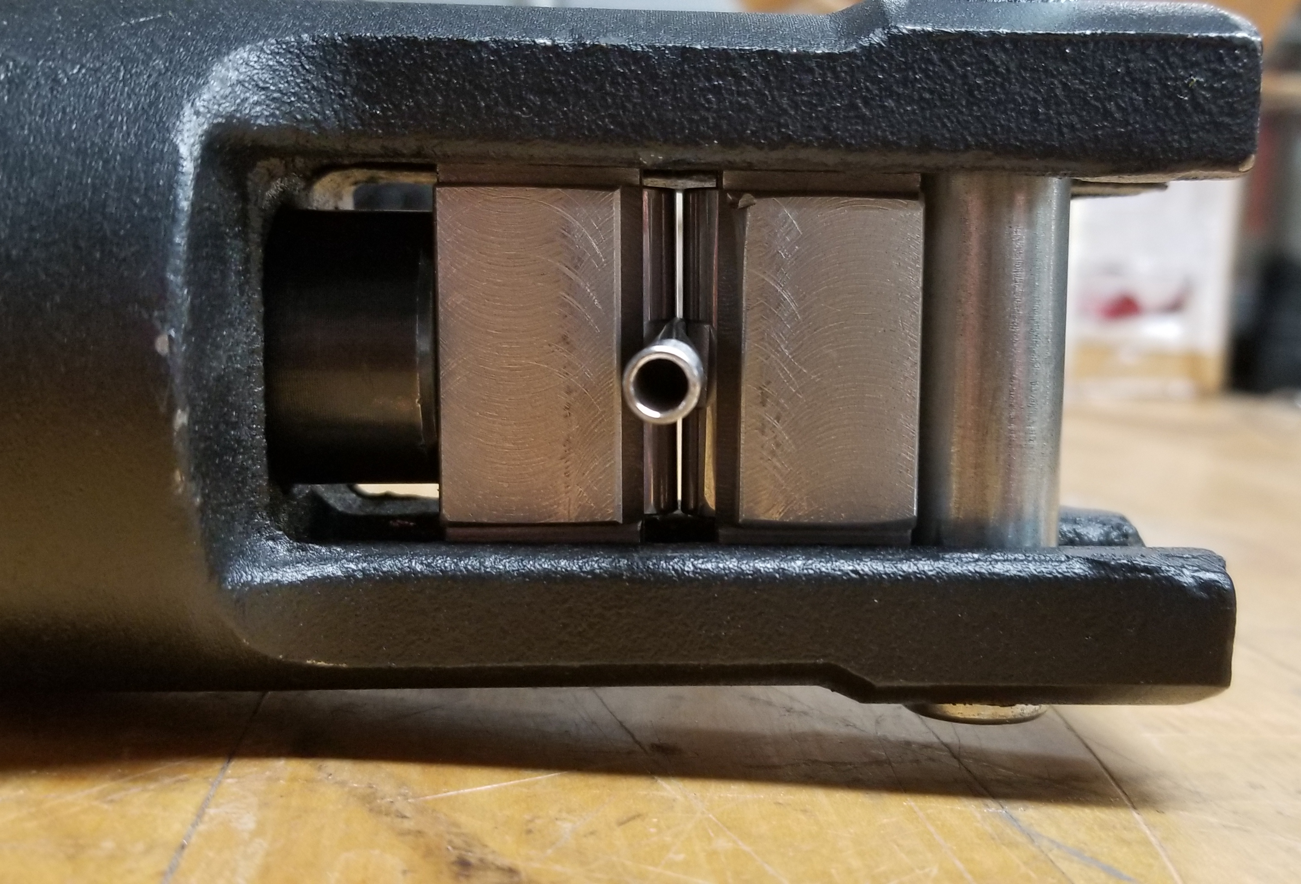
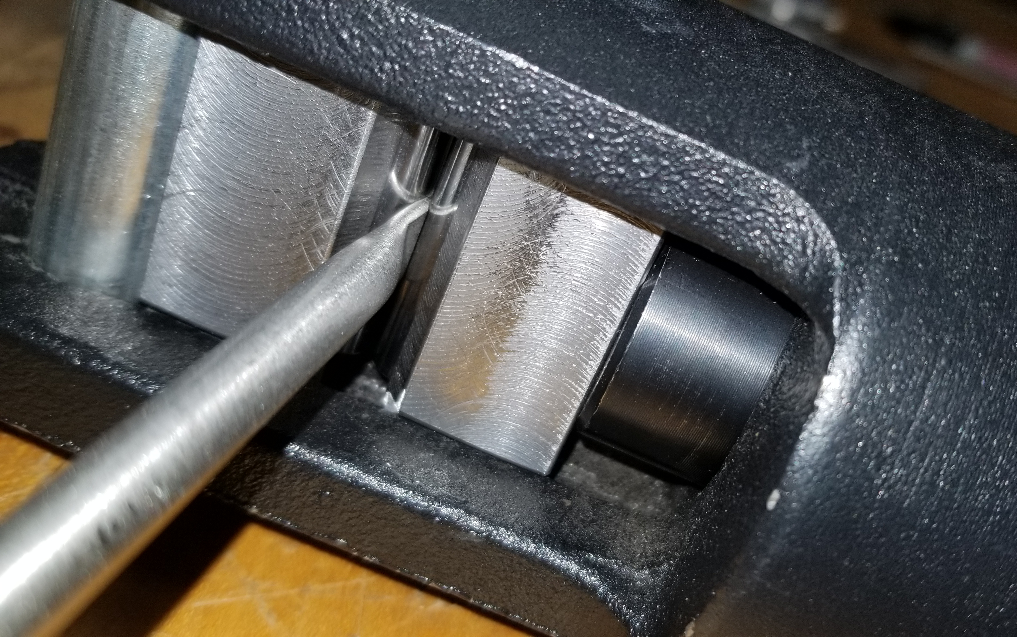
Second Crimping Method (Cont.)
Flattened a section of tube and then crimped
Determined that a gauge pressure of 7,000 [psig] held for 30 [s] gave the best results
Of the crimps done in this manner, all passed helium check

Slide 41
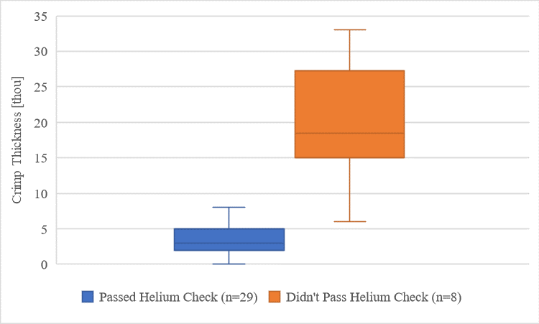
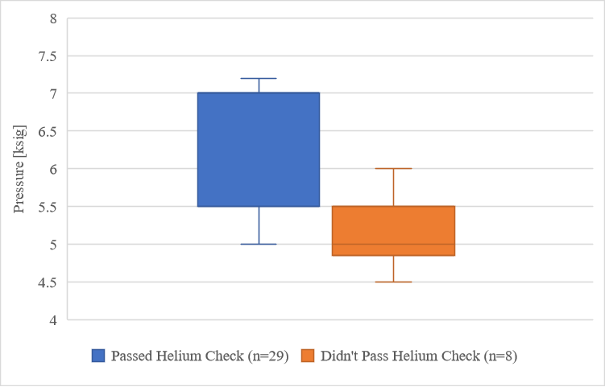
Second Crimping Method Results

Slide 42
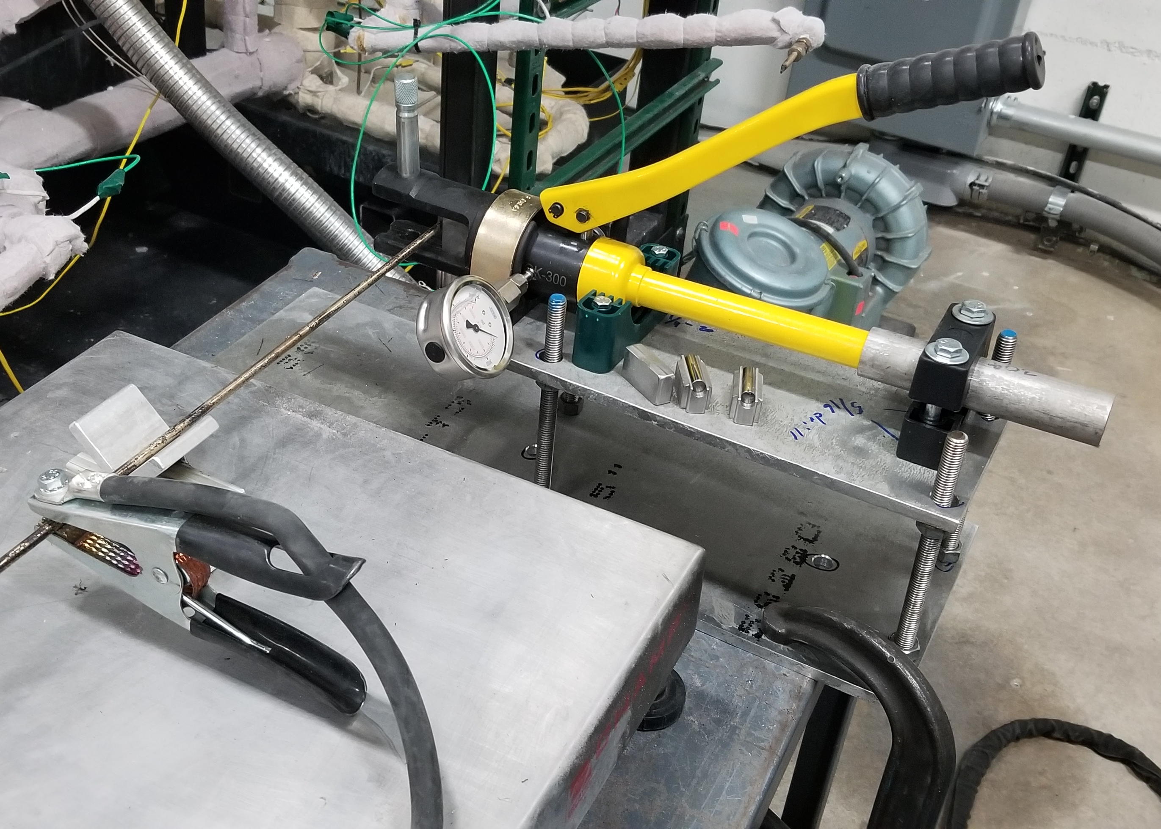
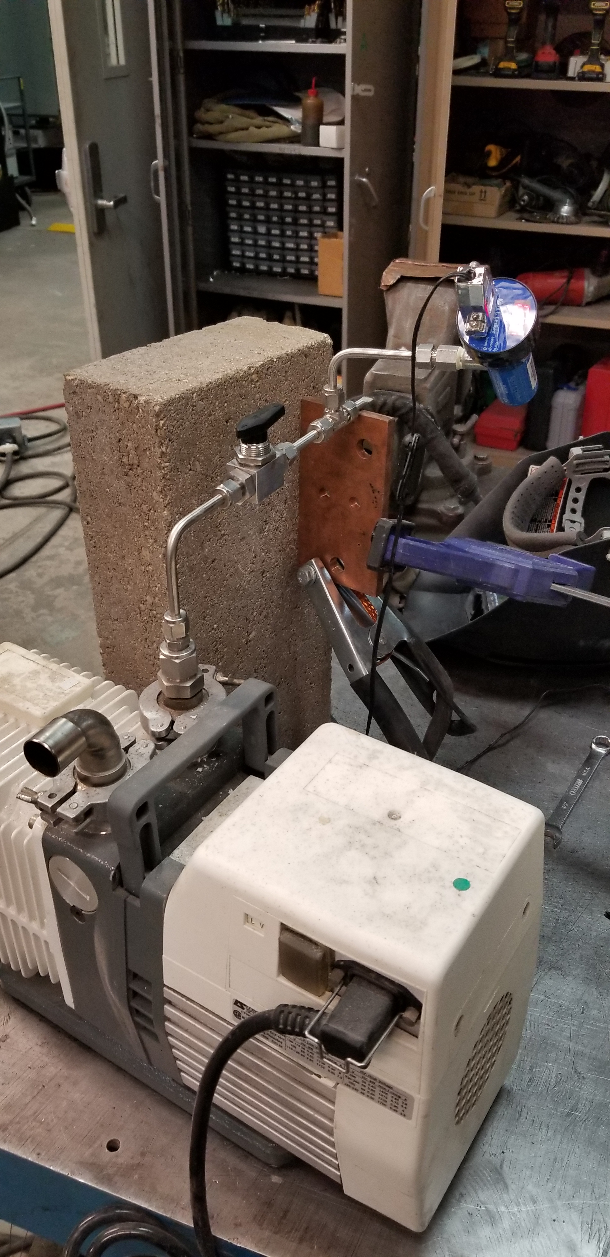
Welding Testing
Need to ensure that there is no leak during welding
Concerned that the weld will break the crimp seal, either through melting or thermal expansion
Weld the crimped section under vacuum and observe the vacuum response on a gauge
Results:
7 successes- vacuum reading remained in the [mtorr] range
3 failures- vacuum reading shot into the [torr] range
Need to further develop and improve the welding process
Notes:
Note that LANL only expects 85% of the pipes they manufacture to actually work

Slide 43
Future Work
Validate manufacturing process and produce several first-iteration heat pipes
Collect temperature data from first-iteration pipe
Conduct X-ray fluoroscopy on first-iteration pipe
Produce second iteration pipe that more closely matches microreactor applications
Collect detailed temperature distribution data using FO-DTS sensors
Take pressure measurements of liquid pressure drop using NaK-filled pressure transducer
Investigate transient behavior of heat pipe including X-ray imaging

Slide 44
References
(2021, February 26). What is a Nuclear Microreactor? Energy.gov. https://www.energy.gov/ne/articles/what-nuclear-microreactor
Zohuri, B. (2020). Nuclear Micro Reactors. Springer Nature, Switzerland. DOI: https://doi.org/10.1007/978-3-030-47225-2
Holdmann, G. and Asmus, P., 2019. Microgrid Innovation in the Circumpolar Arctic: Lessons for Developing World Markets. Navigant Research.
Swartz, M. M., Byers, W. A., Lojek, J., & Blunt, R. (2021). Westinghouse eVinci Heat Pipe Micro Reactor Technology Development. Proceedings of the 2021 28th International Conference on Nuclear Engineering.
Levinsky, A., van Wyk, J. J., Arafat, Y., & Smith, M. C. (2018). Westinghouse eVinci reactor for off-grid markets. Transactions of the American Nuclear Society 119. pp. 931-934.
Mcclure, P. R., Poston, D. I., Dasari, V. R., & Reid, R. S. (2015). Design of Megawatt Power Level Heat Pipe Reactors.
Hernandez, R., Todosow, M., & Brown, N. R. (2019). Micro heat pipe nuclear reactor concepts: Analysis of fuel cycle performance and environmental impacts. Annals of Nuclear Energy 126, pp. 419-426. DOI: https://doi.org/10.1016/j.anucene.2018.11.050
Peterson, G. P. (1994). An introduction to heat pipes: Modeling, testing, and applications. John Wiley & Sons, New York, NY.
Faghri, A. (1995). Heat pipe science and technology. Taylor & Francis, Washington, D. C.
Chi, S. W. (1976). Heat pipe theory and practice: A sourcebook. Hemisphere Publishing Corporation, Washington, D. C.
Mochizuki, M., Singh, R., Nguyen, T., & Nguyen, T. (2014). Heat pipe based passive emergency core cooling system for safe shutdown of nuclear power reactor. Applied Thermal Engineering 73, pp. 699-706.
Beard, D., Anderson, W. G., & Tarau, C. (2016). Self-Venting Arterial Heat Pipes for Spacecraft Applications. AIAA Propulsion and Energy Forum, July 25-27, 2016, 14th International Energy Conversion Engineering Conference. DOI: 10.2514/6.2016-4603
Arafat, Y, & Van Wyk, J. (2019). eVinci Micro Reactor. Nuclear Plant Journal, March-April 2019, pp 34-37.
Zohuri, B. (2019). Heat pipe applications in fission driven nuclear power plants. Springer Nature, Switzerland. DOI: https://doi.org/10.1007/978-3-030-05882-1

Slide 45
References
Kemme, J. E. (1967). High Performance Heat Pipes. Proceedings of the 1967 Thermionic Conversion Specialist Conference, Palo Alto, California.
Zohuri, B. (2016). Heat pipe design and technology. (2nd Ed.). Springer International Publishing, Switzerland
Zhou, Y., Wang, J., Guo, Z., He, Y., Zhang, Y., Qiu, S., Su, G. H., & Corradini, M. L. (2021). 3D-2D coupling multi-dimension simulation for the heat pipe micro-reactor by MOOSE&SAM. Progress in Nuclear Energy 138. https://doi.org/10.1016/j.pnucene.2021.103790
Tien, C. L., & Rohani, A. R. (1974). Analysis of the Effects of Vapor Pressure Drop on Heat Pipe Performance. International Journal of Heat and Mass Transfer 17. pp. 61-67.
John, J. & Keith, T. (2006). Gas Dynamics (3rd. ed.). Pearson Prentice Hall, Upper Saddle River, NJ.
Prenger, F. C. (1979). Heat Pipe Computer Program (HTPIPE) User’s Manual. Los Alamos Scientific Laboratory LA-8101-M.
Martineau, R. C. (2019). DireWolf: MOOSE-based Multiphysics Simulator for Megawatt Scale Micro-Reactor. GAIN-EPRI-NEI-US NIC Micro-Reactor Workshop, April 3-4, 2019
Sunden, B, & Fu, J (2017). Heat Transfer in Aerospace Applications. Elsevier Ltd. ISBN: 978-0-12-809760-1
Edelstein, F., & Haslett, R. (1974). Heat pipe manufacturing study. Final Report prepared by Grumman Aerospace Corp. for NASA, Contract No. NASS5-23156.
Martin, J. & Salvail, P. (2004). Sodium heat pipe module processing for the SAFE-100 reactor concept. AIP Conference Proceedings 699, 148. https://doi.org/10.1063/1.1649569
Stelman, D. & Newcomb, J. (1993). Filling and sealing sodium heat pipes AIP Conference Proceedings 271, 533. https://doi.org/10.1063/1.43065
Teng, W., Wang, X., & Zhu, Y. (2020). Experimental investigations on start-up and thermal performance of sodium heat pipe under swing conditions. International Journal of Heat and Mass Transfer 152(2020).

Slide 46
Thank You!
Questions?

Slide 47
Supporting Slides

Slide 48
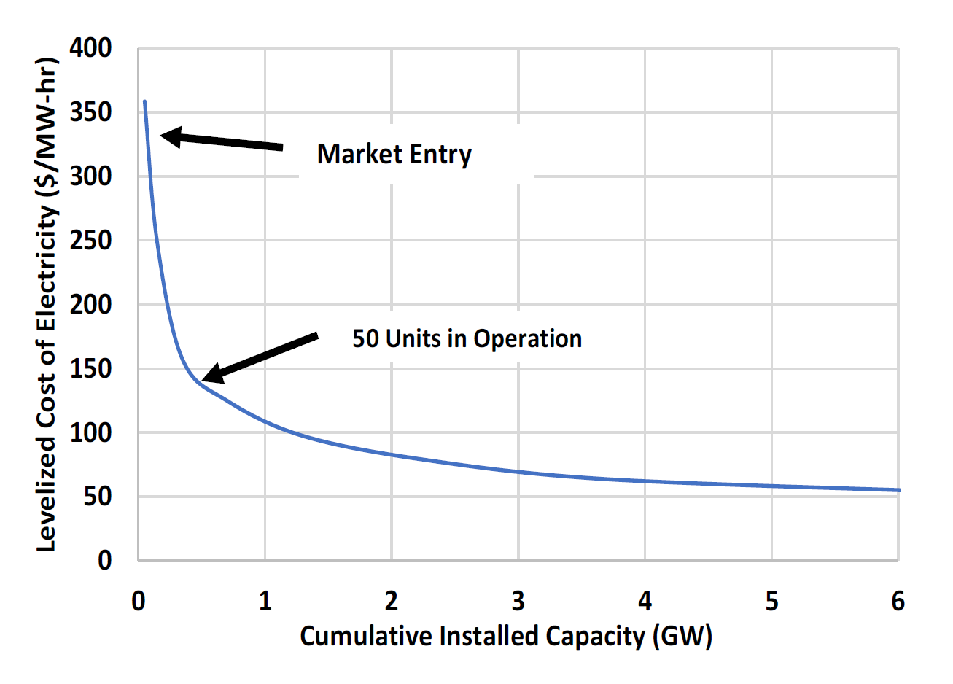
Microreactor LCOE Over Time
Lazard Ltd. 2020. Lazard's Levelized Cost of Energy Analysis–Version 14.0. New York, NY 10112. https://www.lazard.com/media/451419/lazards-levelizedcost-of-energy-version-140.pdf

Slide 49
Entrainment Limit
Pipe Wall
Wick
Liquid Flow (to evaporator)
Vapor Core
Entrained droplets
Vapor Flow (to condenser)
Entrainment of liquid from wick to vapor flow
Notes:
Choked flow: mass flow rate does not increase for a decrease in downstream pressure.

Slide 50
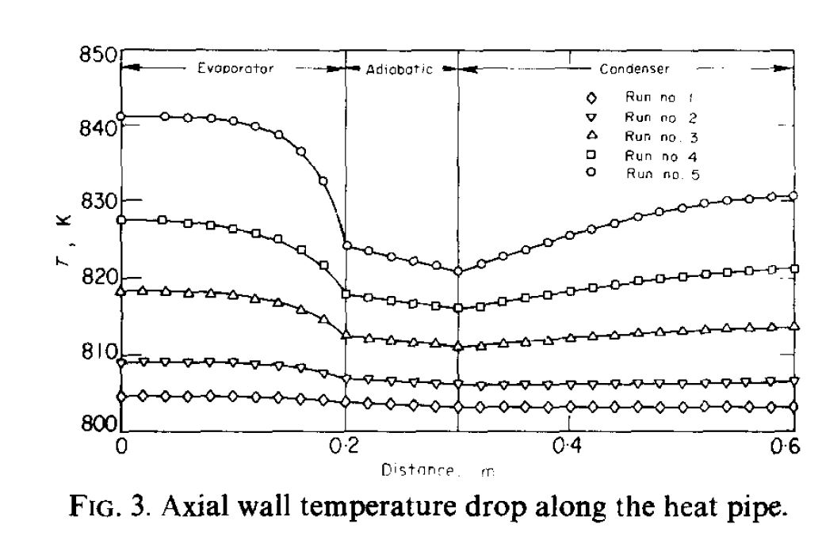
Vapor Flow

Slide 51
Pressure-thickness Relationship

Slide 52
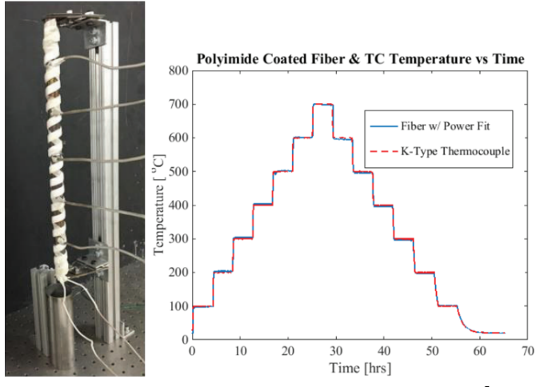
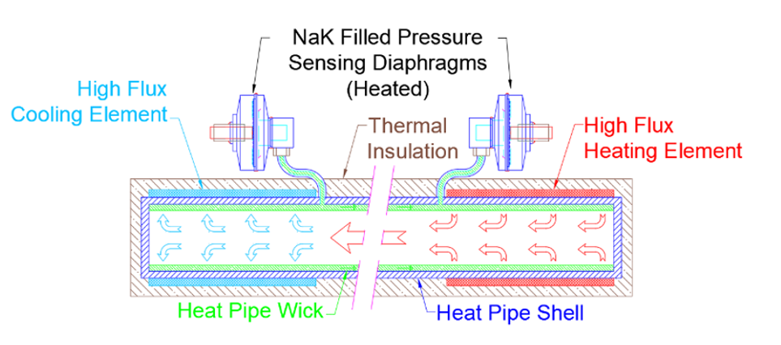
Measurement Technologies

