Slide 1
Informed Feature Selection for Data Clustering of CSP Plant Performance
Matt tuman
Advisors: Mike wagner, Greg Nellis, and Doug Reindl

Slide 2
Personal Information
Hometown: Wausau, WI
Undergraduate: Engineering Mechanics and CS Certificate
Hobbies: Fishing, golfing, playing the guitar

Slide 3
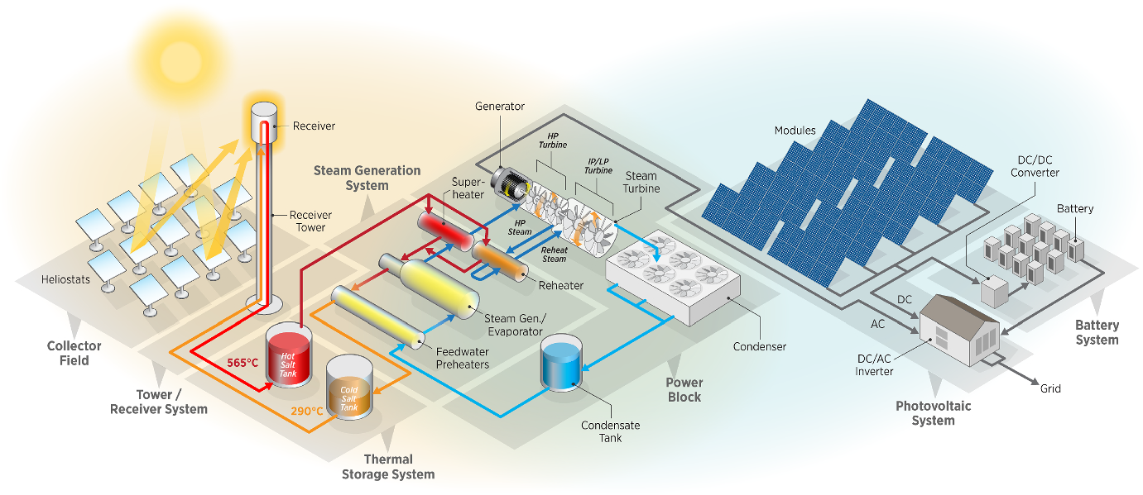
Background: Concentrating Solar Power (CSP)
Utilize heat from the sun as the input for a power cycle to produce electricity
Main Benefit: Thermal Energy Storage (TES)
Can dispatch electricity to meet demand
[1]

Slide 4
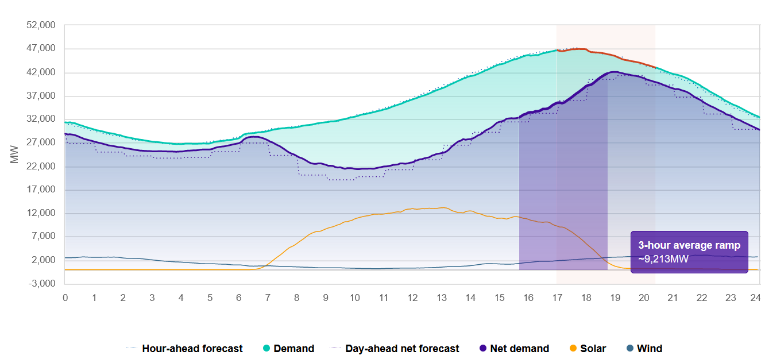
Background: CSP Relevance Today
Recent struggles to meet demand in California
Seven straight days under a state alert urging Californians to reduce electricity consumption between 5 and 9 P.M.
Drop off in solar production during peak demand
CSP storage could help alleviate this issue
[2]
[2] https://www.caiso.com/TodaysOutlook/Pages/default.aspx#section-net-demand-trend

Slide 5
Background: CSP Optimizations
CSP is more expensive (levelized cost of electricity basis) [3]
CSP: $0.11 /kWh
PV: $0.048 /kWh
WIND: $0.033 /kWh
Optimizations must be performed to make CSP more cost competitive
Create “n” Plant Designs
Run Annual Simulation for each Design
Compute Revenue for each Design
Adjust Designs According to Revenue
Simulations include electricity dispatch scheduling optimization which makes them very time consuming (1-2 hours each)
[3] “Renewable power generation costs in 2021”. IRENA International Renewable Energy Agency. (2022, July). Retrieved September 8, 2022, from https://irena.org/publications/2022/Jul/Renewable-Power-Generation-Costs-in-2021

Slide 6
Background: Data Clustering Approach
Goal: Reduce runtime of annual simulation
Idea: Similar days of weather and demand will have similar plant performance
Day 1
Day 2
Day 3
….
Day 363
Day 364
Day 365
Sunny
Partially Cloudy
Cloudy
Production 1
Production 2
Production 3
Production
Production
Production
….
Production
Production
Production

Slide 7
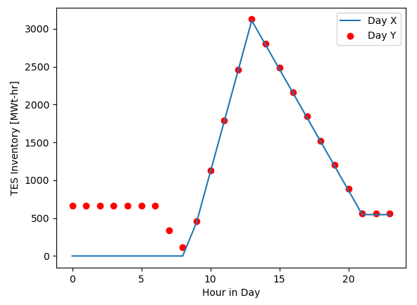
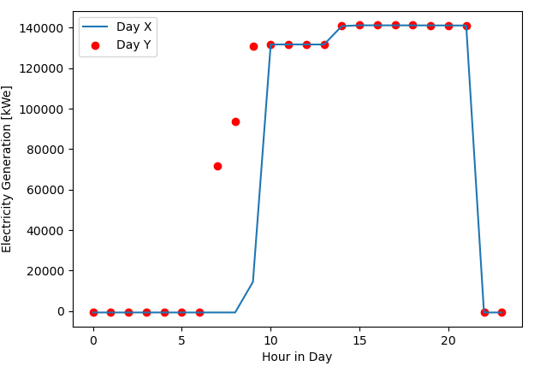
Background: Data Clustering Approach
Previous work has shown that the data clustering approach is feasible and accurate [4]
Clustered days using only weather and price
Problem: consider the case where two days have the same exact weather and demand, but one of the days has thermal energy storage inventory left over from the day before
TES Inventory
Electricity Generation
[4] J. Martinek, and Michael J. Wagner. “Efficient Prediction of Concentrating Solar Power Plant Productivity Using Data Clustering.” Solar Energy 224. June (2021): pp. 730–41.

Slide 8
Objectives
Idea: Thermal energy storage inventory at the beginning of a day ($S_{i})$ should be used in addition to weather and price to cluster days
Goals:
Construct a framework to predict $S_{i}$ throughout the year using a neural network (NN)
Illustrate that using $S_{i}$ as an additional feature improves simulation accuracy

Slide 9
Data Clustering Methodology

Slide 10
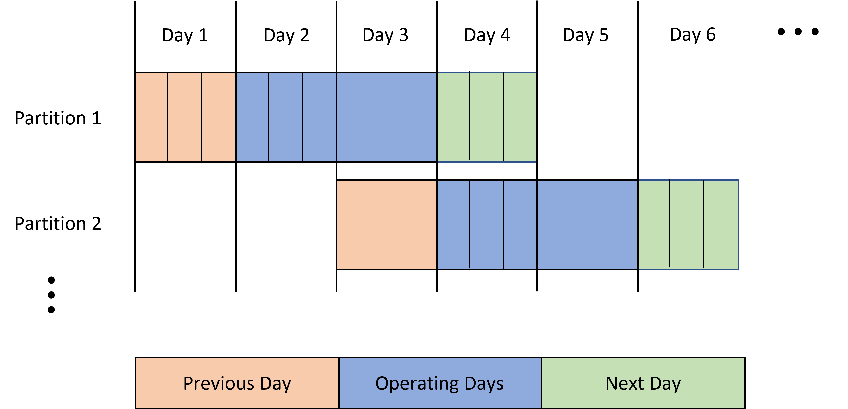
Data Clustering Methodology : Step 1
Divide the year into partitions consisting of one previous day, two operating days, and one next day

Slide 11
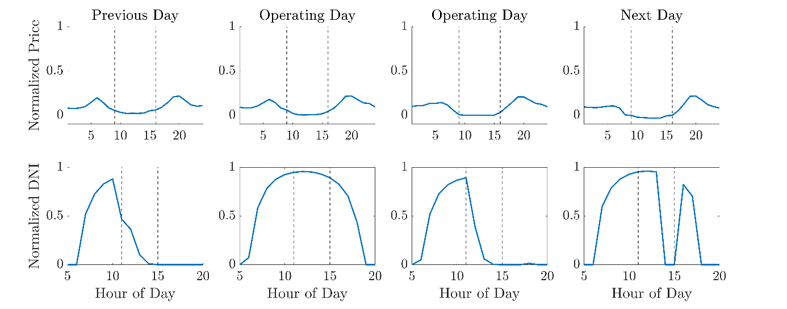
Data Clustering Methodology : Step 2
For each partition, obtain weather, price, and $S_{i}$ features
“Feature”: Quantifiable properties that are used as inputs for a clustering algorithm
Days are divided into $N_{div}$ divisions (Below $N_{div}=3$)
Compute average of normalized price or DNI in each division
DNI: Direct normal irradiance (usable energy from the sun)

Slide 12
Data Clustering Methodology : Step 3
Recall: Data from the Step 2 is normalized to a maximum of 1
Apply a weighting factors ($w_{f})$ to adjust relative importance of a feature ($x_{p,f})$ when forming clusters
$$x_{p,f}^{w}=w_{f}∗x_{p,f}$$
Example:
DNI affects plant performance more than electricity price
$w_{DNI}=2$ and $w_{price}=1$

Slide 13
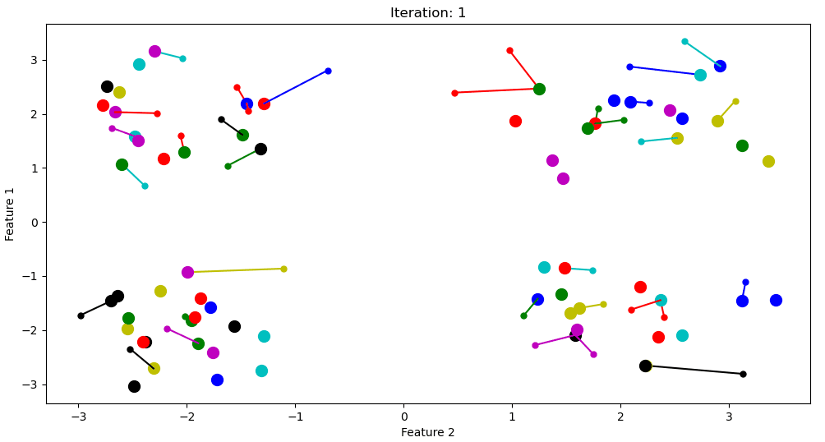
Data Clustering Methodology : Step 4
Use the weighted features as input for a data clustering algorithm
Affinity Propagation is used to cluster data
Iterative algorithm that forms clusters based on distance
Algorithm identifies “exemplars” for each cluster (the most representative individual)

Slide 14
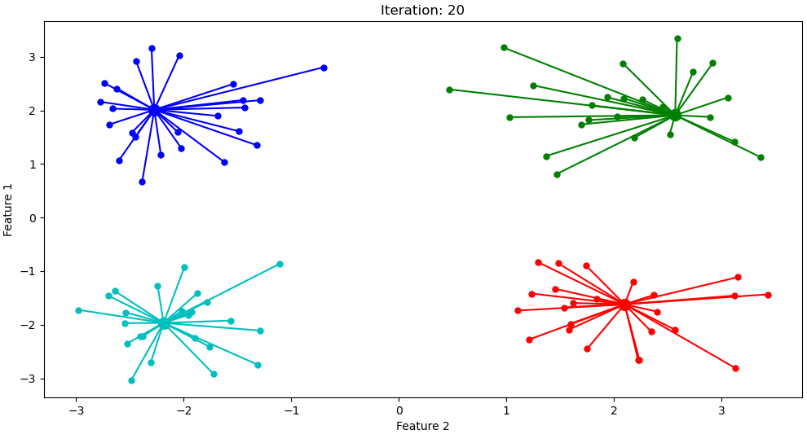
Data Clustering Methodology : Step 5
Simulate each exemplar partition using SAM and the Molten Salt Power Tower module
Can run simulations in parallel because they are independent of another
In this example, run four simulations
Prev.
Op.
Op.
Next
Prev.
Op.
Op.
Next
Prev.
Op.
Op.
Next
Prev.
Op.
Op.
Next

Slide 15
Data Clustering Methodology: Step 6
Reassemble exemplar simulation output to form an annual simulation
Only using the output for the two operating days
SAM Output
Prev.
Op.
Op.
Next
Prev.
Op.
Op.
Next
Prev.
Op.
Op.
Next
Prev.
Op.
Op.
Next
Stitch together annual simulation
...
Day 1
Day 2
Day 3.
Day 4
Day 5
Day 6
Day 5
Day 6
Day 358
Day 359
Day 360
Day 361
Day 362
Day 363
Day 364
Day 365

Slide 16
Neural Network Methodology

Slide 17
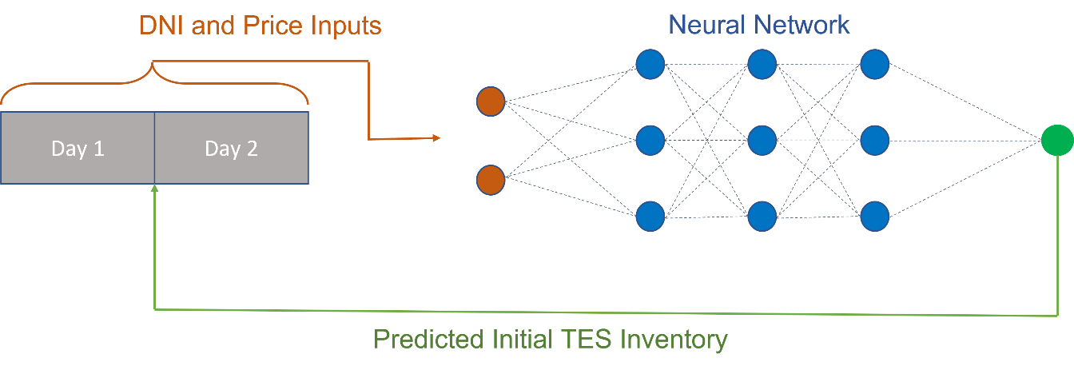
Neural Network Methodology: Overview
Want to solve the regression problem of predicting TES inventory at the beginning of a day ($S_{i}$) throughout the year

Slide 18
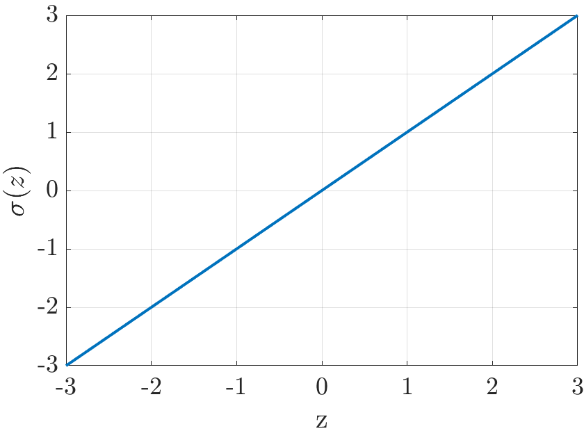
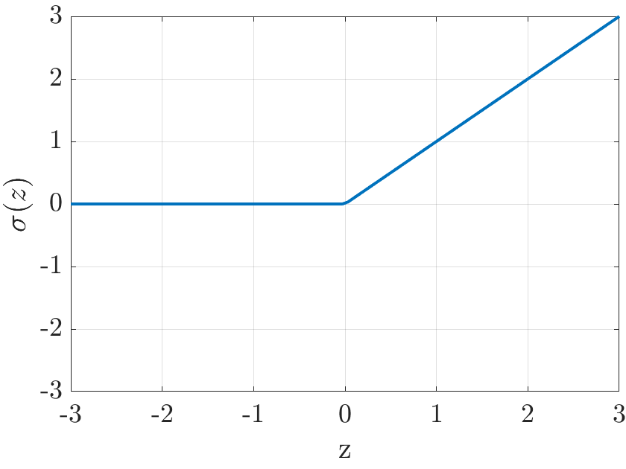
Neural Network Methodology: Terminology
“Weight”
“Node”
$$x_{1}$$
$$w_{1}$$
$σ\left(z\right)$: “Activation Function”
$$w_{2}$$
$$x_{2}$$
$$o$$
$$=σ(\left\langle w, \left.x\right\rangle +b)=σ(w_{1}x_{1}+w_{2}x_{2}+w_{3}x_{3}+b)\right.$$
$$w_{3}$$
$$x_{3}$$
Activation Functions Used:
Linear: $σ\left(z\right)=z$
ReLu: $σ\left(z\right)=\left\{\begin{aligned}0, z<0 \\ &z, z≥0\end{aligned}\right.$
“Layer”

Slide 19
Neural Network Methodology: Architecture
Input Layer
Hidden Layers (H.L.)
Output Layer
($S_{i}$)
*Not Drawn to Scale
 | Input | H.L. 1 | H.L. 2 | H.L. 3 | H.L. 4 | H.L. 5 | H.L. 6 | H.L. 7 | Output
Nodes | 16 | 50 | 25 | 10 | 25 | 50 | 25 | 10 | 1
Act. Fn. | Linear | ReLu | ReLu | ReLu | ReLu | ReLu | ReLu | ReLu | Linear
Almost always use for regression problems

Slide 20
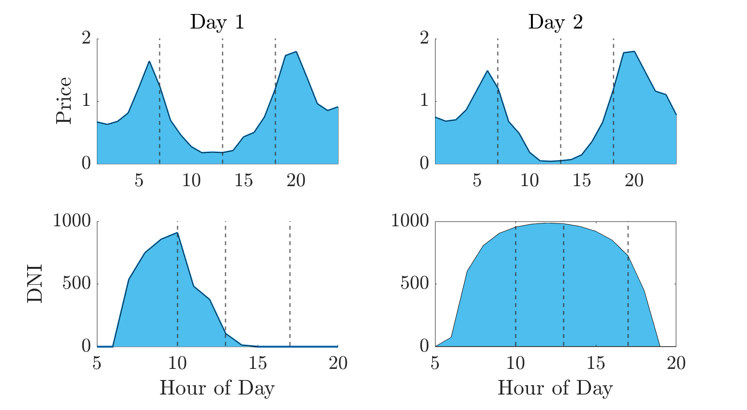
Neural Network Methodology: Inputs I
Break each day up into $N_{div}^{NN}$ divisions ($N_{div}^{NN}=4$ below)
Compute integral of each division using unnormalized data
Data is not normalized because we want the NN to perform well for weather/price files it wasn’t trained with

Slide 21
Case Study

Slide 22
Case Study: Goals
Investigate the performance of a trained neural network with testing data
“Testing Data”: Data that was not used to train the neural network
Determine if using predicted $S_{i}$ from the neural network as a feature improves simulation accuracy
Explore how the (imperfect) neural network approach compares to using perfect $S_{i}$ as a feature

Slide 23
Case Study: Overview
Run annual simulations for one training and eleven testing weather files (same price profile used for all simulations)
Use the weather and price data corresponding to the first simulation along with its output to train the neural network
Use the trained neural network to predict $S_{i}$ for the remaining eleven sets of testing data
Run data clustering approach (30 clusters) to simulate the eleven sets of testing data using features of weather, price, and:
$S_{i}$ predicted using the neural network (imperfect)
$S_{i}$ taken from the annual simulation (perfect)
$S_{i}$ not used

Slide 24
Case Study Results

Slide 25
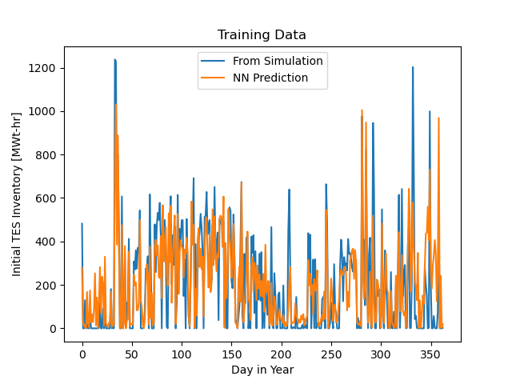
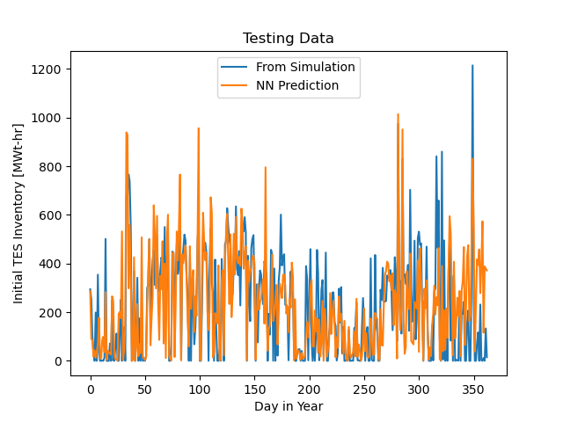
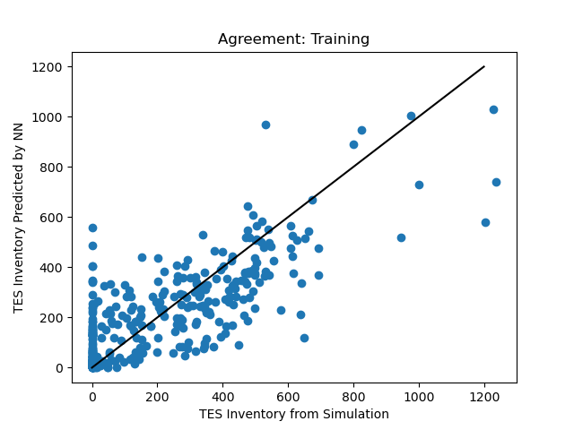
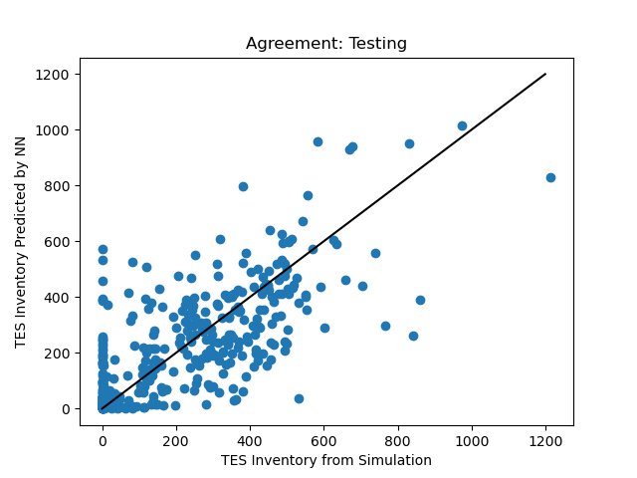
Results: Neural Network Validation

Slide 26
Results: Neural Network Validation
Compute error as a percentage of the total TES capacity
$$error_{TES}=\frac{1}{n}\sum_{i=1}^{n}{\frac{\left| S_{i, sim}−S_{i,NN }\right|}{{TES}_{max. capacity}}}∗100$$
Results:
Training Set Error: 7.4 %
Average Testing Set Error: 8.3%
Conclusion:
Trained neural network performs very well with untrained data

Slide 27
Results: Data Clustering Simulations
Error metrics utilized:
Total Absolute Revenue Percent Error:
$$\% error=\frac{\left|revenue_{full}−revenue_{cluster}\right|}{revenue_{full}}∗100$$
Mean Squared Error of Daily Revenue:
$$MSE=\frac{1}{n_{days}}\sum_{i=1}^{n_{days}}{{\left(revenue_{i,full}−revenue_{i,cluster}\right)}^{2}}$$

Slide 28
Results: Data Clustering Simulations
Using $S_{i}$ as an additional feature improves simulation accuracy!
Imperfect NN-predicted $S_{i}$ results in slight loss of accuracy
Features for Clustering | Average Percent Error [%] | Average Mean Squared Error [Revenue Units] ²
No $S_{i}$ | 4.67 | 30882
Predicted $S_{i}$ | 3.86 | 30538
Perfect $S_{i}$ | 3.23 | 26938

Slide 29
Conclusions
A deep neural network can be utilized to predict TES inventory at the beginning of a day relatively well
Utilizing TES inventory at the beginning of a day as an additional feature improves the simulation accuracy of the data clustering approach
NN-predicted $S_{i}$ is one way to accomplish this

Slide 30
Citations
Hamilton, W.T., Husted, M.A., Newman, A.M. et al. ”Dispatch optimization of concentrating solar power with utility-scale photovoltaics”. Optim Eng 21, 335–369 (2020). https://doi-org.ezproxy.library.wisc.edu/10.1007/s11081-019-09449-y
https://www.caiso.com/TodaysOutlook/Pages/default.aspx#section-net-demand-trend
“Renewable power generation costs in 2021”. IRENA International Renewable Energy Agency. (2022, July). Retrieved September 8, 2022, from https://irena.org/publications/2022/Jul/Renewable-Power-Generation-Costs-in-2021
J. Martinek, and Michael J. Wagner. “Efficient Prediction of Concentrating Solar Power Plant Productivity Using Data Clustering.” Solar Energy 224. June (2021): pp. 730–41.
CAISO, 2018. California ISO Open Access Same-time Information System (OASIS). URL: http://oasis.caiso.com/mrioasis/logon.do
Jordan, J. (2019, September 11). Normalizing your data (specifically, input and batch normalization).Je. Jeremy Jordan. Retrieved September 9, 2022, from https://www.jeremyjordan.me/batch-normalization/

Slide 31
Appendix
Extra slides

Slide 32
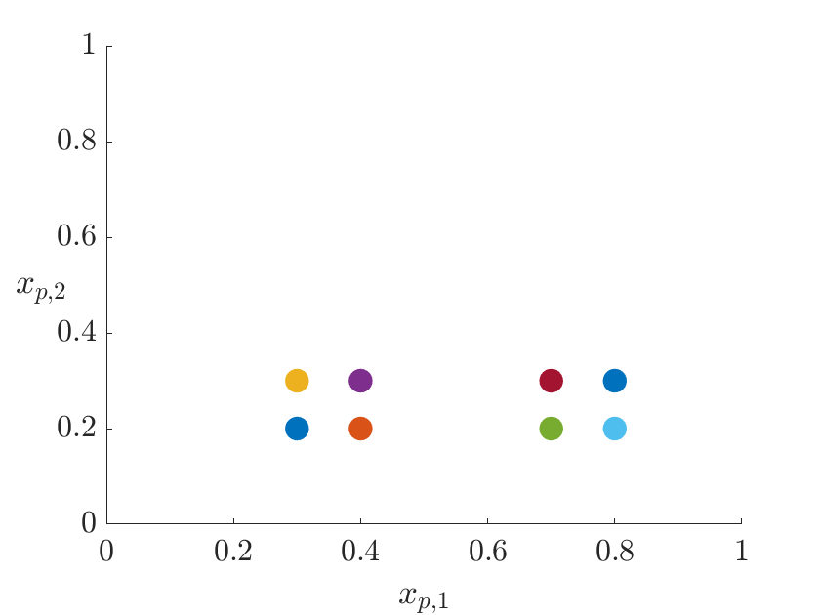
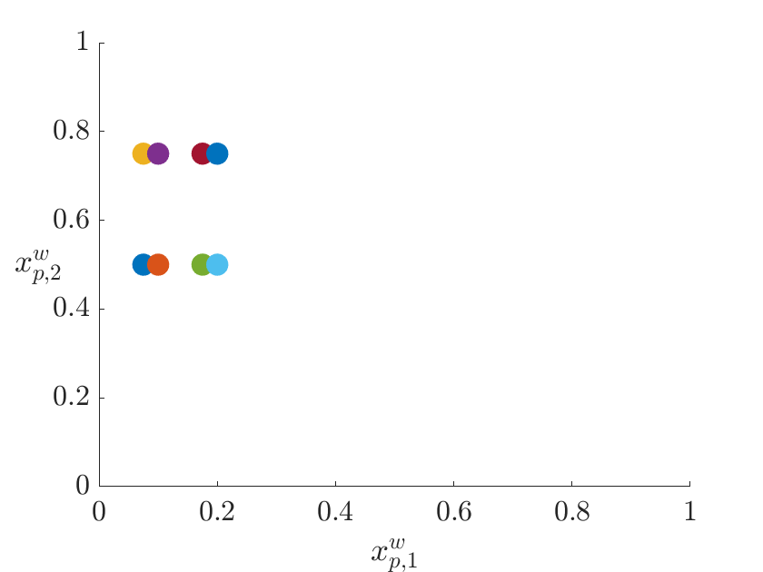
Data Clustering Methodology : Step 3
Recall: Data from the Step 2 is normalized to a maximum of 1
Apply a weighting factors ($w_{f})$ to adjust relative importance of a feature ($x_{p,f})$ when forming clusters
$$x_{p,f}^{w}=w_{f}∗x_{p,f}$$
Unweighted
Weighted
$$w_{2}=2.5$$
$$w_{1}=0.25$$
Notes:
Do a better job of explaining what happens between the plots

Slide 33
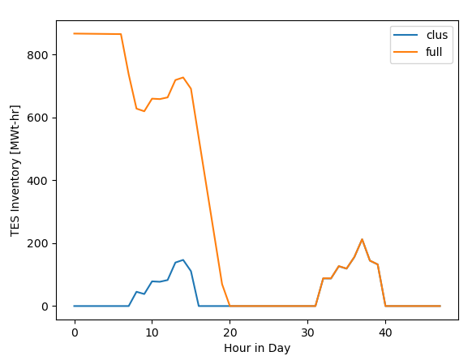
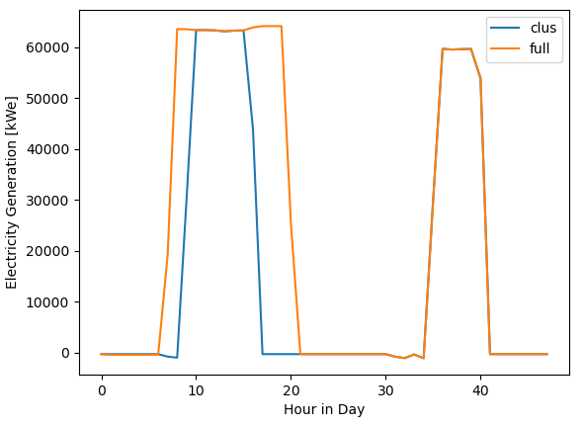
Note on Partition Setup
Previous day is utilized to regulate TES
Next day is utilized for dispatch optimizer to solve over a 48-hour time horizon
TES Inventory
Electricity Generation
Notes:
Maybe cut?

Slide 34
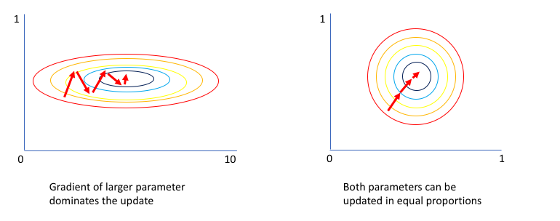
Neural Network Methodology: Inputs II
Scaling: The integrated DNI features are divided by 100 to obtain a magnitude more similar to integrated price
Scaling Purpose: NN “learns” using gradient descent to update weights
Similar magnitude inputs allow the NN to “learn” at the same rate and decreases the number of iterations required to reach an optimal solution
[5]
Notes:
Maybe cut?

Slide 35
Case Study: Parameters
Weather Data:
Training Data (1): Typical Meteorological Year (TMY) for Daggett, CA
Testing Data (11): Odd years from 1999-2019 for Daggett, CA
Price Data:
Locational marginal price (LMP) time series for the “IRONMTN_2_N001” node from 2019-2020 [CITE CAISO]
Number of clusters: 30
Features (Weights / Division )
Case Study | Initial TES | Ave. DNI Op. Days | Ave. Price Op. Days | Ave. Clearsky DNI Op. Days | Ave. DNI Previous Day | Ave. Price Previous Day | Ave. DNI Next Day | Ave Price Next Day
Perfect TES | 0.75 / NA | 0.95 / 4 | 0.75 / 4 | 0.6 / 4 | 0.1 / 2 | 0.1 / 2 | 0.1 / 2 | 0.1 /2
Predicted TES | 0.75 / NA | 0.95 / 4 | 0.75 / 4 | 0.6 / 4 | 0.1 / 2 | 0.1 / 2 | 0.1 / 2 | 0.1 /2
No TES | NA / NA | 1 / 4 | 1 / 4 | 1 / 4 | 0.5 / 2 | 0.5 / 2 | 0.5 / 2 | 0.5 / 2

Slide 36
Future Work
How many days are required to train the neural network?
Ideally, would like this to be as small as possible to reduce the time it takes to run the training simulation
How robust is the neural network?
Would the trained neural network perform well for a simulation with a different price profile?
How can we improve the accuracy of the NN for low and high $S_{i}$ values?

