Slide 1
State of Charge Predication of Lithium-ion batteries
Sahana Upadhya
Lukas Desorcy
Mike Wagner
Allison Mahvi

Slide 2
Battery Degradation Model
Degradation of the battery with every cycle of charging and discharging.
State of Charge (SOC)
Depth of Discharge (DOD)
Number of cycles
Cyclic aging
Aging of the battery over time due to all processes that lead to degradation other than cycling
Rest SOC
Temperature
Calendar aging
Validate model through testing:
Cyclic testing
Aging
Use case SOC estimation
Relaxation tests – rest case SOC estimation
Number of cycles
Battery degradation model
Depends
on
Starting and ending SOC of the half-cycles

Slide 3
State of Charge (SOC)
SOC is a measurement of the amount of energy in a battery expressed in percentage.
VOLTAGE → Simplest estimation of SOC
Charging
Discharging
$$e^{−}$$
transfer
Potential Difference
Potential Difference
Voltage
Voltage
Energy
Energy
SOC
SOC

Slide 4
Voltage
Terminal Voltage
Internal Resistance
Rest
Internal resistance depends on many parameters like time, SOC, SOH
Concentration gradient in electrode of li-ion battery
Time
SOC
Voltage
Equalizes
SOC – Voltage relationship not parallel → Complex
Therefore, voltage changes with time

Slide 5
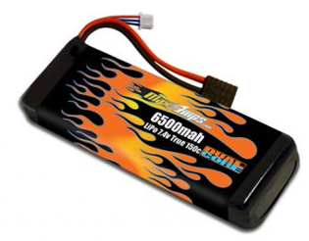
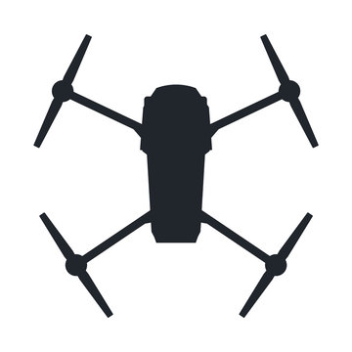
Accurate Estimation of State of Charge
Used in
Lithium batteries
Transport application
Variability in drive cycles and operational profiles
Accurate assessment of available energy
High precision estimation of SoC
Maximized usage and planning
Safety, reliability and endurance
Improved energy management

Slide 6
Equipment
SOC prediction with use
SOC prediction at rest
Cyclic testing of the battery
Data processed
Collaboration with two other teams to develop physics-based model and machine learning models
Relaxation tests at varying SOC
Develop a relationship between various parameters and the relaxation curve
Predict the relaxation curve
Cyclic tester
Battery Management software
Thermal Chamber

Slide 7
Digatron – Lithium Cell Tester
Cyclic testing – Charging, Discharging, Rest
Data acquisition rate – 2 ms per circuit
21 circuits with different current – voltage capabilities.
Current – Voltage capabilities
0.25 – 100 A 0 - 18 V
1000 A 5 V
0.1 – 100 A 5 – 100 V

Slide 8
Battery Management Software
Write intricate test programs.
Register required data – voltage, current, Ah, temp – at desired frequency
Monitor tests in progress
Generate basic graphs
Store battery characteristic data

Slide 9
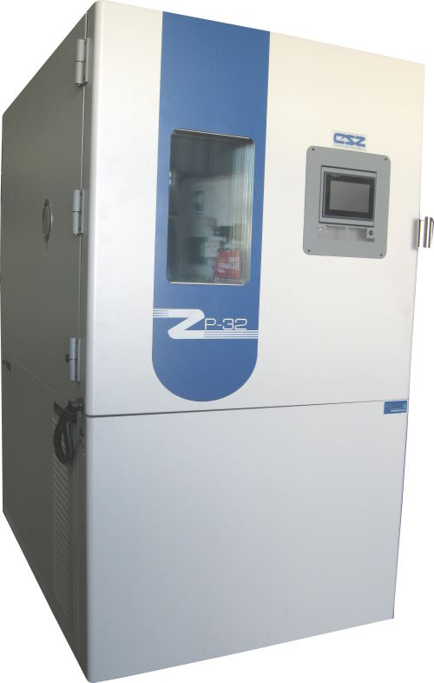
Thermal Chamber
Controls Ambient temperature when performing tests.
Provides a protected environment to perform tests – fire safety features.
Temperature range: -45 ℃ to 190℃.

Slide 10
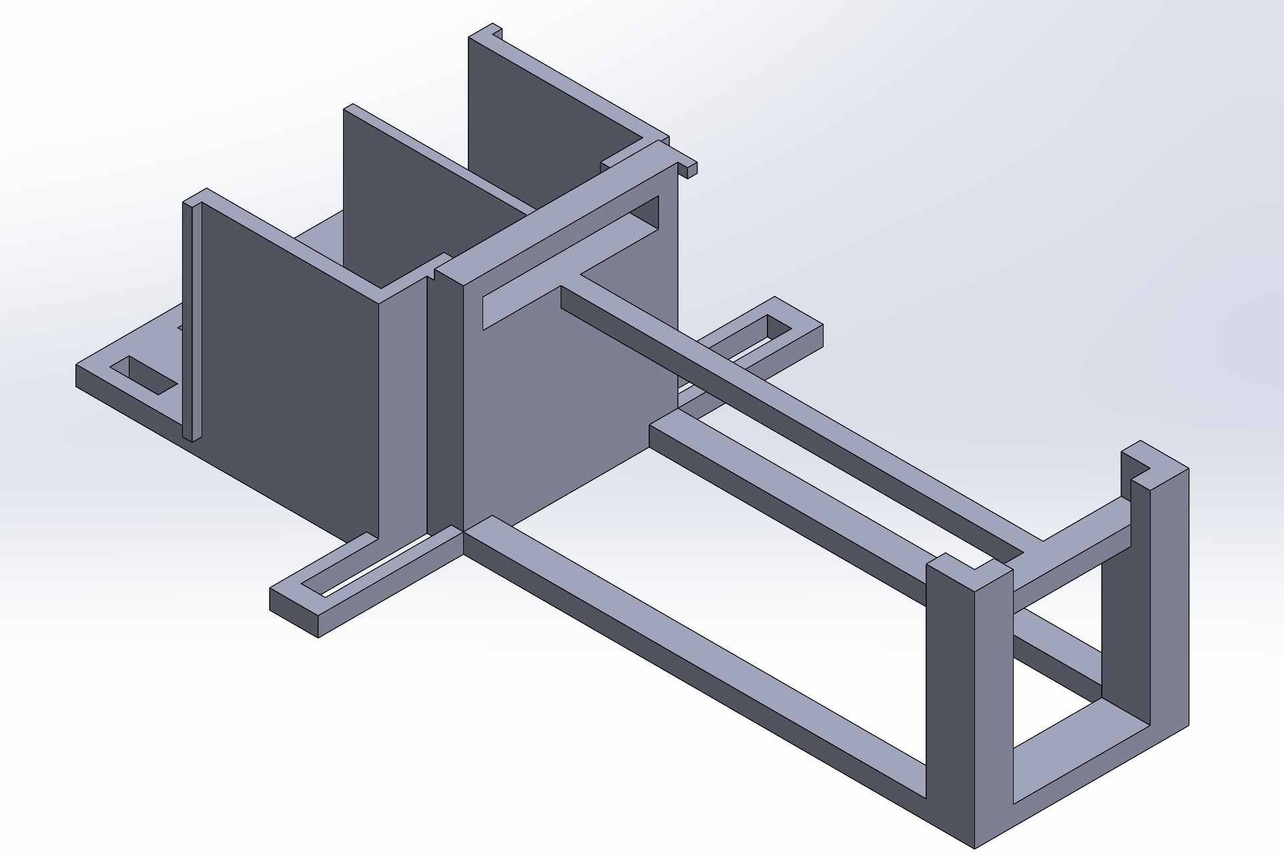
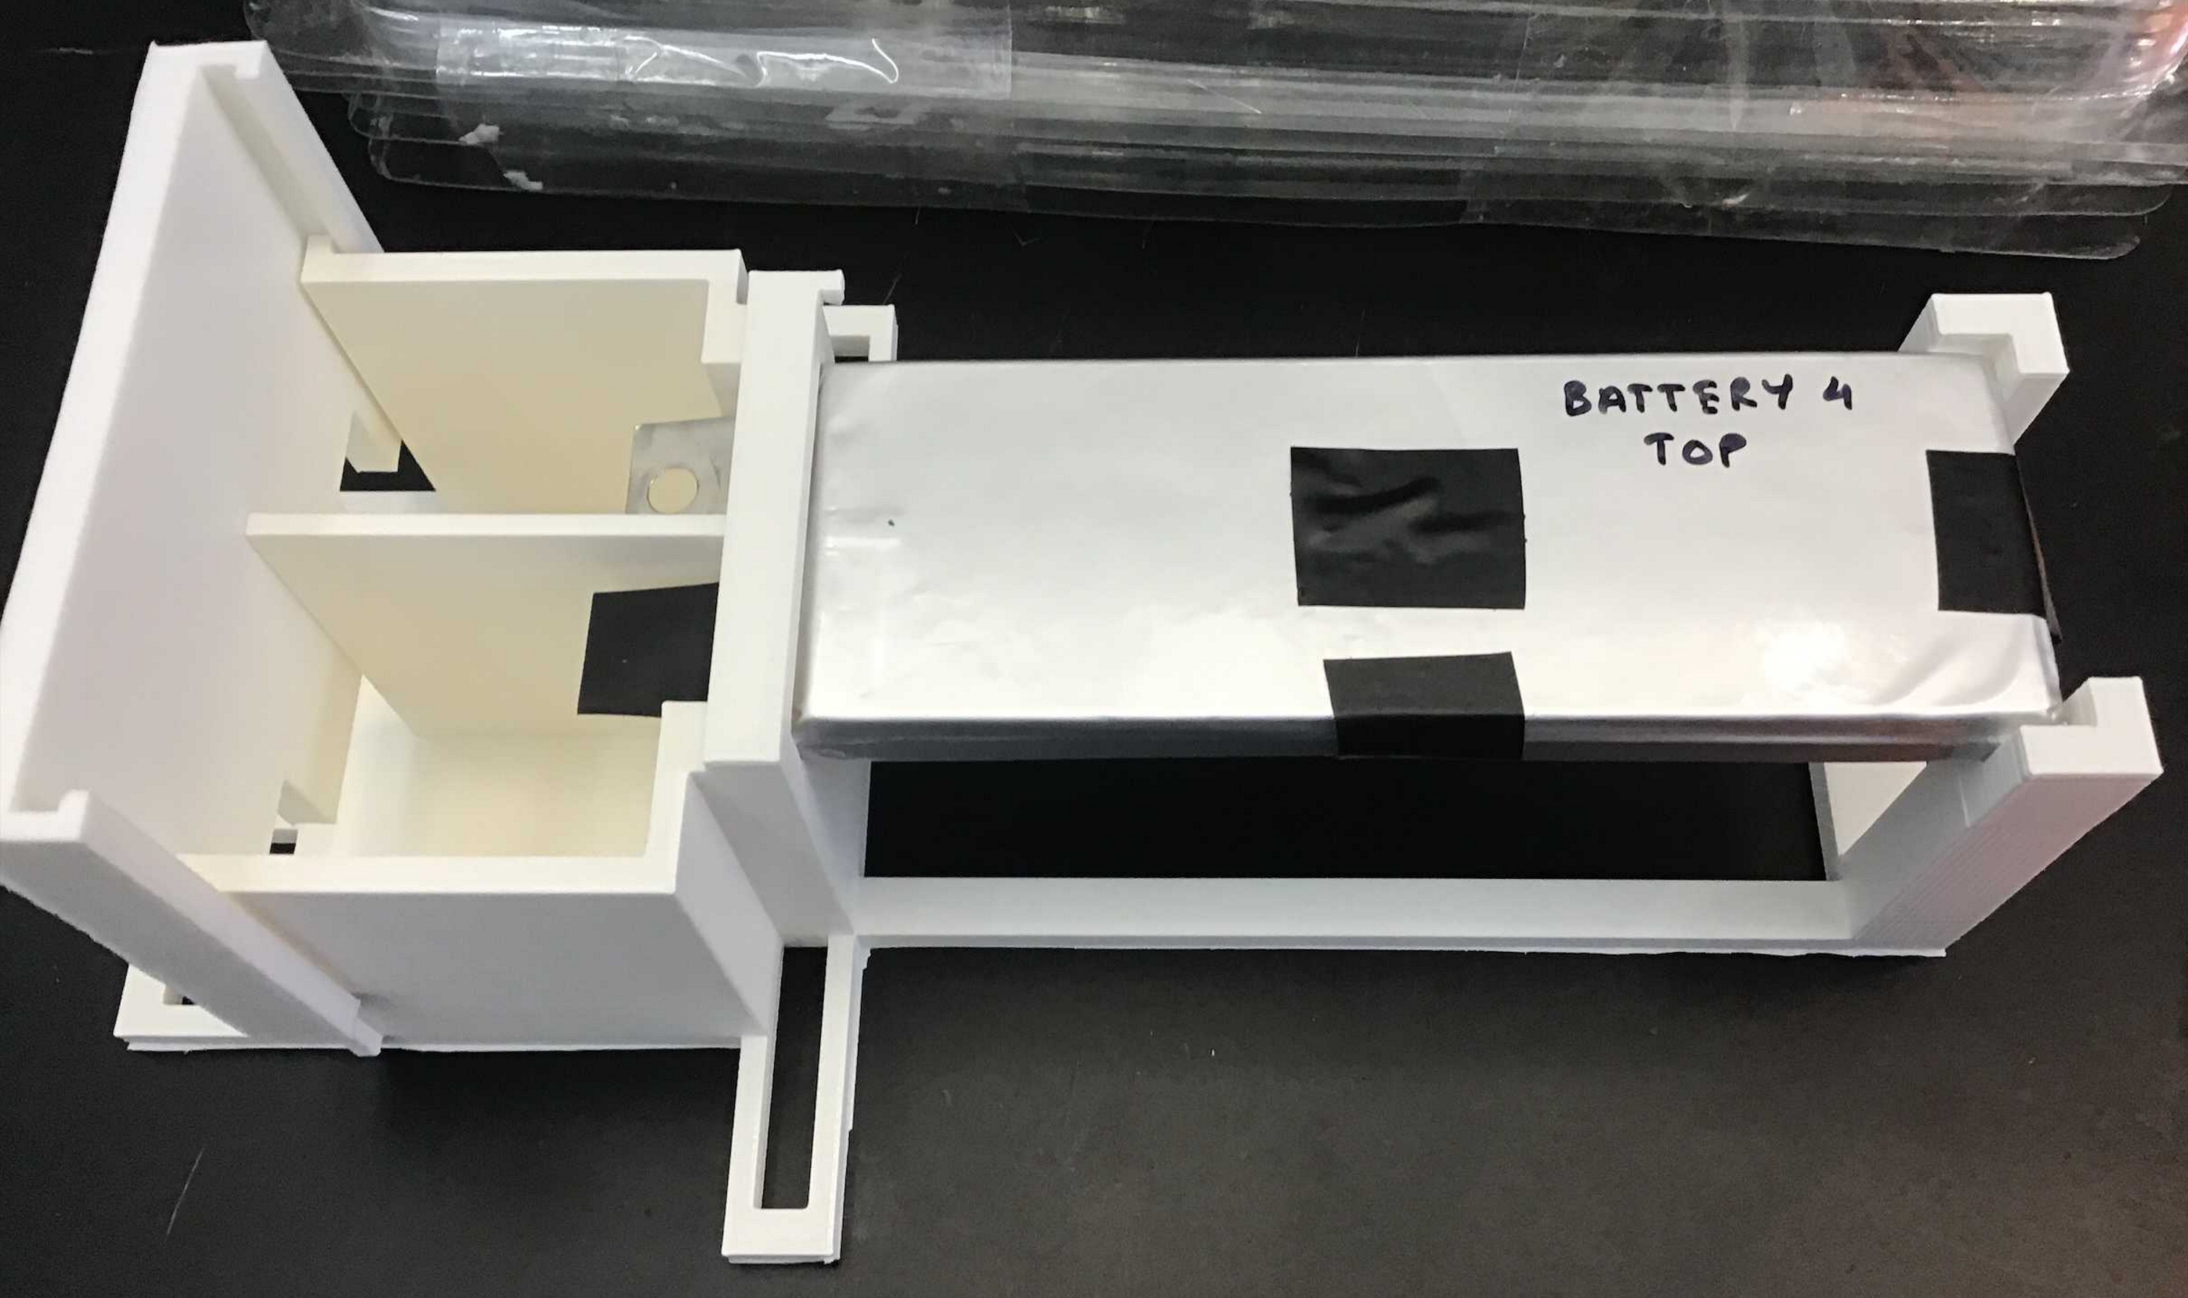
Battery Details
Parameter
Cell geometry | Pouch
Anode Material | $$LiCoO_{2}$$
Cathode Material | Graphite
Electrolyte | $$LiPF_{6}$$
OCV of full cell (100% SOC) | 4.2 V
OCV of empty cell (0% SOC) | 2.75 V
Cell capacity | 5450 mAh
Thermocouples
Battery Fixture

Slide 11
Cyclic testing
C-rate is the rate at which current is supplied to fully charge a battery.
1C – 1 hour to fully charge battery. 4C – ¼ hr = 15 min to fully charge the battery
Step | Operator | Nominal Value | Limit | Action | Registration
1 | SET | Rlevel = 3 | > 4.2 V < 3 V > 60 C1 | ERR 2 ERR 2 ERR 2 | STANDARD
2 | BEG |  |  |  | 1 sec
3 | DCH | 21.8 A | < 3.01 V |  | 1 sec
4 | CHA | 21.8 A 4.1 V | 5 sec & < 0.545 A |  | 1 sec
5 | PAU |  | 30 sec |  | 1 sec
6 | CYC | 20*
Cyclic testing at 1C, 2C, 3C, 4C – 50 cycles
Data Collected:
Current
Voltage
Electric Charge (Ah)
Temperature (four thermocouples)
These tests very performed at ambient temperature

Slide 12
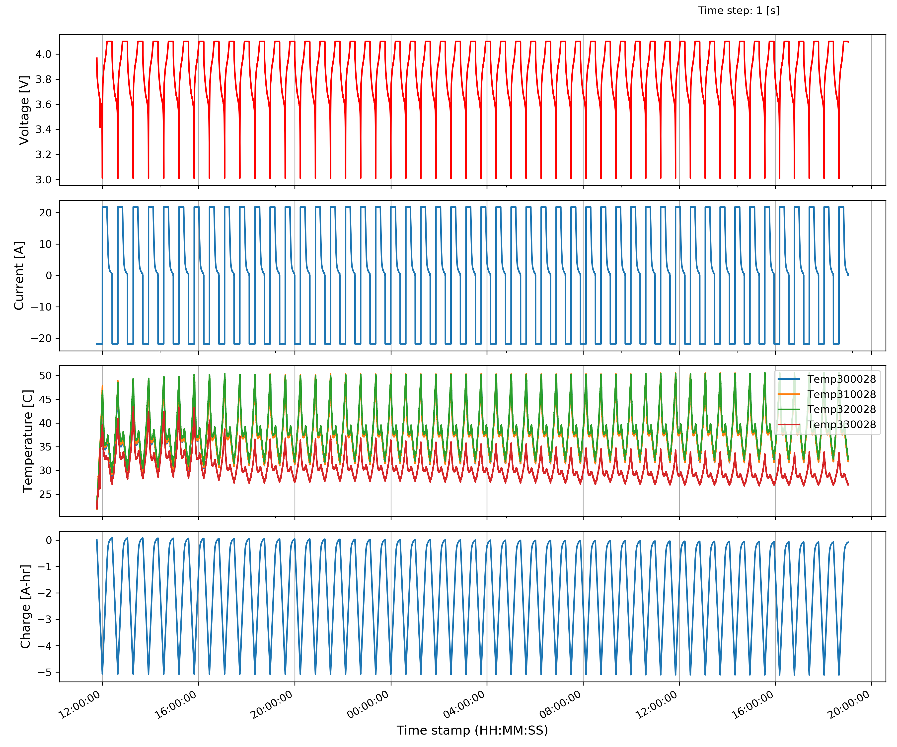
- Top
- Edge
- Bottom
- Side edge

Slide 13
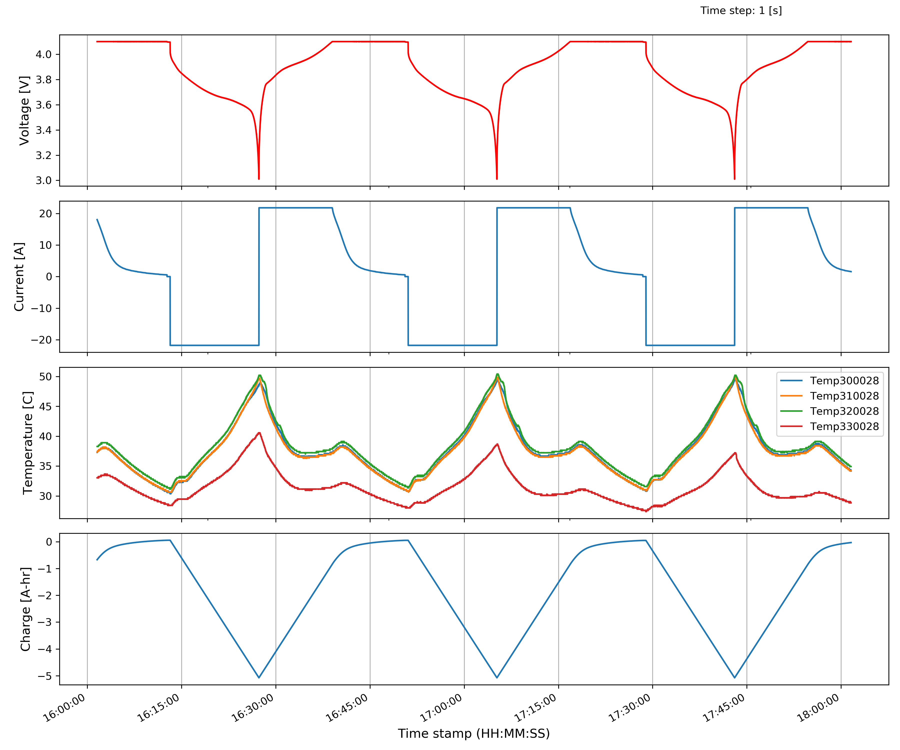
Cyclic data used to calibrate physics-based model
Physics-based model used to generate accurate cell performance data
Experimental data
+
Physics-based model data
Train Machine Learning model

Slide 14
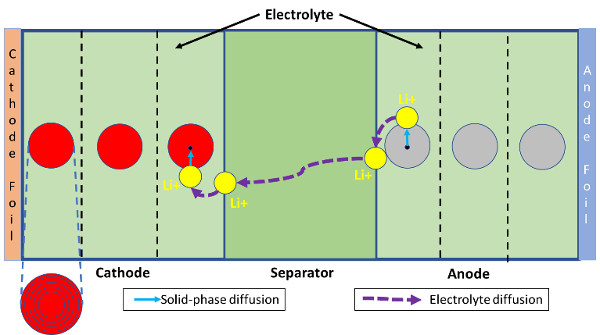
Physics based model
The physics-based modeling approach can simulate the electrochemical and intrinsic dynamic behavior of a cell.
Characterized through 5 main Partial Differential Equations → developed in GT-AutoLion (li-ion simulation software)
Experimental data is used to calibrate the battery

Slide 15
Step 1 - C/20 test
Cathode capacity loading
Cathode thickness
Step 3 – Refining
Match experimental Open-circuit Voltage
N/P ratio
Initial SoC
Anode thickness
Separator thickness
Match SOC
Cathode loading: Capacity of cathode per unit area of the cathode.
Anode and Cathode particle size
Heat transfer coefficient
Step 2
1C-4C test
N/P ratio $=\frac{Anode Loading}{Cathode Loading}$ →This relates to amount of active material in each electrode

Slide 16
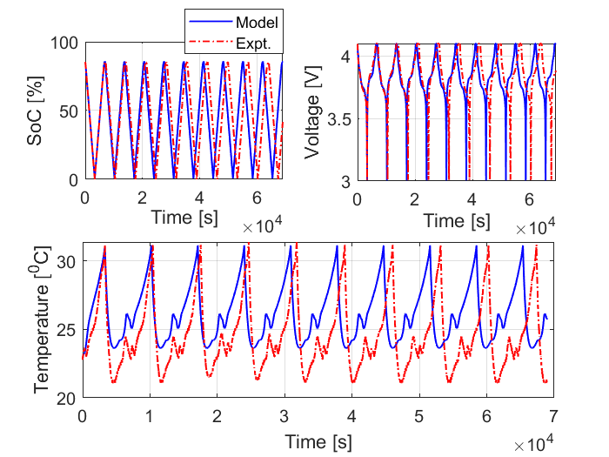
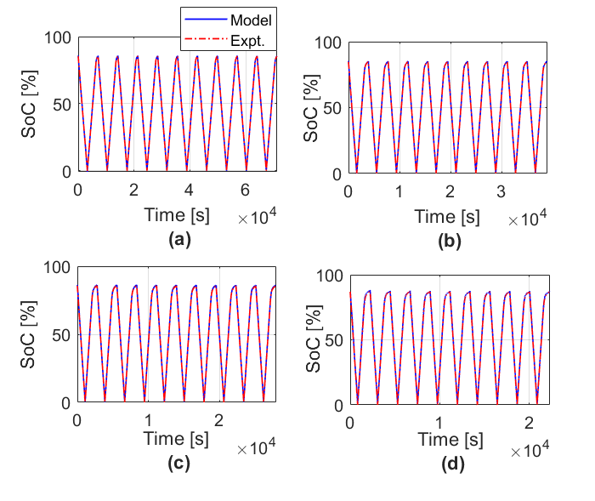
Physics-based model
Feed forward neural network model
10 cycles at 1C C-rate
Predicted SoC values for the last 10 cycles of each C-rate
Predicts SOC within 1-2% root-mean-square-error (RMSE)
Predicts SOC within 1% RMSE
A combination of physics-based modelling and ML may prove valuable for longer test programs and State of health analysis and testing

Slide 17
Relaxation Tests
Identifying a correlation between open-circuit voltage, SOC and relaxation time required to achieve the stabalized OCV

Slide 18
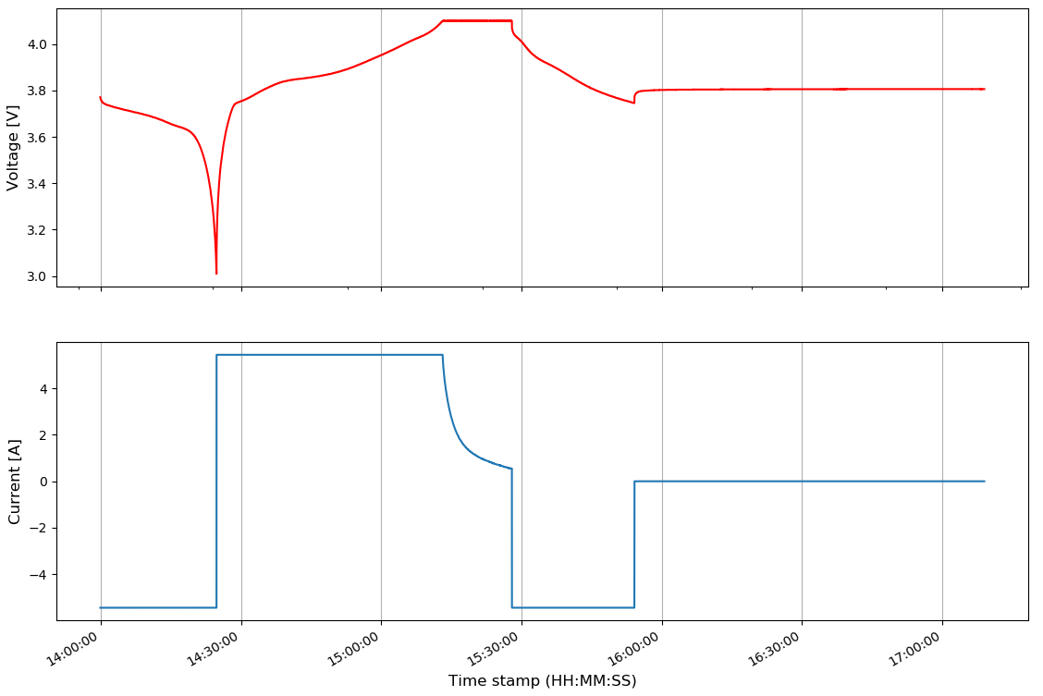
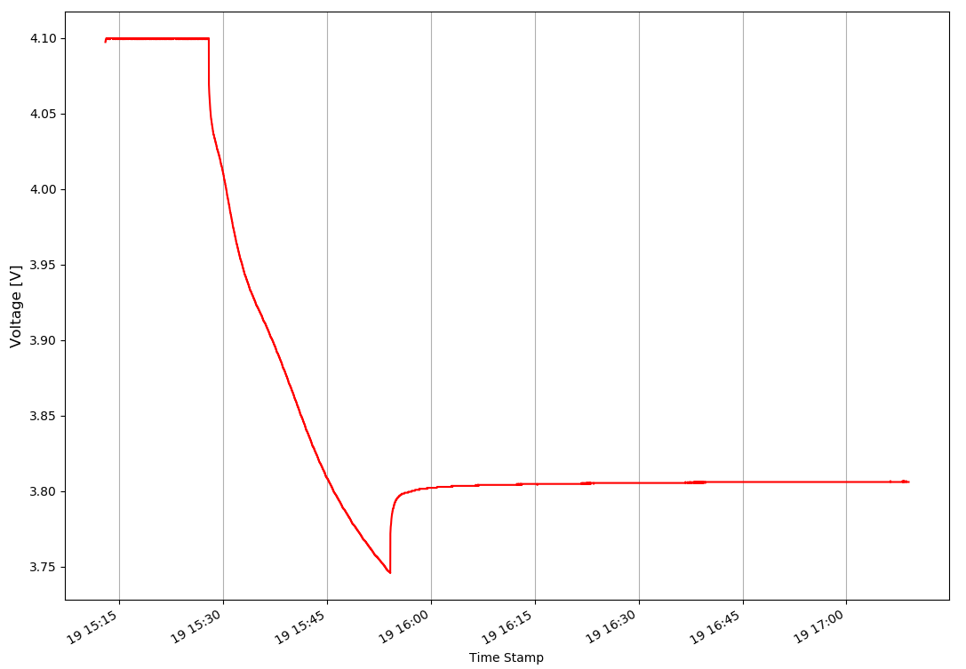
Relaxation time
Battery takes time to stabilize and reach a final stable Open Circuit Voltage (OCV).
Voltage Drop – Change in current
Forced regime – Current not equal to 0
Relaxation – No current battery stabilization
Voltage Drop
Forced Regime
Relaxation
Voltage Drop
Notes:
Graph taken from our experimental data
Shows voltage behavior with change in current value

Slide 19
If a 24 hr OCV value is used to find SOC on a 1 hr OCV vs SOC curve
An approximate error of 4% SOC introduced for a difference in 2 mV
C
D
B
C → OCV measured after 24 hr of relaxation
D → Same OCV on a 1 hr relaxation curve
E → Over-estimation of SOC
F → Actual SOC value
F
E
Li, An, et al. "Fast characterization method for modeling battery relaxation voltage." Batteries 2.2 (2016): 7.
Notes:
This slide demonstrates how a small deviation in OCV results in an error in SOC.
The first graph shows a relaxation curve.
The OCV at point C – after 24 hour relaxation is taken as the OCV
OCV_C is used as the OCV to find the corresponding SOC on a 1hour relaxation time graph as seen in graph two.
This results in an over-estimation of the SOC value.
The realistic value of SOC will be found by taking the OCV at point B – after 1 hour of relaxation of the battery - and using this value as the OCV in a 1 hour relaxation time graph of OCV vs SOC (shown in graph 2 as point B)
The third graph further highlights the same fact:
C → OCV measured after 24 hr of relaxation
D → Same OCV on a 1 hr relaxation curve
E → Over-estimation of SOC
F → Actual SOC value
Taken from literature – test conducted on a Li-ion battery LiFePO4

Slide 20
Relaxation time and Battery History
OCV measured for different SOCs after different relaxation periods after charge and after discharge
Relaxation time
OCV approaches stable value
Battery History plays a role in relaxation characteristics.
Li, An, et al. "Fast characterization method for modeling battery relaxation voltage." Batteries 2.2 (2016): 7.
Notes:
Taken from literature to shows that history and relaxation time effects the stabilizing of the battery to a steady OCV
Charging to a s specific SOC and discharging to the specific SOC effects the relaxation in different ways and we see the charge and discharge values approaching with increased relaxation time.
Taken from literature – test conducted on a Li-ion battery LiFePO4

Slide 21
Objective
Develop correlation between relaxation curve and SOC
Voltage at any stage of relaxation can be related to an accurate SOC
20 min
1 hr
Identify parameters that effect the relaxation curve

Slide 22
Parameters
C-rate – 1C, 2C, 3C, 4C
Temperature – 20℃, 30℃, 40℃
Start and End SOC
Capacity charge/discharge
Charge/discharge
State of Health
- Rate at which current is supplied
- Energy entering/leaving the battery
- Effects of battery degradation
Notes:
Therefore, we have chosen the following parameters to test and analyze their relationship to the relaxation curve

Slide 23
Initial Test Plan
Charge to 100%
Discharge by 5%
C-rate: 1C and 4C
Temperature: 20 ℃
1C and 4C test performed on two different batteries
Relax for 10 hours

Slide 24
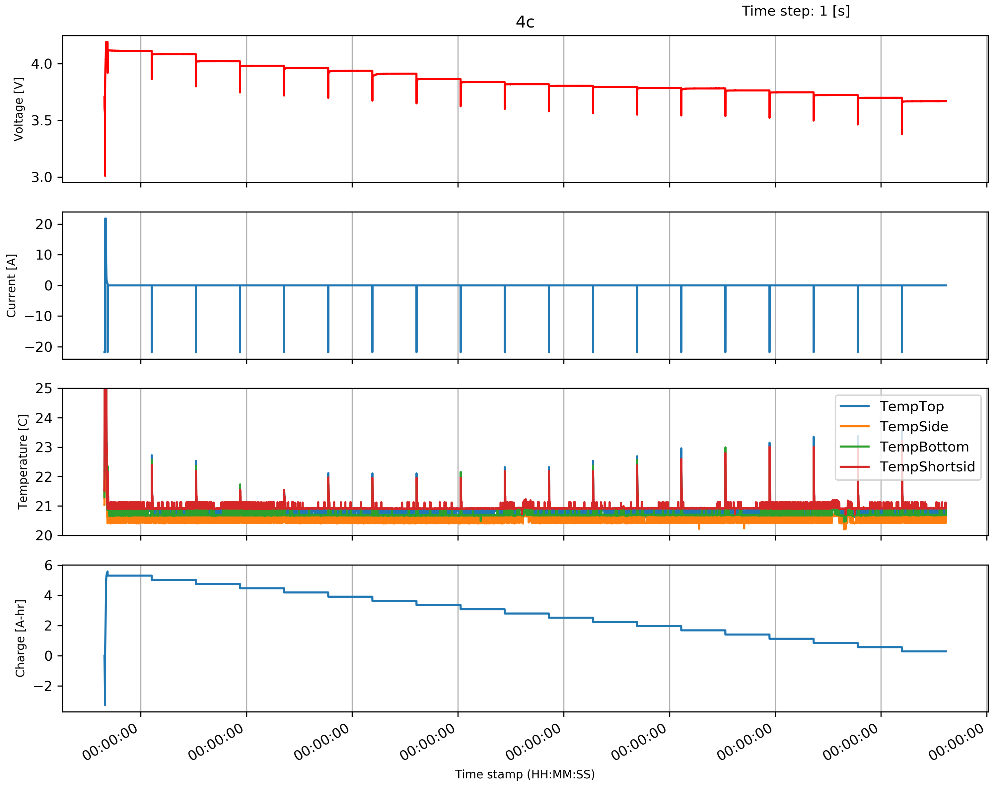
Step wise discharge and relaxation

Slide 25
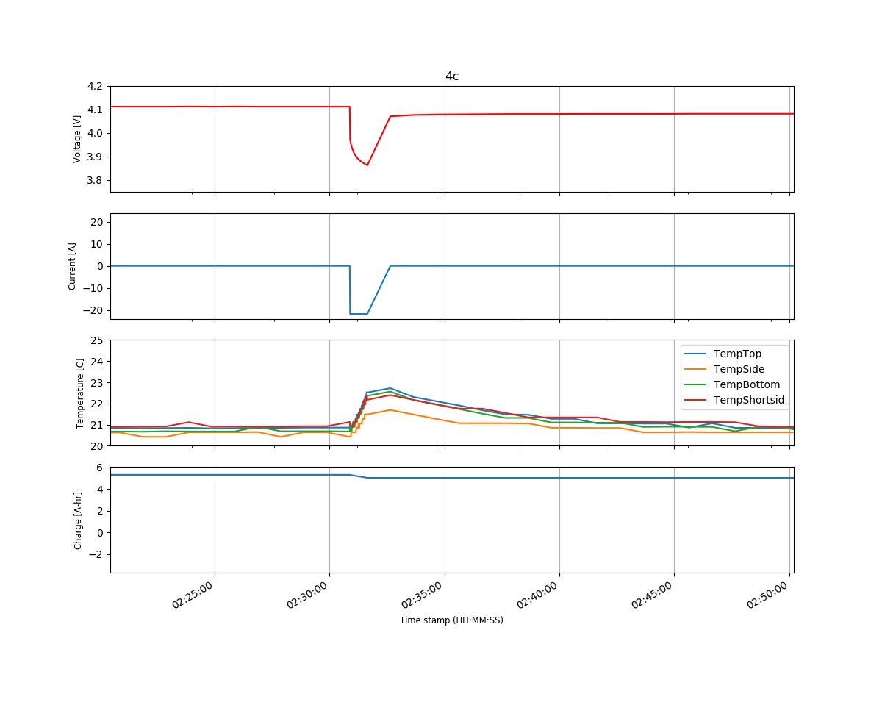
Time taken for voltage to stabilize

Slide 26
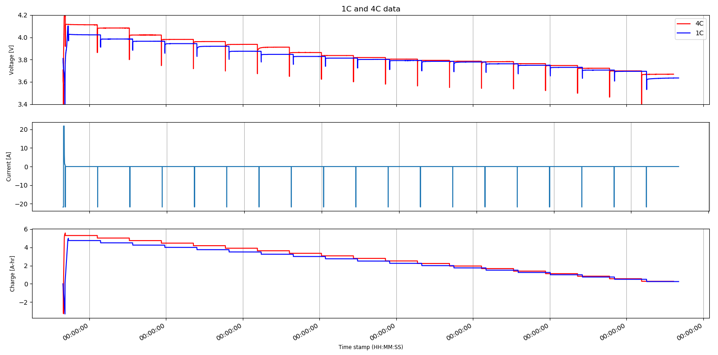
Final voltage for higher C-rate→ higher – especially for higher SOC
Will it converge if allowed to rest for longer?
Battery stabilizes
Voltage drop larger
Two different batteries were used. The capacity of both the batteries are slightly different

Slide 27
Analyzing the time taken to reach fully relaxed voltage
Relaxation begins
Relaxation ends
$$Difference in voltage \%=\frac{V_{f}−V_{i}}{V_{f}}.100$$
For each point i during the relaxation
$$V_{i}$$
$$V_{f}$$
10 hours
For each SOC relaxation curve
SOC
95
90
85
80
75
70
65
60
55
50
45
40
35
30
25
20
15
10
5

Slide 28
Next Steps
Perform the same test again to see if the relaxation behavior is repeatable.
Perform similar tests for the remaining SOCs.
Attempt to find a correlation between various parameters and voltage at various stages of relaxation.
Use physics-based model to predict the relaxation curve and therefore estimate the accurate SOC.
Perform further cyclic testing for state of health analysis and study aging mechanisms.

Slide 29
Thank You

Slide 30
C
D
B
F
E
C → OCV measured after 24 hr of relaxation
D → Same OCV on a 1 hr relaxation curve
E → Over-estimation of SOC
F → Actual SOC value
Notes:
If you think slide 4 is too cluttered and should be spaced into two slides

Slide 31
If a 24 hr OCV value is used to find SOC on a 1 hr OCV vs SOC curve
An approximate error of 4% SOC introduced for a difference in 2 mV
Notes:
If you think slide 4 is too cluttered and should be spaced into two slides

Slide 32
Test Plan
1C
2C
3C
4C
C-rate
20C
30C
40C
Temperature
552 relaxations curves
End SOC
Charge and discharge
100% SOC – 80% SOC → 1% discharge intervals → Relax → 20 relaxations
80% SOC – 20% SOC → 10% discharge intervals → Relax → 6 relaxations
20% SOC – 0% SOC → 1% discharge intervals → Relax → 20 relaxations
1104 relaxations curves
Time required to test all these combinations:
10 min relaxation – 10 days
24 hours relaxation – 1250 days
Notes:
Basic test plan varying the initial test parameters.
Time required to complete it is too long
Plan to use design of experiment to reduce the number of tests required.

