Slide 1
Sahana Upadhya
Masters of Science Mechanical Engineering
Advisors: Dr. Michael Wagner
Room: 1337 ERB
Email: upadhya2@wisc.edu
Hometown: Bangalore, India
Dispatch Optimization Model for Hybrid Renewable and Battery Systems Incorporating A Battery Degradation Model

Slide 2
Importance:
Economical when used with a dispatch optimization model
Increased use of hybrid systems
Batteries used for the storage of power in such systems are expensive
Proposed: battery degradation model would extend the life of batteries
Reduces the cost associated with battery replacement and set up

Slide 3
Background:
Objective: To create a dispatch optimization model that facilitates the economical use of hybrid systems, maximizing revenues, while also optimizing battery lifetime.
Objective of the program:
Maximize net revenue obtained from the sales revenue from dispatch of power and loss due to battery degradation
To understand optimal battery scheduling when considering battery degradation, we analyze:
Degradation of the battery with every cycle of charging and discharging.
State of Charge (SOC)
Depth of Discharge (DOD)
Number of cycles
Cyclic aging
Focus of this paper: Develop a decision model accounting for battery cycling

Slide 4
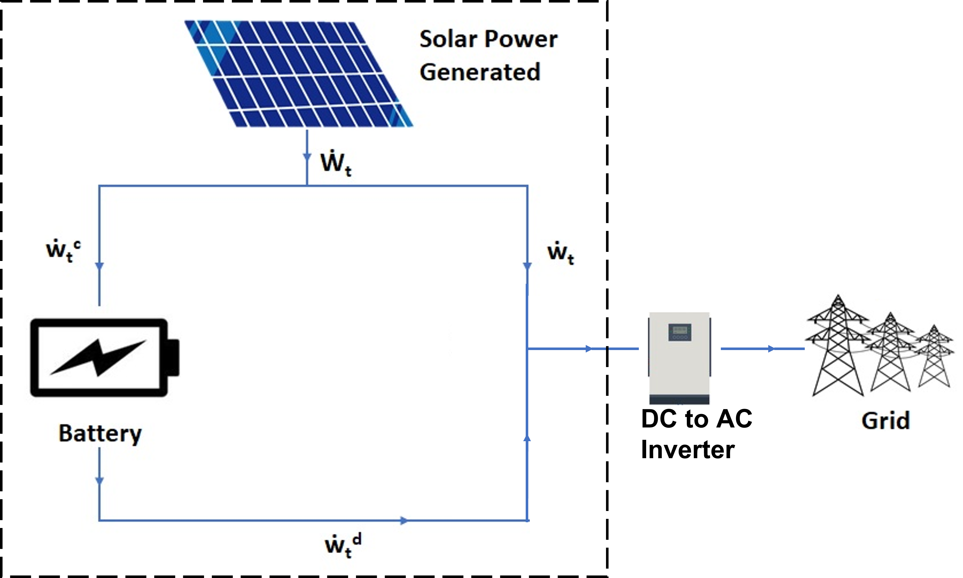
Methodology:
Mixed-integer linear programming is used
The data for the power generated by the PV system is obtained from the System Advisory Model’s (SAM) PV Watts, Residential Model.
Pyomo version 180 5.6.9 and solved using Gurobi version 9.1.0. was used to make this linear program
Objective function shown:
$$\sum_{t∈T}{\left[\left(\dot{w_{t}}+γ.{\dot{w}}_{t}^{d}\right).Z_{t}−\left(\left(f_{t}+ θ_{t}+ β_{t}\right).ε − κ_{t}^{f}\right).U_{1}\right].K − \sum_{t,\hat{t}∈\hat{T}}{[\frac{y_{t.\hat{t}}.P.S}{L.S_{start}}+G_{t,\hat{t}}.K.ε.U_{1}]}}$$
Net capacity of the battery
Sales revenue from power sent to the grid
Cost of battery degradation
Meaningful behavior of binary variables

Slide 5
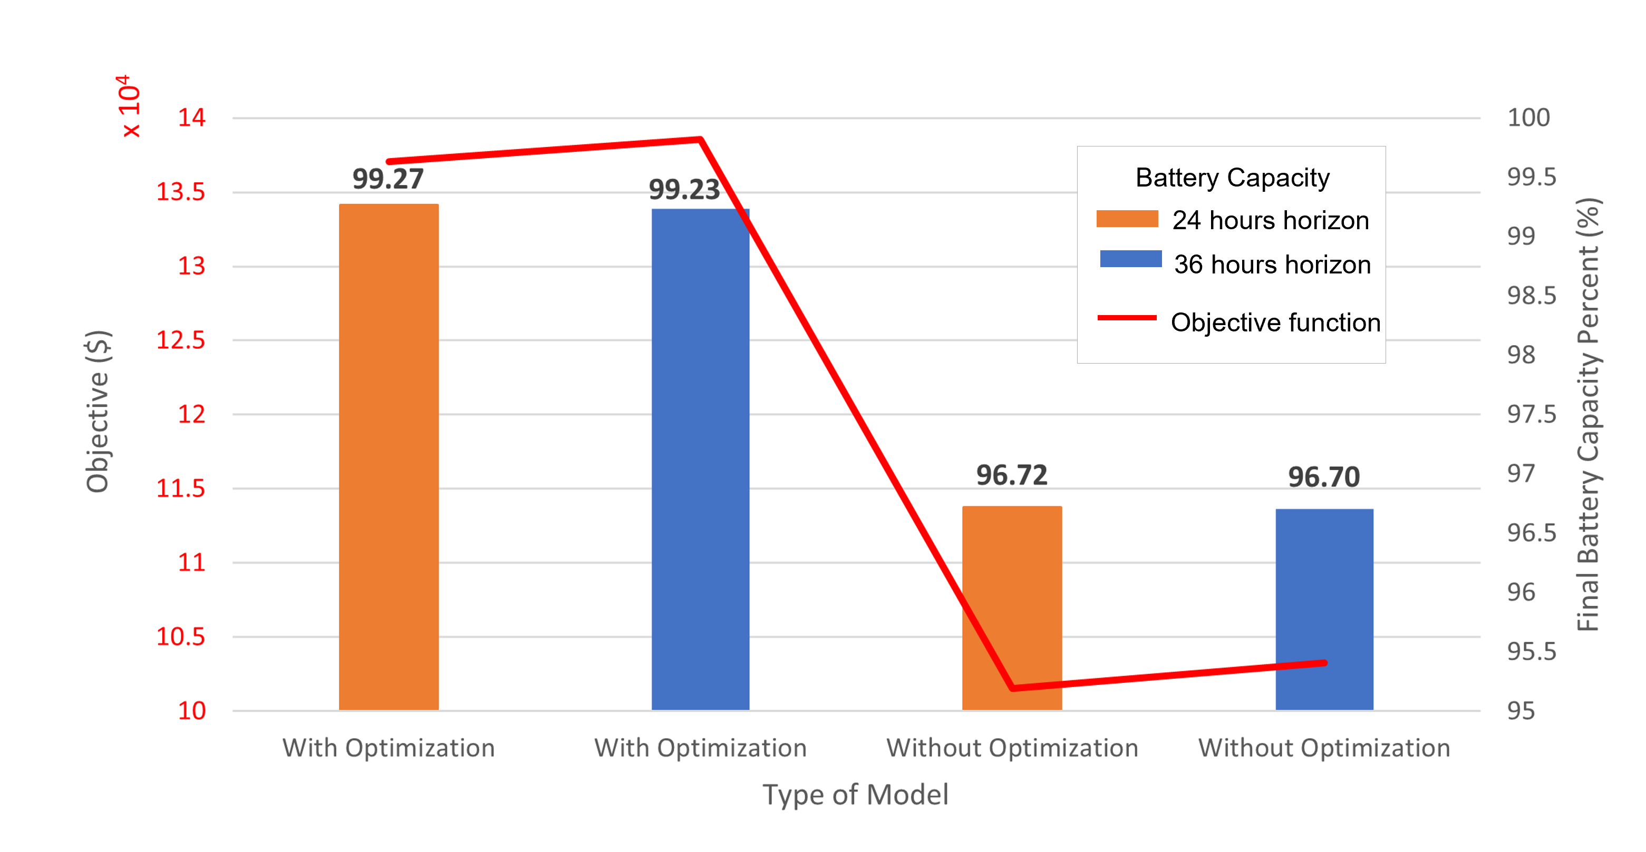
Conclusion:
Increase in objective function by 34.2% when cost of degradation is included
Reduced degradation of battery by 77.7%
Extends life of battery from 6.1 years to 26.5 year
Grid limit
Dispatch of power
Cost of the battery
Net revenue
Battery Degradation
Battery usage
Initial battery capacity
Battery usage
A 36-hour horizon produced noticeably better results in terms of battery lifetime and net revenue than a 24-hour horizon in most cases.

