Slide 1
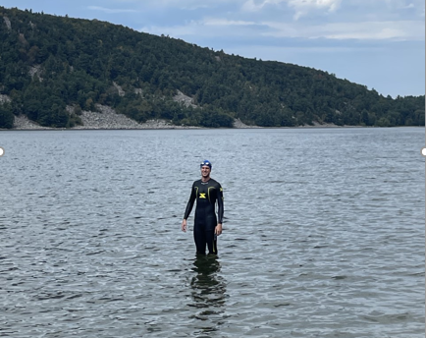
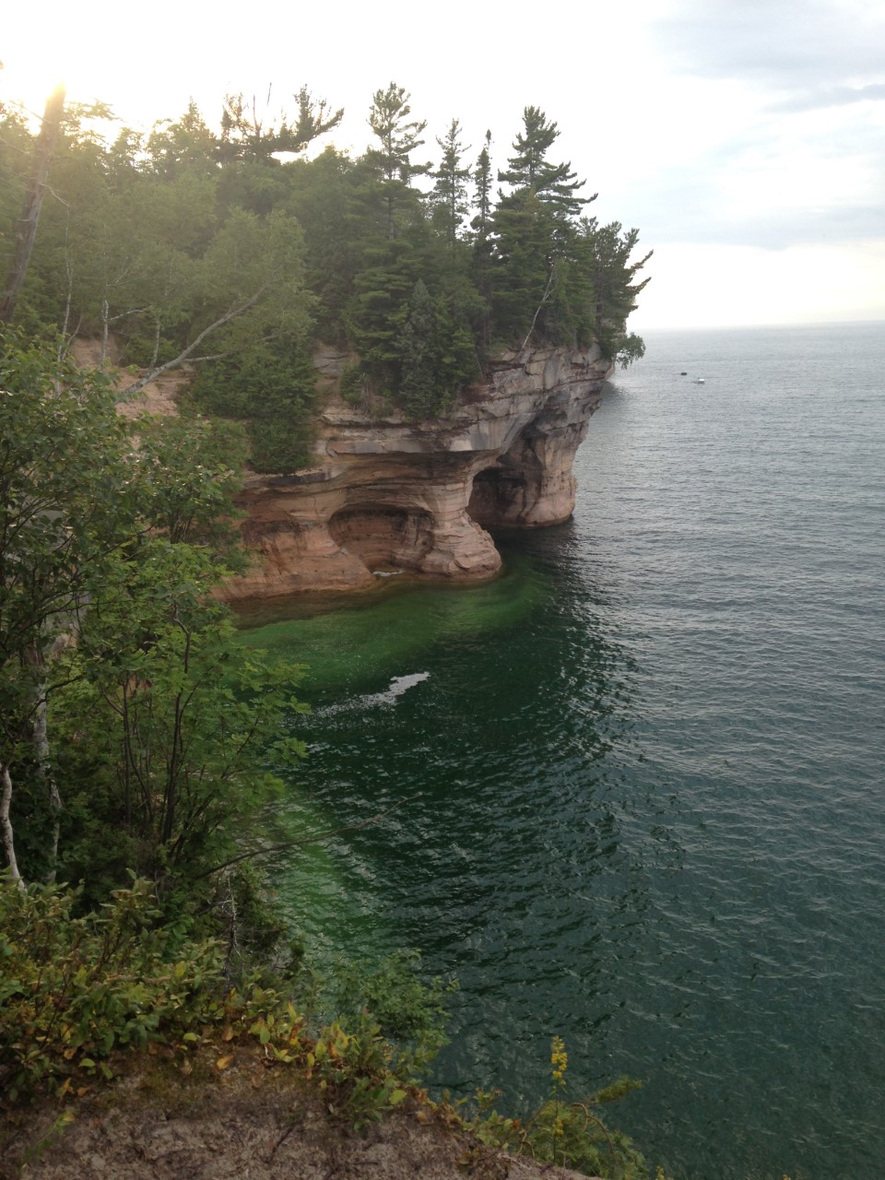
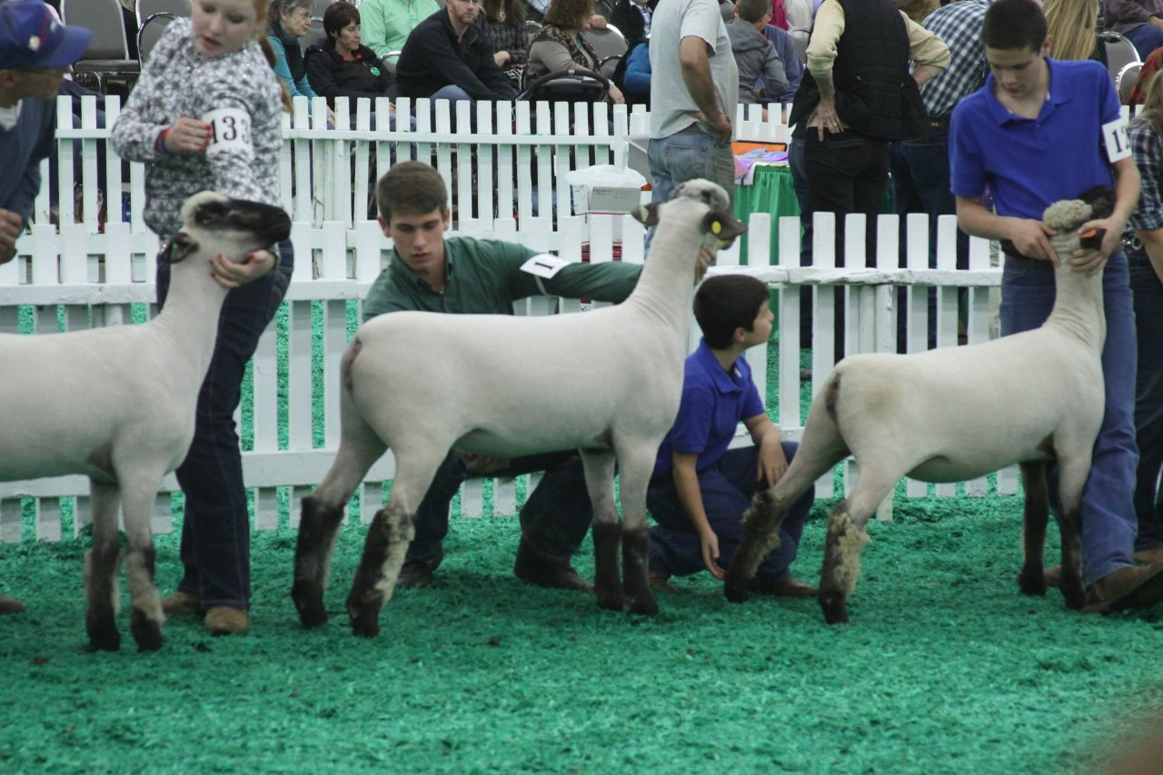
Jacob Wenner – ‘Development of PHIL Testbeds for Hybrid Plant Controllers’
Advisors: Mike Wagner & Mark Anderson
Hometown: Lewis Center, Ohio
Completed bachelor’s degree in December, 2020 at UW-Madison during “The Golden Age of Virtual Education”
Fun Facts:
Did 4H growing up – raised sheep, cattle, chickens and rabbits
UW Rowing Team – Eighty+ 2[km] races, 4 years of pain…
Currently enjoys(?) partaking in various endurance events
Has been described as “obsessed” with Lake Superior

Slide 2
General objective is to develop and advance the Energy System Optimization Lab’s (ESOLab) simulation and experimental capabilities for the testing of powerplant management and design strategies.
Primary tangible goal: ESOLab’s first real time, Power Hardware In the Loop (PHIL) simulation combining virtual plants and physical hardware
Working with High Bay Lab Microgrid equipment and data acquisition system
Turbine-Governor transient modeling
Steam Generation System transient and steady state modeling
Model integration

Slide 3
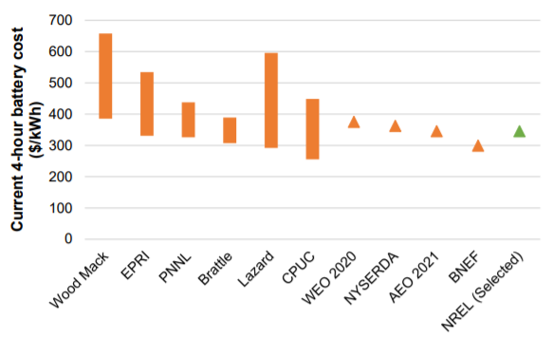
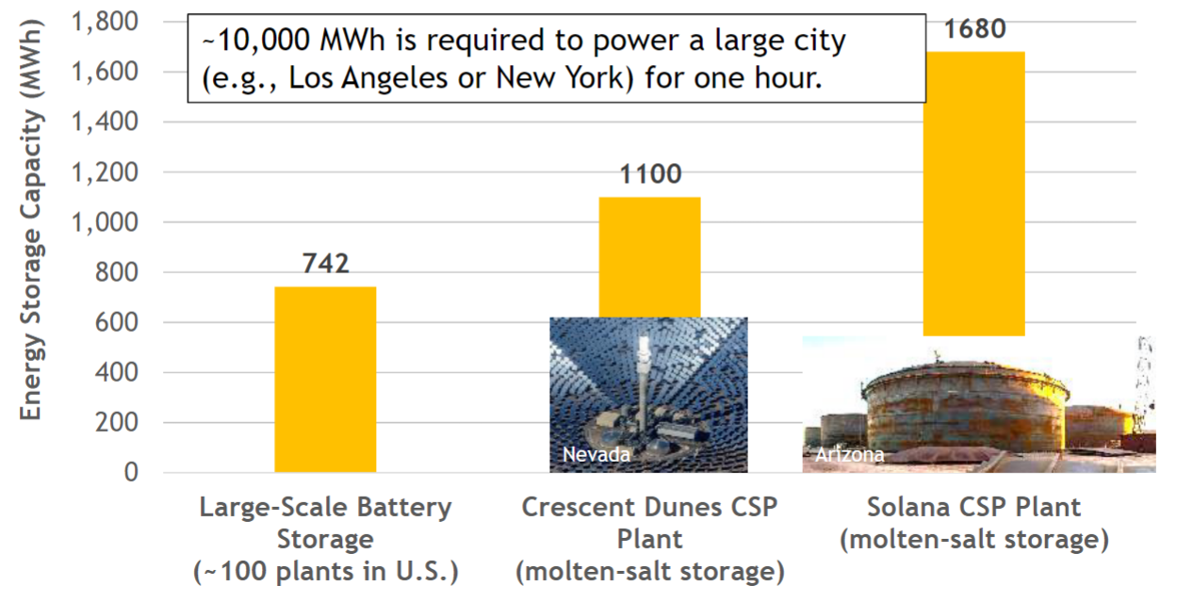
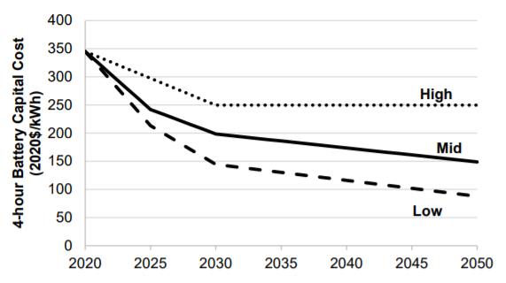
CSP offers an effective thermal energy storage solution
Battery round trip efficiency-82% (EIA)
TES round trip >90% (NREL)
NREL: Estimated and Projected Utility Scale Battery Costs, Figure ES-2, Wesley Cole et al
.
Dr. Cliff Ho ME565 Presentation, 2021 || Sandia Natioanal Laboratory
Notes:
Source: Estimated and Projected Utility Scale Battery Costs, NREL
Source: Cliff Ho’s CSP presentation 12/5/2021, info from NREL and EIA

Slide 4
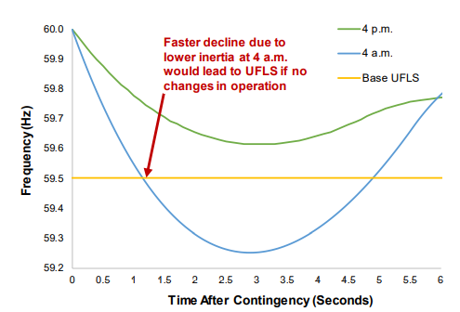
Synchronous Generation Adds Frequency Stability
Inertial constant (H) is a measure of how long a generator could supply its rated capacity solely based on inertial energy generation
Generators and grids typically have H between 2-7 [s]
Graph shows grid response, result of all synchronized loads’ and generators’ response
NREL and UC-Boulder || Inertia and the Power Grid: A Guide Without the Spin, Paul Denholm et al.
.
Notes:
Equation source: Impact of Low Rotational Inertia on Power System Stability and Operation by Andreas Ulbig, Theodor S. Borsche, Göran Andersson
Graph: NREL “Grid Without Inertia”

Slide 5
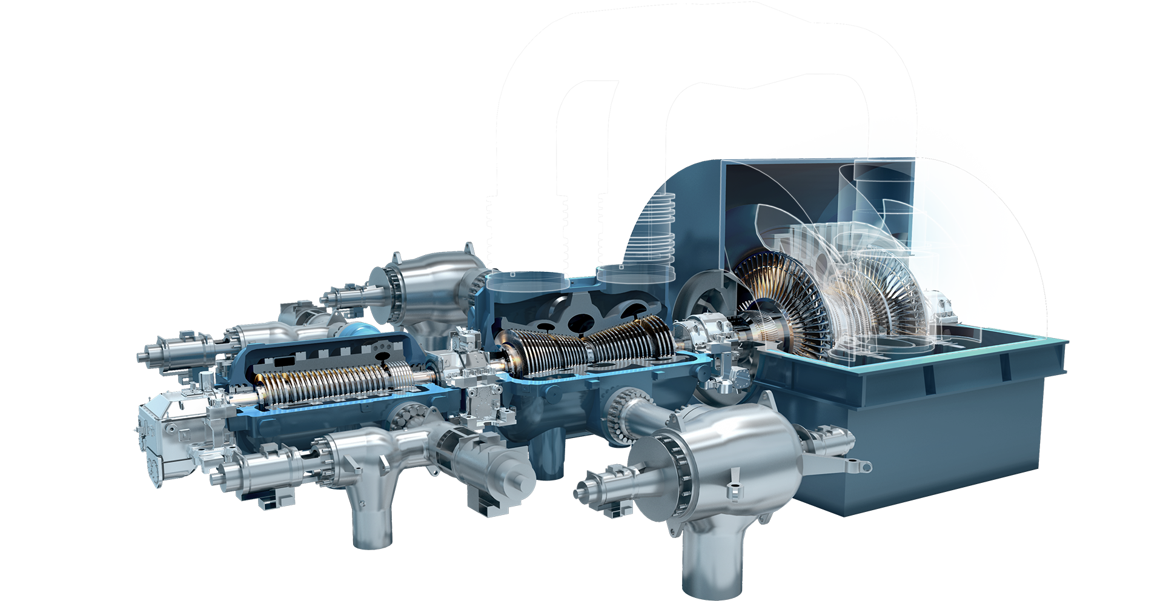
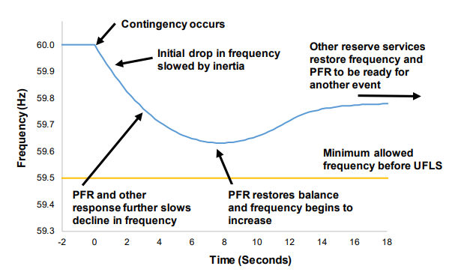
CSP generation also adds frequency stability
Grid frequency stability is dependent on the Swing Equation
The physical inertia stored in turbines/synchronous generators arrests rate of grid frequency change
Stabilizing effect
NREL and UC-Boulder || Inertia and the Power Grid: A Guide Without the Spin, Paul Denholm et al.
.
Equation: Impact of Low Rotational Inertia on Power System Stability and Operation by Andreas Ulbig, et. al
Notes:
Equation source: Impact of Low Rotational Inertia on Power System Stability and Operation by Andreas Ulbig, Theodor S. Borsche, Göran Andersson
Graph: NREL “Grid Without Inertia”

Slide 6
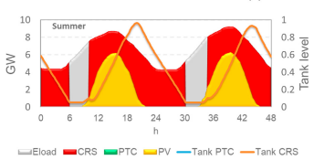
PV-CSP Hybrid Systems
Hybrid Photovoltaic (PV)-CSP “Solar-Parks” are being considered for implementation by multiple nations
PV
Currently lower Levelized Cost of Electricity (LCOE) compared to CSP
Highly modular in nature
Does not have built in energy storage, must be paired with batteries
Lower capacity factors – 29% Statewide Avg. for Arizona (from EIA)
CSP
Higher LCOE compared to PV
More complex construction and higher capital costs
Cheap, dispatchable energy capabilities
CSP capacity factors up to 80% depending on design and location
Hybrid projects hope to combine the dispatchability of CSP with the lower LCOE of PV to create high capacity, minimized capital cost, high overall capacity factor generation plants
The optimal share of PV and CSP for highly renewable power systems in the GCC region, Elisa Ghirardi et. al
Notes:
Source: EIA for capacity factors
Source: The optimal share of PV and CSP for highly renewable power systems in the GCC region

Slide 7
How should we manage a hybrid system?
Optimal management of hybrid systems will require advanced algorithms with diverse considerations
Forecasted weather data
Optimum thermodynamic operating points (CSP only)
Predicted energy demand
Market prices
Predicted PV v/s CSP hourly contribution
Minimizing equipment degradation
Etc.
We need dispatch controllers
Dispatch controllers need to be tested in low-risk realistic environment testbeds
Power Hardware In the Loop (PHIL), sometimes just HIL

Slide 8
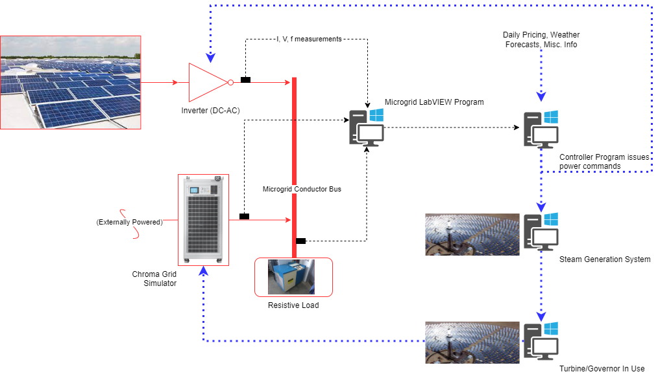
Power Hardware In the Loop tests (PHIL)
Combine power hardware equipment, controllers, and plant models (virtual models)
Differ from predictive simulations because they are real-time
Used for controller testing because the controller is receiving realistic, high-fidelity signals

Slide 9
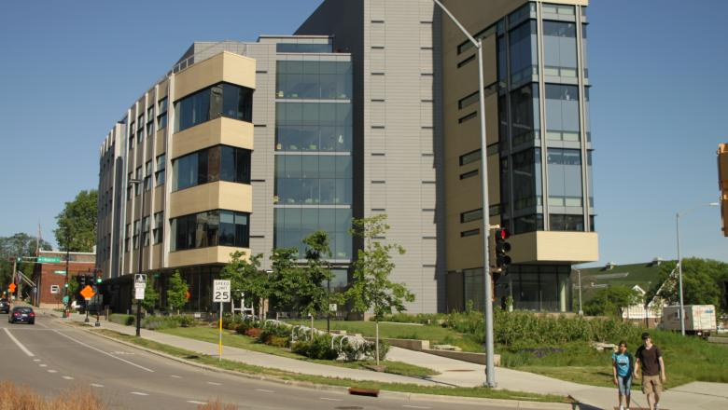
Microgrid Equipment – Solar Panels
Located on the rooftop of WEI
6200 [W] Max. Available DC Power

Slide 10
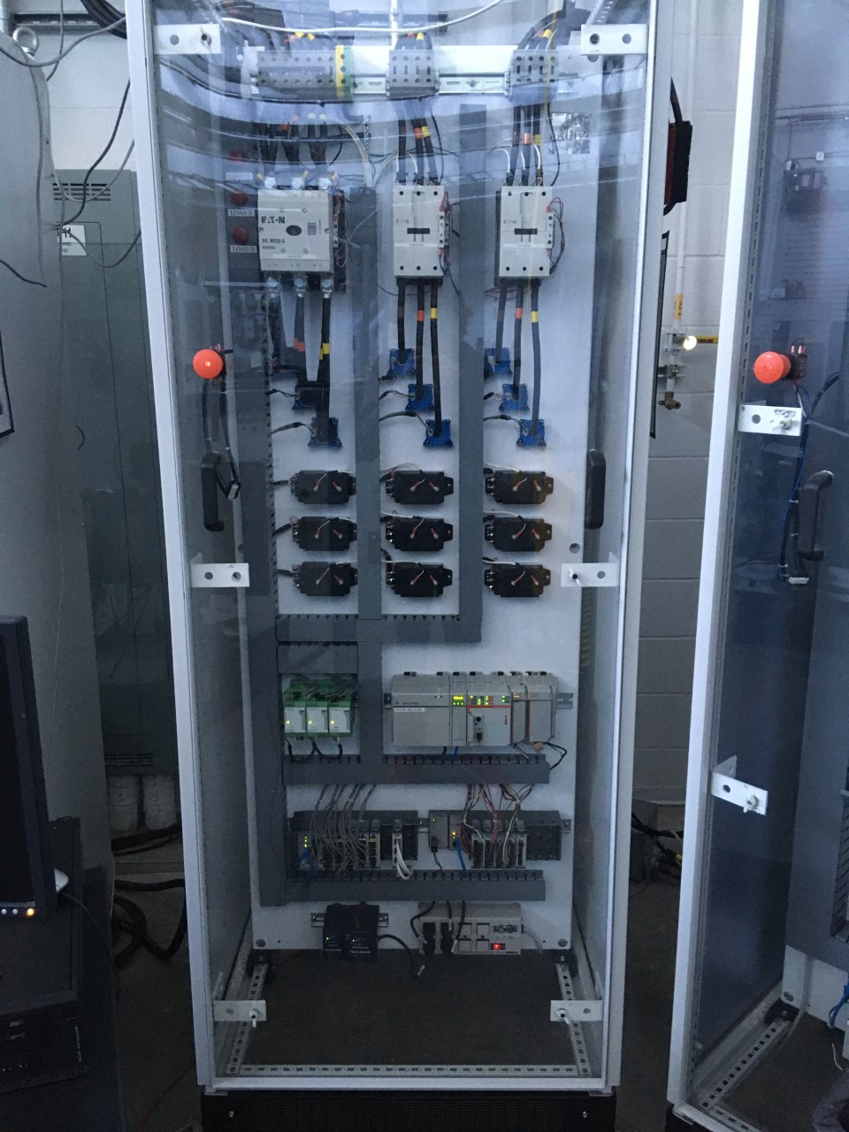
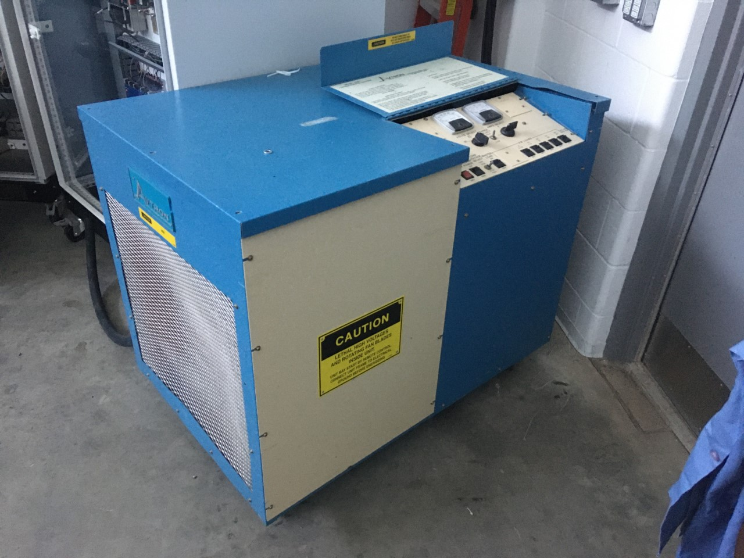
Microgrid Equipment – Avtron Load Bank and Rack
Can dissipate up to 50 [kW] electric power
Power sink is stepped in 5 [kW] increments
Load Rack (right) is a LabVIEW controlled contact switch
Equipped with current and voltage transducers

Slide 11
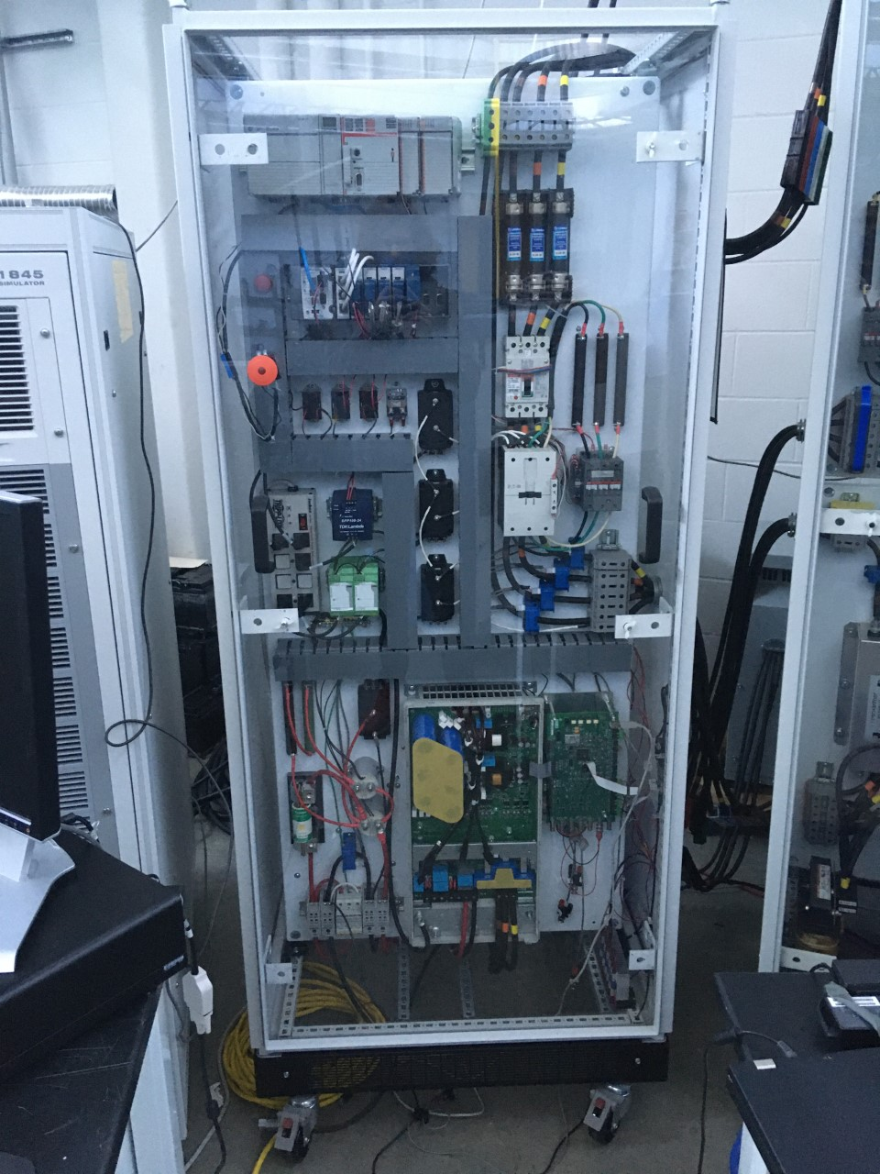
Microgrid Equipment – PV Inverter
Converts DC power from panels to AC power for microgrid via Pulse Width Modulation
Built by WEMPEC students – Dinesh P. and Zhe C.
Controlled by a modifiable and compiled Simulink code
Can generate 5-6 [kW] 3-phase power
We can control:
Maximum power output
Line-To-Line Voltage (generally <480 [V])
Frequency

Slide 12
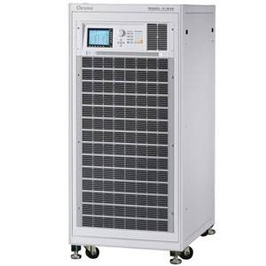
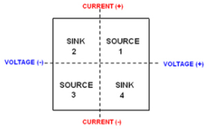
Microgrid Equipment – Chroma Grid Simulator
Capable of 45 [kW] power output
4 quadrant, fully regenerative up to 100% of output current
Highly Programmable…
Frequency
Power output limits
Current and voltage limits
Phase voltage
Programmable waveforms
Power angle
Etc.
Remotely programmable via LabVIEW

Slide 13
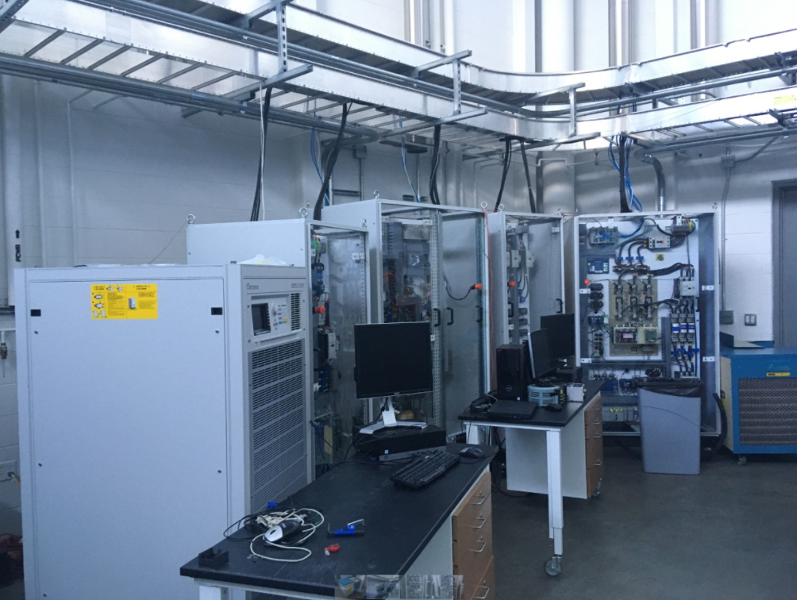
Microgrid Equipment
All equipment has been electrically connected to a common power bus
All voltage and current transducers are integrated into a LabVIEW master program
Basically a control panel
Any power waveforms can be monitored

Slide 14
Microgrid Equipment – Virtual Plant
Meant to imitate Crescent Dunes
Goal is to capture any significant transient response in the plant
2 dominant transient responses under consideration:
Turbine/Governor Valve
Steam Generation System (Boiler, etc.)

Slide 15
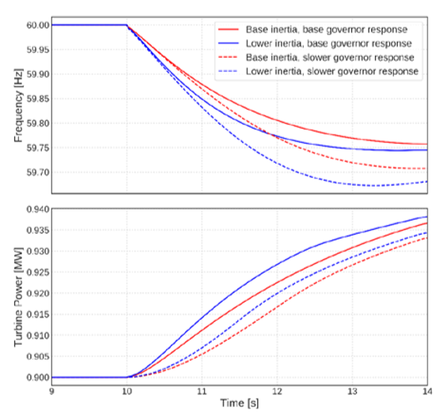
Identifying Dominant Responses
Turbomachinery/governor valve responses
Governor valves involuntarily arrest turbine frequency deviations
Most are electromechanical
Takes time for actuators to open and close the physical valves – introduces delay
Frequency Control Requirements for Reliable Interconnection Frequency Response || Lawrence Berkeley National Laboratory; Joseph Eto, et al.
Notes:
Graph: Frequency Control Requirements for Reliable Interconnection Frequency Response from Lawrence Berkeley National Laboratory; Joseph Eto, et al.

Slide 16
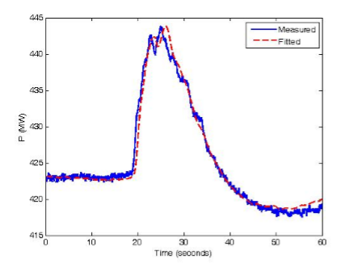
Modeling Turbomachinery/governor valve responses
Many turbomachinery/governor valve models already exist
Used by Grid Planners to assess grid stability
Considerations:
Turbine/governor models need to be specific to CSP applications
Most lag, control constants, and other parameters are experimentally found
Summary of Existing Governor Models, IEEE Technical Report
Notes:
Graph: IEEE Summary of Existing Governor Models

Slide 17
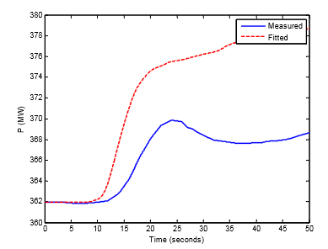
Modeling Turbomachinery/governor valve responses
Currently adapting an Alstom combined cycle steam turbine model
Size is similar to proposed CSP plant
Parameter values are given
Considerations:
Model currently assumes “unlimited steam”
Model also assumes constant boiler pressure, even during a transient response
Dangerous assumption…
“Artificial Headroom” – Predicted additional power capacity that physical plant does not have
Graph provides example of when simple model with above assumptions is insufficient
Summary of Existing Governor Models, IEEE Technical Report
Notes:
Graph: IEEE Summary of Existing Governor Models

Slide 18
Identifying Dominant Responses
2. Steam Generation System (SGS) – Preheater, Boiler, Superheater
Responsible for maintaining boiler pressure and mass flow
Limits the turbine/governor response
Limits how closely the plant can follow a power demand increase
Models exist, but not often shared
If actual plant ramp rates & capabilities of competing plants are known, could result in market tampering
For CSP with molten salt, SGS can be simplified into three large heat exchangers
Molten salt on shell side
Water/steam/superheated steam on tube sides
Shell side: two-pass
Notes:
Source: Control Engineering

Slide 19
Superheater Modeling Process
Matlab Script takes steady state geometry and predicts transient response for given t+dt
PHIL testbed uses
script to predict
CSP’s load following response during real-time experiments
with resolution=dt
EES Steady State
Modeling for realistic sizing
Used an EES Sub-heat-exchanger method to estimate physical size and geometry
110 [GWe] Capacity
Incoming hot tank salt at 565 [C]
Sized using steady state operating points, and known flow rates
Counter-flow control volumes & cross-flow heat transfer coefficient correlations

Slide 20
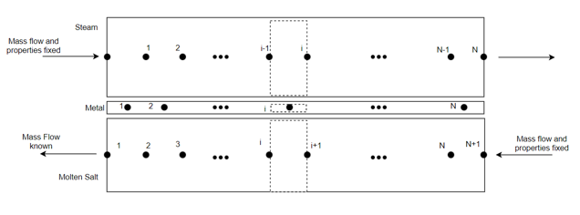
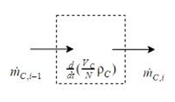
Superheater Transient Modeling
Although steady state modeling is generally valid for heat exchangers, our time scale requires us to reassess this assumption
Our model allows energy storage and steam mass storage terms to be nonzero
Mass Balance for each node:
Notes:
Acknowledge Sam’s work and discuss any differences

Slide 21
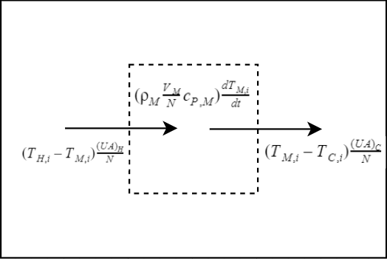
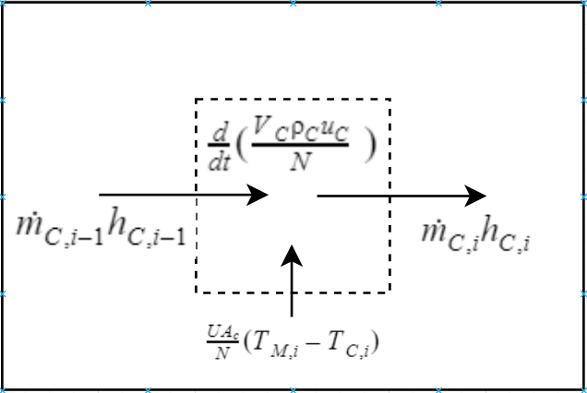
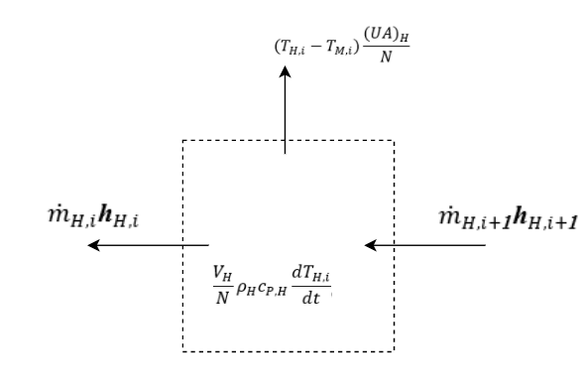
Superheater Transient Modeling
Metal (M):
Steam (C):
Molten Salt (H):

Slide 22
Putting Models to Work in LabVIEW
Compiled Turbo/Governor Model into a .dll via Simulink Coder and Veristand TLC add-on
This creates a “packaged” model that acts as a function block in LabVIEW
LabVIEW measurements can be used as inputs
Based on real-time inputs, model outputs predict real time plant response
Ramp rate
Heat Exchanger Temperature Profiles
Etc.
Using Chroma-built LabVIEW interface, can pass the predicted plant outputs as setpoints to our grid simulator

Slide 23
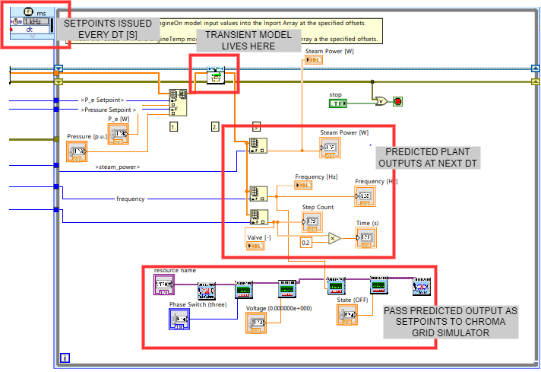
Putting Models to Work in LabVIEW

Slide 24
Planned Work
Model preheater dynamics
Model boiler dynamics
Finish integrating all plant elements into LabVIEW dll
Run solar panels, grid simulator (plant model) in tandem PHIL initial test
Thank you:
Prof. Nellis – Superheater transient modeling
Bruce Beihoff – All questions and concerns electrical
Dinesh Pattabiraman – PV Inverter programming and operation
Ben Bates – Undergraduate assistant, turbo-gov modeling

Slide 25
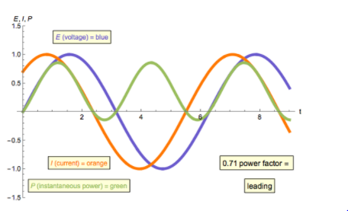
Additional Slides
Power factor
Reactive and real power
Power Factor = Real Power/Apparent Power
All power plants operate with a power factor less than one

Slide 26
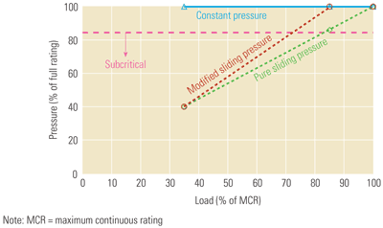
Additional Slides
Pressure mode operation options
Constant Pressure
Pure sliding pressure
Modified sliding pressure

Slide 27
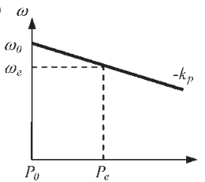
Additional Slides
Droop (speed) Control
As frequency decreases, power plants increase output
A way to coordinate fast, involuntary reactions

Slide 28
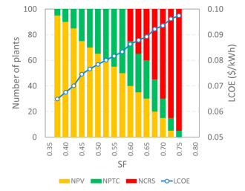
Additional Slides

