Slide 1
Mechanical Engineering M.S. Advisors: Mike Wagner and Ben Lindley December 6th, 2022
University of Wisconsin – Madison
Mechanical Engineering
Thermodynamic Modeling of a Supercritical Steam-Rankine Cycle for an Integrated CSP-Nuclear System
Brian White

Slide 2
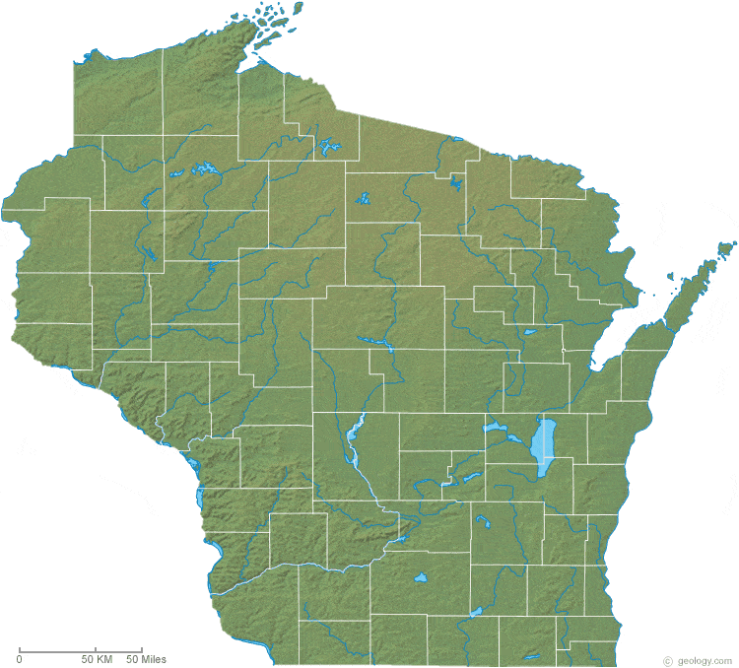
Hometown: Green Lake, Wisconsin Undergrad Degree: UW-Madison Mechanical Engineering Activities: Fishing, Tennis, Volleyball, Cooking, Downhill Skiing.
Personal Background
Early Morning - Green Lake, WI
Heliostat - Sandia National Lab, NM
Ice Fishing Trout – Ontario, Canada
Notes:
Wisconsin Image From: https://geology.com/state-map/wisconsin.shtml

Slide 3
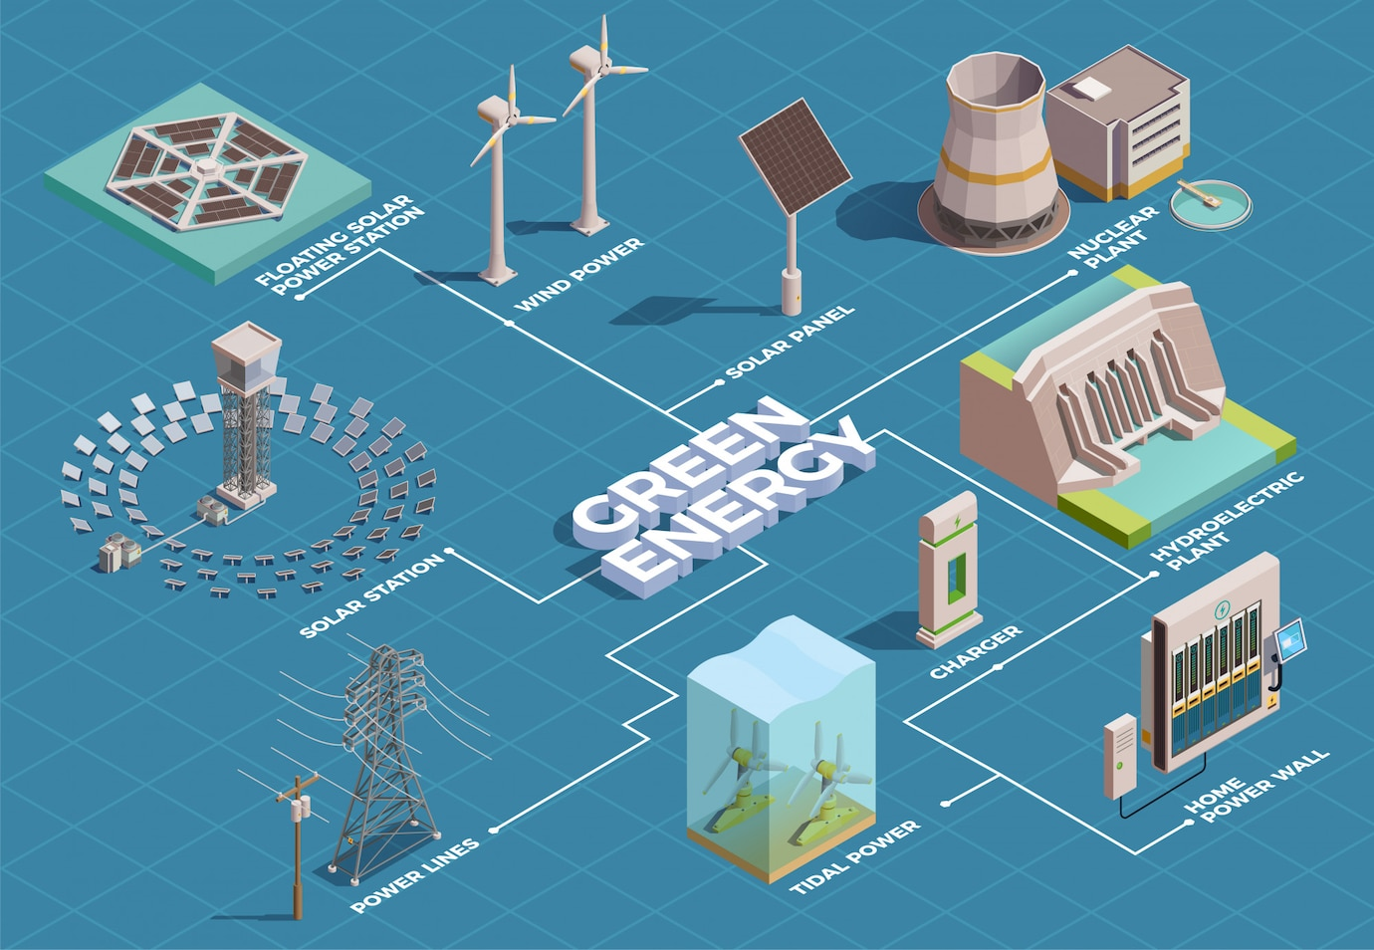
Background – Integrated Technology
Combines technologies in a logical sense:
Using waste heat from one process in another process
Coupling power cycles to offset drawbacks of each
Intermittency of solar and wind
Non-load following nuclear
Energy storage needs
Integrated technology illustration from:
https://www.powerengineeringint.com/renewables/greece-to-expand-renewables-deployment-with-e2-27bn-aid/
Notes:
Integrated Technology Image From: https://www.powerengineeringint.com/renewables/greece-to-expand-renewables-deployment-with-e2-27bn-aid/

Slide 4
Background – Integrated Technology
Combines technologies in a logical sense:
Using waste heat from one process in another process
Coupling power cycles to offset drawbacks of each
Intermittency of solar and wind
Non-load following nuclear
Energy storage needs
Integrating Concentrating Solar Power Tower (CSP) and Lead-Cooled Fast Reactor (LFR):
Increases dispatchability
LFR as base load with thermal energy storage (TES) load following
Solar irradiance variable on weather and time of day
LFR and CSP share TES
Integrated technology illustration from:
https://www.powerengineeringint.com/renewables/greece-to-expand-renewables-deployment-with-e2-27bn-aid/
Notes:
Integrated Technology Image From: https://www.powerengineeringint.com/renewables/greece-to-expand-renewables-deployment-with-e2-27bn-aid/

Slide 5
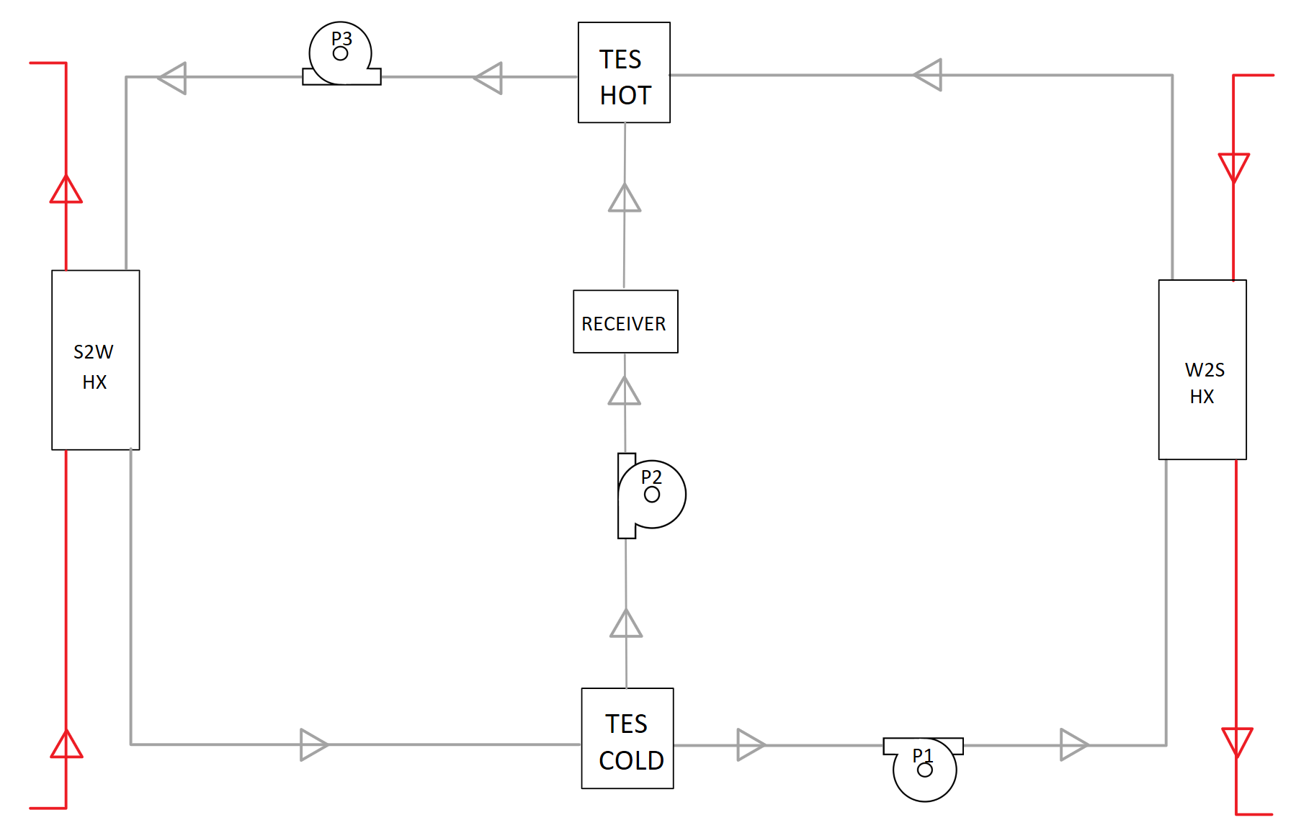
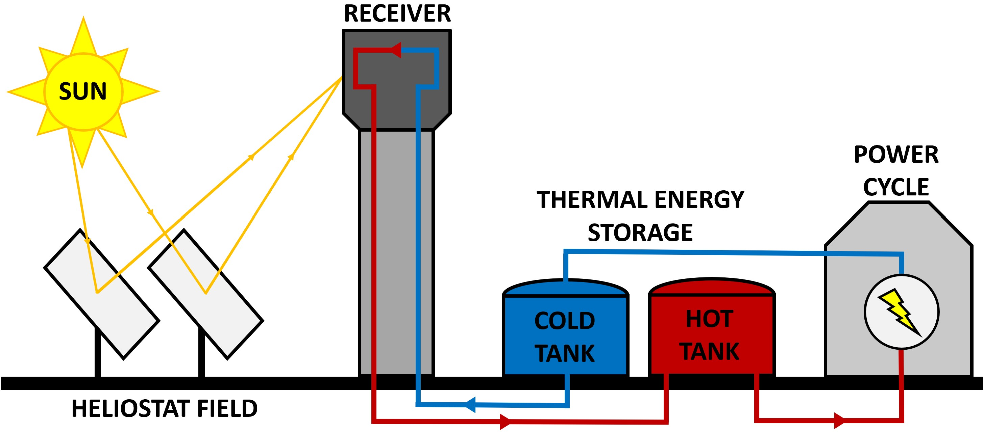
Background – Concentrating Solar Power Tower
Heat Transfer Fluid:
Solar Salt
60% Sodium Nitrate (NaNO₃) and 40% Potassium Nitrate (KNO₃)
Thermal Energy Storage (TES):
Hot storage at 560 ºC
Cold Storage at 350 ºC
Water-to-Salt (W2S) heat exchanger transfers heat from steam-Rankine for storage in hot storage tank
Salt-to-Water (S2W) heat exchanger transfers heat from hot storage tank to steam-Rankine increasing steam mass flow and power generation
Receiver power is 750 MW
Dependent on time of day and weather conditions
CSP salt cycle diagram
CSP plant visual diagram

Slide 6
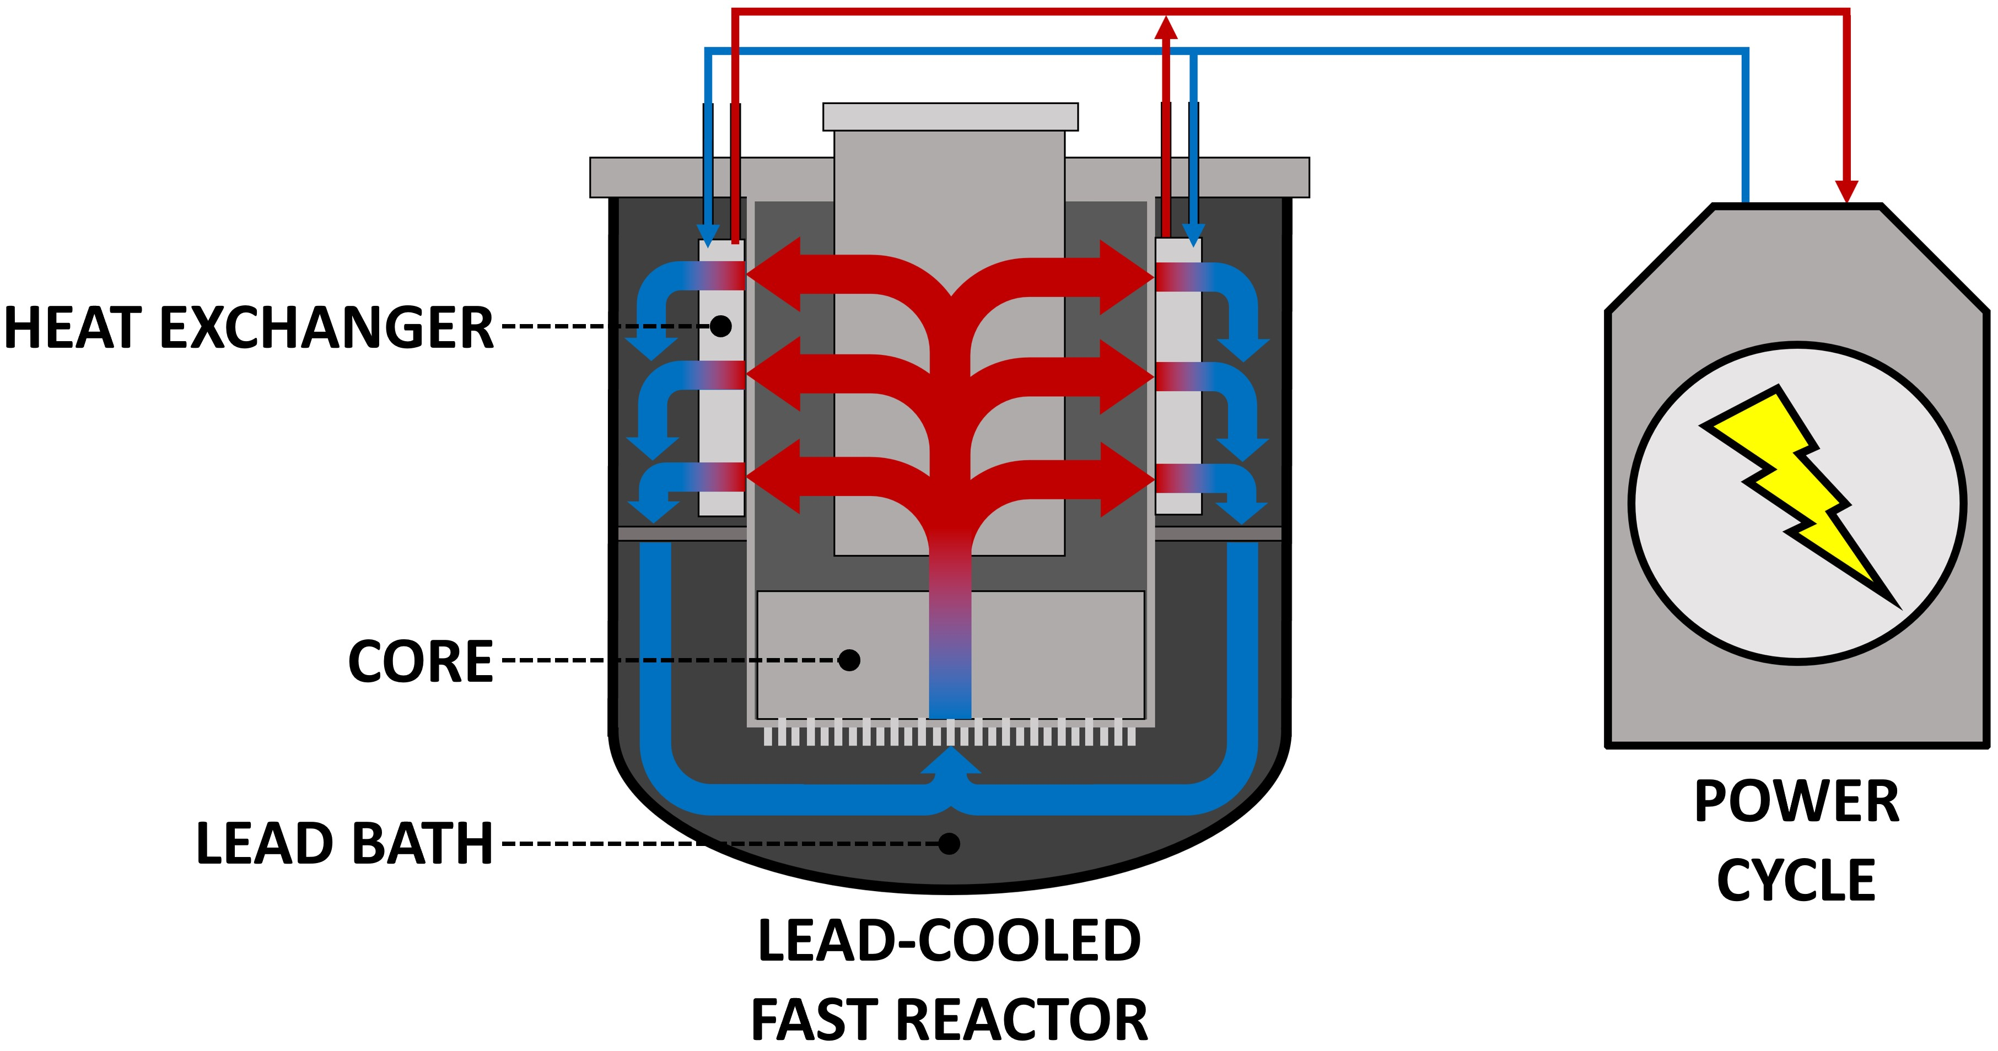
Background – Lead-Cooled Fast Reactor
Fission chain reaction sustained by fast neutrons
Heat Transfer Fluid:
Liquid lead is primary coolant
Circulated through LFR exchanging heat from the core to power cycle via heat exchangers
Operating Temperatures:
Steam Outlet is 632 ºC
Steam Inlet is 340 ºC
Power Input is 950 MW
Values provided by Westinghouse Electric Company
Notes:
LFR photo from https://www.westinghousenuclear.com/Portals/0/new%20plants/LFR/ECOE-0002_LeadFastReactor.pdf

Slide 7
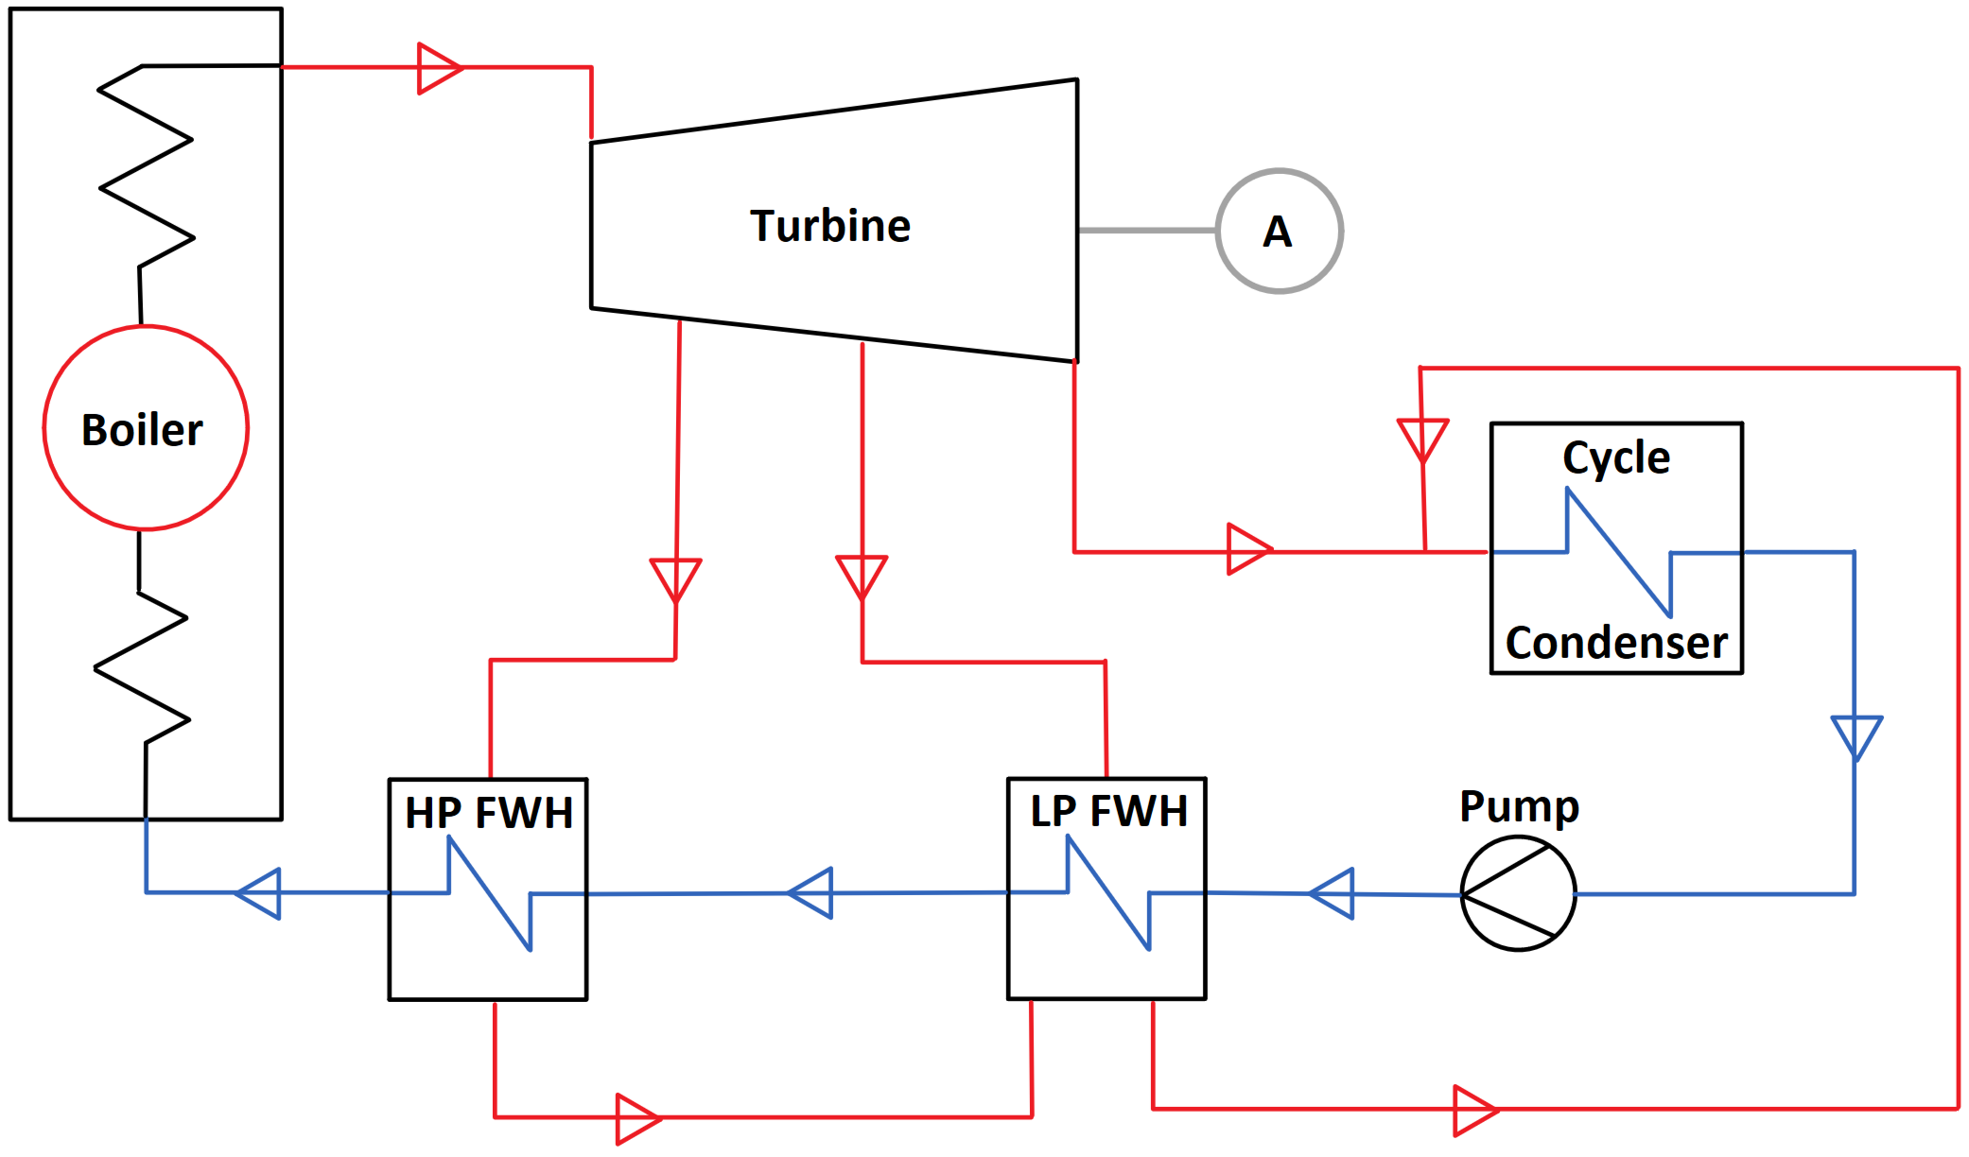
Background – Supercritical Steam-Rankine Cycle
Supercritical Steam-Rankine Cycle
~6% higher efficiencies than subcritical steam-Rankine on average
Typically need reheat to ensure high quality steam in LP turbine
Quality <90% water droplets lead to flow accelerated corrosion
Simple Steam Rankine Cycle with T-s diagrams:
T
T
1
1
1
2
2
4
8
2
3
10
11
8
11
5
3
7
9
3
7
12
7
9
12
6
8
6
6
11
12
5
4
5
4
10
s
10
s
9
Subcritical Steam-Rankine T-s
Simple steam-Rankine cycle diagram
Supercritical Steam-Rankine T-s
Notes:
Evidence for Supercritical Steam Rankine Cycle Efficiency Advantages:
M. Salazar-Pereyra, R. Lugo-Leyte, A. E. Bonilla-Blancas, and H. D. Lugo-Mendez, “Thermodynamic analysis of supercritical and subcritical rankine cycles,” in Turbo Expo: Power for Land, Sea, and Air, American Society of Mechanical Engineers, vol. 49866, 2016, V008T26A041.
Information for state points of Sub and Supercritical Rankine:
M. M. El-Wakil, “Powerplant technology,” 1984.

Slide 8
Goals and Methodology
Goals:
Combine Lead-cooled fast reactor and concentrating solar power into single cycle
Compare efficiency, power production, and characteristics of supercritical steam-Rankine cycles
Methodology:
All cycles and components modeled in Engineering Equation Solver
Model cycle for different operating modes:
‘off’ - lead-cooled fast reactor is only heat input into cycle, operating as base load
‘charging’ - salt is being stored in hot TES from supercritical steam-Rankine cycle
‘discharging’ - salt from hot TES is dispatching to supercritical steam-Rankine cycle
Off-design operation cases for flexibility to grid demand

Slide 9
Modeling System Components – Sub-Heat Exchanger
Sub-Heat Exchanger
Discretizes counter flow heat exchangers into many sub-heat exchangers
Captures capacitance rate changes, internal temperature behavior, and phase change
Multiple fluid type capability
Used for feedwater heater sections, Salt-to-Water heat exchanger, and Water-to-Salt heat exchanger.
Procedure for counterflow heat exchanger discretized into Sub-heat exchangers
Notes:
Procedure for sub-hx created based on Nellis & Klein Heat Transfer textbook:
Nellis, Gregory, and Sanford Klein. 2008. Heat transfer. Cambridge University Press.

Slide 10
Modeling System Components – Feed Water Heaters
Feed Water Heaters (FWH)
Feedwater heaters are broken into three sections exchanging heat from turbine exhaust to feedwater:
Desuperheater - superheated turbine exhaust exchanges heat until saturated steam
Condenser - saturated steam fully condenses to liquid
Drain Cooler - mixed liquid turbine exhaust subcools
Drain from previous FWH is injected after turbine exhaust is fully condensed in mixer (M)
Sections capture capacitance rate changes and internal temperatures using sub-heat exchanger procedure
Notes:
Information on FWH modeling found at:
Yongliang Zhao, Chaoyang Wang, Ming Liu, Daotong Chong, and Junjie Yan, “Improving operational flexibility by regulating extraction steam of high pressure heaters on a 660 MW supercritical coal-fired power plant: A dynamic simulation” in Applied Energy vol. 212, 2018 (pg. 1295-1309)
El-Wakil, Mohamed Mohamed. 1984. Powerplant technology

Slide 11
Modeling System Components – Feed Water Heaters
Feed Water Heaters (FWH)
Feedwater heaters are broken into three sections exchanging heat from turbine exhaust to feedwater:
Desuperheater, Condenser, Drain Cooler
T
$$TTD=T_{sat}−T_{C,out}$$
$$∆T_{FWH}=T_{H, out}−T_{C,in}$$
Terminal Temperature Difference (TTD)
Approach Temperature ($∆T_{FWH}$)
x
Notes:
Information on FWH modeling found at:
Yongliang Zhao, Chaoyang Wang, Ming Liu, Daotong Chong, and Junjie Yan, “Improving operational flexibility by regulating extraction steam of high pressure heaters on a 660 MW supercritical coal-fired power plant: A dynamic simulation” in Applied Energy vol. 212, 2018 (pg. 1295-1309)
El-Wakil, Mohamed Mohamed. 1984. Powerplant technology

Slide 12
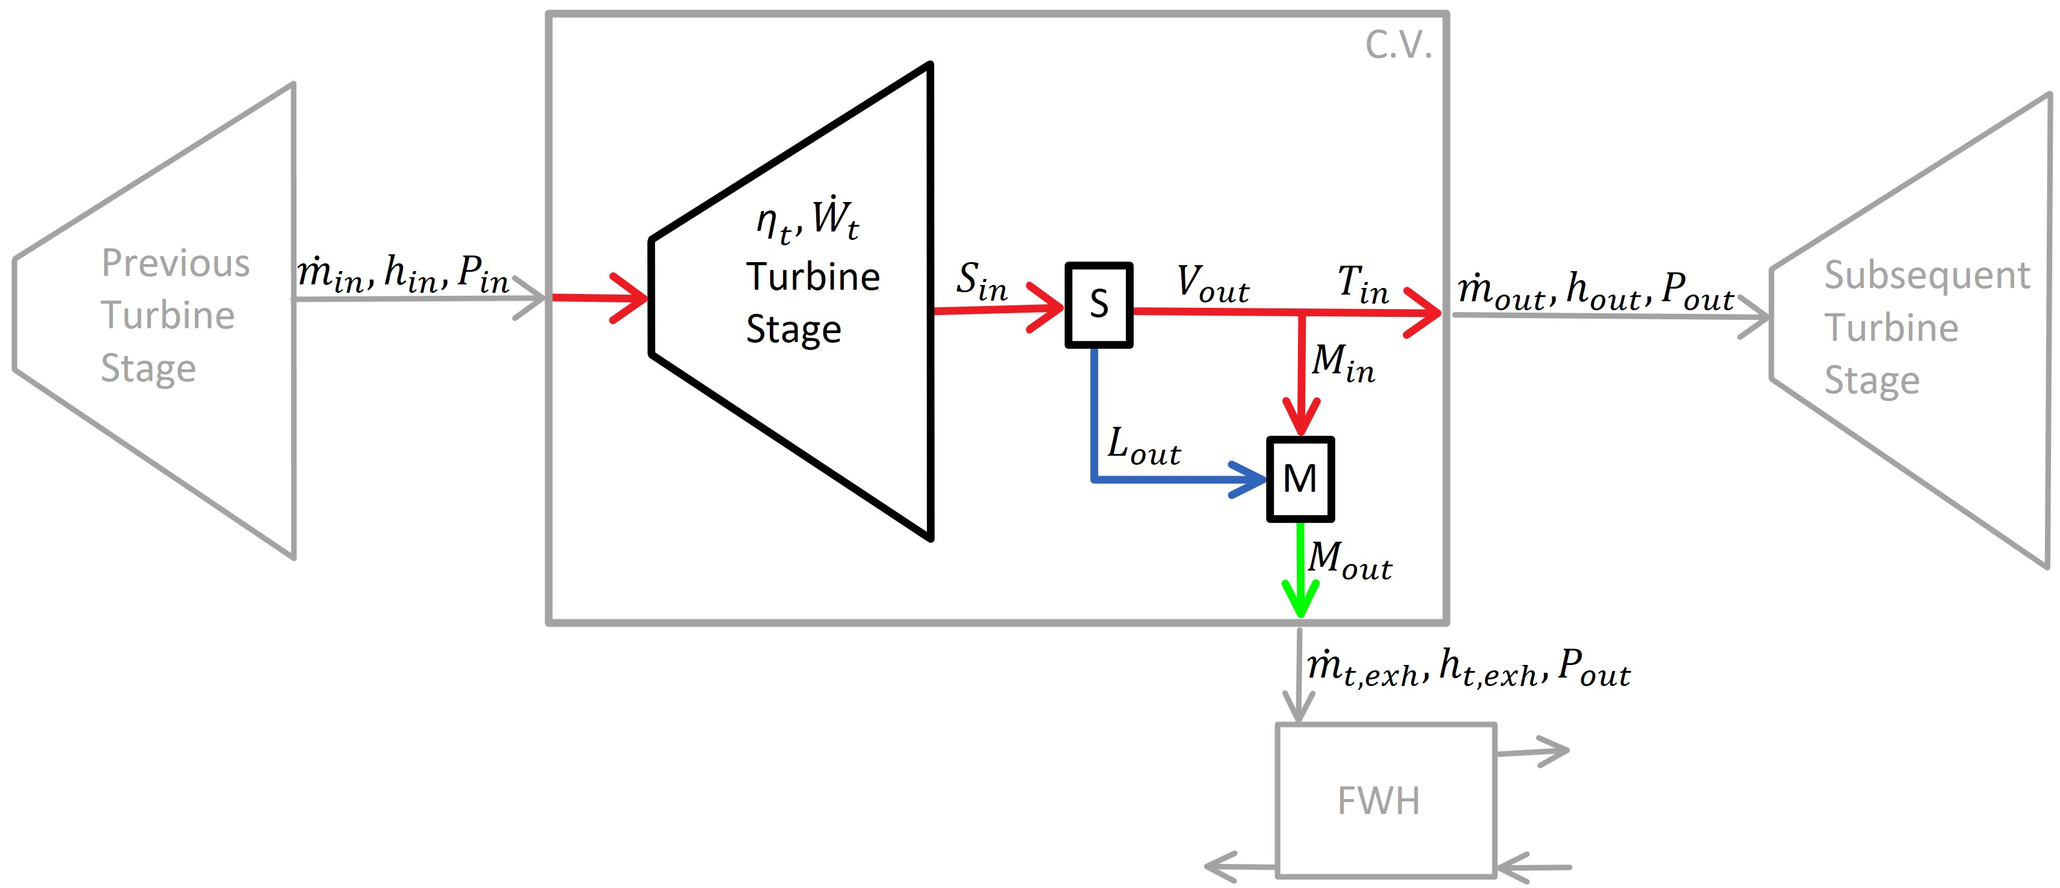
Modeling System Components – Turbines
Turbines
High-pressure, intermediate-pressure, and low-pressure turbines (HPT, IPT, LPT)
Isentropic turbine operation for HPT and IPT, operate with superheated steam
LPTs are modeled with liquid extraction from turbine shell
Liquid extraction for qualities greater than 90% to reduce flow accelerated corrosion
Diagram for liquid extraction in LPT
Notes:
Information on Turbine liquid separation found at:
Sato, Hideaki, Soichiro Tabata, Naoto Tochitani, Yasuhiro Sasao, Ryo Takata, and Masaki Osako. 2020. “Investigation of Moisture Removal on Last Stage Stationary Blade in Actual Steam Turbine” Volume 9: Oil and Gas Applications; Organic Rankine Cycle Power Systems; Steam Turbine.
Hoznedl, Michal, Ladislav Taj ˇc, Lukáš Bedná ˇr, Aleš Macálka, and Antonín Živný. 2019. “Separation of Water Film From Last Stage Guide Blades of 1000 MW Steam Turbine” Volume 8: Microturbines, Turbochargers, and Small Turbomachines; Steam Turbines.

Slide 13
System Parameters and Acronyms
Parameter | Design Point Value
Efficiencies
HPT | 0.90 [-]
IPT | 0.90 [-]
LPT | 0.90 [-]
Pumps | 0.90 [-]
Approach Temperatures
S2W | 10 [ºC]
W2S | 10 [ºC]
Pressures
LFR | 330 [Bar]
LPT outlet | 50 [mBar]
Heat into System
LFR Heat Transfer | 950 [MW]
CSP Heat Transfer | 750 [MW]
Temperature
LFR Steam Inlet | 340 [ºC]
LFR Steam Outlet | 632 [ºC]
TES hot tank | 560 [ºC]
TES cold tank | 350 [ºC]
Steam Quality
LPT outlet | > 0.90 [-]
System parameters are constant throughout modes of operation for SSRC
Representative values for concentrating solar power and lead-cooled fast reactor listed
Acronyms | Definition | Acronyms | Definition
LFR | Lead-cooled Fast Reactor | HPT | High Pressure Turbine
CSP | Concentrating Solar Power | IPT | Intermediate Pressure Turbine
TES | Thermal Energy Storage | LPT | Low Pressure Turbine
SSRC | Supercritical Steam-Rankine Cycle | S2W | Salt-to-Water Heat Exchanger
FWH | Feed Water Heater | W2S | Water-to-Salt Heat Exchanger
A | Alternator
Tabulated acronyms (above) and constant system parameters (right)

Slide 14
Supercritical steam-Rankine Cycle
Three modes of operation:
1). ‘off’ 2). ‘charging’ 3). ‘discharging’
Charging Flow Path
Discharging Flow Path
CSP
LFR as sole heat input into SSRC without CSP or TES, operating as base-load for the grid

Slide 15
Supercritical steam-Rankine Cycle
Three modes of operation:
1). ‘off’ 2). ‘charging’ 3). ‘discharging’
Charging Flow Path
Discharging Flow Path
CSP
HPT exhaust transferring heat to hot TES through W2S, reducing SSRC power generation and storing heat for later use

Slide 16
Supercritical steam-Rankine Cycle
Three modes of operation:
1). ‘off’ 2). ‘charging’ 3). ‘discharging’
Charging Flow Path
Discharging Flow Path
CSP
Hot TES is dispatching salt and transferring heat to the SSRC through S2W, increasing power generation

Slide 17
Supercritical steam-Rankine Cycle
Three modes of operation:
1). ‘off’ 2). ‘charging’ 3). ‘discharging’
Charging Flow Path
Discharging Flow Path
CSP
Full cycle diagram showing ‘off’, ‘charging’ and ‘discharging’ modes of operation with CSP and TES

Slide 18
Supercritical steam-Rankine Cycle
Three modes of operation:
1). ‘off’ 2). ‘charging’ 3). ‘discharging’
Charging Flow Path
Discharging Flow Path
CSP
If CSP is producing sufficient heat for storage, SSRC may never enter ‘charging’ mode

Slide 19
Results: SSRC On-Design
LFR operating at full capacity or base-load while flexibility to grid demand is accomplished by TES storage salt dispatch
SSRC operating modes follow their intended use-case:
‘off’ – operating as base-load to grid
Generates 508 MW at 52.35% thermal efficiency
‘charging’ – stores heat in hot TES when grid demand is low
Generates 477.1 MW, or 30.9 MW less than ‘off’
‘discharging’ – increases steam mass flow through turbines for increased grid demand
Generates 587.8 MW, or 79.8 MW more than ‘off’
$$ⴄ_{cycle}=\frac{power produced by cycle}{heat input to cycle}=\frac{({\dot{W}}_{HPT}+{\dot{W}}_{IPT}+{\dot{W}}_{LPT})−({\dot{W}}_{HP Pump}+{\dot{W}}_{LP Pump})}{{\dot{Q}}_{LFR}+{\dot{Q}}_{S2W}}$$

Slide 20
SSRC Off-Design
On-design studies show SSRC power outputs with minimum of 477.1 to maximum 587.8 MW
Previous ‘charging’ and ‘discharging’ for on-design were done at 100% operation
‘charging’ on-design is limited to 190 kg/s of salt storage to TES by HTP exhaust temperature and mass flow restrictions
‘discharging’ on-design is 100 kg/s of excess steam to the SSRC and 525 kg/s of salt dispatch
Off-design studies observe fractional range of SSRC power outputs from 477.1 to 587.8 MW
‘charging’ varies salt mass flow rate values from 10%-100% [19 kg/s-190kg/s] in 10% increments
‘discharging’ varies additional steam mass flow rate values from 10%-100% [10 kg/s-100kg/s] in 10% increments
‘discharging’ has above-design cases from 100%-441% [100 kg/s-441kg/s] of additional steam mass flow rate
‘Discharging’ and ‘Charging’ modes of operation percentage case studies with associated salt and steam mass flow rates

Slide 21
SSRC FWH Scaling
Conductance (UA) for FWH:
Area (A) is assumed to remain constant with convective heat transfer coefficients (h) change with variable mass flow rates in FWHs during SSRC three modes of operation
FWH UA power law scaling technique from Patnode 2006 thesis:
UA_{REF} , ${\dot{m}}_{H,REF}$, and ${\dot{m}}_{C,REF}$ reference values set from ‘discharging’ on-design mode of operation with TTD = 3 ºC and $∆T_{FWH}$ = 5.55 ºC
$$\frac{1}{UA}=R_{H,conv}+R_{cond}+R_{C,conv}=\frac{1}{h_{H}A}+\frac{1}{h_{C}A}$$
$$UA_{FWH}=UA_{REF}\left[\left(\frac{{\dot{m}}_{C,FWH}^{0.8}∙{\dot{m}}_{H,FWH}^{0.8}}{{\dot{m}}_{C,REF}^{0.8}∙{\dot{m}}_{H,REF}^{0.8}}\right)∙\left(\frac{{\dot{m}}_{C,REF}^{0.8}+{\dot{m}}_{H,REF}^{0.8}}{{\dot{m}}_{C,FWH}^{0.8}+{\dot{m}}_{H,FWH}^{0.8}}\right)\right]$$
Notes:
Information and equation used for UA scaling of FWH from Patnode 2006 thesis:
Patnode, Angela M. 2006. Simulation and performance evaluation of parabolic trough solar power plants.

Slide 22
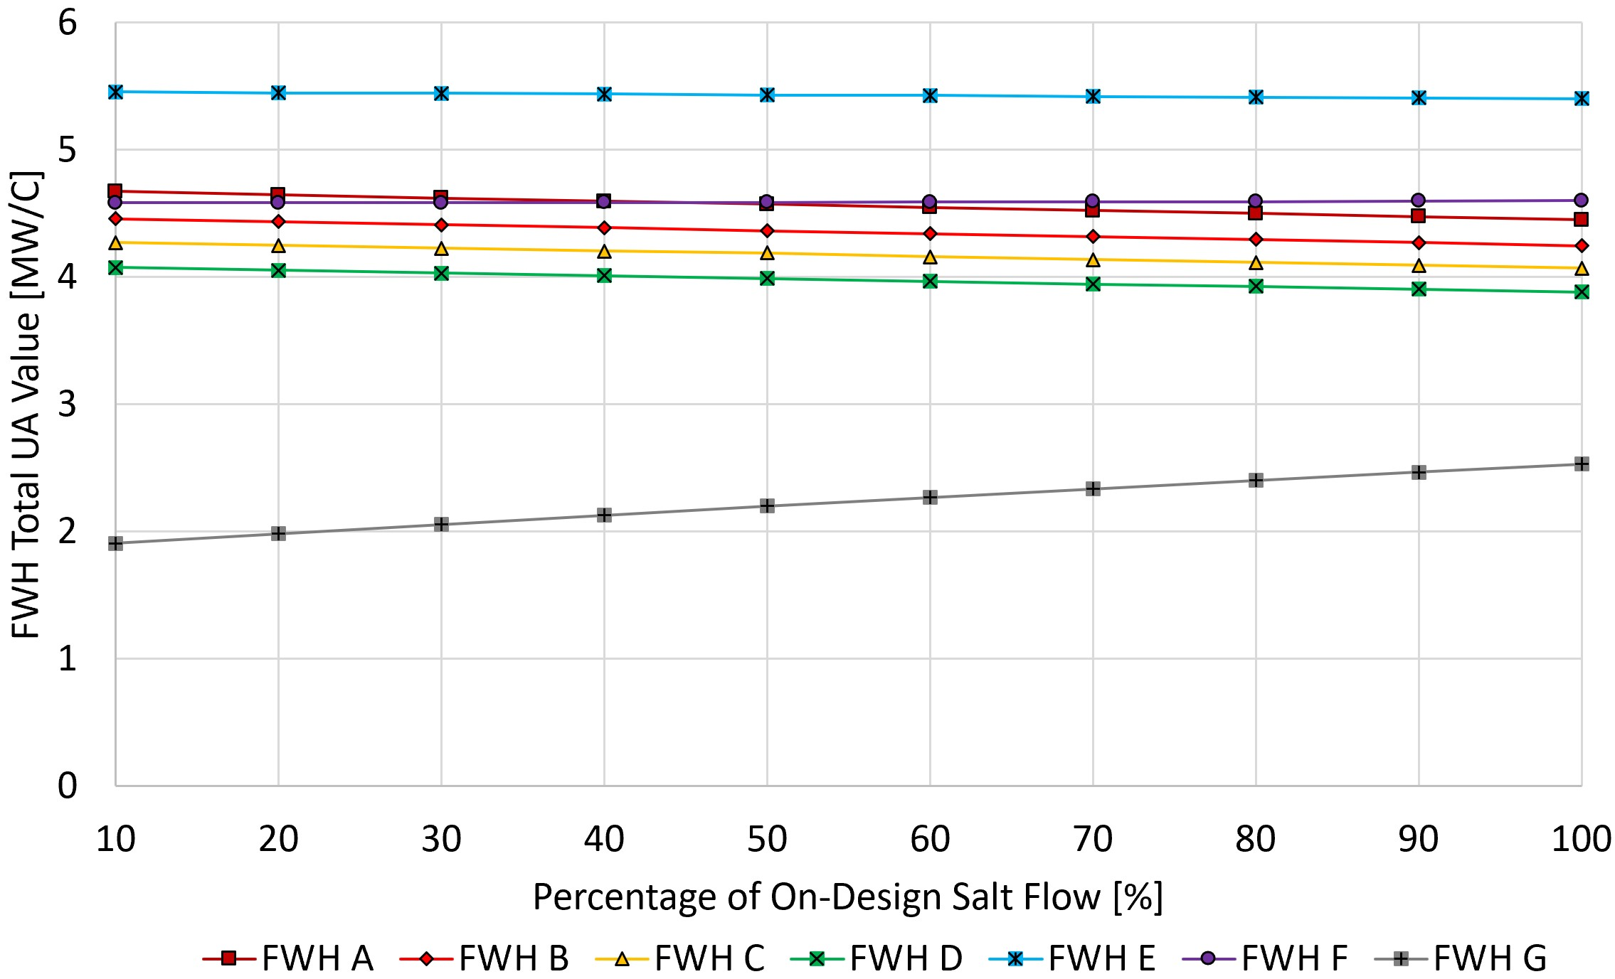
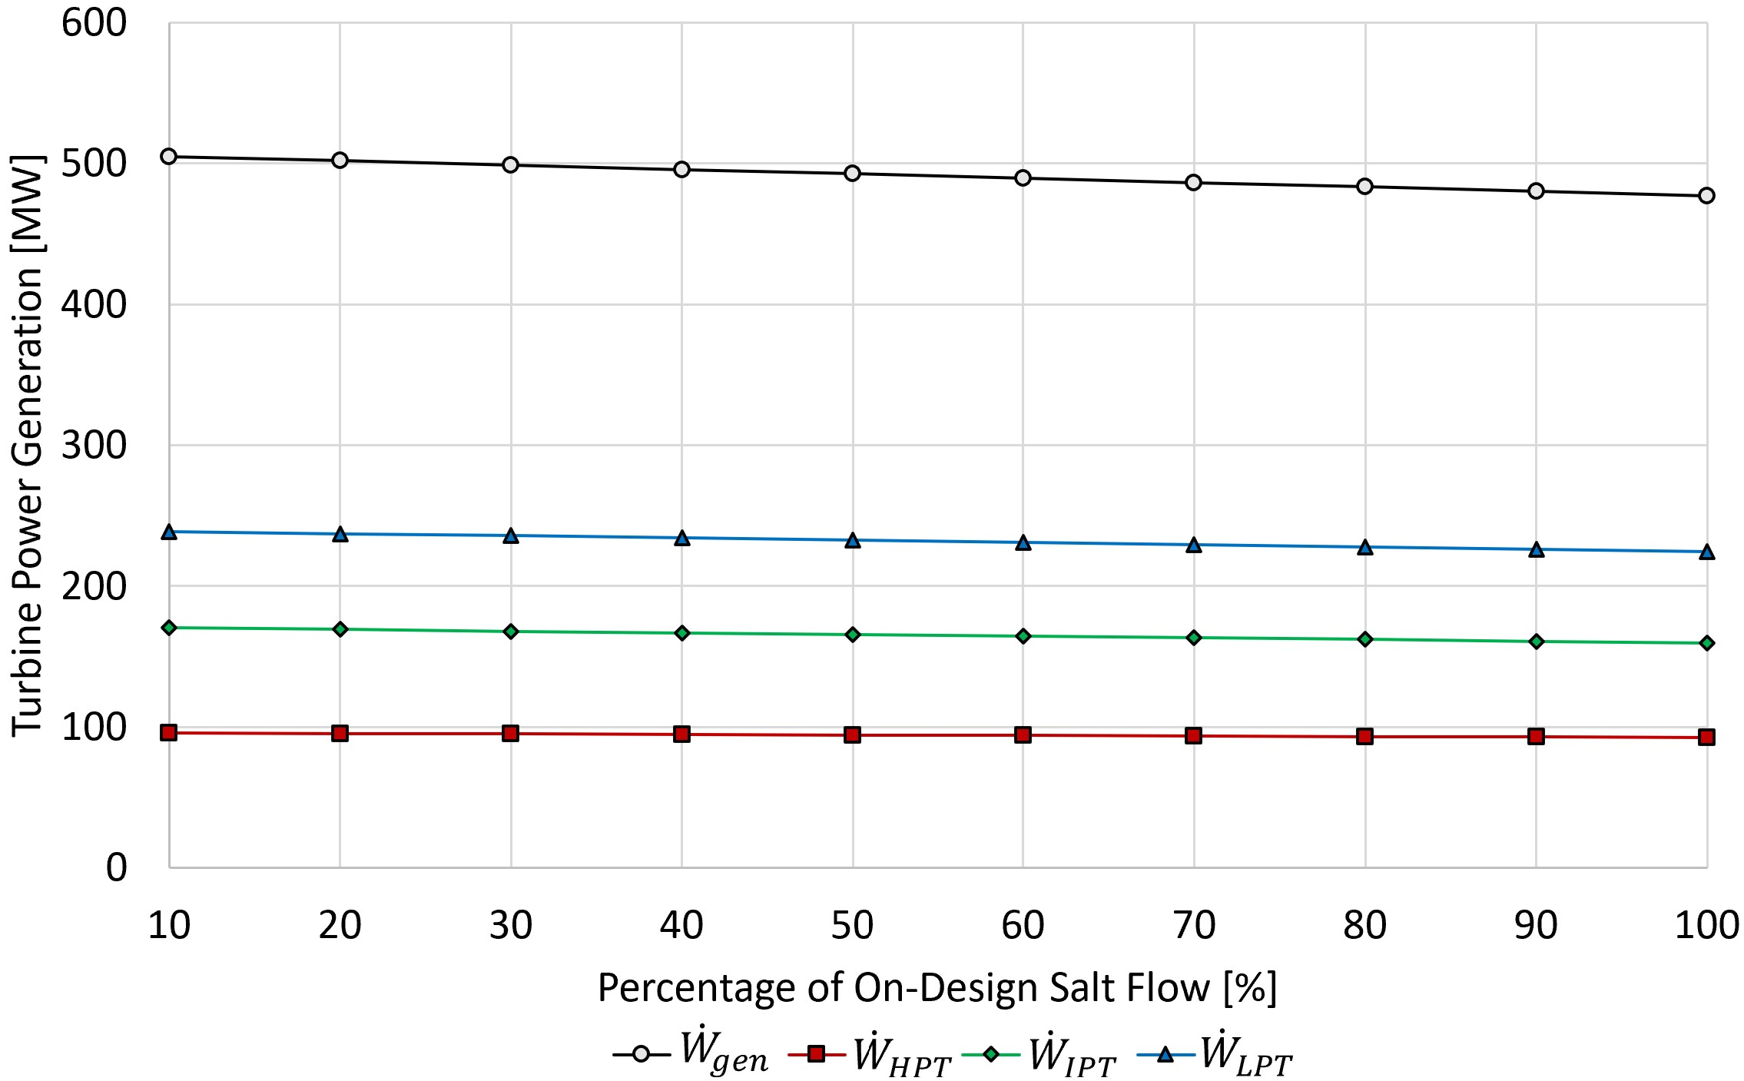
Results: Off-Design
‘Charging’ 10%-100% cases:
Generation power of HPT, LPT and IPT decrease
Increases steam mass flow from HPT exhaust, reducing available mass flow for subsequent turbines
UA values for FWHs A-F decrease by marginal amount
Small changes in mass flows through FWHs
FWH G UA value is increasing due to largest changes in mass flow for salt storage
FWH UA (left) and HPT, IPT, LPT, and total turbine generation (right) as a function of 10%-100% ‘charging’ salt mass flow percentage case studies

Slide 23
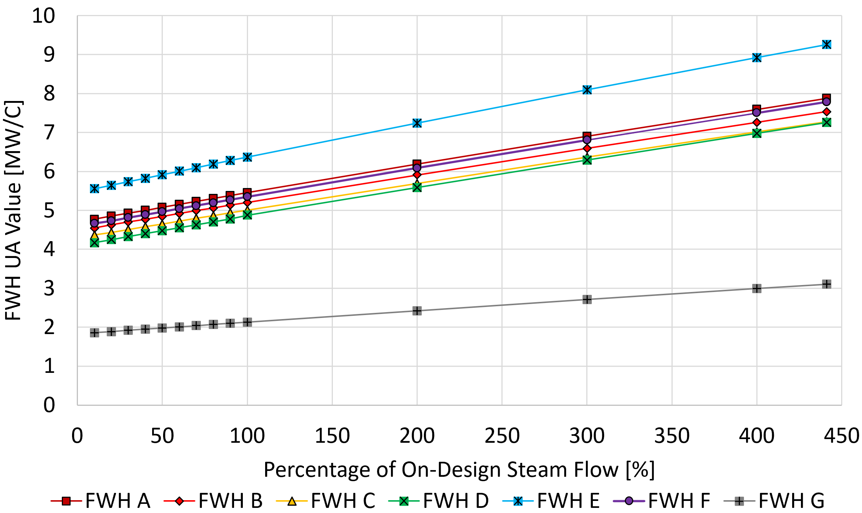
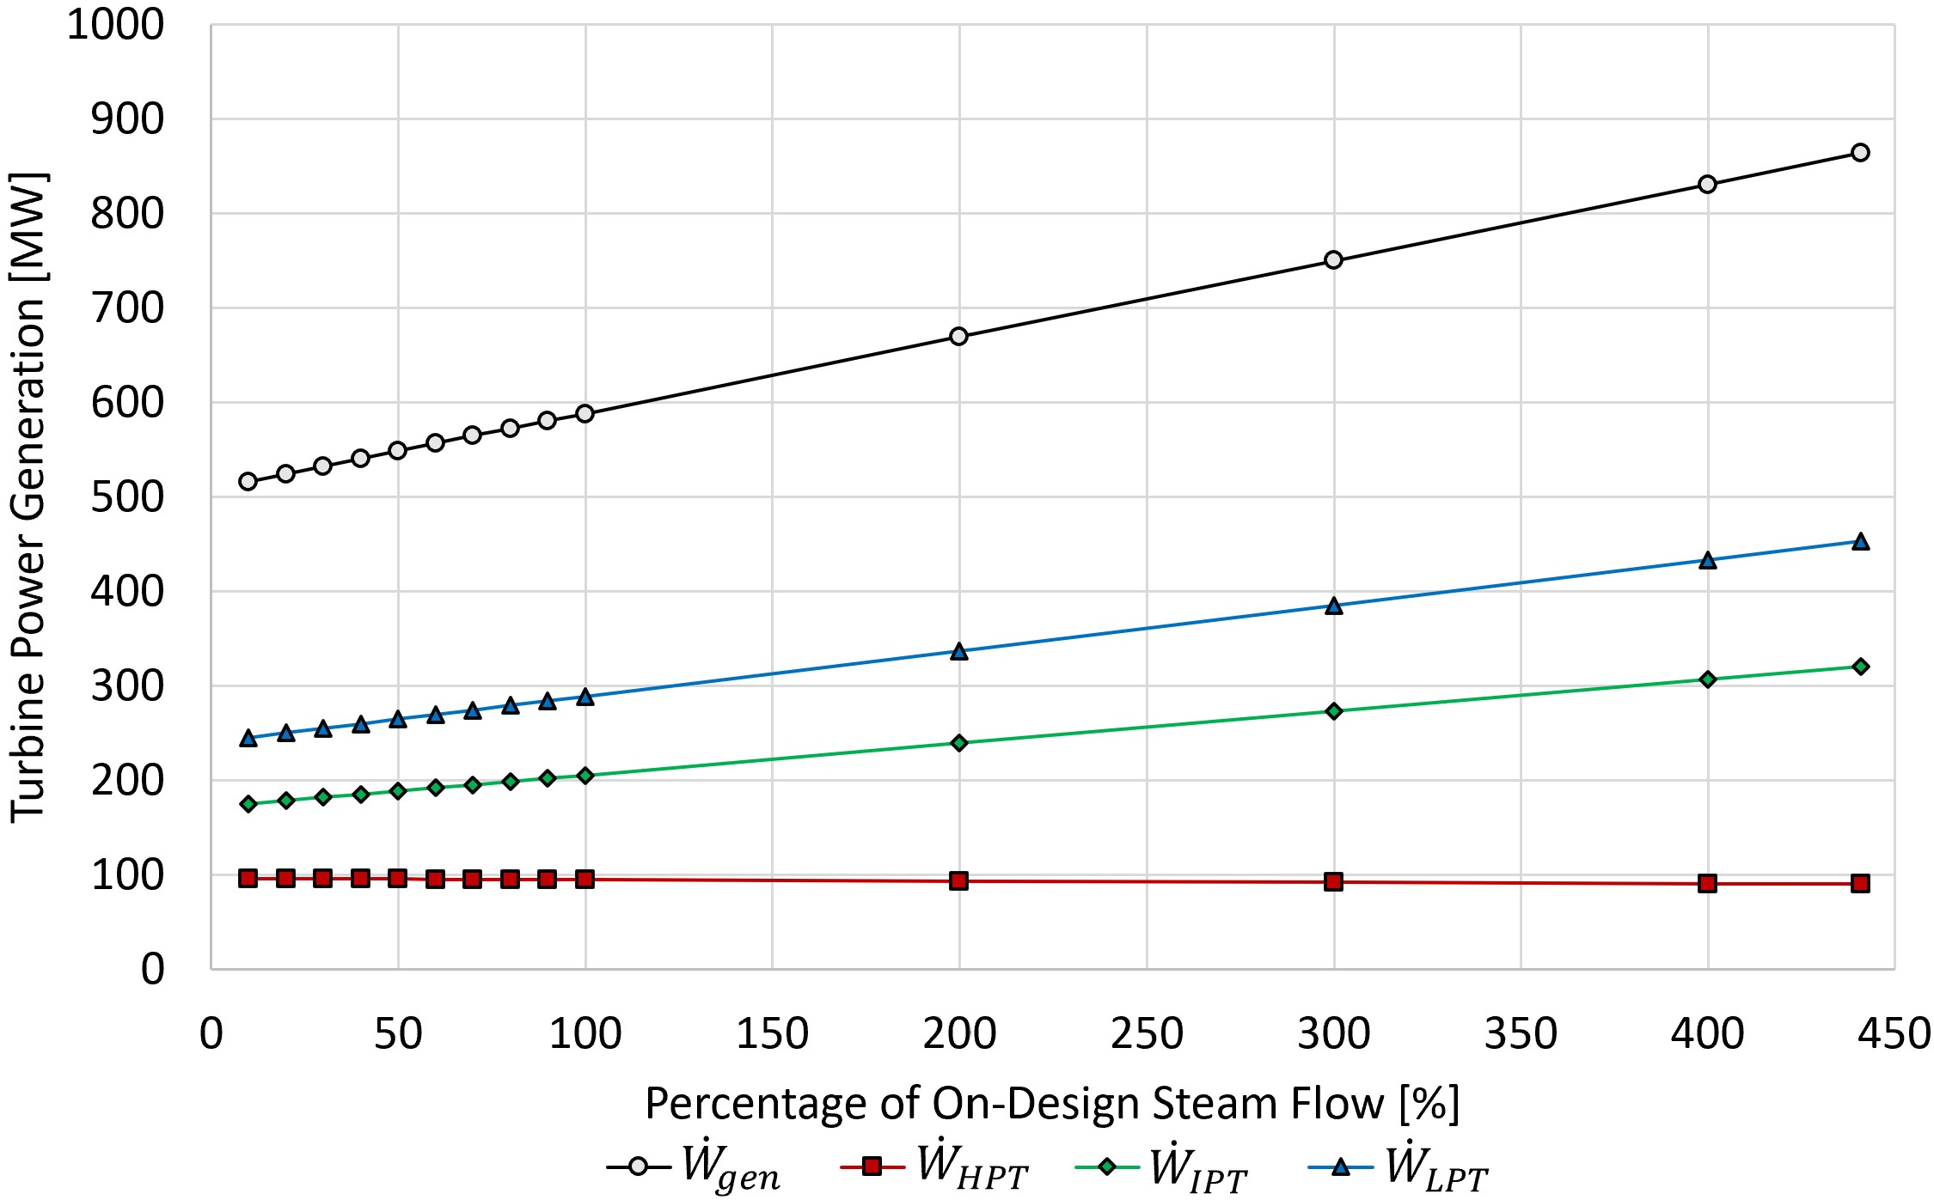
Results: Off-Design
‘Discharging’ 10%-441% cases:
FWHs increase mass flow while remaining at constant size, increasing the UA value
Additional Mass flow injected prior to IPT increasing power generation of subsequent turbines
FWH G is the lowest UA value due to turbine exhaust supercritical operation and higher capacitance ratio
UA is driven to higher values in FWHs A-F by pinch point
FWH UA (left) and HPT, IPT, LPT, and total turbine generation (right) as a function of 10%-441% ‘discharging’ additional steam mass flow percentage case studies

Slide 24
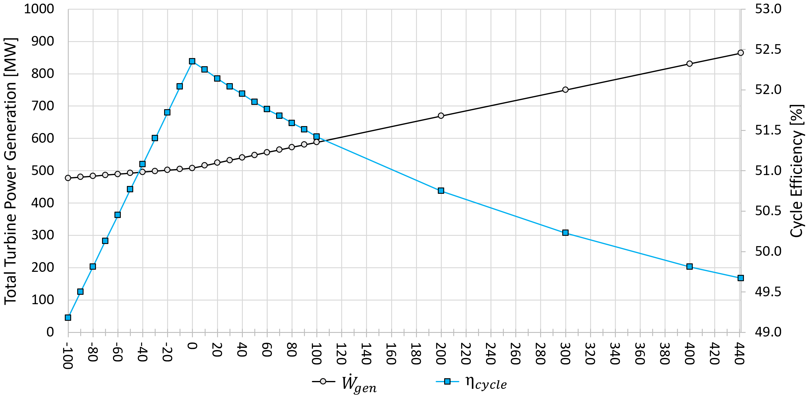
Results: Off-Design
‘off’
100%-10% ‘charging’
10%-441% ‘discharging’
*‘Discharging’ percentage case based on additional steam mass flow while ‘Charging’ percentage case done on salt mass flow rate*

Slide 25
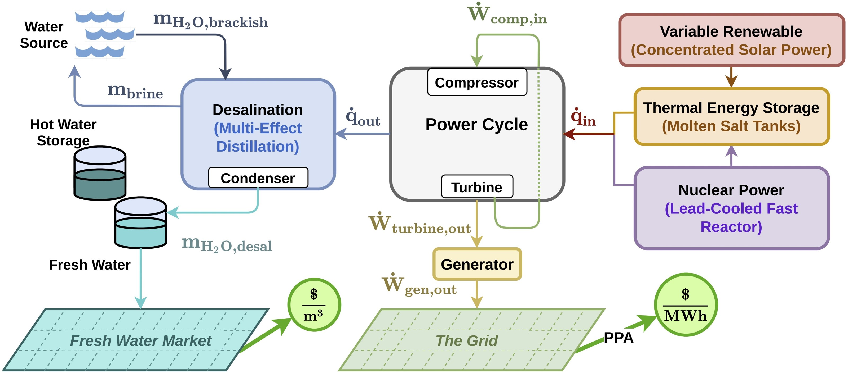
Future Research
IES graphic from: Soto, Gabriel J, Una Baker, Brian White, Ben Lindley, and Mike Wagner. 2021. Modeling a lead-cooled fast reactor with thermal energy storage using optimal dispatch and SAM. Transactions of the American Nuclear Society 125(2116).
Notes:
IES diagram from:
Soto, Gabriel J, Una Baker, Brian White, Ben Lindley, and Mike Wagner. 2021. Modeling a lead-cooled fast reactor with thermal energy storage using optimal dispatch and sam. Transactions of the American Nuclear Society 125(2116).

Slide 26
Summary
Coupling the CSP and LFR into SSRC allows for the LFR to maintain full capacity operation load-following via the CSP thermal energy storage:
‘Charging’ – salt storage rate up to 190 kg/s
Reduces power generation by 30.9 MW
‘Discharging’ – additional steam mass flow of 100 kg/s
Increases power generation by 79.8 MW
Off-design and above-design cases display SSRC flexibility to grid demand with associated efficiency impacts
10%-100% ‘charging’ – incremental decreases in power from 508 - 477.1 MW
10%-100% ‘discharging’ – incremental increases in power from 508 – 587.8 MW
100%-441% ‘discharging’ above-design – increase in power from 587.8 – 863.8 MW

Slide 27
Questions?

Slide 28
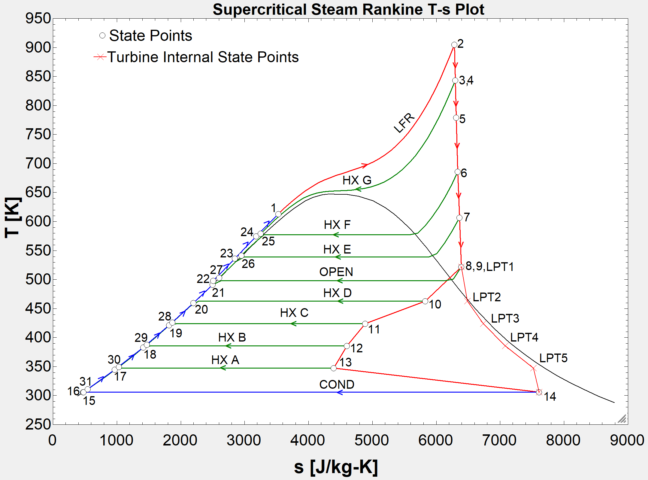
Extra Slides
‘Off’ mode of operation T-s diagram showing moisture separation in turbines

Slide 29
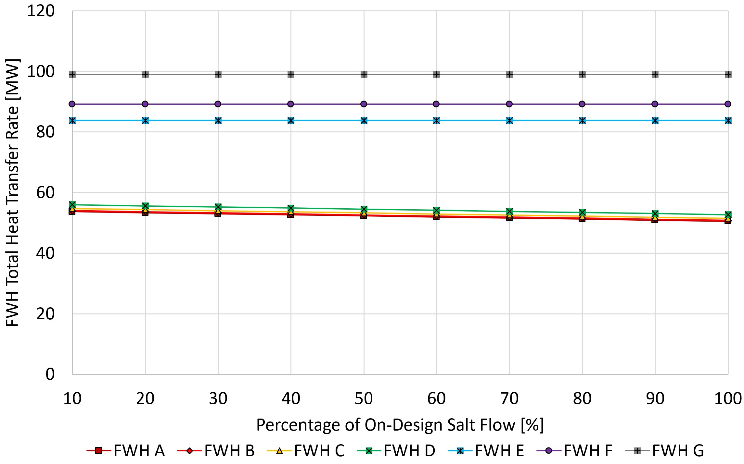
Extra Slides
‘Charging’ 10% - 100% FWH heat transfer rates

Slide 30
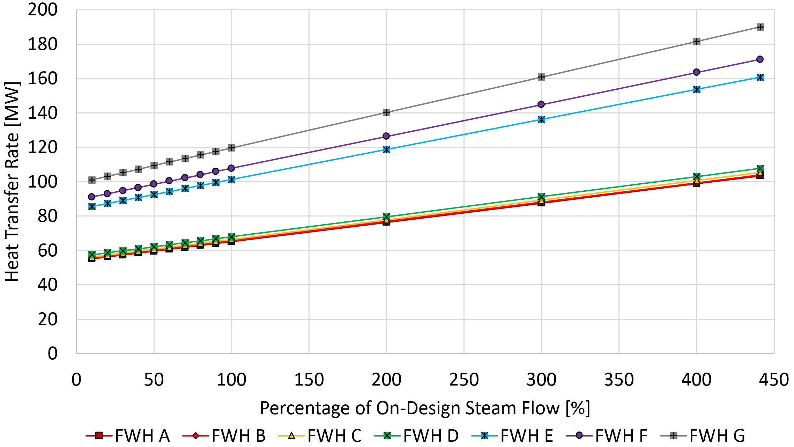
Extra Slides
‘Discharging’ 10% - 441% FWH heat transfer rates

Slide 31
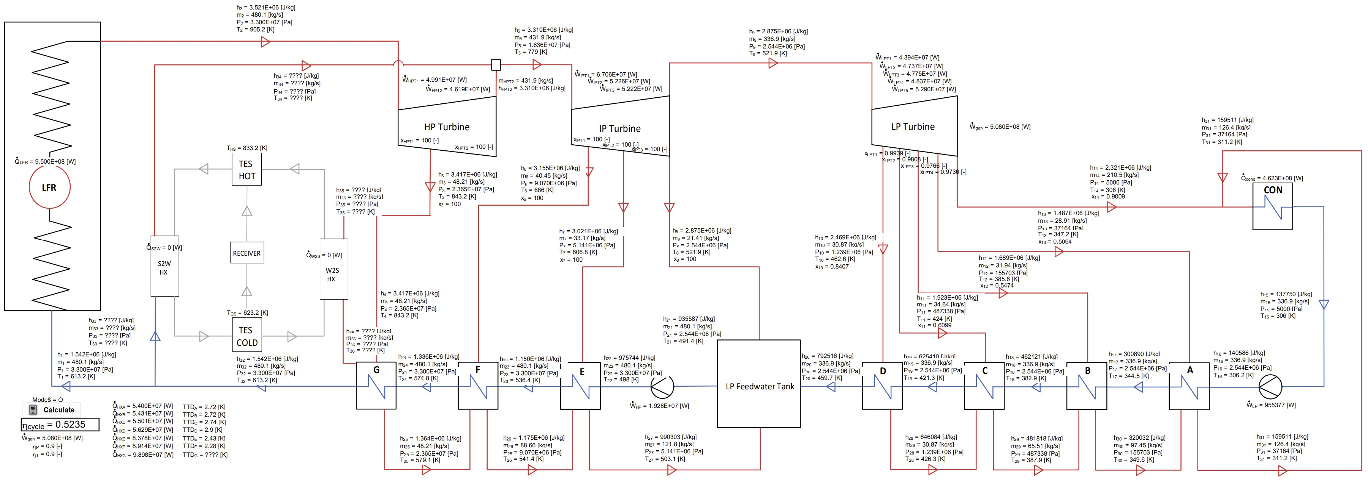
Extra Slides
‘Off’ mode of operation diagram

Slide 32
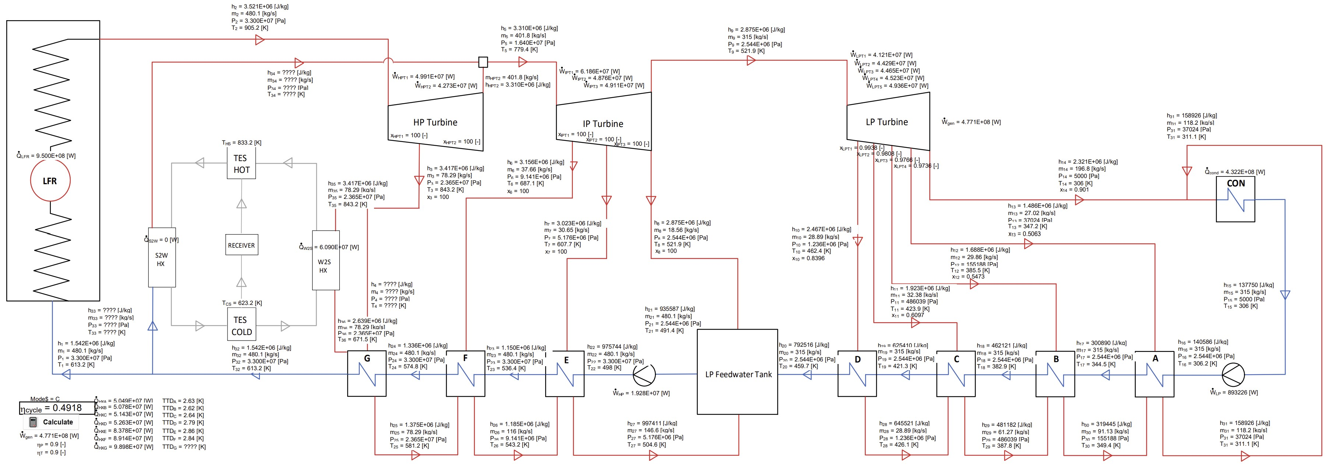
Extra Slides
100% ‘charging’ mode of operation SSRC diagram

Slide 33
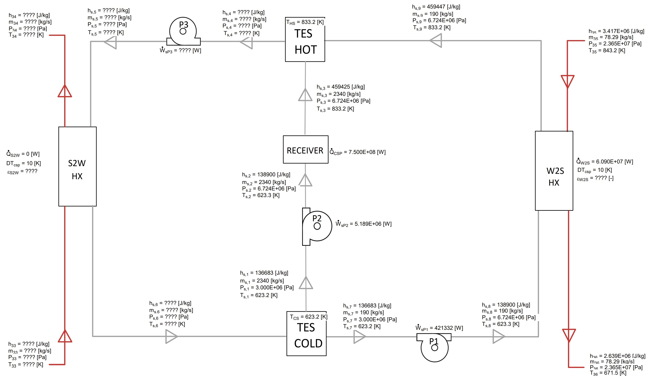
Extra Slides
100% ‘charging’ mode of operation CSP diagram

Slide 34
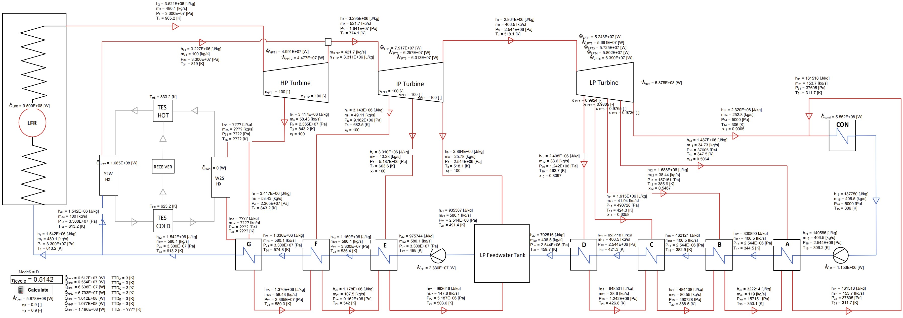
Extra Slides
100% ‘discharging’ mode of operation SSRC diagram

Slide 35
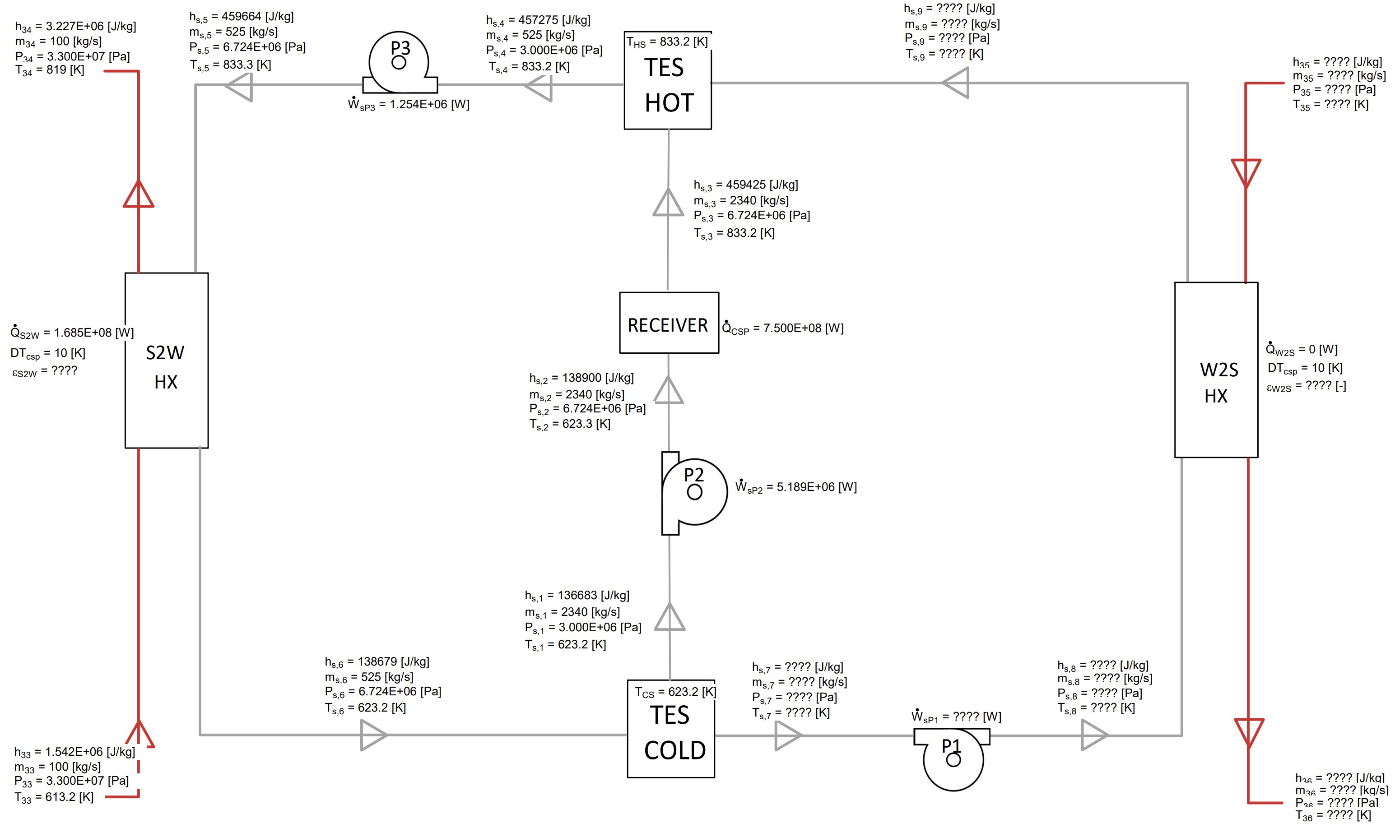
Extra Slides
100% ‘discharging’ mode of operation CSP

