Slide 1
Mechanical Engineering M.S. Advisor: Mike Wagner November 30th, 2021
University of Wisconsin – Madison
Mechanical Engineering
sCO₂ Cycle Modeling for Integrated Nuclear and CSP
Brian White

Slide 2
Hometown: Green Lake, Wisconsin Undergrad Degree: UW-Madison Mechanical Engineering Activities: Fishing, Traveling, Cooking, Downhill Skiing.
Personal Background
Notes:
Wisconsin Image From: https://geology.com/state-map/wisconsin.shtml

Slide 3
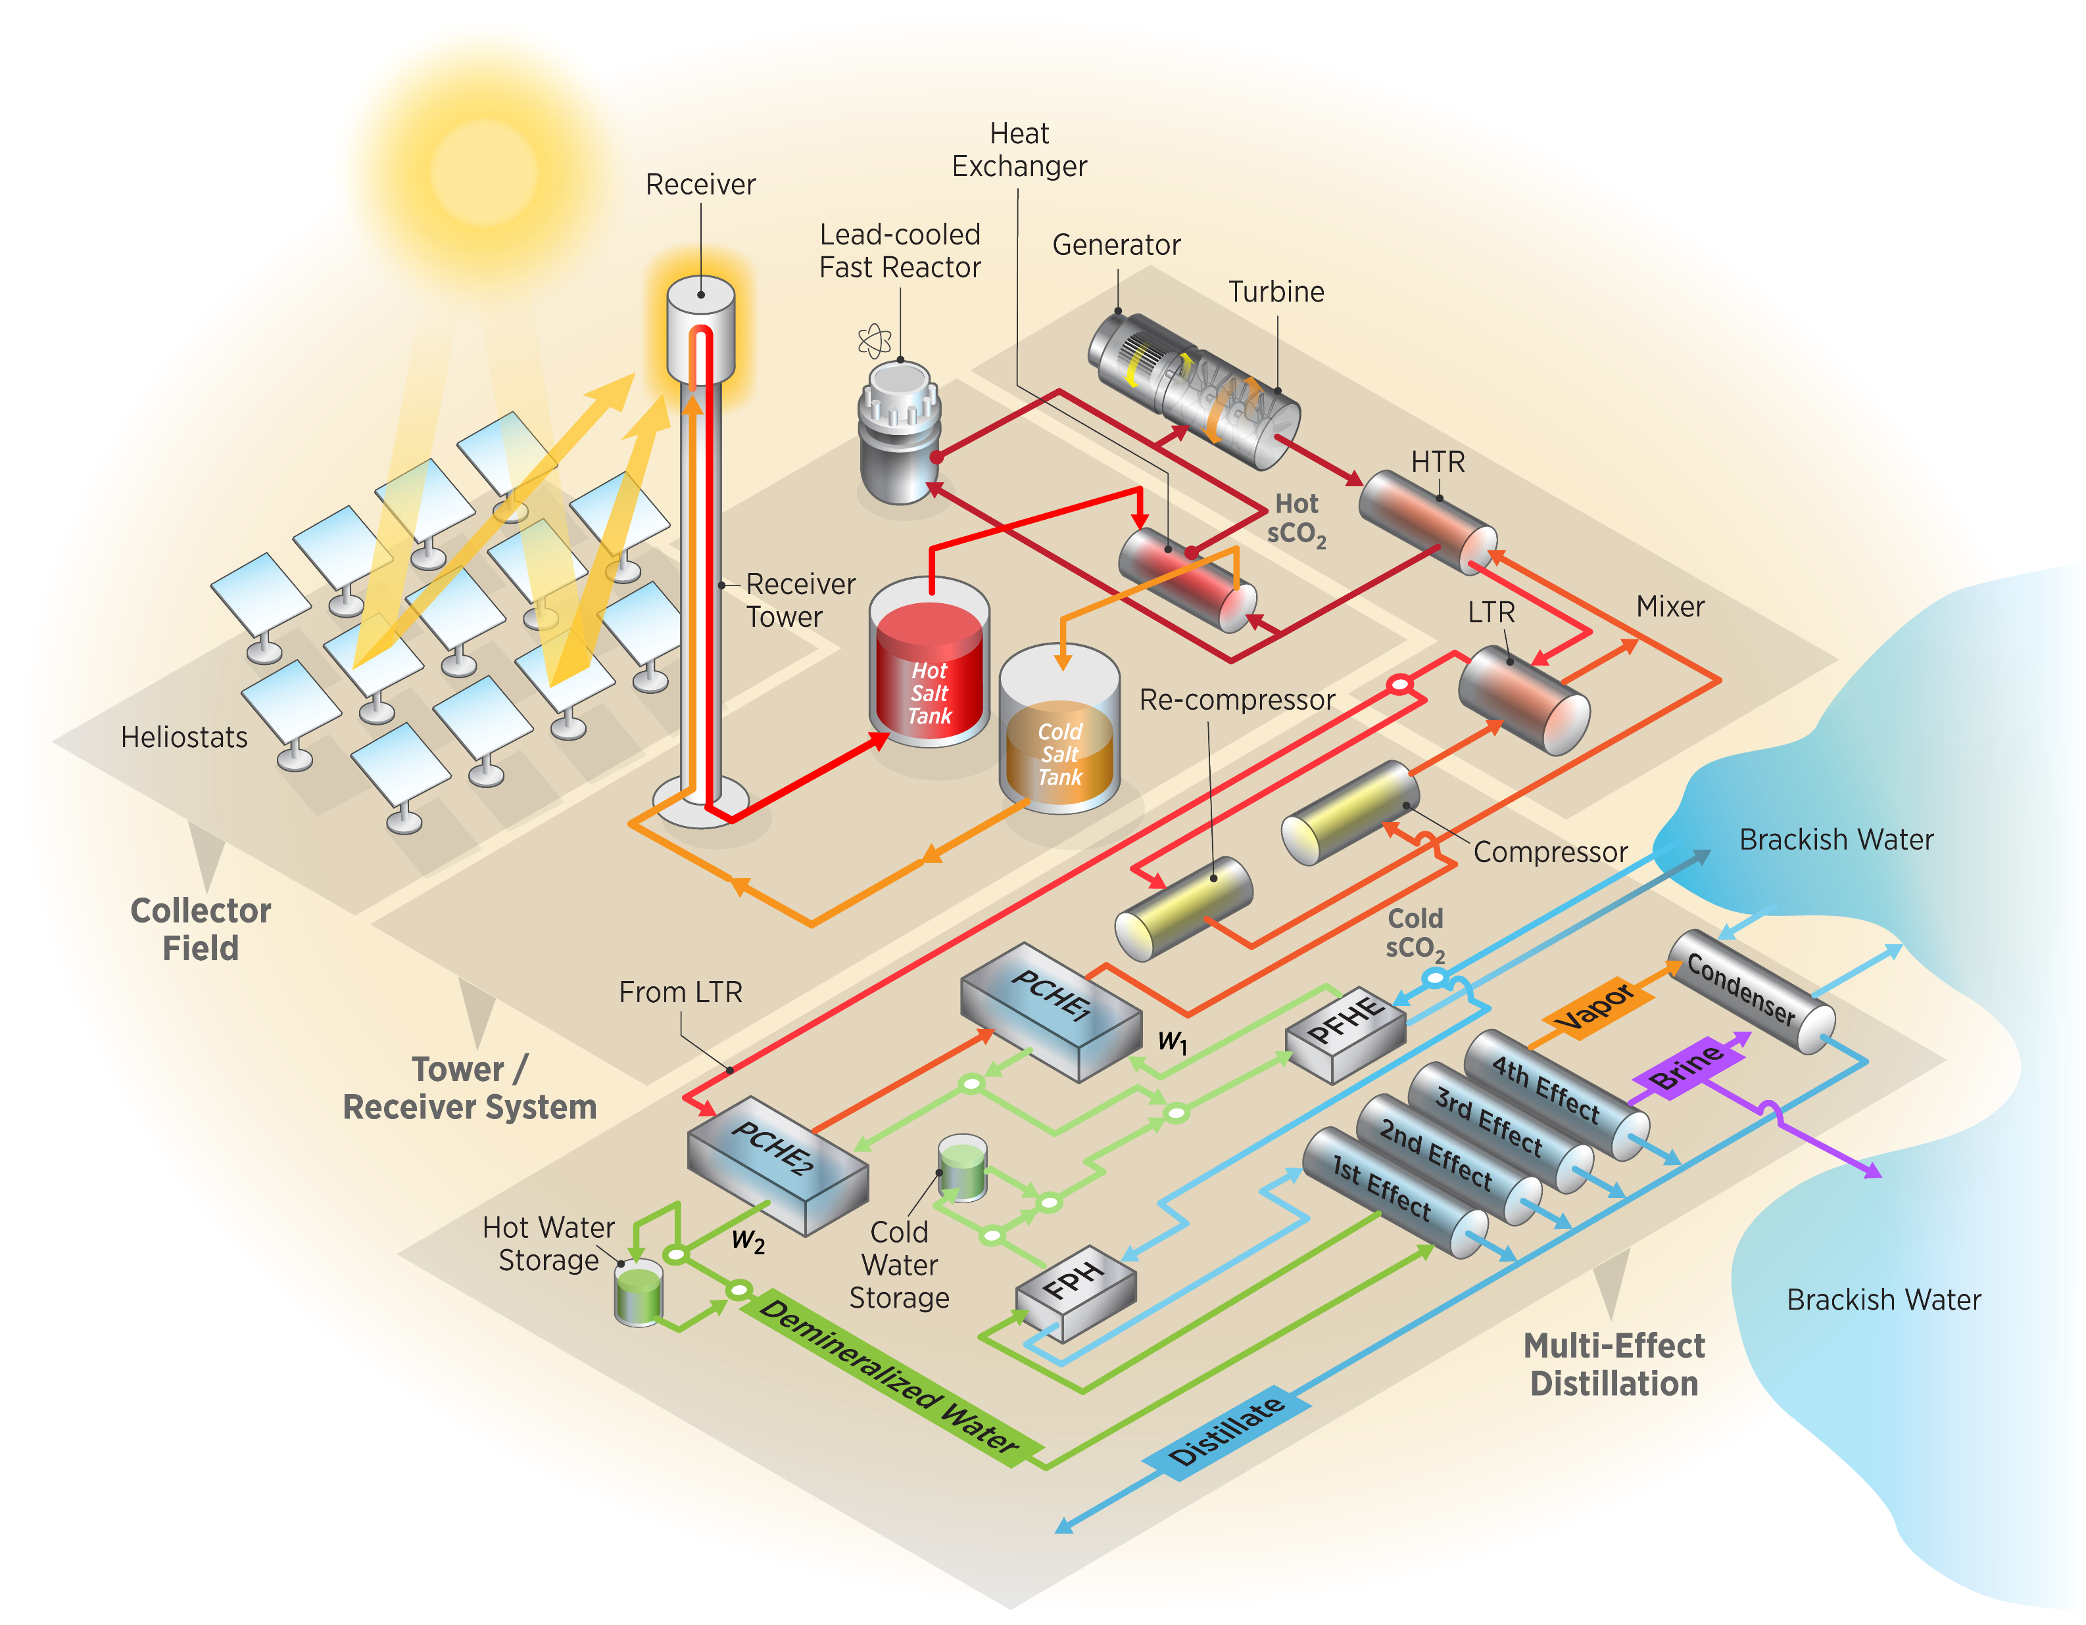
Background – Integrated Technology
Combines technologies in a logical sense:
Using waste heat in another process
Coupling power cycles to offset drawbacks of each
Integrating Concentrating Solar Power and Lead-Cooled Fast Reactor:
Increases dispatchability
Reduces weather and time effects of solar power
Allows for the reactor to store energy in thermal energy storage instead of ramping down power
Concentrating
Solar Power
Multi-effect
Distillation
Notes:
Integrated Technology Image From: https://www.osti.gov/servlets/purl/1502344

Slide 4
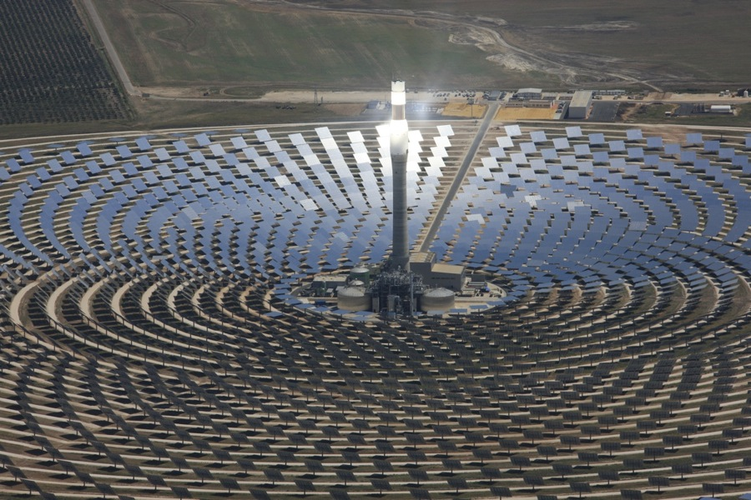
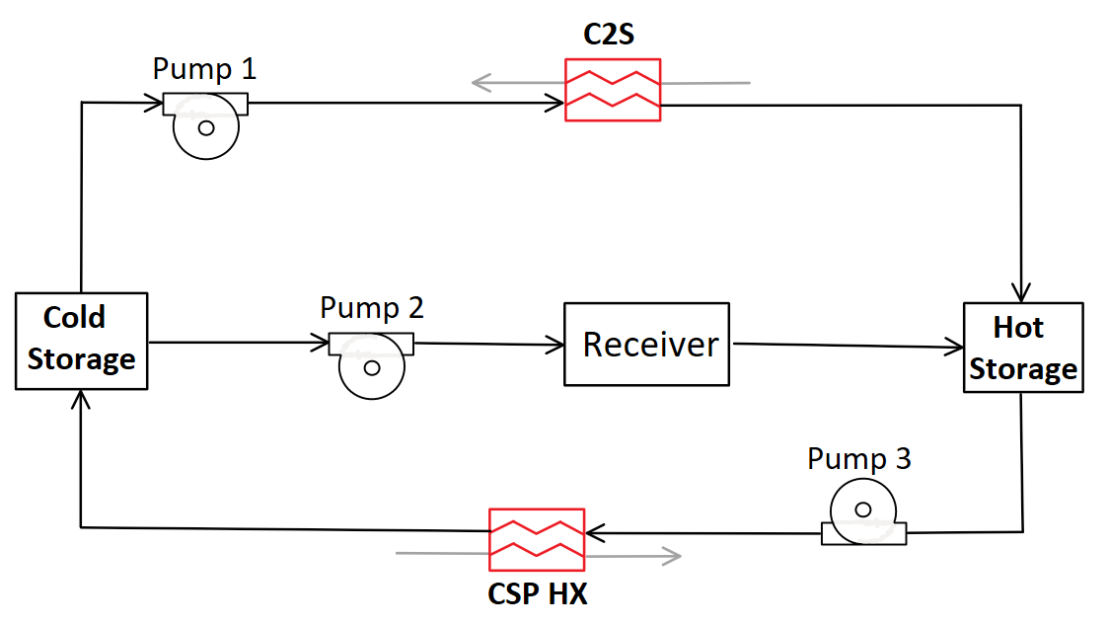
Background – Concentrating Solar Power
Heat Transfer Fluid:
60% Sodium Nitrate (NaNO₃) and 40% Potassium Nitrate (KNO₃)
Thermal Energy Storage:
Hot storage at 560 ºC
Cold Storage at 390 ºC, 410 ºC, and 440 ºC
Varies according to cycle configurations
C2S counter flow heat exchanger capable of transferring heat from supercritical carbon dioxide cycle to be stored in hot storage
Receiver power is 750 MW
Dependent on time of day and weather conditions
Notes:
CSP photo from https://arena.gov.au/blog/what-is-concentrated-solar-thermal/
Solar Salt:
260 -> freeze
600 -> boil

Slide 5
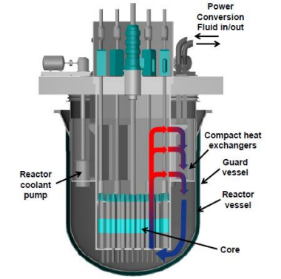
Background – Lead-Cooled Fast Reactor
Fission chain reaction sustained by fast neutrons
(~1MeV)
Heat Transfer Fluid:
Liquid lead is primary coolant
Operating Temperatures:
sCO₂ Hot Inlet is 595 ºC
sCO₂ Cold Inlet is 400 ºC
Power Input is 950 MW
Values provided by Westinghouse Electric Company
Notes:
LFR photo from https://www.westinghousenuclear.com/Portals/0/new%20plants/LFR/ECOE-0002_LeadFastReactor.pdf

Slide 6
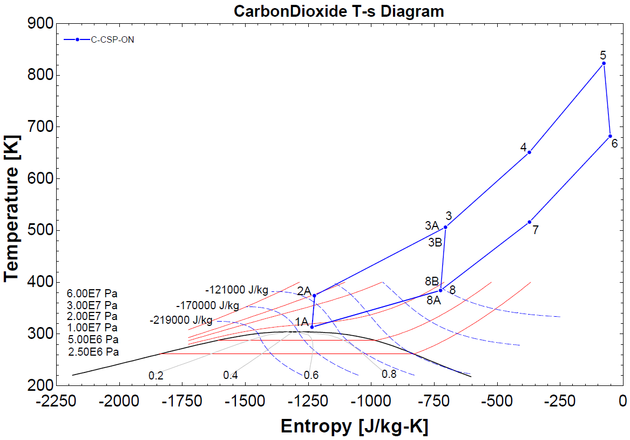
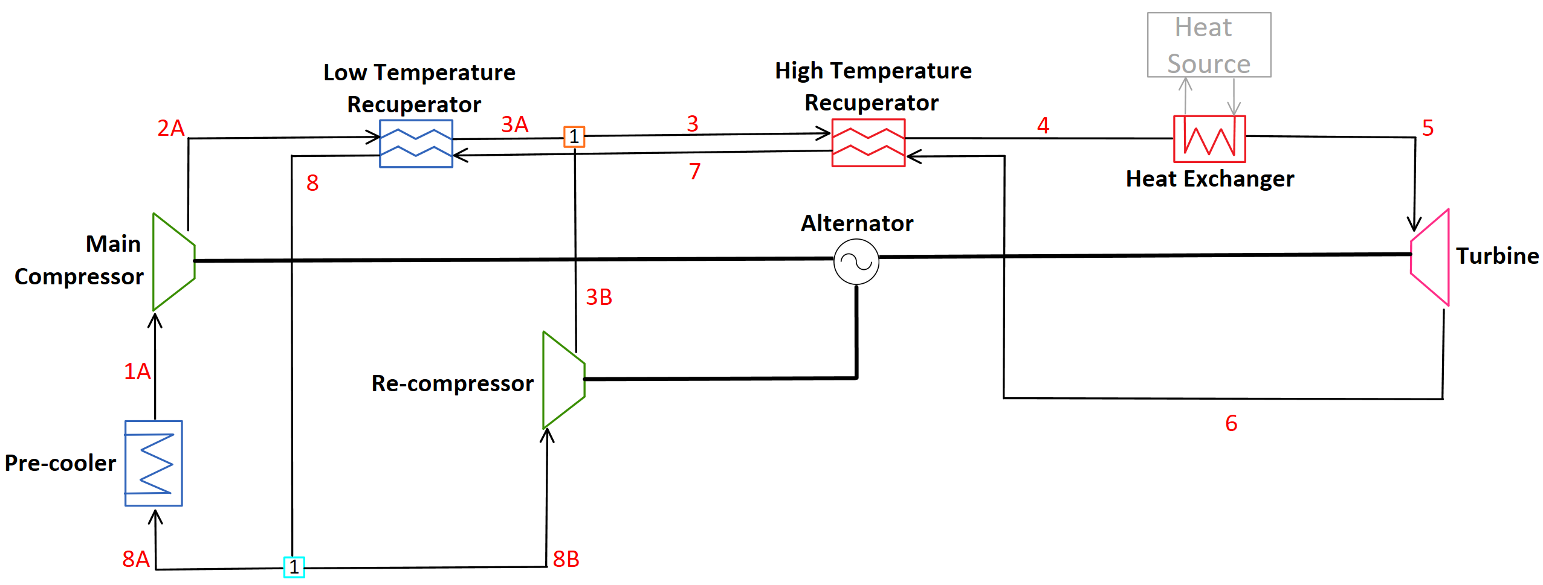
Background – Recompression Cycle
Brayton recompression cycle with no reheat
Offers high efficiencies with sCO₂ working fluid
Up to 50% efficient with turbine inlet of 873.2-973.2 K
Goal is to decrease the pinch point effect that occurs with a single recuperator
Competitive when compared to Rankine and air Brayton cycles
Brayton cycles discussed are based on this recompression cycle
Notes:
Evidence for Recompression Cycle Efficiency Advantages:
Turchi, C.S.; Ma, Z.; Neises, T.W.; Wagner, M.J. Thermodynamic study of advanced supercritical carbon dioxide power cycles for
concentrating solar power systems. J. Sol. Energy Eng. 2013, 135, 041007 .
Wang, K.; Li, M.J.; Guo, J.Q.; Li, P.; Liu, Z.B. A systematic comparison of different S-CO2 Brayton cycle layouts
based on multi-objective optimization for applications in solar power tower plants. Appl. Energy 2018, 212, 109–121.
https://doi.org/10.1016/j.apenergy.2017.12.031.
Ahn, Y.H.; Bae, S.J.; Kim, M.S.; Cho, S.K.; Baik, S.J.; Lee, J.I.; Cha, J.E. Cycle layout studies of S-CO2 cycle for the next generation
nuclear system application. In Proceedings of the The Korean Nuclear Society Autumn Meeting, Pyongchang, Korea, 29–31
October 2014.

Slide 7
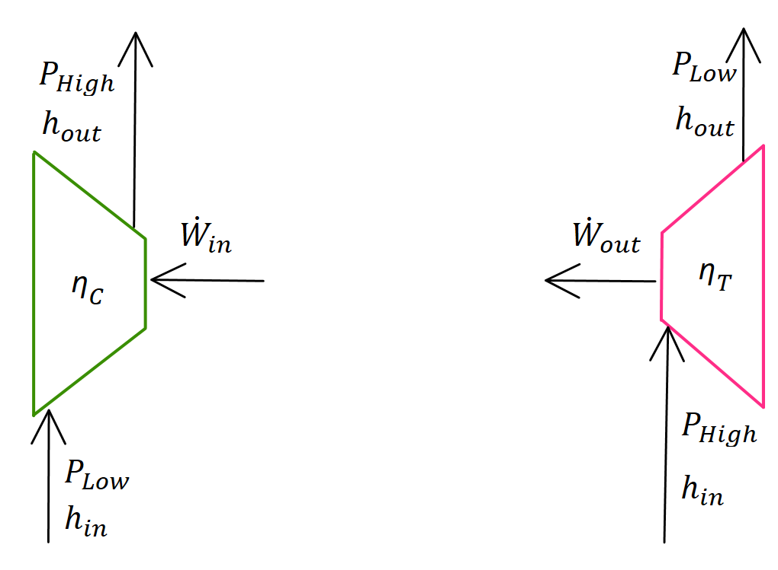
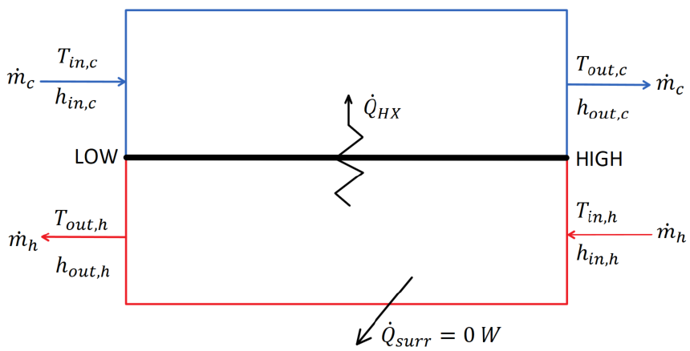
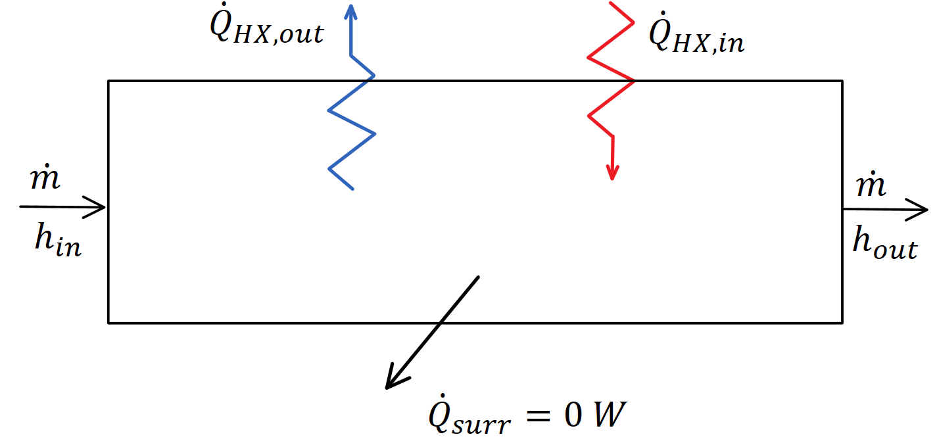
Modeling System Components
Compressor Turbine
Compressor and Turbines
Modeled using constant isentropic efficiencies
Single inlet and outlet streams at steady state
No parasitic heat loss
Counter-Flow Heat Exchangers
Low-Temperature Recuperator, High-Temperature Recuperator, CSP Heat Exchanger, and C2S Heat Exchanger
Assume no phase change, internal pinch point, constant capacitance rate and negligible pressure drop
Black Box Heat Exchangers
CSP Receiver, Pre-cooler, and LFR
Simple energy balance for heat input or output of cycle
State points on inlet and outlet are clearly defined by design parameters
Counter Flow Heat Exchanger
Black Box Heat Exchanger

Slide 8
Goals and Methodology
Goals:
Combine Lead-cooled fast reactor and concentrating solar power into complementary cycle configurations
Compare efficiency, cost, and characteristics of sCO₂ Brayton recompression cycles
Methodology:
Model cycle configurations for different operating modes:
Non-Charging: focus on electrical generation when grid demand increases
Charging: focus on storing heat when grid demand or prices are low
All cycles modeled in Engineering Equation Solver (EES)
Vary design points of cycle components to accommodate pairing of non-charging and charging modes
Defined metrics using parametric studies to compare cycle configurations and operating modes

Slide 9
Modeled Cycle Configurations
All modeled cycles are recompression sCO₂ Brayton cycles
Cycle Label | Description
Non-Charging
C-LFR-ON | Two-cycle configuration with LFR as heat source
C-CSP-ON | Two-cycle configuration with CSP as heat source
C-1HTR1T-ON | CSP and LFR heat sources in parallel with one turbine
C-2HTR3T-ON | CSP and LFR loops each with dedicated HTR and turbine
Charging
C-LFR-PRE | Turbine is prior to the C2S
C-LFR-POST | Turbine is after the C2S
C-LFR-PAR | Turbine is parallel to the C2S
C-LFR-CIRC | Circulator bridges the LFR and C2S

Slide 10
Standardizing System Components
Parameter | Design Point Value
Efficiencies
Main Compressor | 0.91 [-]
Re-Compressor | 0.89 [-]
Turbine | 0.90 [-]
Pumps 1-3 | 0.90 [-]
Approach Temperatures
LTR | 10 [ºC]
HTR | 10 [ºC]
CSP Heat Exchanger | 10 [ºC]
Pressures
Pressure Ratio | 3.27 [-]
High Side Pressure | 28.8 [MPa]
Heat into System
LFR Heat Transfer | 950 [MW]
CSP Heat Transfer | 750 [MW]
Temperature
Main Compressor Inlet | 40 [ºC]
LFR sCO₂ Outlet Temperature | 595 [ºC]
Draw more direct comparison between cycle configurations
Values are representative of concentrating solar power and lead-cooled fast reactor properties
All cycles have identical positioning of components on recompression side:
Pre-cooler
Low-Temperature Recuperator
High-Temperature Recuperator
Main Compressor
Re-compressor

Slide 11
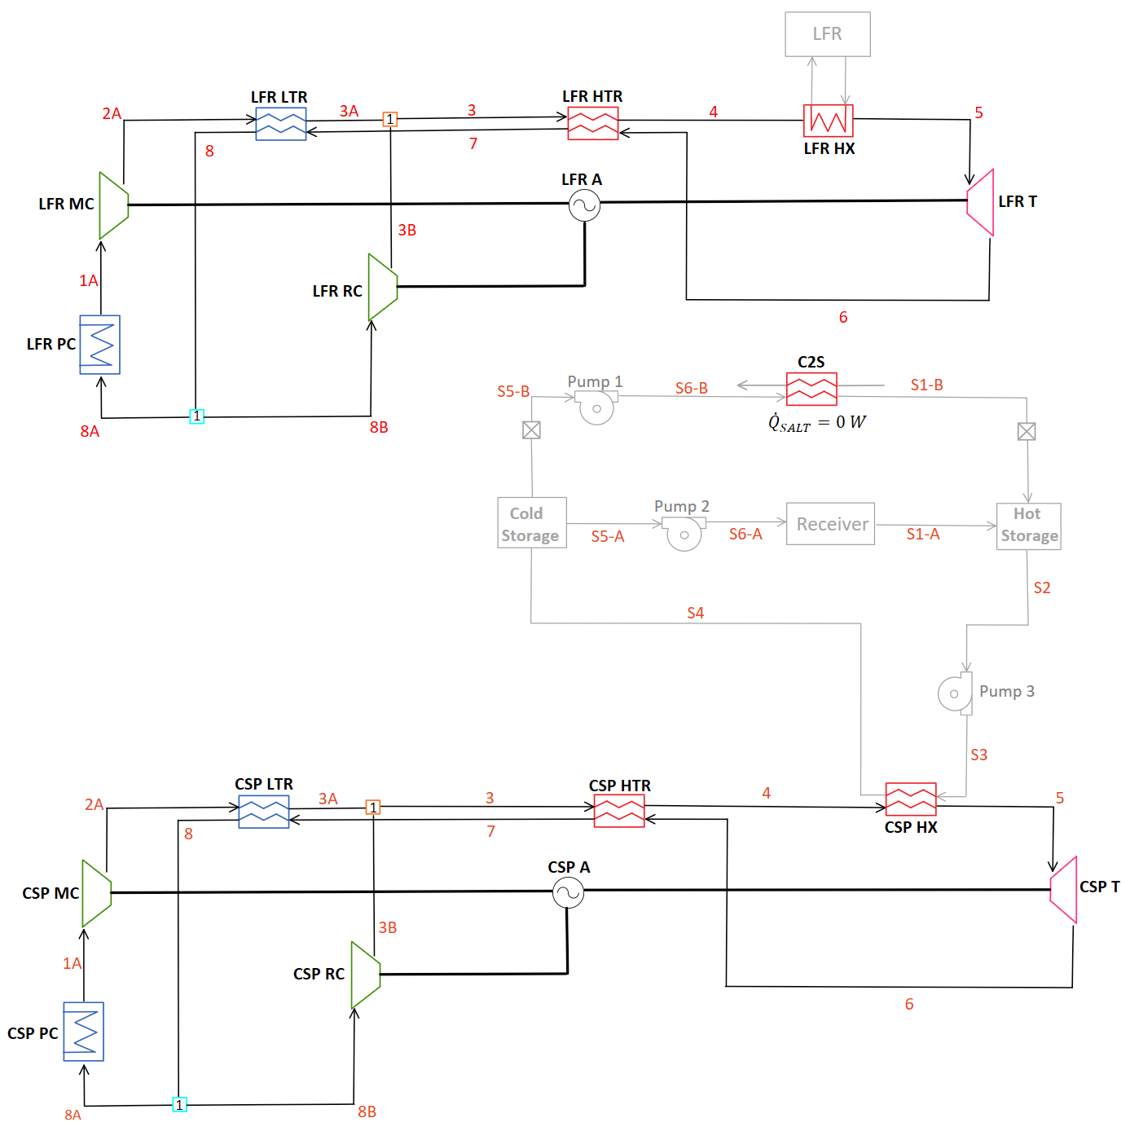
Two Cycle Configuration
Composed of two separate operating cycles:
C-LFR-ON and C-CSP-ON
Bridged by the CSP when operating in ‘charging’ and disconnected when in ‘non-charging’ mode
Allows for cycles to not have codependent operating conditions.
Double the components, increased complexity and cost.
Acronyms | Definition | Acronyms | Definition
LFR | Lead-cooled Fast Reactor | MC | Main Compressor
CSP | Concentrating Solar Power | RC | Re-compressor
TES | Thermal Energy Storage | HTR | High Temperature Recuperator
sCO₂ | Super Critical Carbon Dioxide | LTR | Low Temperature Recuperator
PC | Pre-cooler | A | Alternator
T | Turbine

Slide 12
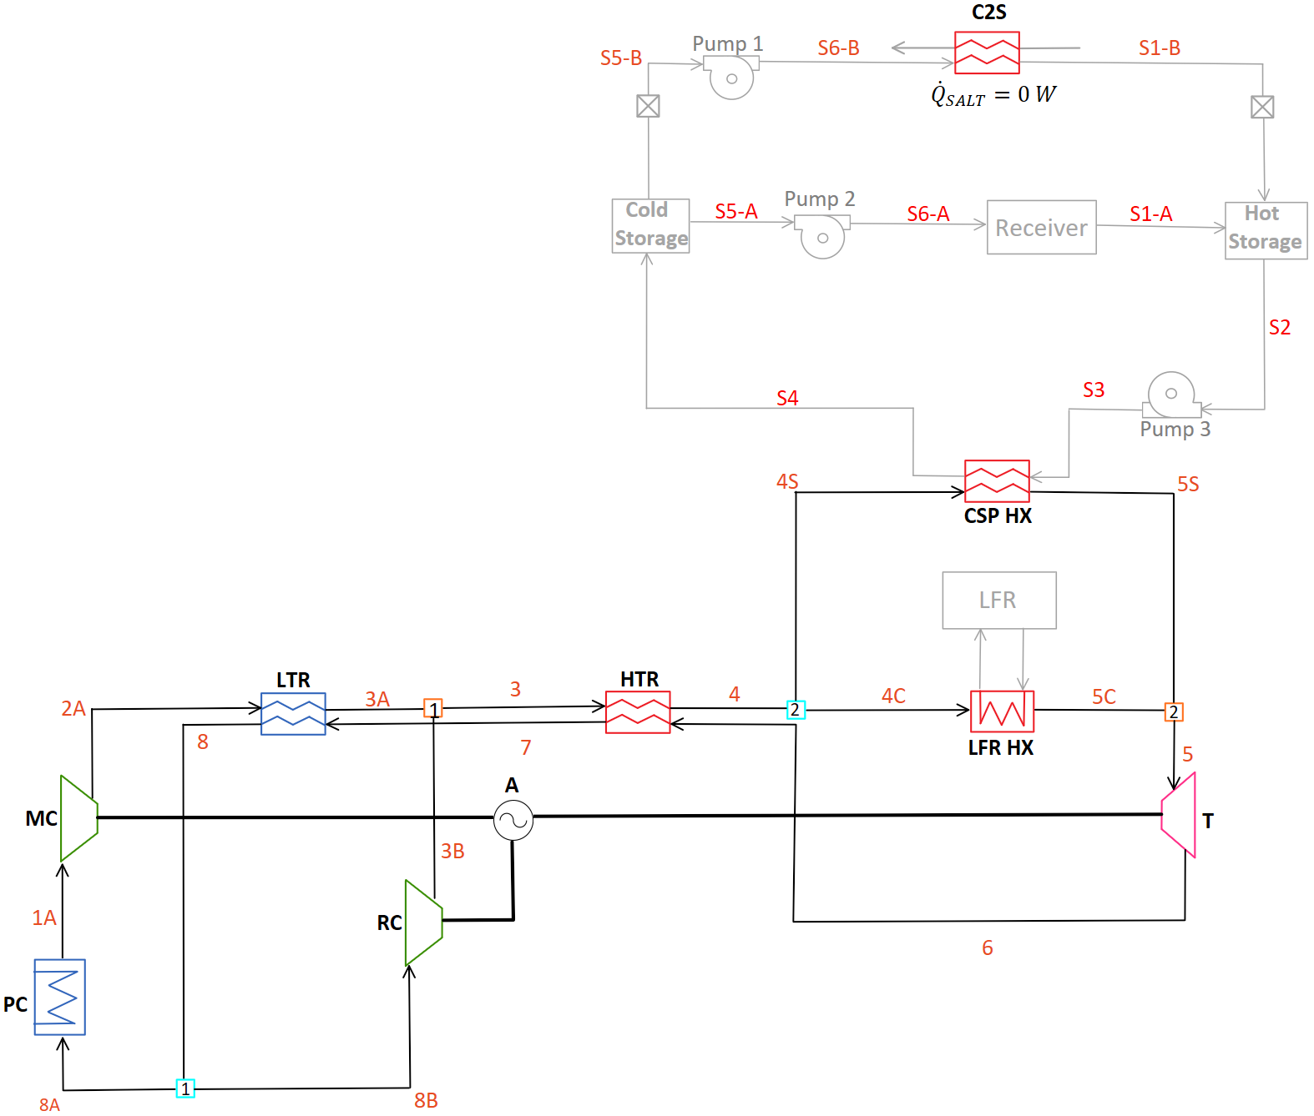
C-1HTR1T-ON
Heat from LFR and CSP are in parallel
Creates dependency on inlet temperatures of CSP and LFR
LFR inlet temperature effects temperature of CSP cold storage
Reduces number of components required
Acronyms | Definition
LFR | Lead-cooled Fast Reactor
CSP | Concentrating Solar Power
TES | Thermal Energy Storage
sCO₂ | Super Critical Carbon Dioxide
PC | Pre-cooler
T | Turbine
MC | Main Compressor
RC | Re-compressor
HTR | High Temperature Recuperator
LTR | Low Temperature Recuperator
A | Alternator

Slide 13
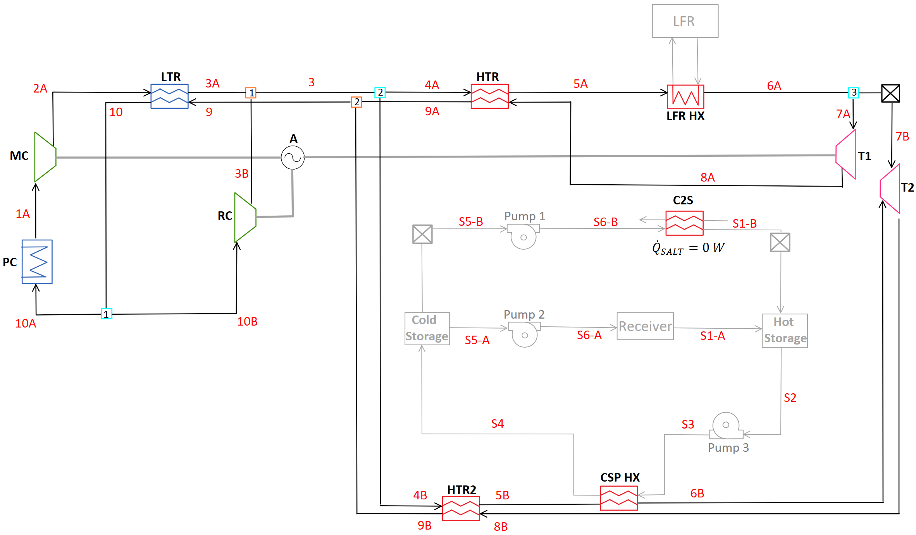
C-2HTR3T-ON
Dedicated HTR and turbines for both LFR and CSP
Tests effect of mixing dissimilar temperature flow downstream of turbines
Acronyms | Definition
LFR | Lead-cooled Fast Reactor
CSP | Concentrating Solar Power
TES | Thermal Energy Storage
sCO₂ | Super Critical Carbon Dioxide
PC | Pre-cooler
T | Turbine
MC | Main Compressor
RC | Re-compressor
HTR | High Temperature Recuperator
LTR | Low Temperature Recuperator
A | Alternator

Slide 14
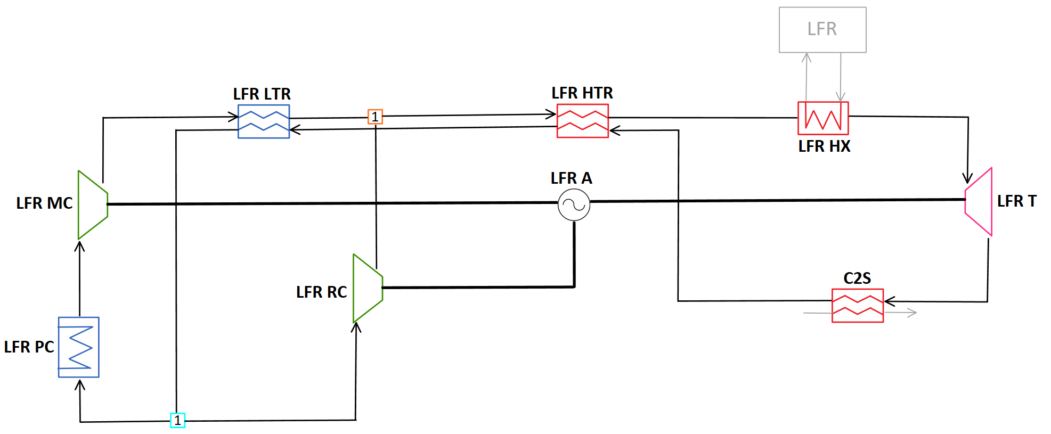
Charging
Four Considered Configurations:
C-LFR-PRE
C-LFR-PAR
C-LFR-CIRC
C-LFR-POST (Not Viable)
Acronyms | Definition | Acronyms | Definition
LFR | Lead-cooled Fast Reactor | MC | Main Compressor
CSP | Concentrating Solar Power | RC | Re-compressor
TES | Thermal Energy Storage | HTR | High Temperature Recuperator
sCO₂ | Super Critical Carbon Dioxide | LTR | Low Temperature Recuperator
PC | Pre-cooler | A | Alternator
T | Turbine

Slide 15
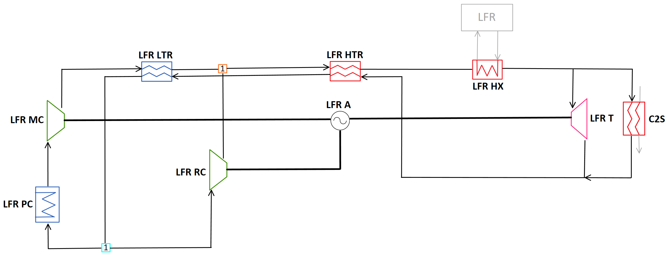
Charging
Four Considered Configurations:
C-LFR-PRE
C-LFR-PAR
C-LFR-CIRC
C-LFR-POST (Not Viable)
Acronyms | Definition | Acronyms | Definition
LFR | Lead-cooled Fast Reactor | MC | Main Compressor
CSP | Concentrating Solar Power | RC | Re-compressor
TES | Thermal Energy Storage | HTR | High Temperature Recuperator
sCO₂ | Super Critical Carbon Dioxide | LTR | Low Temperature Recuperator
PC | Pre-cooler | A | Alternator
T | Turbine

Slide 16
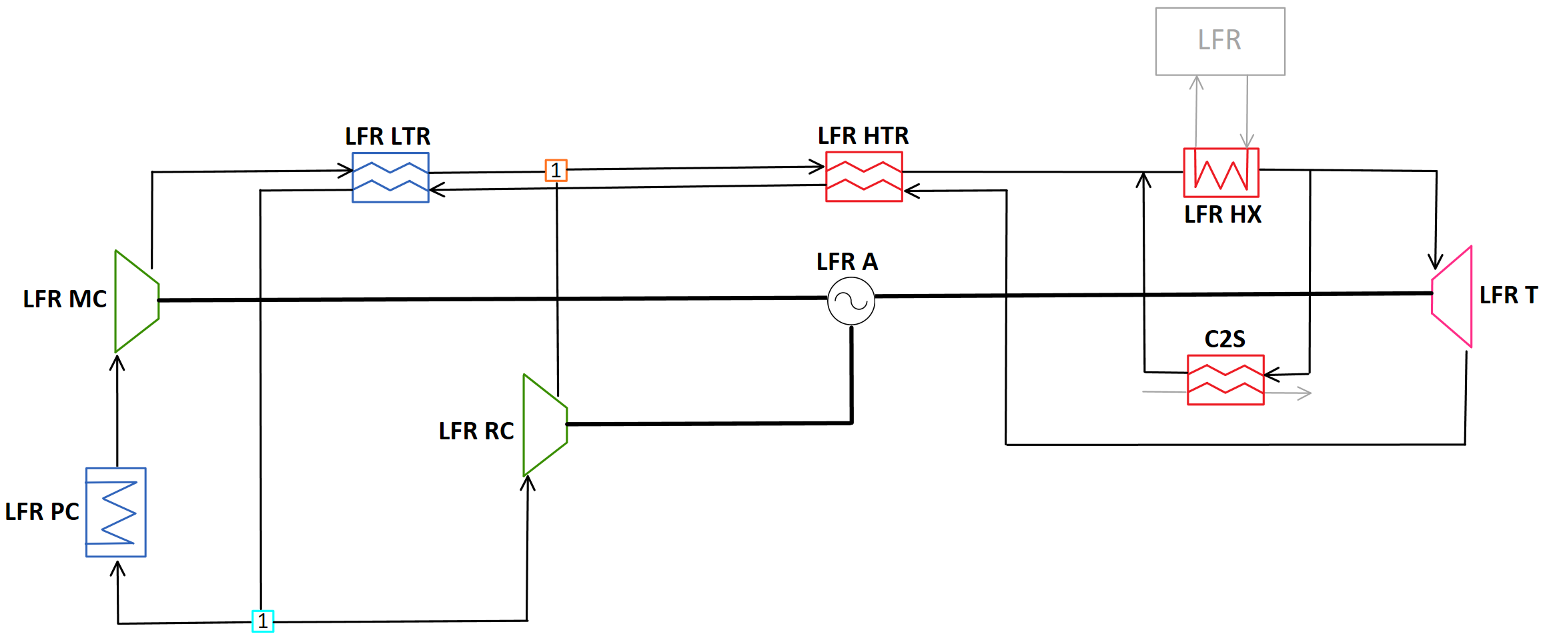
Charging
Four Considered Configurations:
C-LFR-PRE
C-LFR-PAR
C-LFR-CIRC
C-LFR-POST (Not Viable)
Acronyms | Definition | Acronyms | Definition
LFR | Lead-cooled Fast Reactor | MC | Main Compressor
CSP | Concentrating Solar Power | RC | Re-compressor
TES | Thermal Energy Storage | HTR | High Temperature Recuperator
sCO₂ | Super Critical Carbon Dioxide | LTR | Low Temperature Recuperator
PC | Pre-cooler | A | Alternator
T | Turbine

Slide 17
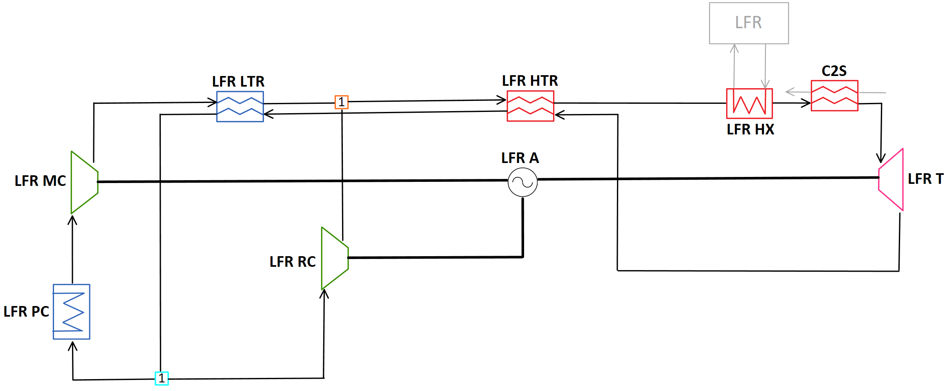
Charging
Four Considered Configurations:
C-LFR-PRE
C-LFR-PAR
C-LFR-CIRC
C-LFR-POST (Not Viable)
Reduced turbine power output causing major hit on cycle efficiency
Acronyms | Definition | Acronyms | Definition
LFR | Lead-cooled Fast Reactor | MC | Main Compressor
CSP | Concentrating Solar Power | RC | Re-compressor
TES | Thermal Energy Storage | HTR | High Temperature Recuperator
sCO₂ | Super Critical Carbon Dioxide | LTR | Low Temperature Recuperator
PC | Pre-cooler | A | Alternator
T | Turbine

Slide 18
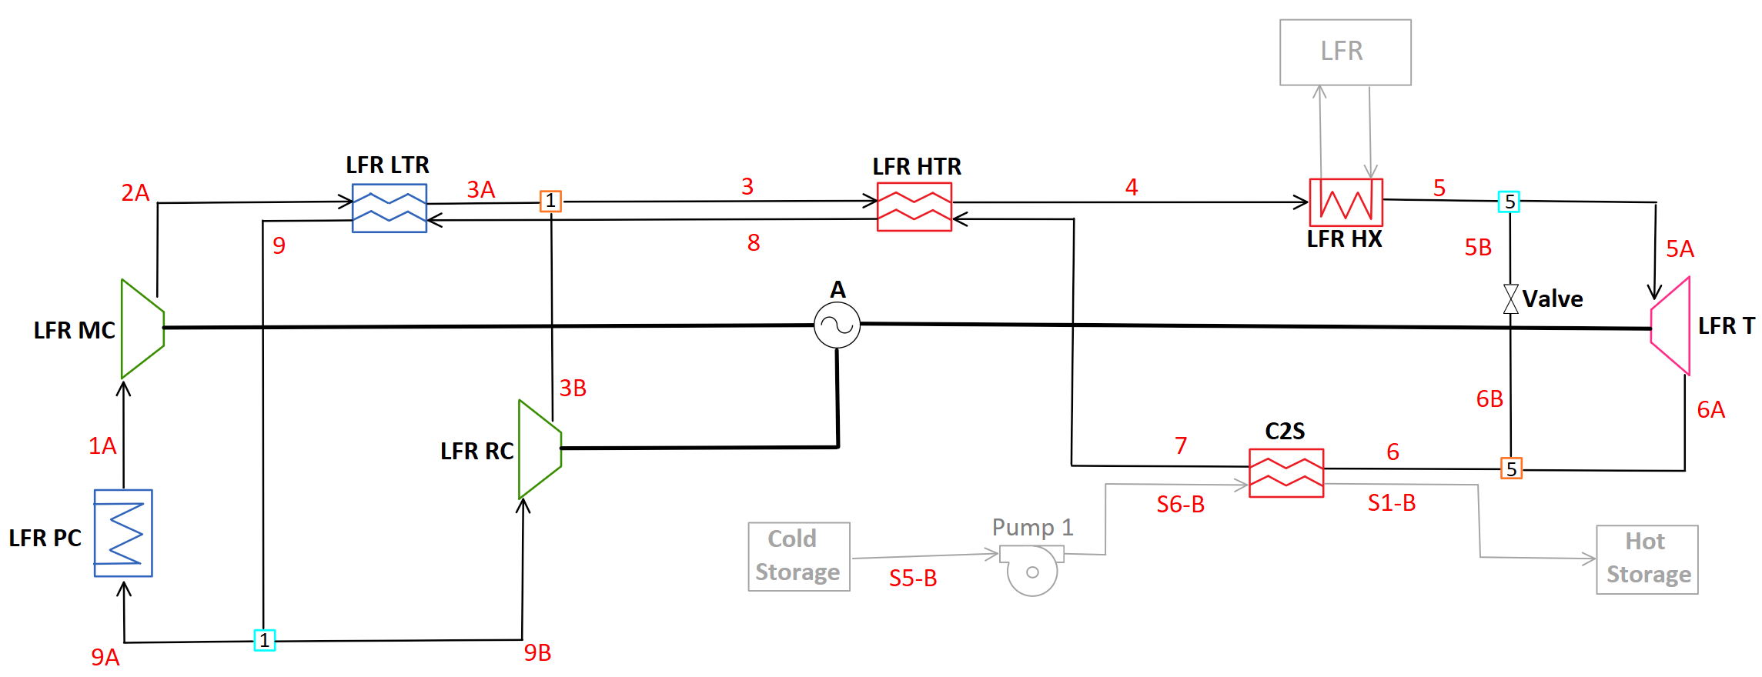
C-LFR-PRE
Temperature out of the turbine is nearly suitable to charge the hot storage
To reach the required temperature for storage, a valve is used to bypass the turbine with high temperature sCO₂ and is mixed downstream.
Requires higher temperature than the 595 ºC sCO₂ outlet temperature of LFR
Acronyms | Definition
LFR | Lead-cooled Fast Reactor
CSP | Concentrating Solar Power
TES | Thermal Energy Storage
sCO₂ | Super Critical Carbon Dioxide
PC | Pre-cooler
T | Turbine
MC | Main Compressor
RC | Re-compressor
HTR | High Temperature Recuperator
LTR | Low Temperature Recuperator
A | Alternator

Slide 19
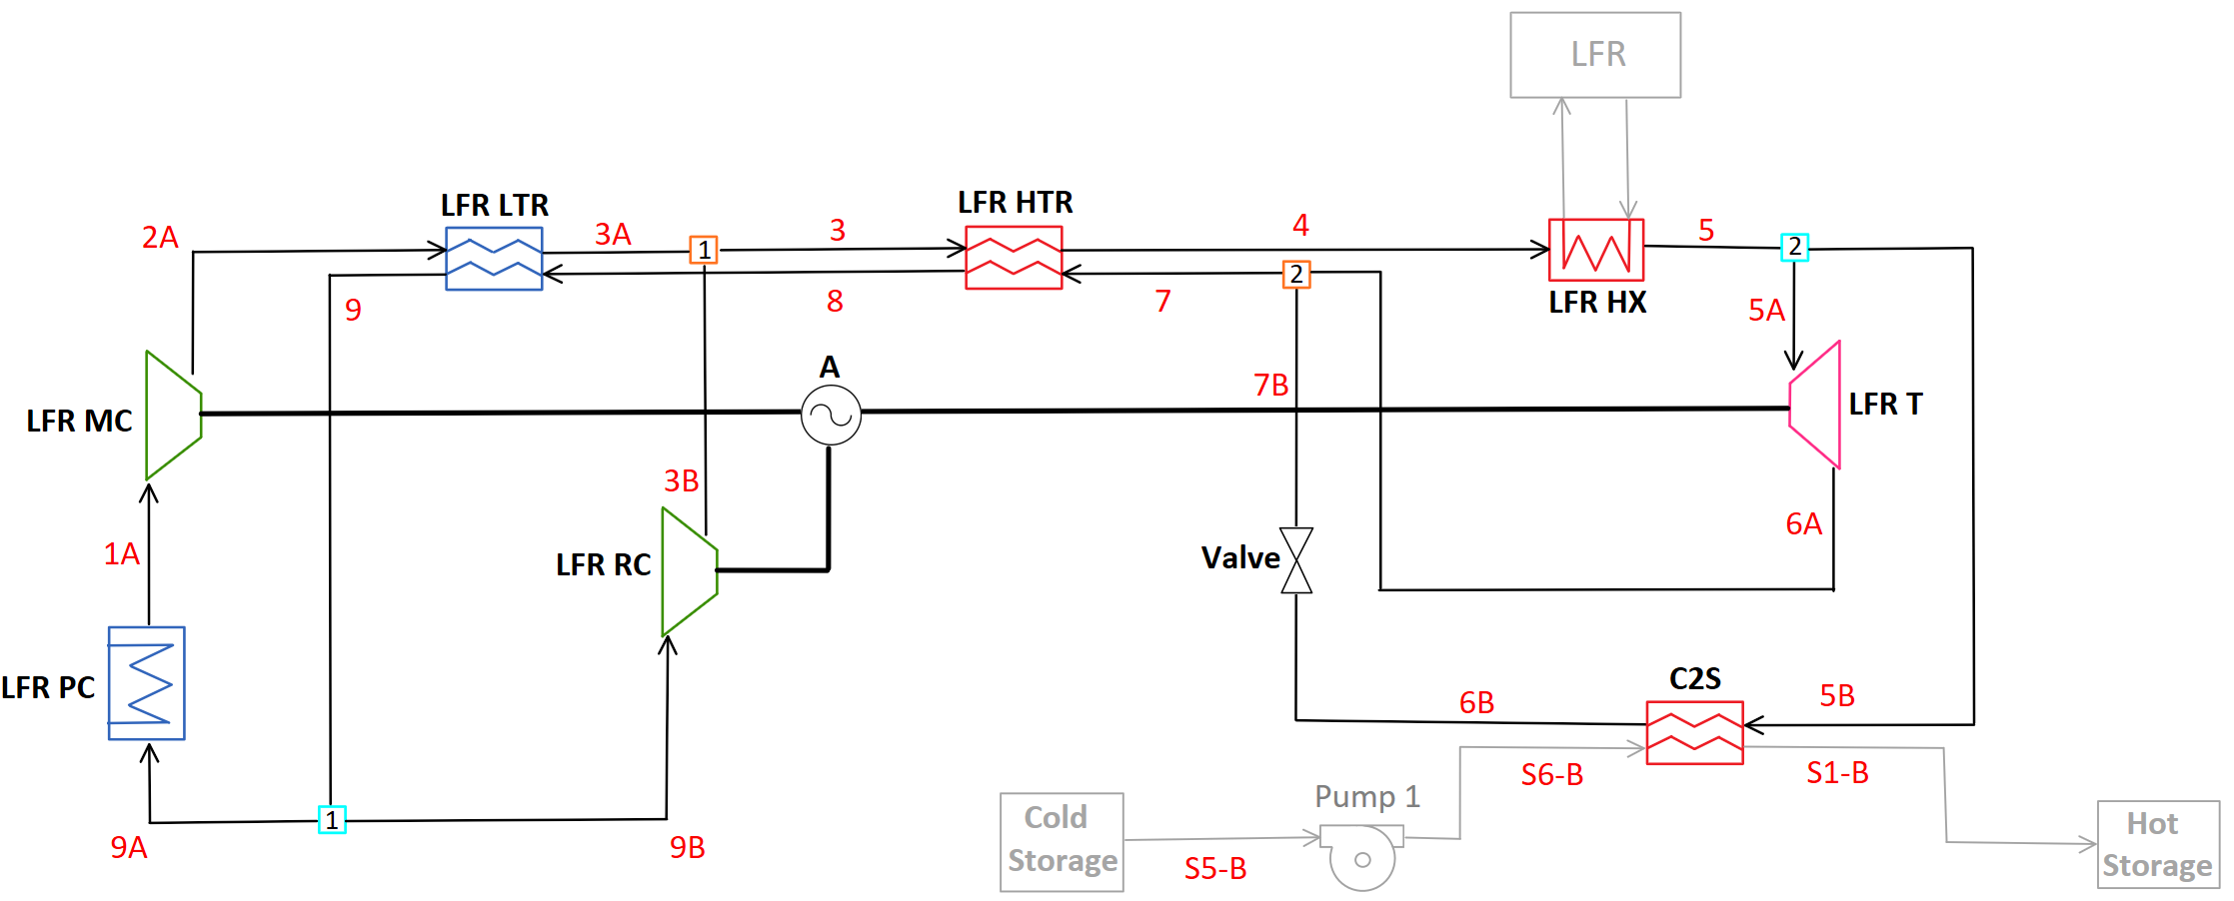
C-LFR-PAR
Splits flow before turbine allowing for the high temperature and pressure flow to be utilized for thermal storage
Restricts the available mass flow for the turbine and therefore reducing the turbine power output
Acronyms | Definition
LFR | Lead-cooled Fast Reactor
CSP | Concentrating Solar Power
TES | Thermal Energy Storage
sCO₂ | Super Critical Carbon Dioxide
PC | Pre-cooler
T | Turbine
MC | Main Compressor
RC | Re-compressor
HTR | High Temperature Recuperator
LTR | Low Temperature Recuperator
A | Alternator

Slide 20
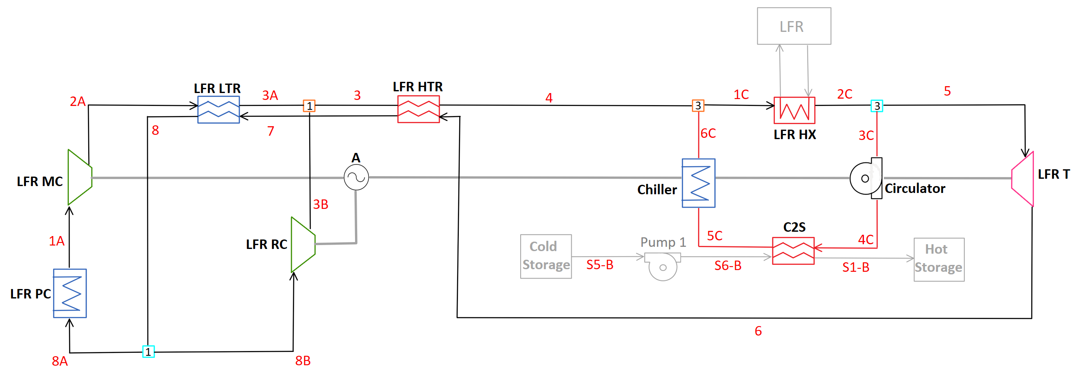
C-LFR-CIRC
Dedicated circulator loop for C2S heat exchanger
Avoids losses associated with running turbines and compressors
Requires additional chiller and circulator system components
Acronyms | Definition
LFR | Lead-cooled Fast Reactor
CSP | Concentrating Solar Power
TES | Thermal Energy Storage
sCO₂ | Super Critical Carbon Dioxide
PC | Pre-cooler
T | Turbine
MC | Main Compressor
RC | Re-compressor
HTR | High Temperature Recuperator
LTR | Low Temperature Recuperator
A | Alternator

Slide 21
Results: Non-Charging
Two Cycle Configuration (C-CSP-ON and C-LFR-ON):
Overall combined cycle efficiency: 45.10 – 46.10%
Offers the highest efficiency because of independent operation during power generation
C-1HTR1T-ON:
Overall cycle efficiency: 44.22 - 44.90%
Least complex and therefore cost efficient
C-2HTR3T-ON:
Overall cycle efficiency: 44.34 – 46.10%
Reduced number of cycle components with flexibility for dissimilar inlet temperature on CSP and LFR
$$ⴄ_{cycle}=\frac{power produced by cycle}{heat input to cycle}=\frac{{\dot{W}}_{T}−{\dot{W}}_{MC}−{\dot{W}}_{RC}}{{\dot{Q}}_{LFRHX}+{\dot{Q}}_{CSPHX}}$$

Slide 22
Results: Charging
C-LFR-PRE:
Overall cycle efficiency: 34.53%
Requires higher outlet temperature of turbine to be effective
C-LFR-PAR:
Overall cycle efficiency: 45.30%
Moderate efficiency with negligible complexity addition
C-LFR-CIRC:
Overall cycle efficiency: 74.29 – 99.92%
Eliminates losses associated with isentropic efficiencies of turbines and compressors and additional heat rejection in the pre-cooler
Increases complexity and cost
C-LFR-PRE:
Infeasible due to thermodynamic efficiency
$$ⴄ_{heatstorage}=\frac{heat into thermal energy storage}{heat input from LFR}=\frac{{\dot{Q}}_{C2S}}{{\dot{Q}}_{LFRHX}}$$

Slide 23
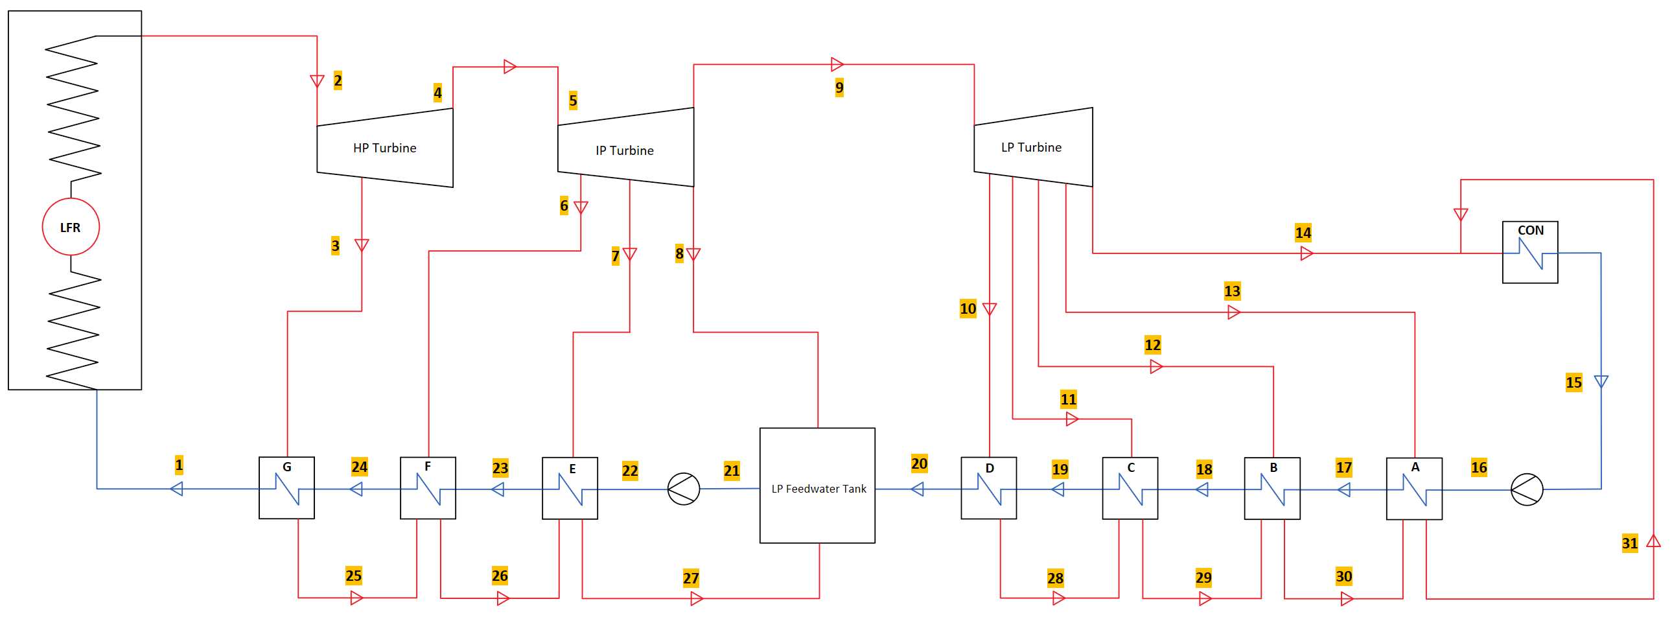
Future Plans
Rankine cycle with LFR heat addition with CSP heat extraction from the high-pressure turbine
Separate dedicated cycle for CSP electrical generation
Allows LFR full time operation for electrical generation or thermal storage

Slide 24
Summary
Coupling the CSP and LFR into cycles allows for the LFR to utilize the CSP thermal energy storage, increasing dispatchability.
Reduces time and weather dependency of CSP power generation.
Comparison of modeled cycle configurations with focus on electrical power generation or thermal energy storage efficiencies.

Slide 25
Questions?

Slide 26
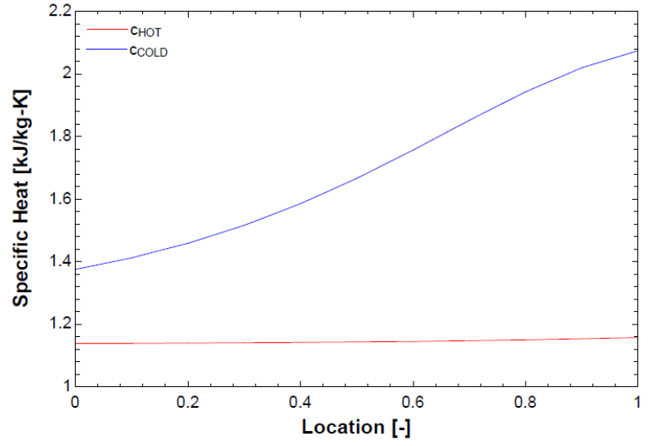
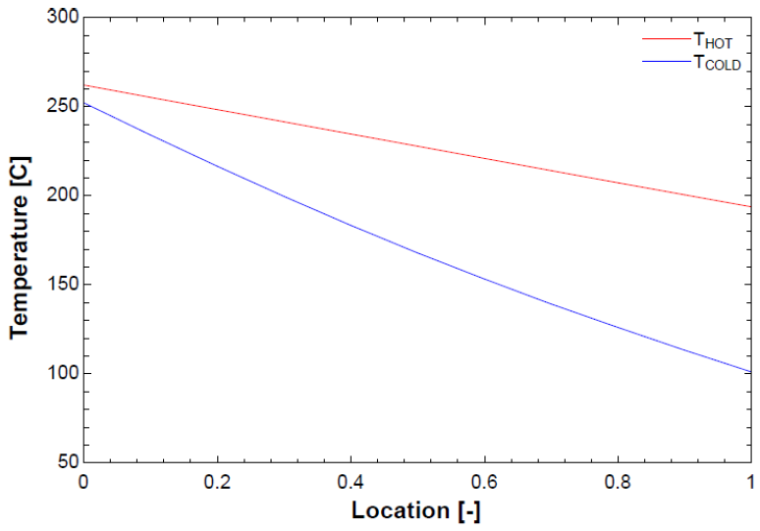
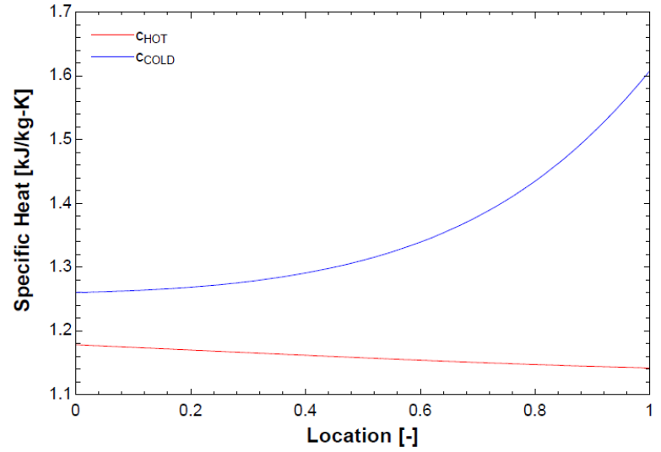
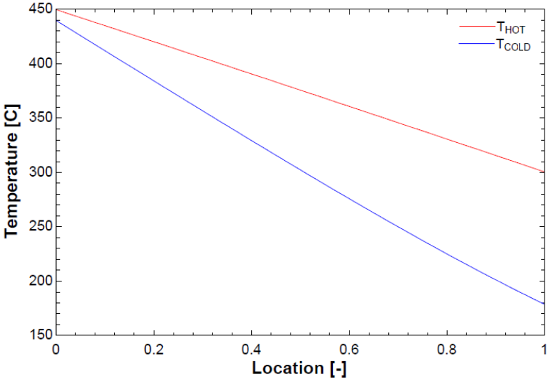
Constant $\dot{C}$ Assumption for Counter-Flow HX
LTR
Sub HX model to confirm assumptions
No internal approach temperature
Constant capacitance rate with extreme values tested and linear approximation is acceptable
HTR

Slide 27
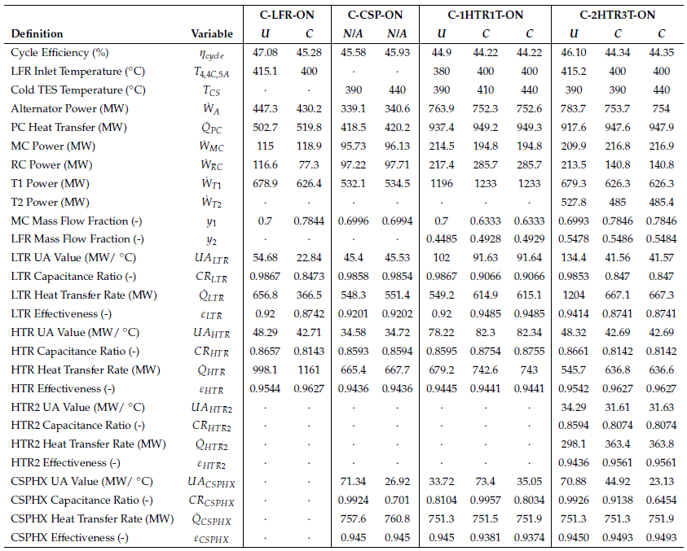
Detailed Results: Non-Charging

Slide 28
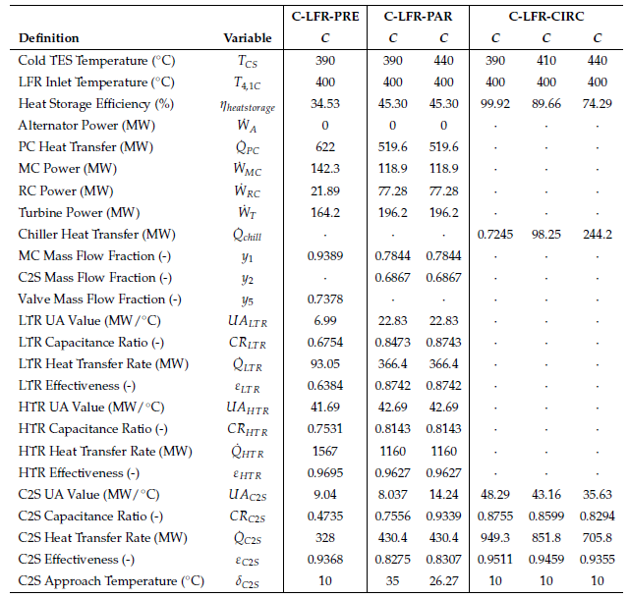
Detailed Results: Charging

